Slide 1
SIR Vaccination Model
With Vital Dynamics
MTH 3006 // 17 April, 2017

Slide 2
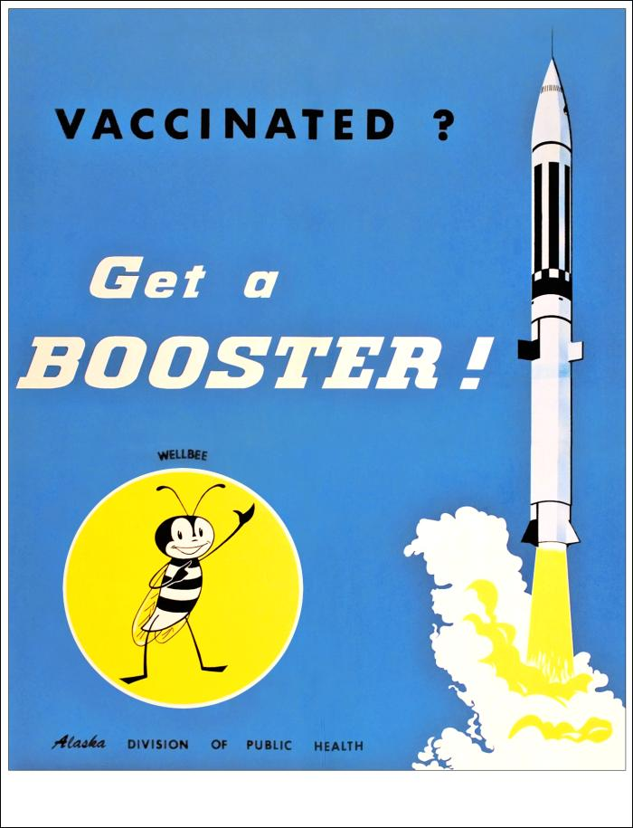
The Focus
This model will represent the behavior of communicable disease amongst a susceptible population using an SIR-type model.
The model will analyze the effects of vaccination within a burdened population, and will serve to highlight the most effective vaccination strategies.

Slide 3
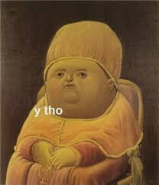
“why is this important to me?”

Slide 4
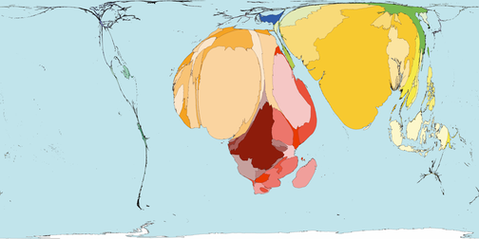
[1]
The world map redistributed to represent the deaths that occurred by diseases preventable by vaccination.

Slide 5
2.5 million deaths are prevented every year due to vaccinations
(WHO, 2011) [2]
2 million additional lives (children under 5) could be saved yearly by expanding vaccination coverage
(WHO, UNICEF, World Bank, 2009)[3]

Slide 6
Understanding the problem
Case 1
Case 2
Case 3
All vaccinations occur at birth/ early age (simplest model)
Vaccinations can occur at any stage of the SIR-type model
No vaccinations occur
This was modeled previously in class (SIR with Vital Dynamics) so we will ignore this case moving forward

Slide 7
Building the Model: Case 1
Assumptions
Variables
Parameters
All vaccinations occur at birth (early age)
The total population is split between three populated groups, Susceptible (S), Infected (I), Recovered (R)
Total population is constant, death rate=birth rate
All births split into unvaccinated (susceptible) and vaccinated (recovered)
Immunity may be lost over time
Susceptible become ill only through contact will an infected being
S= susceptible population
I= infected population
R= recovered population
N= total population= S+I+R
Rate of susceptible becoming ill: β
Rate of ill recovering: δ
Rate of recovered losing immunity: ρ
Vaccinated birth rate: μv
Unvaccinated birth rate: μu
Total birth rate=death rate: μ

Slide 8
Building the Model: Case 2
Assumptions
Variables
Parameters
Vaccinations occur at any stage of the SIR model
The total population is split between three populated groups, Susceptible (S), Infected (I), Recovered (R)
Total population is constant, death rate=birth rate
When births are vaccinated they are part of the Recovered population
Immunity may be lost over time
Susceptible become ill only through contact will an infected person
S= susceptible population
I= infected population
R= recovered population
N= total population= S+I+R
Rate of susceptible becoming ill: β
Rate of ill recovery unvaccinated: δu
Rate of vaccinated recovery: δi
Rate of immunity loss: ρ
Rate of susceptible vacc: Θ
Vaccinated birth rate: μv = Vo (initial vaccination conditions ie. those vaccinated at birth)
Unvaccinated birth rate: μu
Total birth rate=death rate: μ
Vaccination rate: Vi (infected), Vs (susceptible)

Slide 9
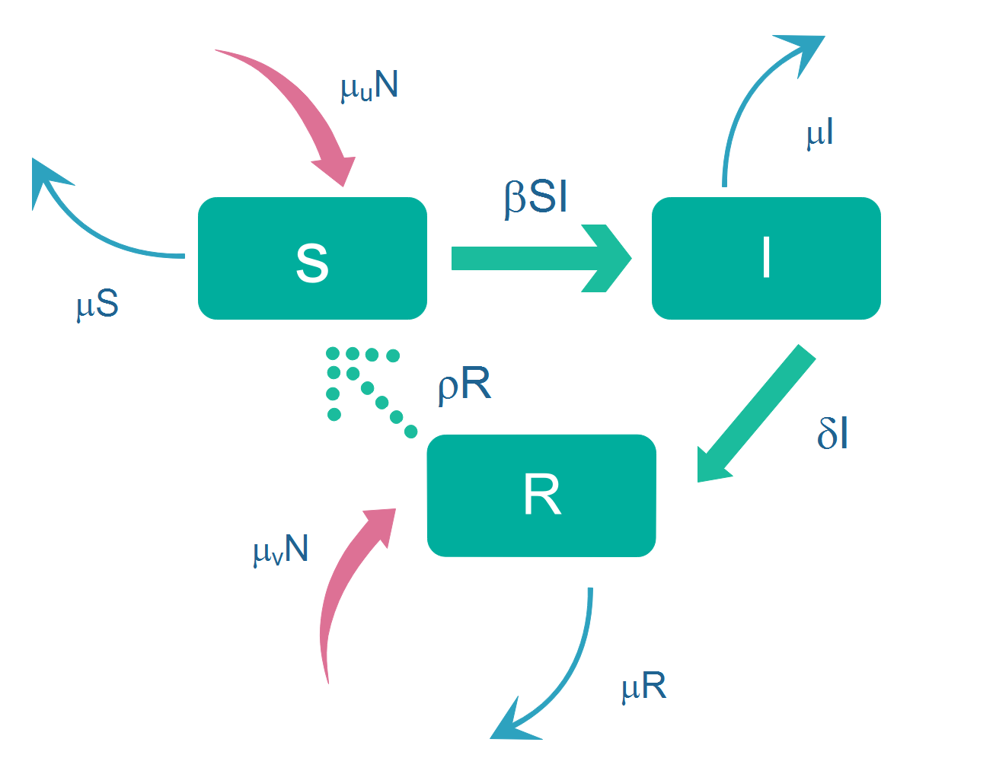
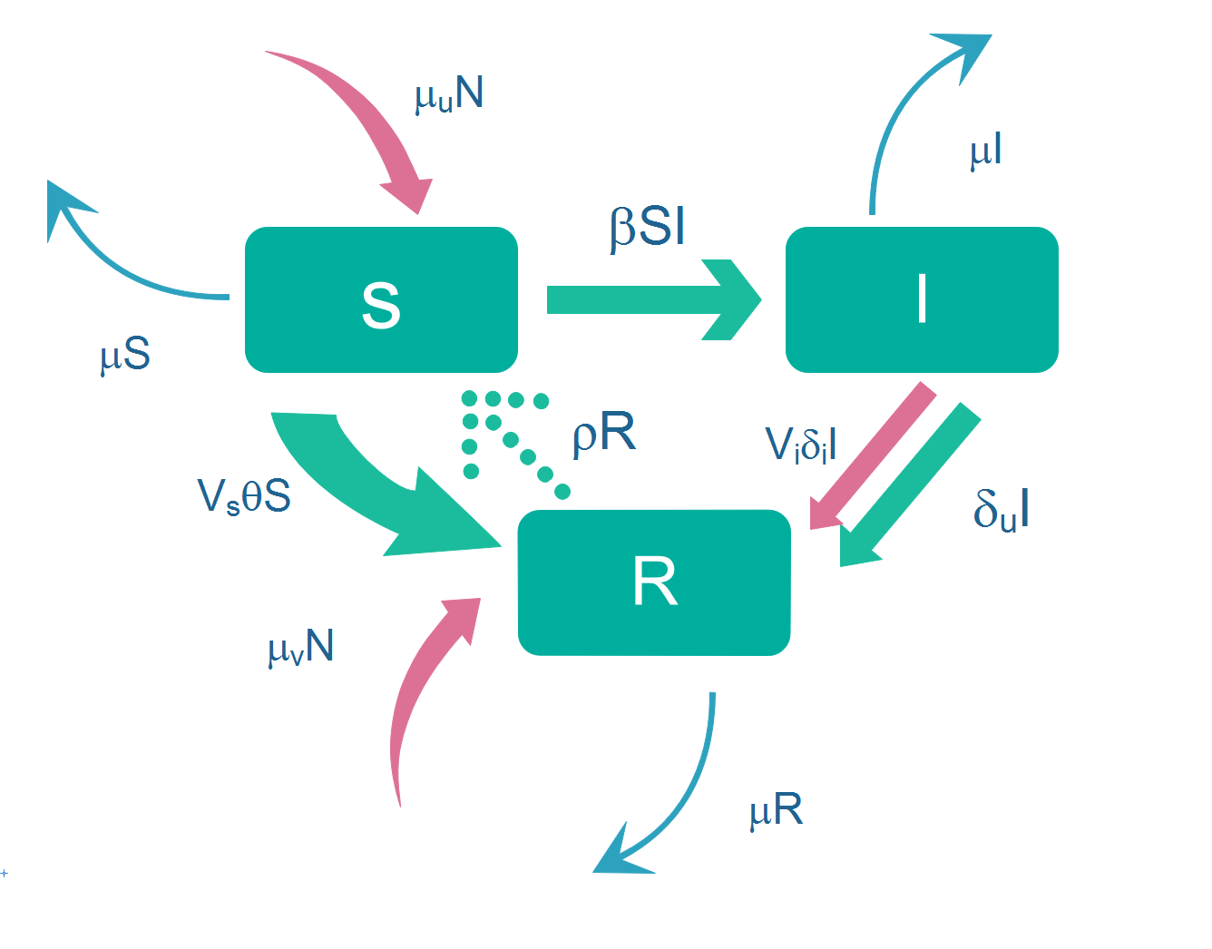
The Models:
CASE 1: all vacc at birth
CASE 2: vacc at any stage
Law of Mass Action
Equations: dS/dt=-βSI+ρR+μuN-μS
dI/dt= βSI-δI-μI
dR/dt= δI-ρR+μvN-μR
Equations: dS/dt=-βSI+ρR+μuN-μS-VsΘS
dI/dt= βSI-(Viδi+δu)I-μI
dR/dt= (Viδi+δu)I-ρR+μvN-μR+VsΘS

Slide 10
Since N=S + I + R R= N - S - I, using the conservation law, we can rewrite the S, I equations:
CASE 1: CASE 2:
dS/dt=-βSI+ρ(N-S-I)+μuN-μS a) dS/dt=-βSI+ρ(N-S-I)+μuN-μS-VsΘS
dI/dt= βSI-δI-μI b) dI/dt= βSI-(Viδi+δu)I-μI
Conservation Laws:

Slide 11
Letting S=Nx, I=Ny, R=Nz, t=Tτ and choosing T=1/μ, βN/μ=β’ , ρ/μ=ρ’ , δ/μ=δ’ , Θ/μ=Ө’ , μu/μ=μ’, we get:
CASE 1: CASE 2:
dx/dτ=-β’xy+ρ’(1-x-y)+μ’-x a) dx/dτ=-β’xy+ρ’(1-x-y)+μ’-(1+VsΘ’)x
dy/dτ= β’xy-y(δ+1) b) dy/dτ= β’xy-(1+Viδi’+δu’)y
Non-Dimensionalization

Slide 12
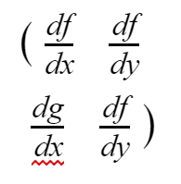
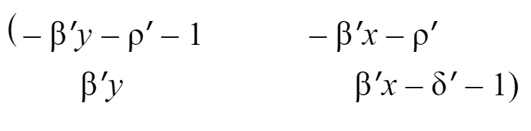



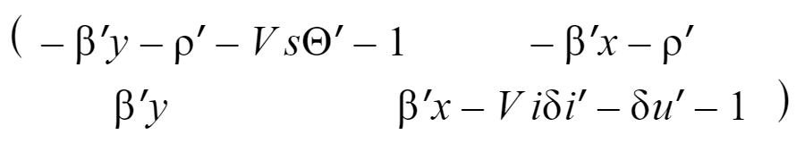
FIXED POINTS
WHERE dx/dτ=dy/dτ=0
JACOBIAN:
CASE 1:
CASE 1:
(x*,y*)= : disease free equilibrium
(x*,y*)= : Endemic
CASE 2:
(x*,y*)= : disease free equilibrium
(x*,y*)=
CASE 2:

Slide 13


Analysis I:
*After plugging in fixed points to the Jacobian Matrices, the results gave,
CASE 1:
Disease Free Equilibrium
Stable when:
Endemic
Unstable when DFE is stable
(which is the desired outcome!)
CASE 2:
Disease Free Equilibrium
Stable when:
Endemic
Unstable when DFE is stable
(yay!)

Slide 14
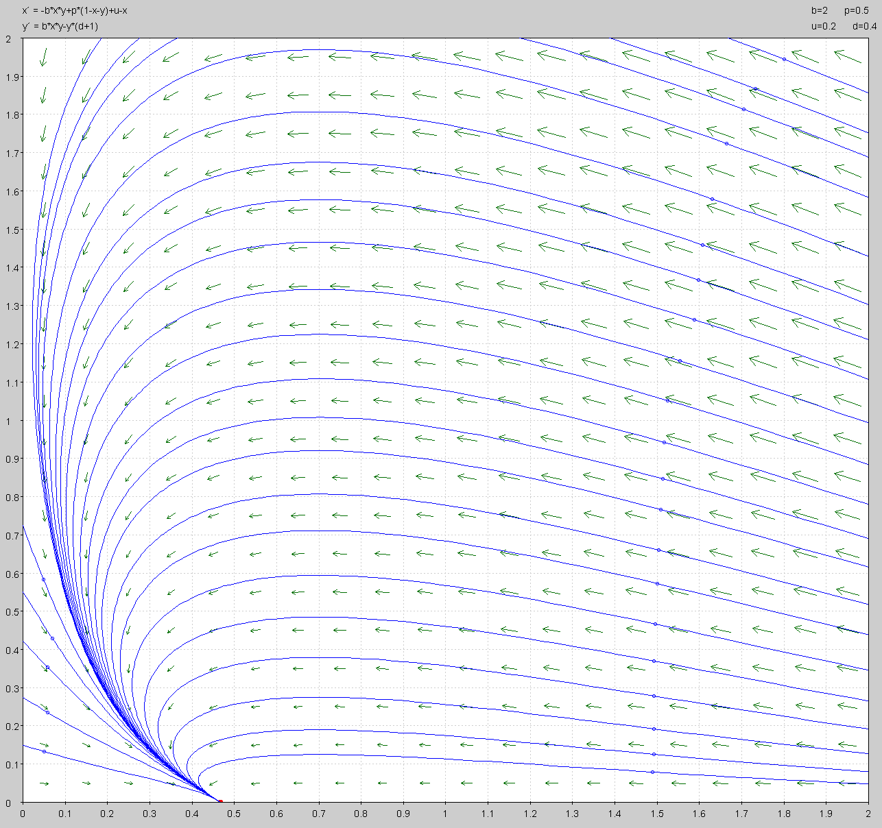
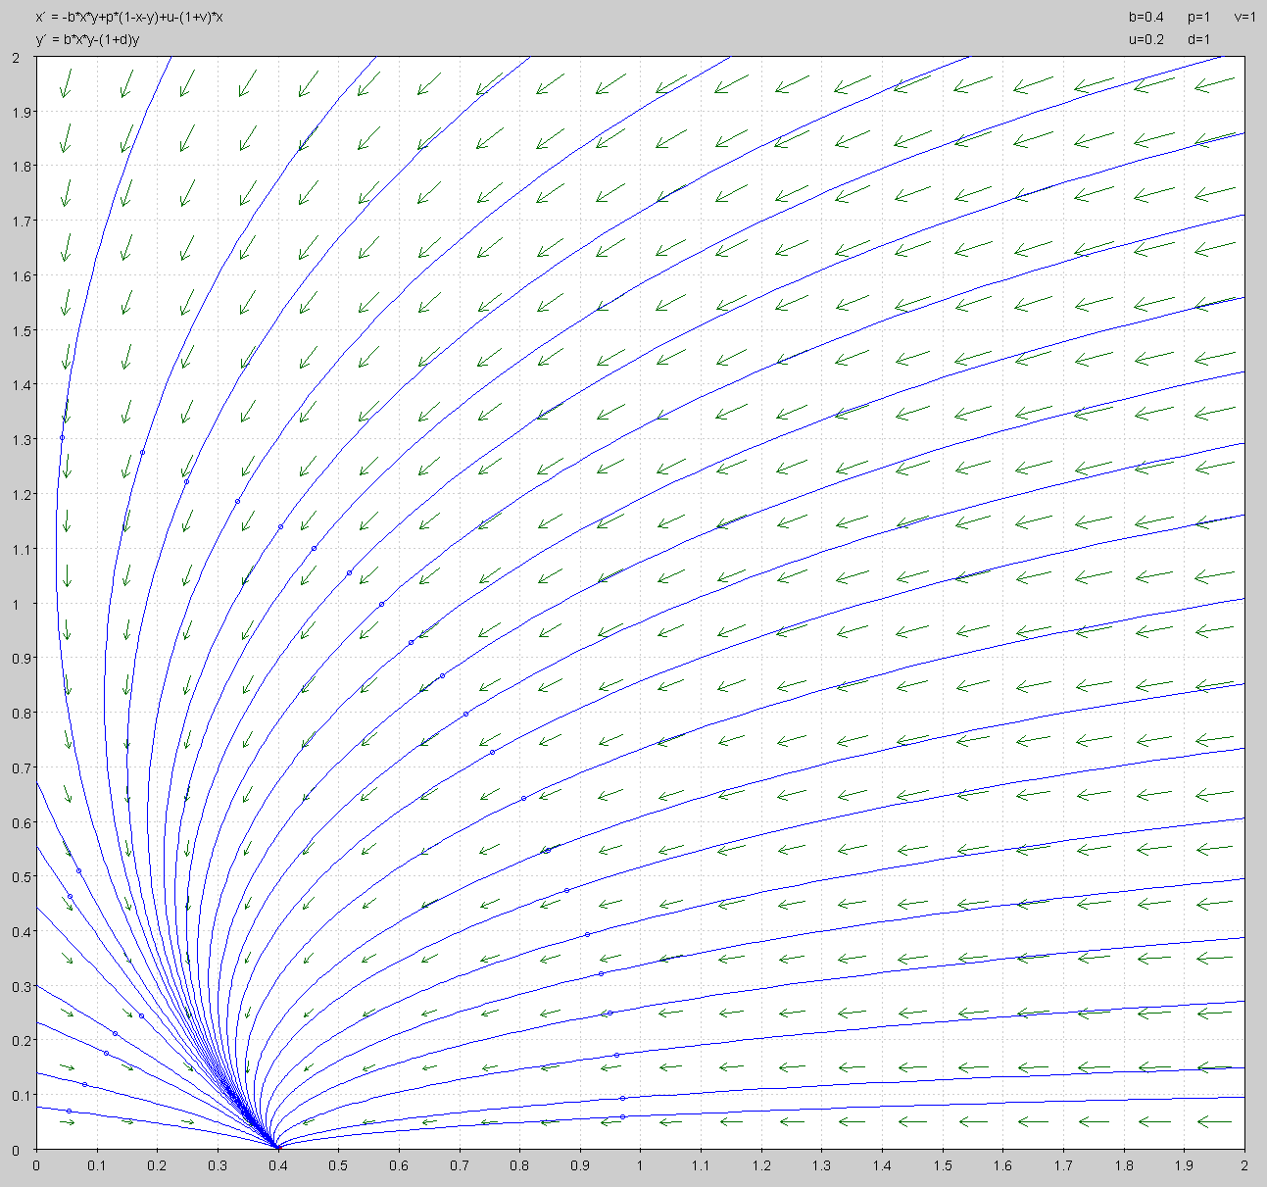
CASE 1:
CASE 2:
Y-axis: rescaled infected population
Y-axis: rescaled infected population
X-axis: rescaled susceptible population
X-axis: rescaled susceptible population
Interpretation: as long as the conditions from the previous slide are met, and μ’ < 1 (meaning the birth rate that is unvaccinated is strictly less than the total birth rate) this model will achieve a stable DFE. For some time, as the susceptible population decreases the infected population increases. As the infected population starts decreasing to a stable zero, the susceptible population settles into a population > 0.
Interpretation: As long as DFE constraints are met (from previous slide), there will be a stable solution with zero infected people. Because of the Vsϴ’ (rate of susceptible vaccination) term, both the susceptible and infected population are decreasing through time.

Slide 15
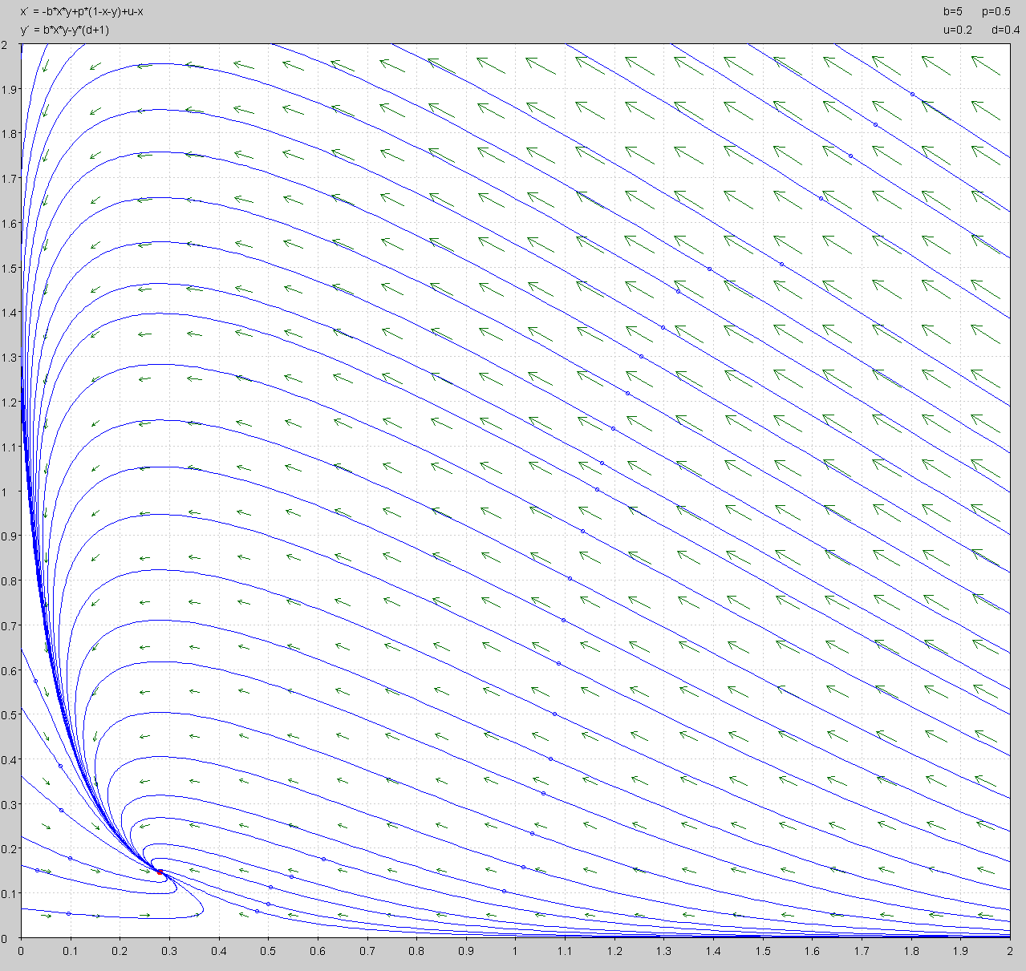
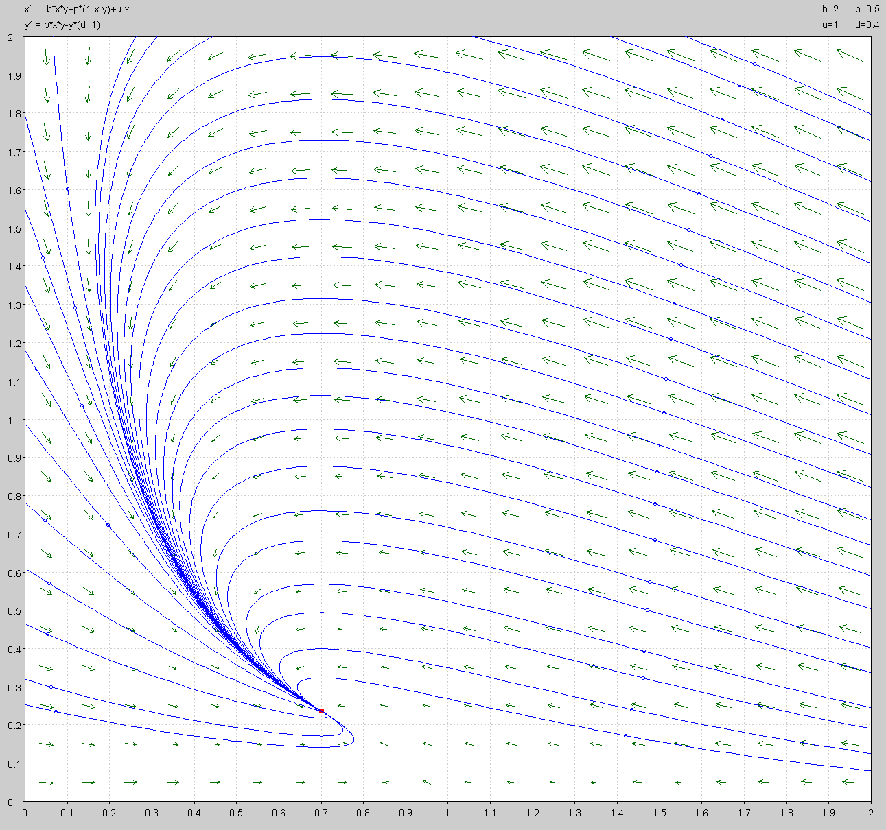

What-If Scenarios: Case 1
Y-axis: rescaled infected population
Y-axis: rescaled infected population
X-axis: rescaled susceptible population
X-axis: rescaled susceptible population
What if, stable endemic solution
What if, μ’ = 1 (the unvaccinated birth rate = total birth rate)
(all other parameters same as DFE stable solution)

Slide 16
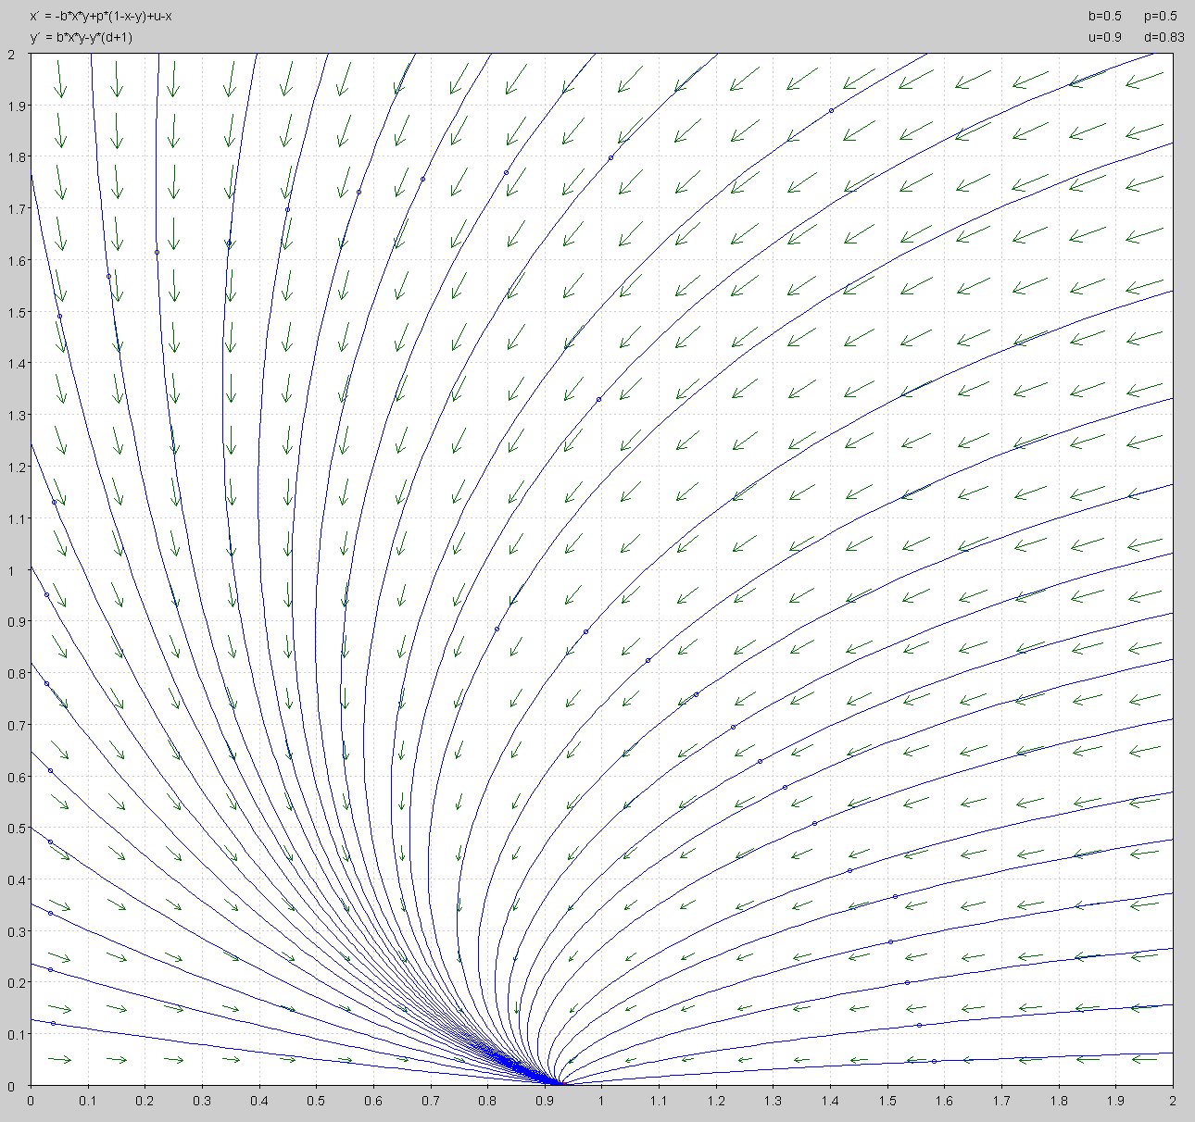
Influenza Model:
Using given parameters (rate of transmission: β’ , rate of recovery (vaccinated and unvaccinated): δ’ ) from Modeling the Effects of Vaccination and Treatment on Pandemic Influenza [4], and using the constraints previously stated for DFE stability, I found the rate of immunity loss: ρ’ and a chosen unvaccinated birth rate: μ’ < 1.
Y-axis: rescaled infected population
X-axis: rescaled susceptible population

Slide 17
Results Summary
Vaccinations present
Zero infected people through time
[vs]
No Vaccinations Present
There will exists an infected population

Slide 18

YOU GET A VACCINE!
YOU GET A VACCINE!
WE ALL GET A VACCINE!

Slide 19




REFERENCES
[1]
[2]
[3]
[4]
World Mapper. (2002). Vaccine Preventable Deaths. Retrieved April 2017.
http://www.worldmapper.org/display_extra.php?selected=380
WHO. (2011). Global Immunization Data. Retrieved April 2017.
http://www.who.int/mediacentre/factsheets/fs178/en/index.html
WHO. (2011). Children: Reducing Mortality. Retrieved April 2017.
http://www.who.int/immunization_monitoring/Global_Immunization_Data.pdf
Zhilan Feng, Sherry Towers, Yiding Yang. (2011). The AAPS Journal, Vol. 13, No. 3, September 2011. Modeling the Effects of Vaccination and Treatment on Pandemic Influenza. Retrieved April 2017.

