Slide 1
The Scala Programming Language

Slide 2
“If I were to pick a language to use today other than Java, it would be Scala.”
James Gosling

Slide 3
“Scala, it must be stated, is the current heir apparent to the Java throne. No other language on the JVM seems as capable of being a replacement for Java as Scala, and the momentum behind Scala is now unquestionable”.
Charlies Olivier Nutter - JRuby lead

Slide 4
“My tip ... for the long term replacement of javac is Scala. I'm very impressed with it! I can honestly say if someone had shown me the Programming in Scala book by by Martin Odersky, Lex Spoon & Bill Venners back in 2003 I'd probably have never created Groovy”.
James Strachen

Slide 5
Agenda
Background
Basic syntax (c.f. Java)
A few example programs in Eclipse IDE
Who is using Scala
Resources for learning more

Slide 6
What is Scala?
Object oriented
Functional
Statically typed
Java compatible
Concise, extensible, consistent syntax
A better Java

Slide 7
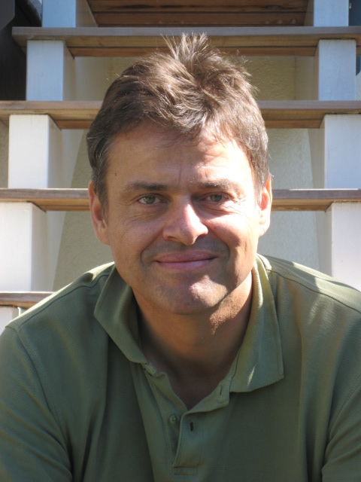
Who invented Scala?
Martin Odersky and team
  Prof. At EPFL (Lausanne)
  ACM Fellow
  Designed Java generics for Sun
  Authored current Sun Java compiler
  Open source at www.scala-lang.org
  Goal: an industrial-strength language, a better Java
  2.8 beta

Slide 8
Scala is object oriented
Every value is an object
Behavior described by
  classes
  traits
Behavior composed by
  Inheritance
  Mixin-based trait composition

Slide 9
Scala is functional
Every function is a value
Lightweight syntax for anonymous functions
Higher-order functions and methods
Nested functions
Curried functions
List comprehensions
Functions can be defined using pattern-matching on the arguments

Slide 10
(Aside on functions as objects)
Scala compiler translates thus:
  f(args) f.apply(args)

Slide 11
Scala is statically typed
Compiler detects type errors
Generic classes
Local type inference => most type annotations can be omitted

Slide 12
Java interoperability
Compiles to JVM byte code indistinguishable from that of Java
Scala can use Java (and vice versa)
  instantiate any class
  call any method
  implement any Java interface
  subclass any Java class
Syntaxes are incompatible

Slide 13
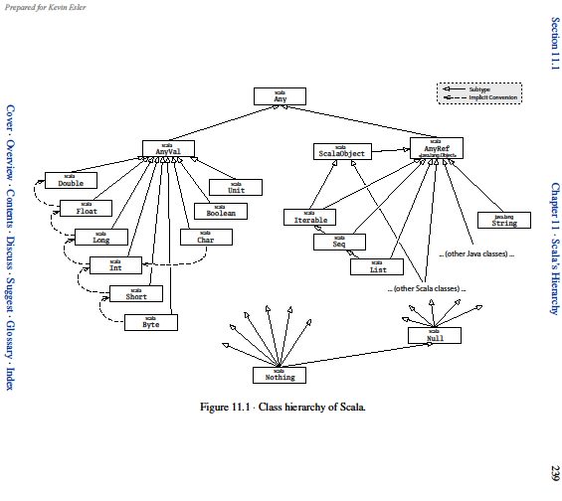

Slide 14
Scala's heritage
Java:
  Classes, JVM, exceptions, generics
Lisp
  mixins
Scripting languages:
  REPL
  type annotations largely unnecessary
Smalltalk:
  objects all the way down

Slide 15
Scala's heritage (cont'd)
Functional languages (Haskell, ML et al.)
  1st class functions
  higher-order methods and functions
  type inference
  algebraic types
  pattern matching
  side-effect free subset
  curried functions

Slide 16
Unifier
Agile with lightweight syntax
Scala
Object-oriented
Scala
Functional
Safe and performant with strong typing

Slide 17
public class Person {
private int age;
private String name;
public Person(int age, String name) {
this.age = age;
this.name = name;
}
public int getAge() {
return this.age;
}
public void setAge(int age) {
this.age = age;
}
public String getName() {
return this.name;
}
public void setName(String name) {
this.name = name;
}
}
class Person(var age: Int, var name: String)

Slide 18
List<Person> persons = ...
List<Person> adults = new LinkedList<Person>(); List<Person> kids = new LinkedList<Person>();
for (Person person : persons) {
if (person.getAge() < 18) {
kids.add(person);
} else {
adults.add(person);
}
}
val(kids, adults) = persons partition { p =>
p.age < 18}

Slide 19
BufferedReader reader = null;
try {
reader = new BufferedReader(new FileReader("f.txt"));
System.out.println(reader.readLine());
} finally {
if (reader != null) {
try {
reader.close();
} catch (IOException e) {
// Exception on close, ignore
}
}
}
using(new BufferedReader(new FileReader("f.txt"))) {
reader => println(reader.readLine())
}

Slide 20
def using[T <: { def close() }, A]
(closeable: T)
(f: T => A) = {
try {
f(closeable)
} finally {
if (closeable != null) {
try {
closeable.close()
}
catch {
case e: Exception =>
}
}
}
}

Slide 21
Scala syntax basics

Slide 22
;

Slide 23
Type definitions
Scala
s: String
i: Int
Java
String s
int i / Integer i

Slide 24
Variables
Scala:
val s = “Hello World”
var i = 1
private var j = 3
Java:
public final String s = “Hello World”;
public int i = 1;
private int j = 3;

Slide 25
Methods
Scala:
def add(x: Int, y: Int): Int = {
x + y
}
def add(x: Int, y: Int) = x + y
def doSomething(text: String) {
}
Java:
public int add(int x, int y) {
return x + y;
}
public void doSometing(String text) {
}

Slide 26
Methods (2)
Scala:
myObject.myMethod(1)
myObject myMethod(1)
myObject myMethod 1
myObject.myOtherMethod(1, 2)
myObject myOtherMethod(1, 2)
myObject.myMutatingMethod()
myObject.myMutatingMethod
myObject myMutatingMethod
Java:
myObject.myMethod(1);
myObject.myOtherMethod(1, 2);
myObject.myMutatingMethod()

Slide 27
Methods (3)
Scala:
override def toString = ...
Java:
@Override
public String toString() {...}

Slide 28
Classes and constructors
Scala:
class Person(val name: String)
Java:
public class Person {
private final String name;
public Person(String name) {
this.name = name;
}
public String getName() {
return name;
}
}

Slide 29
Traits (= Interface + Mixin)
Scala:
trait Shape {
def area: Double
}
class Circle extends Object with Shape
Java:
interface Shape {
public double area();
}
public class Circle extends Object implements Shape

Slide 30
No “static” in Scala
Scala:
object PersonUtil {
val AgeLimit = 18
def countPersons(persons: List[Person]) = ...
}
Java:
public class PersonUtil {
public static final int AGE_LIMIT = 18;
public static int countPersons(List<Person> persons) {
...
}
}

Slide 31
if-then-else
Scala:
if (foo) {
...
} else if (bar) {
...
} else {
...
}
Java:
if (foo) {
...
} else if (bar) {
...
} else {
...
}

Slide 32
For-loops
Scala:
for (i <- 0 to 3) {
...
}
for (s <- args) println(s)
Java:
for (int i = 0; i < 4; i++) {
...
}
for (String s : args) {
System.out.println(s);
}

Slide 33
While-loops
Scala:
while (true) {
...
}
Java:
while (true) {
...
}

Slide 34
Exceptions
Scala:
throw new Exception(“...”)
try {
} catch {
case e: IOException => ...
} finally {
}
Java:
throw new Exception(“...”)
try {
} catch (IOException e) {
...
} finally {
}

Slide 35
Varargs
def foo(values: String*){ }
foo("bar", "baz")
val arr = Array("bar", "baz")
foo(arr: _*)
public void foo(String... values){ }
foo("bar", "baz");
String[] arr = new String[]{"bar", "baz"}
foo(arr);

Slide 36
(Almost) everything is an expression
val res = if (foo) x else y
val res = for (i <- 1 to 10) yield i // List(1, ..., 10)
val res = try { x } catch { ...; y } finally { } // x eller y

Slide 37
Collections – List
Scala:
val numbers = List(1, 2, 3)
val numbers = 1 :: 2 :: 3 :: Nil
numbers(0)
=> 1
Java:
List<Integer> numbers =
new ArrayList<Integer>();
numbers.add(1);
numbers.add(2);
numbers.add(3);
numbers.get(0);
=> 1

Slide 38
Collections – Map
Scala:
var m = Map(1 -> “apple”)
m += 2 -> “orange”
m(1)
=> “apple”
Java:
Map<Int, String> m =
new HashMap<Int, String>();
m.put(1, “apple”);
m.put(2, “orange”);
m.get(1);
=> apple

Slide 39
Generics
Scala:
List[String]
Java:
List<String>

Slide 40
Tuples
Scala:
val tuple: Tuple2[Int, String] =
(1, “apple”)
val quadruple =
(2, “orange”, 0.5d, false)
Java:
Pair<Integer, String> tuple = new Pair<Integer, String>(1, “apple”)
... yeah right... ;-)

Slide 41
Packages
Scala:
package mypackage
...
Java:
package mypackage;
...

Slide 42
Imports
Scala:
import java.util.{List, ArrayList}
import java.io._
import java.sql.{Date => SDate}
Java:
import java.util.List
import java.util.ArrayList
import java.io.*
???

Slide 43
IDE support
Eclipse
  Edit, debug, code completion...
  Mixed Java/Scala projects
  No refactoring (yet)
IntelliJ
Netbeans

Slide 44




Who's using Scala

Slide 45
Scala resources
www.scala-lang.org
Book: “Programming In Scala”, Odersky, Spoon, Venner
“The busy Java developer's guide to Scala”, series by Ted Neward, http://www.ibm.com/developerworks/views/java/libraryview.jsp?search_by=scala+neward
“Scala for Java Refugees”, http://www.codecommit.com/blog/scala/roundup-scala-for-java-refugees

