Slide 1

Central Limit Theorem
For Markov Chain
Yichen Zhao

Slide 2
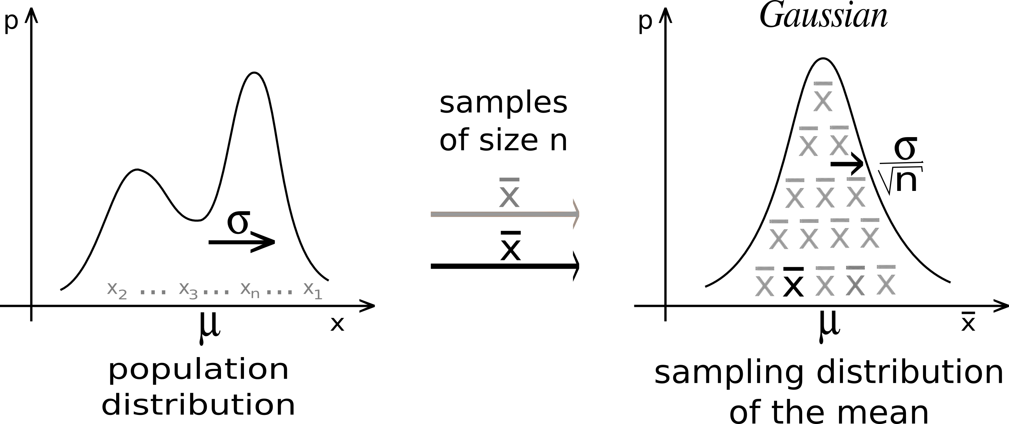
Recall: Central Limit Theorem
X1, X2, …, Xn are independent !

Slide 3
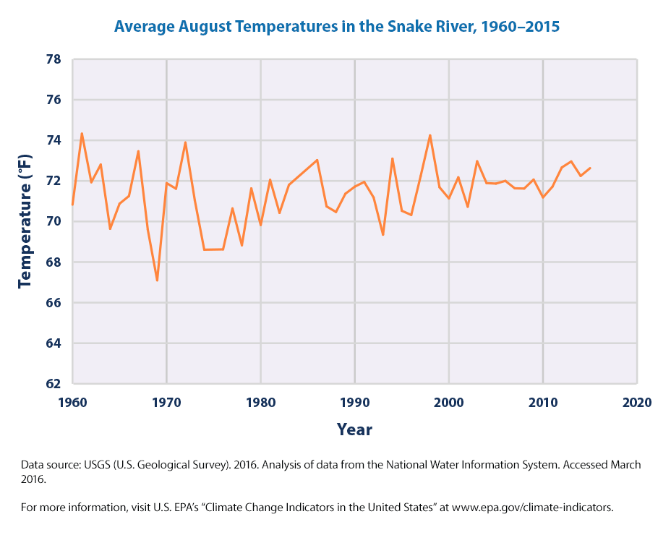
Independent or not, that is the question.
Temperature trend
Stock price
Brownian motion

Slide 4
Markov Property and Markov Chain
Given a sequence of random variables X1, X2, … , we have:
Why care?

Slide 5
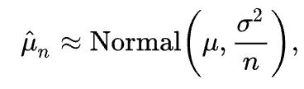
Markov Chain Central Limit Theorem
A sequence of n random variables with Markov property
while classical CLT assumes independence
Xi’s are identically distributed

Slide 6
Summary
Weaker assumption √
Same conclusion √
Broader context √

