Slide 1
DATA ENGENEERING WITH PYTHON -
KAEYROS ANALYTICS

Slide 2
Data Science
Data Engineering vs Data Scientist
Data Engineering vs Data Science
Data engeneering
Build and maintain of structures and systems for data store, extract and organization
Analyse data that to make prediction ( trends, business insights) and answer to relevant question
The data engineers get the data to the data scientist
The data scientist can interpret data only after receiving it in an appropriate format
data processing (aggregation, grouping, arranging ...)

Slide 3
Data engineering and Data scientist job examples
Data engineering
Data scientist
Develop scalable data architecture
Monitor business processes
Clean corrupt data
Statistical modeling
Streamline data acquisition
Predictive models using machine learning
Cloud technology
Clean statistical outliers in data
Set up process to bring together data
Mining data for patterns

Slide 4
Data Engineering Tools
E
L
T
EXTRA
TRANSFORM
LOAD
the data from its original source, whether that is another database or an application
data by cleaning it up, deduplicating it, combining it, and otherwise getting ready to…
the data into the target database
One ETL tool does all three of these steps
Right ETL software is more critical than ever.

Slide 5
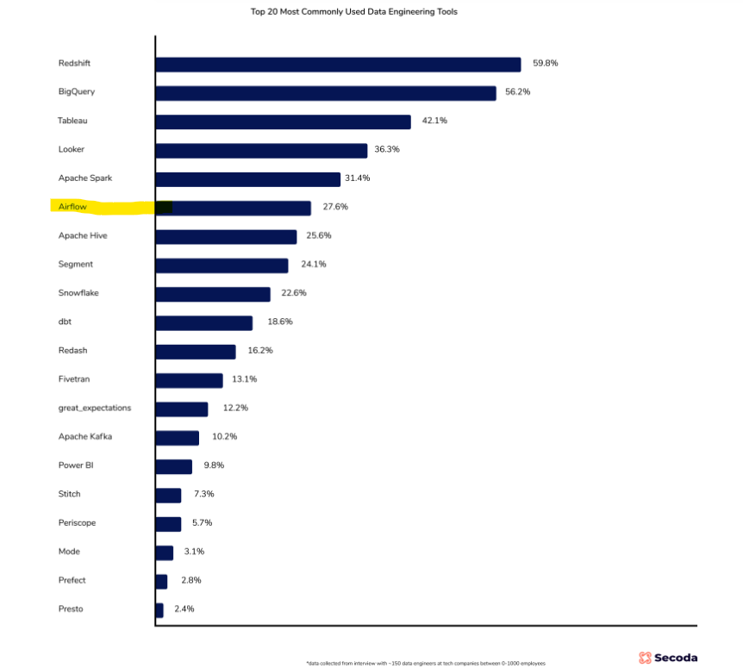
Data Engineering Tools

Slide 6
AIRFLOW/APACHE AIRFLOW
open-source workflow management platform
How to create tasks dynamically ?
How to choose one task or another ?
According to a connection how to share data between your tasks ?
How to schedule your data pipeline in airflow (importantly )?

Slide 7
DAG: directed acyclic graph
T2
T2
T1
T3
T1
T3
T4
T4
DAG
NOT DAG

Slide 8
OPERATOR
Operator : Task in your dag.
T2
EXECUTE A PYTHON FUNCTION
T1
T3
EXCECUTE A BASH COMMAND
T4
INSERTS DATA INTO DATABASE

Slide 9
OPERATOR
Python operator
Bash operator
email operator
time operator
…

Slide 10
INSTALL AIRFLOW
we have all the details in the link below
Run Apache Airflow on Windows 10 without Docker | by Philipp Schmalen | Towards Data Science

Slide 11
START AIRFLOW
Open three cmd windows
Scheduler
Webserver
To do test

Slide 12
Start airflow scheduler
wsl to enter in linux environment
sudo su
airflow scheduler
Start the airflow web server
wsl to enter the linux environment
sudo airflow webserver
(option ) initialize database in AIRFLOW_HOME
airflow db init ( option :just for the first time )
access the UI on localhost:8080 in your browser

Slide 13
Edit airflow.cfg
Wsl
2. sudo su
3. run airflow info to find out where the airflow home is
4. cd path_to_airflow home
5. nano airflow.cfg to edit the content of the file
7. ctrl + o + enter enter to save
8 . ctrl+x to exit the editor
NB:
You can make a search in airflow.cfg file
Type ctrl + w, then type the word to search, then type enter to search the file

Slide 14
Do python test
wsl
sudo to work as superuser
python3 filename_.py
Manually test your python script with: python3 filename_.py (go to the folder where the file is located or give the path to the file) to make sure it works

Slide 15
Do dags test
wsl pour to enter in linux environment
sudo to work as superuser
3. pipenv run test nom_de_fichier_.py
NB
airflow info: and look in which directory your dag located

Slide 16
Create a data Pipeline in four steps
Make the right imports
Create a instance of a dag class
Implementing the tasks
Specifie the dependencies

Slide 17

Thank You

Slide 18
DATA ANALYTICS WORKFLOW
V
RISK MANAGER
OTHER STAKEHOLDER
DATA VISUALIZATION
RECO. SYSTEM
ANALYTICS ENVIRONMENT
EXPLORATION
IDEATION
TRANSFORMATION
MODELIZATION
DATA STORAGE & INTEGRATION
DATA ACQUISTION
MU-DATA
FI-DATA
MP DATA
MVP ARCHITECTURE

Slide 19






DATA PIPELINES
External Data
PLC-DATA
SENSORS DATA
GEO-DATA
FINANCIAL DATA
OTHER DATA
API
Mongo DB
INGEST
PROCESS
ETL
SQL
DB
DATA PIPELINE

Slide 20









TOOLS SET
TOOLS

