Slide 1
EASE DATA PIPELINE
KAEYROS ANALYTICS

Slide 2
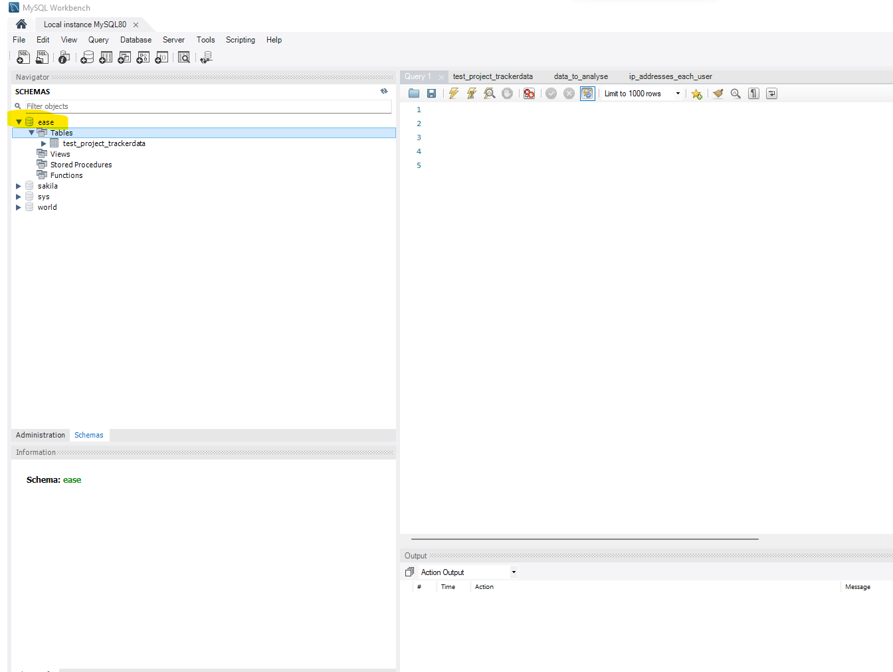
EXTRAT DATA FROM MYSQLDATA BASE
COLLECT DATA EVERYDAY AT 5:00 PM

Slide 3
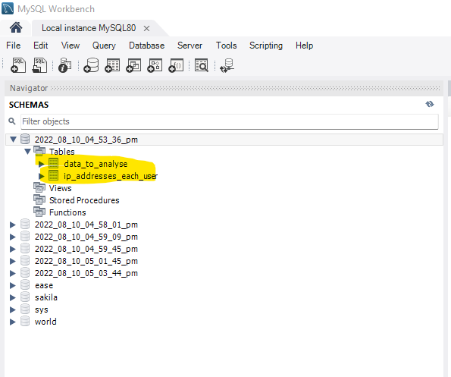
DATA PROCESSING
CREATE KPI

Slide 4
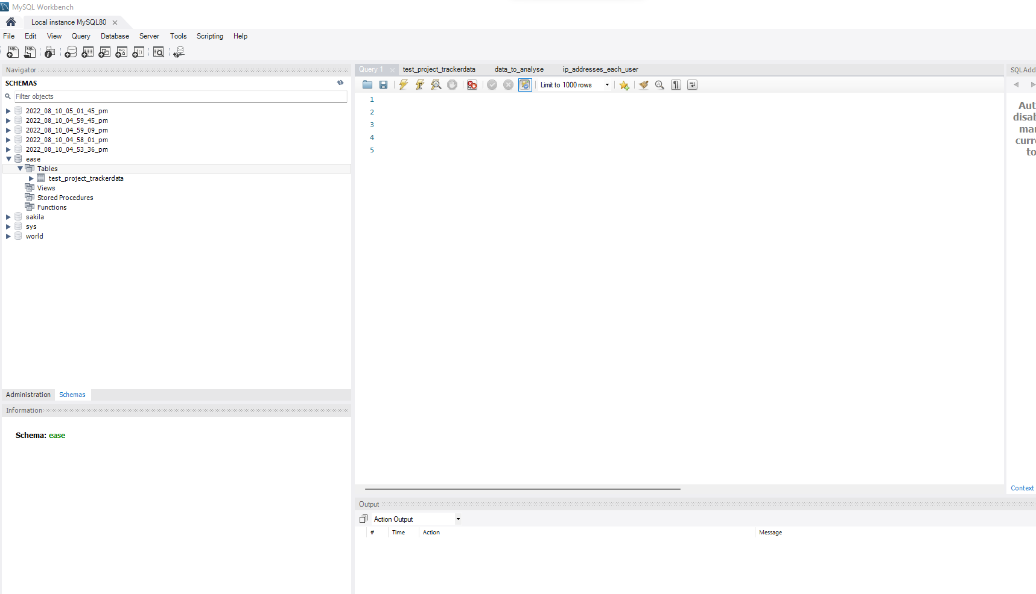
NEW DATA SAVE TO SQL
LOAD NEW DATA TO MYSQL DATABASE

Slide 5
DATA PIPELINE UI

Slide 6
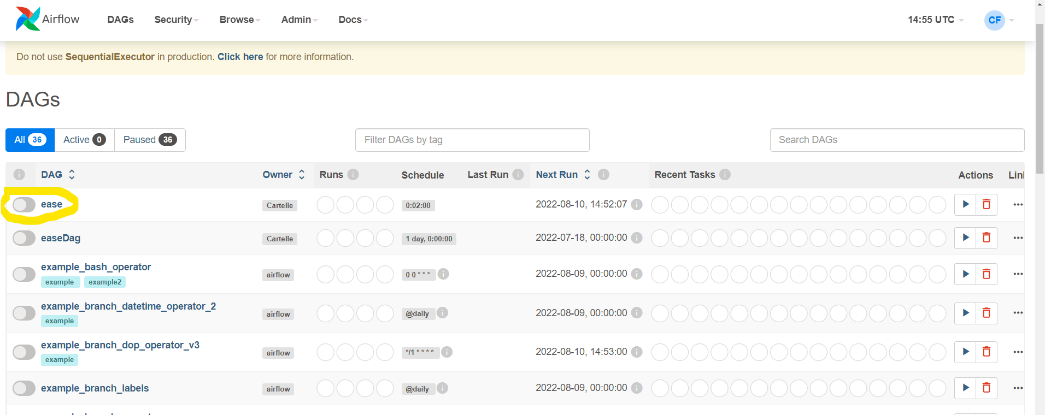
AIRFLOW DAGS

Slide 7
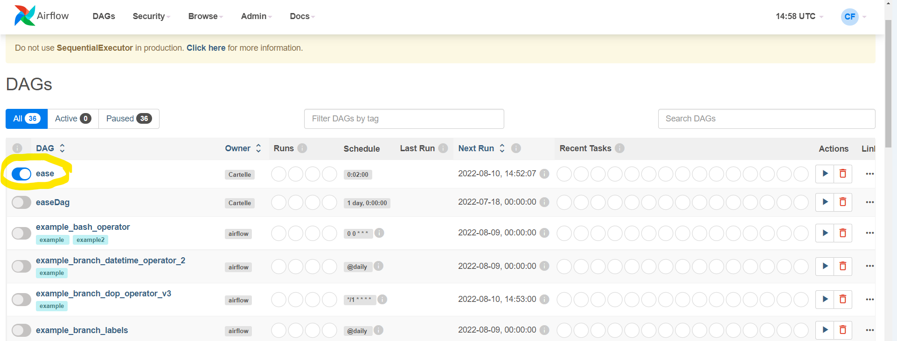
ACTIVE DAGS

Slide 8
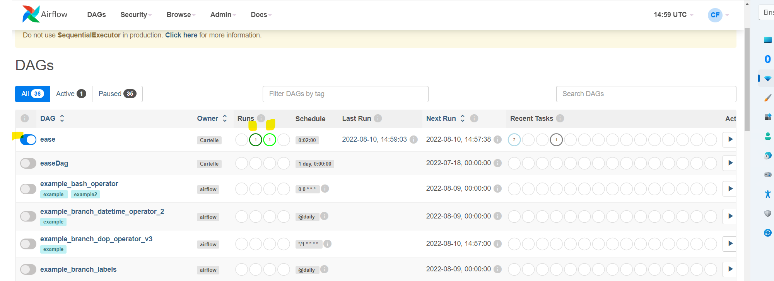
TRIGGER DAGS
1 JOB SUCESS; 1 JOB RUNING

Slide 9
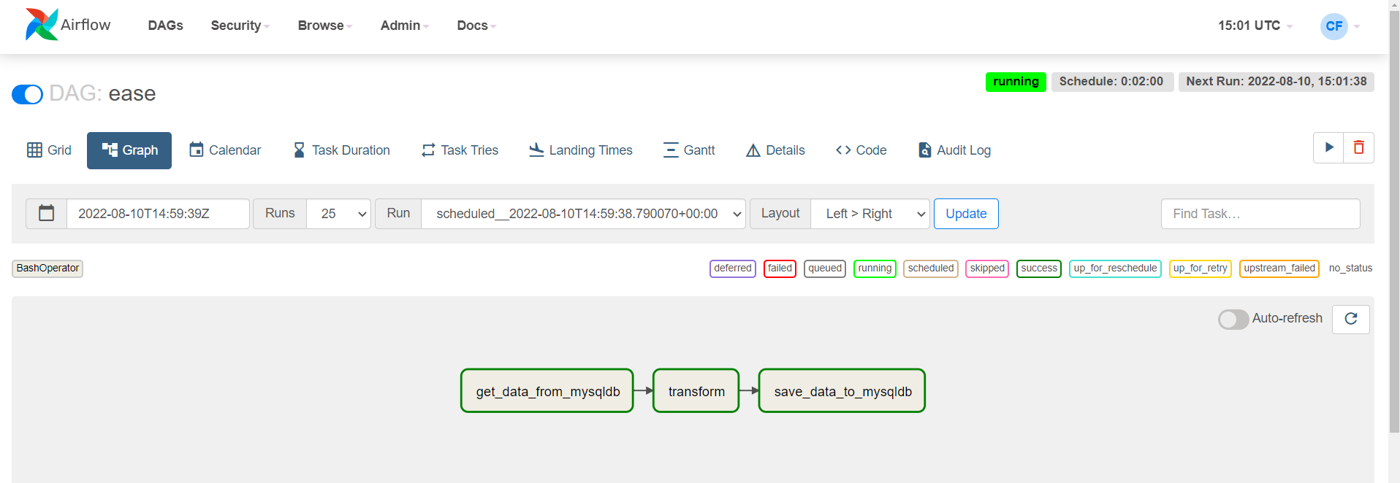
DAG GRAPH
SUCCESSFUL WITH GREEN

Slide 10
NEW DATABASE WITH NEW KPI

Slide 11

Thank You

