Slide 1
DDX-IoT
Dynamic Pricing

Slide 2

STATIC PRICING
MACHINERY INSURANCE – ACV -
DYNAMIC PRICING
CONCEPT– BUSINESS CASE
INPUT DATA
INTERNAL - EXTERNAL
IMPLEMENTATION
SIMULATION – MODELIZATION - FORECAST
CONTENT
USER INTERFACE
PRICING CALCULATOR - REQUIREMENTS

Slide 3
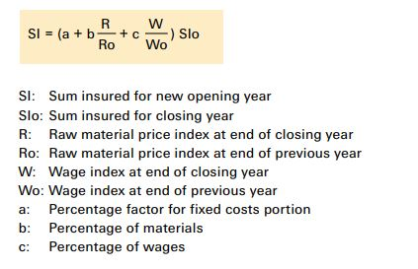
Machinery Insurance is generally understood as accident insurance
Machines have service lives depending on operating conditions (IoT_Health_Index ?)
Machine Owners must allocate proper reserves for replacing machines and equipment at the end of service lives
Machinery Insurance cover is designed to ensure enough capital will be available for the new procurement at the end of the service lives
STATIC PRICING
Credits: https://www.swissre.com/dam/jcr:67af69c6-4cd5-4938-8bff-b287897c5d91/pub_machinery_insurance_en.pdf

Slide 4
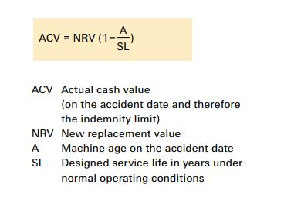
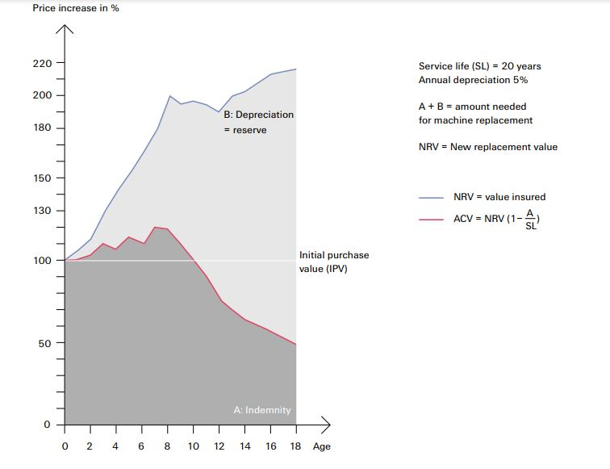
There are 2 main concepts for Machinery Valuation:
Actual Cash Balue Basis (ACV)
Repair or Replacement Basis (NRV)
STATIC PRICING
Credits: https://www.swissre.com/dam/jcr:67af69c6-4cd5-4938-8bff-b287897c5d91/pub_machinery_insurance_en.pdf

Slide 5
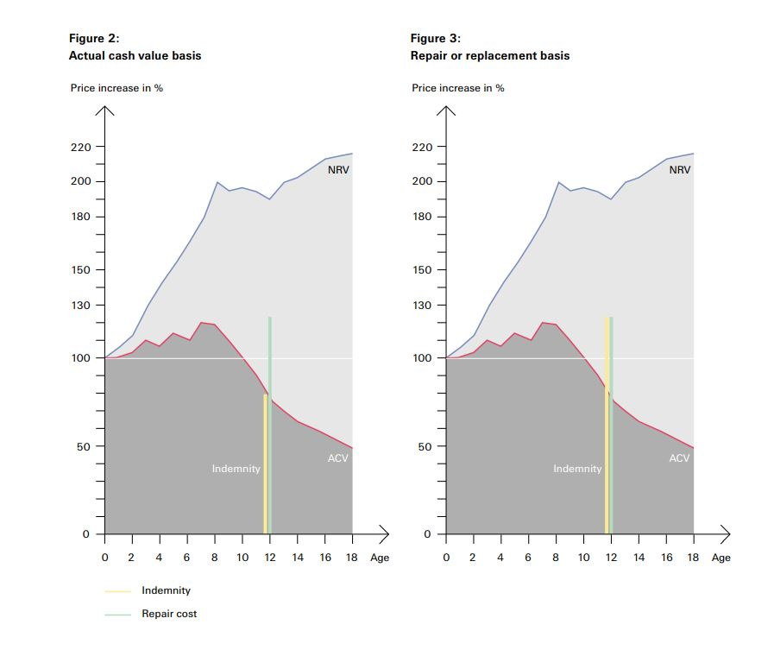
STATIC PRICING
Credits: https://www.swissre.com/dam/jcr:67af69c6-4cd5-4938-8bff-b287897c5d91/pub_machinery_insurance_en.pdf

Slide 6
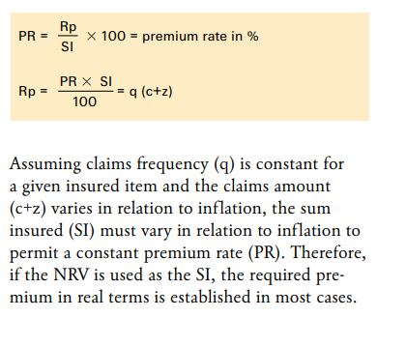
Basic Premium Calculation usually based on
Loss frequency in a given annual period
Claim amount
Surcharge to compensate specific perils and administrative costs
STATIC PRICING
Credits: https://www.swissre.com/dam/jcr:67af69c6-4cd5-4938-8bff-b287897c5d91/pub_machinery_insurance_en.pdf

Slide 7
Generally three approaches for dynamic pricing (t):
Cost-based-pricing
Competitor-based pricing
Demand-based pricing
DDX Dynamic Machinery Insurance:
All the three above (desired profit margin, average market price, demand data)
Machine related information (currently → IoT_health_index)
Other external/internal input (inflation, weather, season, gpr-index, natural hazards, duration customer relationship, season, consumer confidence index, …)
c PRICING
Credits: https://www.swissre.com/dam/jcr:67af69c6-4cd5-4938-8bff-b287897c5d91/pub_machinery_insurance_en.pdf

Slide 8
Benefits for the Insurer
Flexible Risk Adaptation to external Risk Factors (inflation, geo-political situation, ..)
Better Estimation of Provisions required
Potential Increase of Investment Capital
Motivation for better machine/equipment maintenance
Benefits for the Insured
Rewards for good maintenance
Rewards for good maintenance
DYNAMIC PRICING
Credits: https://www.swissre.com/dam/jcr:67af69c6-4cd5-4938-8bff-b287897c5d91/pub_machinery_insurance_en.pdf

Slide 9
Internal factors (insured*)
IoT_Health_Index
Company_size (small, middle, large)
Internal factors (insurer*)
duration Customer relationship (nbr of years)
Number of payment reminder
external factors
Industry demands, seasonality, wethaer, geo_political_index, natural hazard
Better Estimation of Provisions required
INPUT DATA
Credits: https://www.swissre.com/dam/jcr:67af69c6-4cd5-4938-8bff-b287897c5d91/pub_machinery_insurance_en.pdf

Slide 10
Concept
dyn_price(t) = fixed_premium(t) + shift_function(t)
fixed_premium(t) as baseline
shift_function(t) = function(t, iot_healt_index, weather, location, seasonality, inflation, …) will be estimated
dyn_price(t) will be simulated based on certain conditions (max_values, profit margin)
dyn_price(t) should not exceed fixe_premium_rate of previous year
dyn_price should be calculated so that a desired profit margined is attained
IMPLEMENTATION
Credits: https://www.swissre.com/dam/jcr:67af69c6-4cd5-4938-8bff-b287897c5d91/pub_machinery_insurance_en.pdf

Slide 11
Simulation
Simulate dyn(t) with opposite
fixed_premium(t) as baseline
shift_function(t) = function(t, iot_healt_index, weather, location, seasonality, inflation, …) will be estimated
Modelization
Simulate dyn(t) with opposite
fixed_premium(t) as baseline
Forecast
Simulate dyn(t) with opposite
fixed_premium(t) as baseline
IMPLEMENTATION
Credits: https://www.swissre.com/dam/jcr:67af69c6-4cd5-4938-8bff-b287897c5d91/pub_machinery_insurance_en.pdf

Slide 13
Generally three approaches for dynamic pricing (t):
Cost-based-pricing
Competitor-based pricing
Demand-based pricing
DDX Dynamic Machinery Insurance:
All the three above (desired profit margin, average market price, demand data)
Machine related information (currently → IoT_health_index)
Other external/internal input (inflation, weather, season, gpr-index, natural hazards, duration customer relationship, season, consumer confidence index, …)
DYNAMIC PRICING
Credits: https://www.swissre.com/dam/jcr:67af69c6-4cd5-4938-8bff-b287897c5d91/pub_machinery_insurance_en.pdf

Slide 14
Current „static“ Machinery Insurance is generally understood as accident insurance
Machines have service lives depending on operating conditions (IoT_Health_Index ?)
Machine Owners must allocate proper reserves for replacing machines and equipment at the end of service lives
Machinery Insurance cover is designed to ensure enough capital will be available for the new procurement at the end of the service lives
DYNAMIC PRICING
Credits: https://www.swissre.com/dam/jcr:67af69c6-4cd5-4938-8bff-b287897c5d91/pub_machinery_insurance_en.pdf

Slide 15

Thank You

