Slide 1
DDX-IoT
Dynamic Pricing

Slide 2

STATIC PRICING
MACHINERY INSURANCE – ACV -
DYNAMIC PRICING
CONCEPT– BUSINESS CASE
INPUT DATA
INTERNAL - EXTERNAL
IMPLEMENTATION
SIMULATION – MODELIZATION - FORECAST
CONTENT
USER INTERFACE
PRICING CALCULATOR - REQUIREMENTS

Slide 3
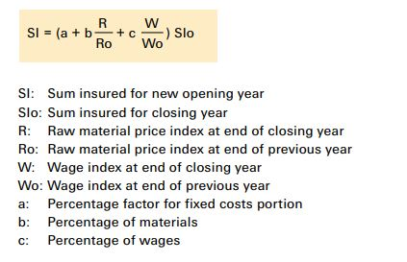
Machinery Insurance is generally understood as accident insurance
Machines have service lives depending on operating conditions (IoT_Health_Index ?)
Machine Owners must allocate proper reserves for replacing machines and equipment at the end of service lives
Machinery Insurance cover is designed to ensure enough capital will be available for the new procurement at the end of the service lives
STATIC PRICING
Credits: https://www.swissre.com/dam/jcr:67af69c6-4cd5-4938-8bff-b287897c5d91/pub_machinery_insurance_en.pdf

Slide 4
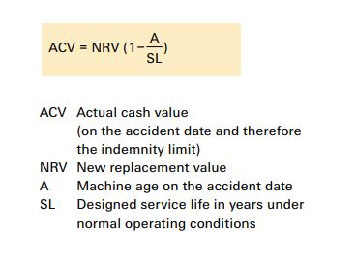
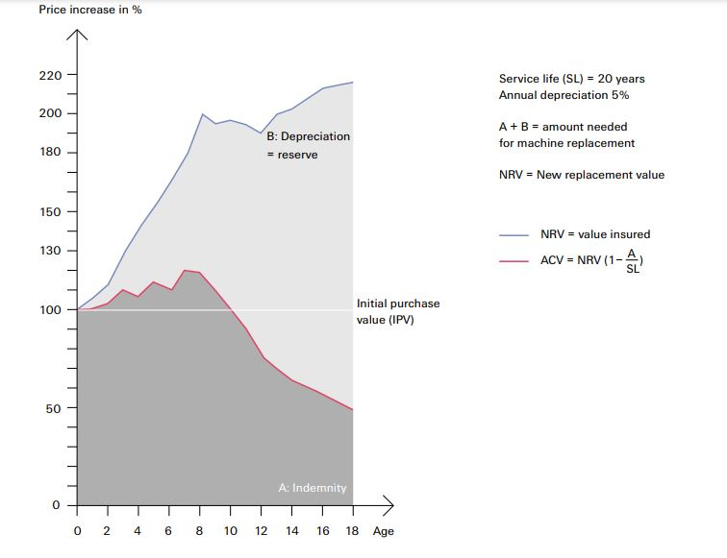
There are 2 main concepts for Machinery Valuation:
Actual Cash Calue Basis (ACV)
Repair or Replacement Basis (NRV)
STATIC PRICING
Credits: https://www.swissre.com/dam/jcr:67af69c6-4cd5-4938-8bff-b287897c5d91/pub_machinery_insurance_en.pdf

Slide 5
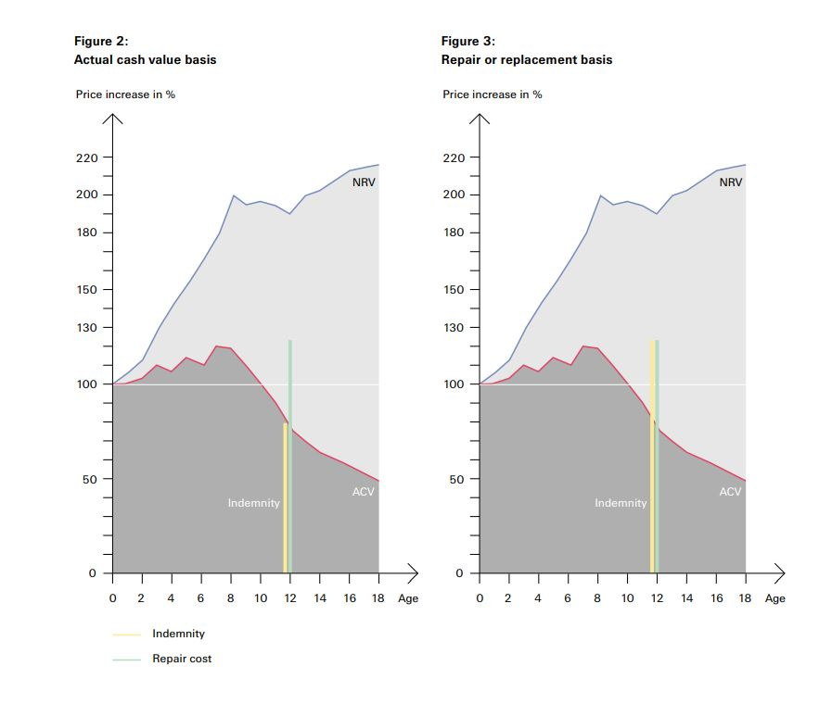
STATIC PRICING
Credits: https://www.swissre.com/dam/jcr:67af69c6-4cd5-4938-8bff-b287897c5d91/pub_machinery_insurance_en.pdf

Slide 6
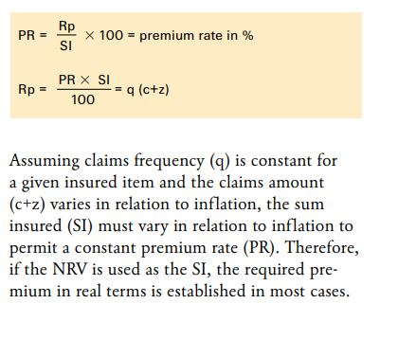
Basic Premium Calculation usually based on
Loss frequency in a given annual period
Claim amount
Surcharge to compensate specific perils and administrative costs
STATIC PRICING
Credits: https://www.swissre.com/dam/jcr:67af69c6-4cd5-4938-8bff-b287897c5d91/pub_machinery_insurance_en.pdf

Slide 7
Generally three approaches for dynamic pricing (t):
Cost-based-pricing
Competitor-based pricing
Demand-based pricing
DDX Dynamic Machinery Insurance:
All the three above (desired profit margin, average market price, demand data)
Machine related information (currently → IoT_health_index)
Other external/internal input (inflation, weather, season, gpr-index, natural hazards, duration customer relationship, season, consumer confidence index, …)
c PRICING
Credits: https://www.swissre.com/dam/jcr:67af69c6-4cd5-4938-8bff-b287897c5d91/pub_machinery_insurance_en.pdf

Slide 8
Business Case (Insurer)
Flexible Risk Adaptation to external Risk Factors (inflation, geo-political situation, ..)
Better Estimation of Provisions required → Increase of Investment Capital
Reduction of Claims amount → Motivation for better machine/equipment maintenance
Better Estimation of Actual Value → Residual Value
Data as delivery for Insurers
Benefits for the Insured
Rewards for good maintenance
Price Transparency
DYNAMIC PRICING
Credits: https://www.swissre.com/dam/jcr:67af69c6-4cd5-4938-8bff-b287897c5d91/pub_machinery_insurance_en.pdf

Slide 9
Basic Concept Dynamic Pricing of Insurance Products for the Insurer
Premium(P) = Marketin_Costs(M) + Operational_Costs(O) + Claims(C) + Profit(PF)
Profit(PF) = Premium(P) - Marketin_Costs(M) - Operational_Costs(O) - Claims(C)
The main idea is then to maximize the Profit (PF): Max PF = P – M – O – C under certain constraints (M < M_max; O < O_max; P< P_max)
Linear Programming → best optimal price to get the maximal margin
DYNAMIC PRICING
Credits: https://medium.com/analytics-vidhya/dynamic-pricing-of-insurance-products-d042dfb63b16

Slide 10
IoT-Concept Dynamic Pricing of Insurance Products for the Insurer
P = IoT_health_Index + M + O + C + PF + other_input_param(OIP)
PF → Margin (%tge expected ~ M)
M = P - IoT_health_Index - O - C - OIP
M = P - IoT_health_Index - OP
Reminder → P := historical premium price (fix)
Constraints: P < P_max (previous year)
DYNAMIC PRICING
Credits: https://medium.com/analytics-vidhya/dynamic-pricing-of-insurance-products-d042dfb63b16

Slide 11
Internal factors (insured*)
IoT_Health_Index
Company_size (small, middle, large)
Internal factors (insurer*)
duration Customer relationship (nbr of years)
Number of payment reminder
external factors
Industry demands,
seasonality,
weather
geo_political_index,
natural hazard
INPUT DATA
Credits: https://www.swissre.com/dam/jcr:67af69c6-4cd5-4938-8bff-b287897c5d91/pub_machinery_insurance_en.pdf

Slide 12
Implementation (Scenario 1)
STEP 1: Select a machine type
STEP 2: Estimate modell coefficients (Bayesian Hierarchical Regression)
STEP 3: Derive dynamic price
STEP 4: Forecast dynamic prioce for the next time points using VAR/VARMA
DYNAMIC PRICING
Credits: https://medium.com/analytics-vidhya/dynamic-pricing-of-insurance-products-d042dfb63b16

Slide 13
Implementation (Scenario 2)
Simulate dynamic_price to increase when IoT_healt_Index decrease
Use simulated values and add other parameters to model
Forecast dynamic price for the next time points using VAR/ VARMA
DYNAMIC PRICING
Credits: https://medium.com/analytics-vidhya/dynamic-pricing-of-insurance-products-d042dfb63b16

Slide 14

Thank You

