Slide 1
MANIPULATIVES / INTERACTIVE MEDIA

Slide 2
Content Standards
The learners demonstrate an understanding of manipulatives / interactive media and information, and gain comprehensive knowledge on how to effectively evaluate them.

Slide 3
Learning Competencies
Describe the different dimensions of manipulatives / interactive media.
Comprehend how manipulatives / interactive media are produced, organized, and disseminated.
Evaluate the reliability and validity of manipulatives / interactive media, as well as their sources using selection criteria.
Produce and evaluate a creative presentation on manipulatives / interactive, using design principles and elements.

Slide 4
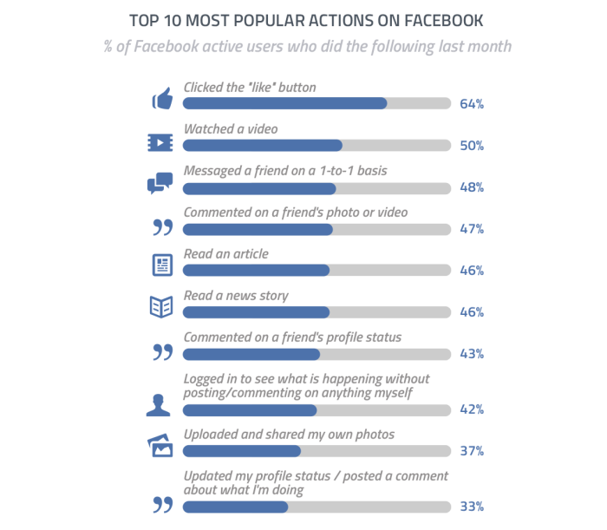
“Top Ten Most Popular Actions on Facebook” - Which of the following actions are interactive?

Slide 5

TERMS: Interactive Media
– a method of communication in which the program's outputs depend on the user's inputs, and the user's inputs in turn affect the program's outputs - Interactive media engage the user and interact with him or her in a way that non-interactive media do not - Websites and video games are two common types of interactive media.

Slide 6

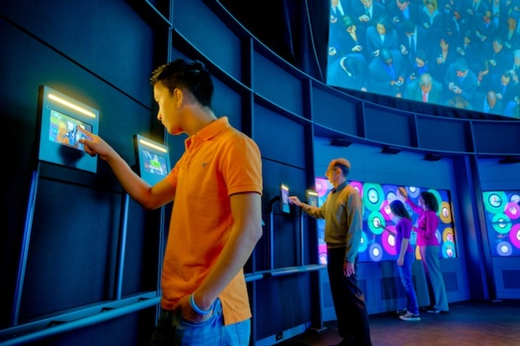
Interactivity
– the communication process that takes place between humans and computer software - The most constant form of interactivity is typically found in games, which need a continuous form of interactivity with the gamer

Slide 7
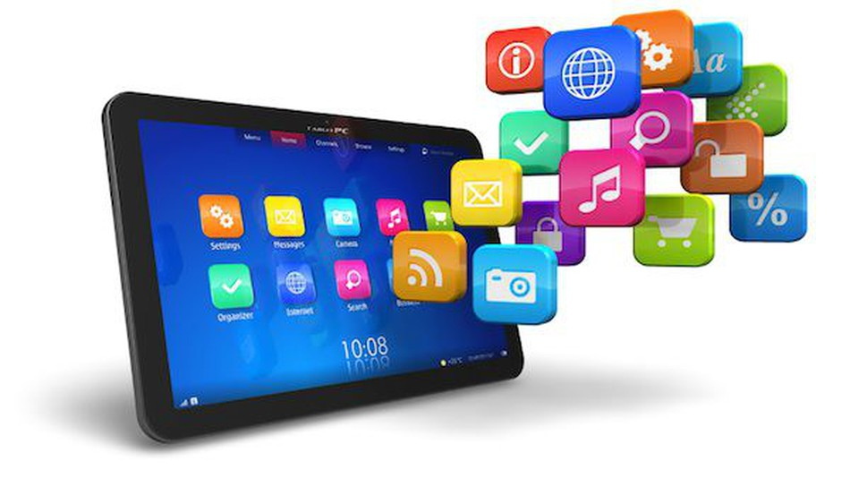
DIFFERENT PLATFORMS OF INTERACTIVE MEDIA
Mobile apps - a software application developed specifically for use on small, wireless computing devices such as smartphones and tablets, rather than desktop or laptop computers

Slide 8

3D TV - a television display technology that enables a three-dimensional effect, so that viewers perceive that an image has depth as well as height and width, similar to objects in the real world

Slide 9
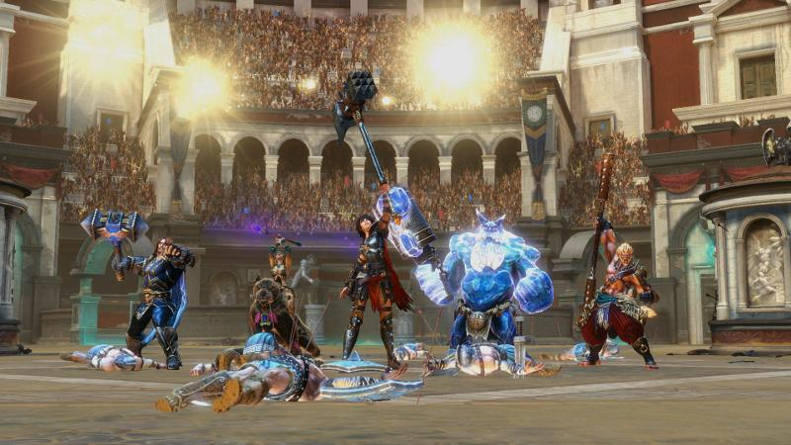
Video games (multi-player) - a game played by electronically manipulating images produced by a computer program on a television screen or other display screen. Multiplayer games allow two or more players to play with one another or play together.

Slide 10

Role-playing games (RPG) - a game in which players assume the roles of characters in a fictional setting. Players take responsibility for acting out these roles within a narrative, either through literal acting or through a process of structured decision-making or character development.

Slide 11
Massively Multiplayer Online Role Playing Game (MMORPG) - any story-driven online video game in which a player, taking on the persona of a character in a virtual or fantasy world, interacts with a large number of other players.

Slide 12

Interactive websites (pools, surveys, exams, exercises)

Slide 13

Virtual reality and immersive environments - the computer-generated simulation of a three dimensional image or environment that can be interacted with in a seemingly real or physical way by a person using special electronic equipment, such as a helmet with a screen inside or gloves fitted with sensors.

Slide 14

Social media - websites or online services where users (actual people) are the creators and consumers of the content, and where social interactions (commenting, liking, posting, talking) are the main features of content. Examples are Facebook, Twitter, Instagram, Snapchat, Vine, etc. Relate this topic to their output in the previous activity.

Slide 15
Different Ways of Interacting with the Internet
Online shopping
Online gaming
Online classes
Chat
News and information
Videos

Slide 16
Types of Interactivity and their Purposes
Click on images
Hotspot - a special region to act as a trigger to another web page. The hotspot could be a circle, triangle, rectangle or polygon.
Rollover - an image or portion of an image that changes in appearance when the mouse cursor moves over it.
Tabs - clicking on them displays a relevant content with an appropriate graphic.
Timeline - a menu slide that branches to different events.

Slide 17

f. Numbers/processes - the number of clicks and the time spent in an interactive function provide data points.
g. Slideshow - non-linear interactive slideshow where the pathway through the show is determined by the user's interaction with it.
h. Frequently asked questions (FAQs)
i. Flip cards - a card that when clicked flips to display a description and other information

Slide 18

Emerging Interactive Media
a. Interactive television - also known as ITV or iTV. A form of media convergence, adding data services to traditional television technology.
b. Allow viewers to participate in games shows - viewers compete with on-screen contestants
c. Select alternate endings to their favorite program
d. Encourage children to interact with educational programs

Slide 19
Individual Task Complete the worksheet below:
Interactive media platform | example | Non-interactive action | Interactive action
Mobile apps | Candy crush | Looking at the highest score | Asking others to send you life
Video games
Social media
Multi-player online game
3D TV

