Slide 1
The Prosodic Syntax of Right Dislocation in Cantonese
The 5th Workshop on Innovations in Cantonese Linguistics
April 18-19, 2020
The Ohio State University
Session 1-A
Ka-Fai Yip, The Chinese University of Hong Kong kafaiyip@cuhk.edu.hk

Slide 2
Right dislocation (RD)
A string is dislocated to the right of a sentence
Leads to a non-canonical sentence-medial position of the sentence-final particles (SFPs)
main chunk
R(ight-)D(dislocated) chunk
Introduction #1 RD is one I.P. #2 SFP requirement Conclusion
● ○ ○ ○ ○ ○ ○ ○ ○ ○ ○ ○ ○ ○ ○ ○ ○ ○ ○ ○ ○ ○ ○ ○ ○ ○ ○ ○ ○ ○ ○ ○

Slide 3
Two syntactic puzzles
Puzzle #1: one clause or two clauses?
Cheung (2009), Lee (2017), Lai (2019)
Monoclausal movement approach
[_{FocP} Loeng go zungtau [_{CP} laa3, [_{TP} keoi zau-zo __ ]]] two CL hour SFP 3SG leave-PFV "He has left for two hours."
Shi (1992) (for Mandarin), Tang (2018)
Biclausal deletion approach
[_{CP} keoi zau-zo Loeng go zungtau laa3 ] [_{CP} keoi zau-zo loeng go zungtau laa3 ]
Introduction #1 RD is one I.P. #2 SFP requirement Conclusion
○ ● ○ ○ ○ ○ ○ ○ ○ ○ ○ ○ ○ ○ ○ ○ ○ ○ ○ ○ ○ ○ ○ ○ ○ ○ ○ ○ ○ ○ ○ ○

Slide 4

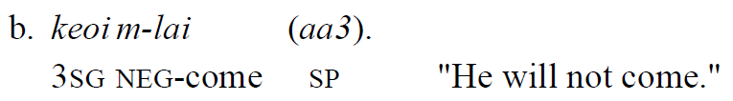
Puzzle #2: SFP requirement
SFP must occur in RDs
Also pointed out by Lai (2019) on dislocation copying
Syntactic account: Null C⁰ does not carry structure-building features that attract movement
Stipulative; and inadequate in capturing language variation
Introduction #1 RD is one I.P. #2 SFP requirement Conclusion
○ ○ ● ○ ○ ○ ○ ○ ○ ○ ○ ○ ○ ○ ○ ○ ○ ○ ○ ○ ○ ○ ○ ○ ○ ○ ○ ○ ○ ○ ○ ○

Slide 5
Goal
To provide prosodic evidence from acoustic experiments for settling these two syntactic puzzles
Spoilers:
#1: RD is one intonational phrase, supporting a monoclausal analysis
#2: Hybrid syntactic-prosodic approach to account for the SFP requirement: Cantonese intonations as C and boundary tones
Introduction #1 RD is one I.P. #2 SFP requirement Conclusion
○ ○ ○ ● ○ ○ ○ ○ ○ ○ ○ ○ ○ ○ ○ ○ ○ ○ ○ ○ ○ ○ ○ ○ ○ ○ ○ ○ ○ ○ ○ ○

Slide 6
Resolving puzzle #1: RD as one intonational phrase

Slide 7
Experiment one: design
Trichotomy: (declaratives)
[1] Non-RD (one sentence) [S-V-O-SP]
[2] Non-RD (two sentences) [S-V-O-SP] [S-V-O-SP]
[3] RD [V-O-SP-S]
7 syllables in tone 3 (mid-level, 33)
[1] sung3 zi3 heoi3 gwo3 taai3 gwok3 gaa3. 宋智去過泰國架。 [2] ngo5 heoi3 gwo3 taai3 gwok3 gaa3. sung3 zi3 dou1 heoi3 gwo3 taai3 gwok3 gaa3. 我去過泰國架。宋智都去過泰國架。 [3] heoi3 gwo3 taai3 gwok3 gaa3 sung3 zi3. 去過泰國架宋智。 “Sungzi had a trip in Thailand.”
Introduction #1 RD is one I.P. #2 SFP requirement Conclusion
○ ○ ○ ○ ● ○ ○ ○ ○ ○ ○ ○ ○ ○ ○ ○ ○ ○ ○ ○ ○ ○ ○ ○ ○ ○ ○ ○ ○ ○ ○ ○

Slide 8
Data
Target-filler ratio is approximately 1:1.7.
Subjects: 3 female, 3 male (19-22) speaking Hong Kong Cantonese
3 types x 3 sets of lexical items x 3 repetition x 6 subjects = 162 tokens
Processed by ProsodyPro (Xu 2013) to get time-normalized F0 (10 time points per syllable) and average across speakers
Introduction #1 RD is one I.P. #2 SFP requirement Conclusion
○ ○ ○ ○ ○ ● ○ ○ ○ ○ ○ ○ ○ ○ ○ ○ ○ ○ ○ ○ ○ ○ ○ ○ ○ ○ ○ ○ ○ ○ ○ ○

Slide 9
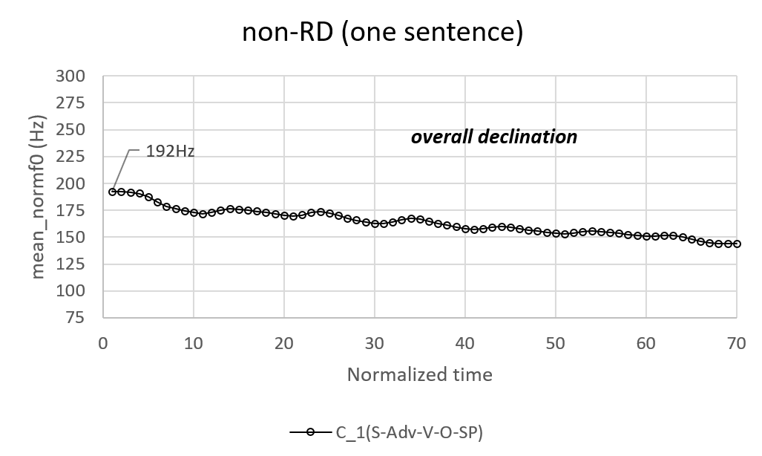
Experiment one: results
Introduction #1 RD is one I.P. #2 SFP requirement Conclusion
○ ○ ○ ○ ○ ○ ● ○ ○ ○ ○ ○ ○ ○ ○ ○ ○ ○ ○ ○ ○ ○ ○ ○ ○ ○ ○ ○ ○ ○ ○ ○

Slide 10
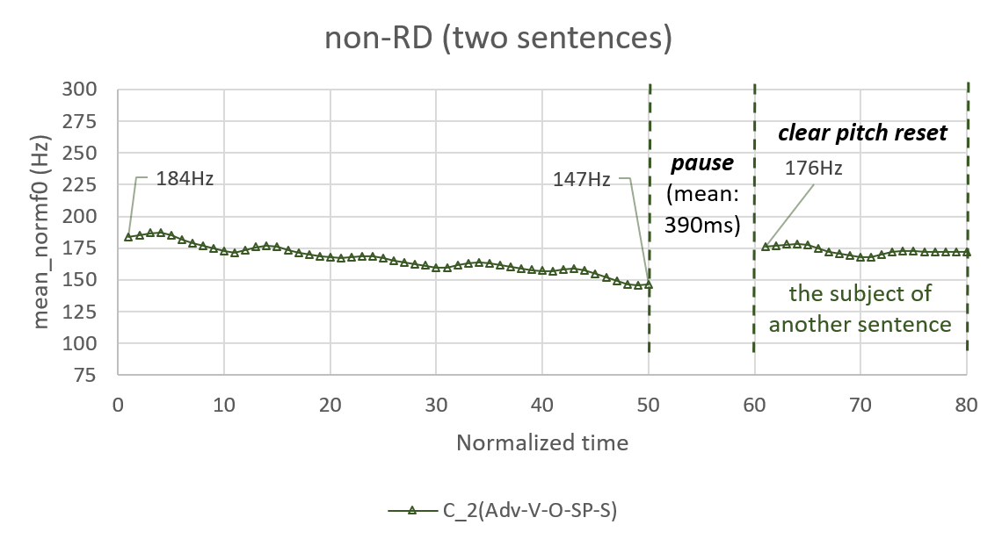
Introduction #1 RD is one I.P. #2 SFP requirement Conclusion
○ ○ ○ ○ ○ ○ ○ ● ○ ○ ○ ○ ○ ○ ○ ○ ○ ○ ○ ○ ○ ○ ○ ○ ○ ○ ○ ○ ○ ○ ○ ○

Slide 11

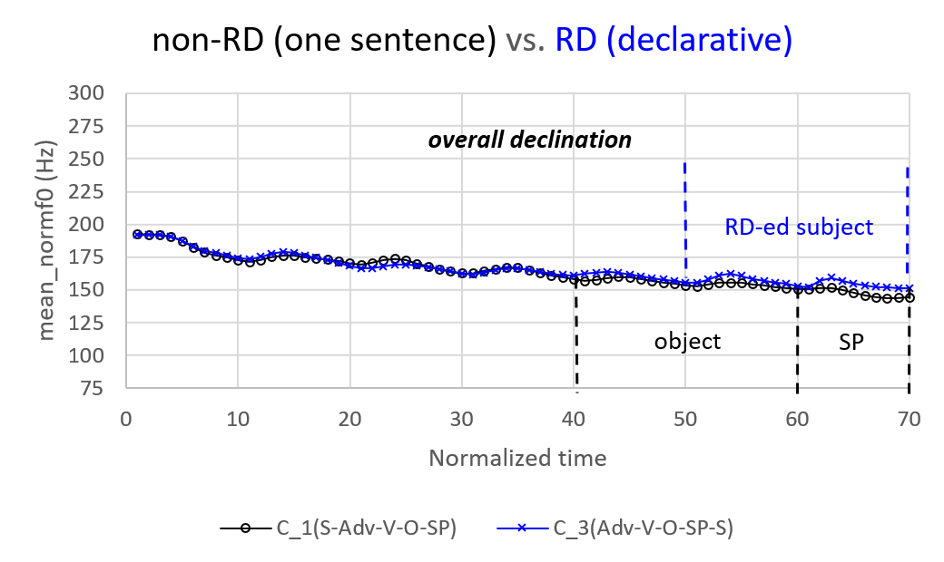
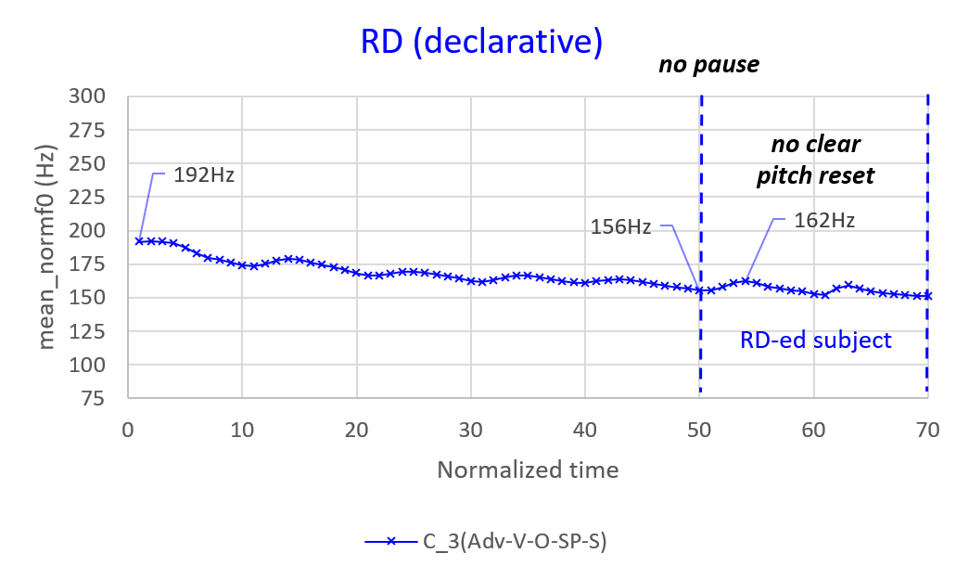
Introduction #1 RD is one I.P. #2 SFP requirement Conclusion
○ ○ ○ ○ ○ ○ ○ ○ ● ○ ○ ○ ○ ○ ○ ○ ○ ○ ○ ○ ○ ○ ○ ○ ○ ○ ○ ○ ○ ○ ○ ○

Slide 12
Experiment one: discussion
Prosodic properties of RD
Pause before RD chunk | NO
Pitch reset of RD chunk | NO
Overall declination | YES
Take home message:
RD is one intonational phrase (main chunk-SFP RD chunk %)
Introduction #1 RD is one I.P. #2 SFP requirement Conclusion
○ ○ ○ ○ ○ ○ ○ ○ ○ ● ○ ○ ○ ○ ○ ○ ○ ○ ○ ○ ○ ○ ○ ○ ○ ○ ○ ○ ○ ○ ○ ○

Slide 13
Resolving puzzle #1
Biclausal deletion approach
[_{CP} keoi zau-zo Loeng go zungtau laa3 ] [_{CP} keoi zau-zo loeng go zungtau laa3 ]
→ Two intonational phrases (i.e. [2])
Monoclausal movement approach
[_{FocP} Loeng go zungtau [_{CP} laa3, [_{TP} keoi zau-zo __ ]]] two CL hour SP 3SG leave-PFV
(main chunk-SFP RD chunk %)
→ One intonational phrase
Introduction #1 RD is one I.P. #2 SFP requirement Conclusion
○ ○ ○ ○ ○ ○ ○ ○ ○ ○ ● ○ ○ ○ ○ ○ ○ ○ ○ ○ ○ ○ ○ ○ ○ ○ ○ ○ ○ ○ ○ ○

Slide 14
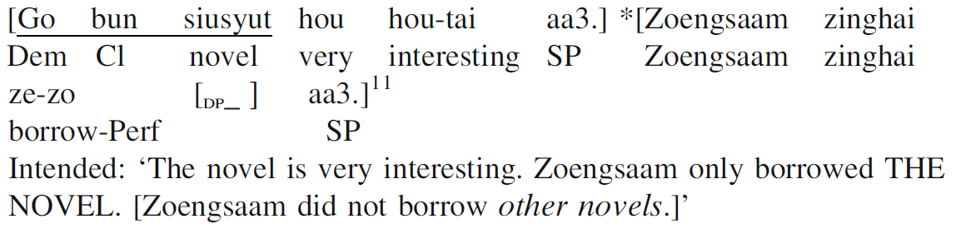
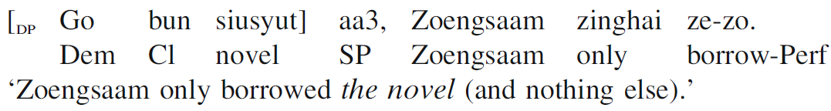
Compatible with syntactic evidence
Cheung (2009):
SFPs (C-heads) cannot occur twice
*Loeng go zungtau laa3 keoi zau-zo laa3 ‘He has left for two hours.’
Connectivity effects
Association of “only” and focus
Introduction #1 RD is one I.P. #2 SFP requirement Conclusion
○ ○ ○ ○ ○ ○ ○ ○ ○ ○ ○ ● ○ ○ ○ ○ ○ ○ ○ ○ ○ ○ ○ ○ ○ ○ ○ ○ ○ ○ ○ ○

Slide 15
Resolving puzzle #2: Cantonese intonations as C and boundary tones

Slide 16
What will happen if we put intonations into RD?
Knowing that RD is an intonational phrase…
Cantonese uses a final rising boundary tone H% to express yes-no questions (Xu & Mok 2011, Zhang 2014).
Keoi wui lai H%? (佢會嚟?) 3SG will come H% ‘Will he come?’
→ Expect to occur at the last syllable of the RD chunk (main chunk RD chunk H% )
Is that true? Let’s find out!
Introduction #1 RD is one I.P. #2 SFP requirement Conclusion
○ ○ ○ ○ ○ ○ ○ ○ ○ ○ ○ ○ ● ○ ○ ○ ○ ○ ○ ○ ○ ○ ○ ○ ○ ○ ○ ○ ○ ○ ○ ○

Slide 17
Experiment two: design
Dichotomy (with control sentences):
[4] Control: non-RD with a question particle [S-V-O-QP]?
[5] Target: RD with a question particle [V-O-QP-S]?
[6] Control: non-RD with question intonation [S-V-O]?
[7] Target: RD with question intonation [V-O-S]?
7 syllables (6 syllables for [6][7]) in tone 3 (mid-level, 33)
[4] sung3 zi3 heoi3 gwo3 taai3 gwok3 maa3? 宋智去過泰國嗎？ [5] heoi3 gwo3 taai3 gwok3 maa3 sung3 zi3? 去過泰國嗎宋智？ [6] sung3 zi3 heoi3 gwo3 taai3 gwok3? 宋智去過泰國？ [7] heoi3 gwo3 taai3 gwok3 sung3 zi3? 去過泰國宋智？
Introduction #1 RD is one I.P. #2 SFP requirement Conclusion
○ ○ ○ ○ ○ ○ ○ ○ ○ ○ ○ ○ ○ ● ○ ○ ○ ○ ○ ○ ○ ○ ○ ○ ○ ○ ○ ○ ○ ○ ○ ○

Slide 18
Data
Target-filler ratio is approximately 1:2.
Subjects: 3 female, 3 male (19-22) speaking Hong Kong Cantonese
4 types x 3 sets of lexical items x 3 repetition x 6 subjects = 216 tokens
Processed by ProsodyPro (Xu 2013) to get time-normalized F0 (10 time points per syllable) and average across speakers
Introduction #1 RD is one I.P. #2 SFP requirement Conclusion
○ ○ ○ ○ ○ ○ ○ ○ ○ ○ ○ ○ ○ ○ ● ○ ○ ○ ○ ○ ○ ○ ○ ○ ○ ○ ○ ○ ○ ○ ○ ○

Slide 19
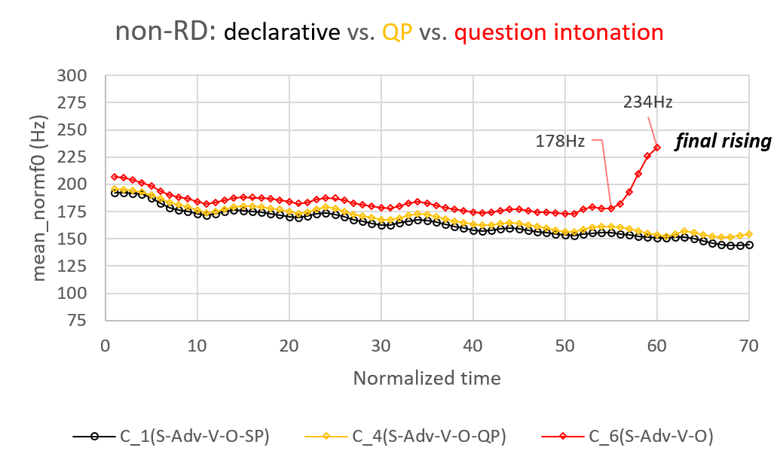
Experiment two: results
Introduction #1 RD is one I.P. #2 SFP requirement Conclusion
○ ○ ○ ○ ○ ○ ○ ○ ○ ○ ○ ○ ○ ○ ○ ● ○ ○ ○ ○ ○ ○ ○ ○ ○ ○ ○ ○ ○ ○ ○ ○

Slide 20
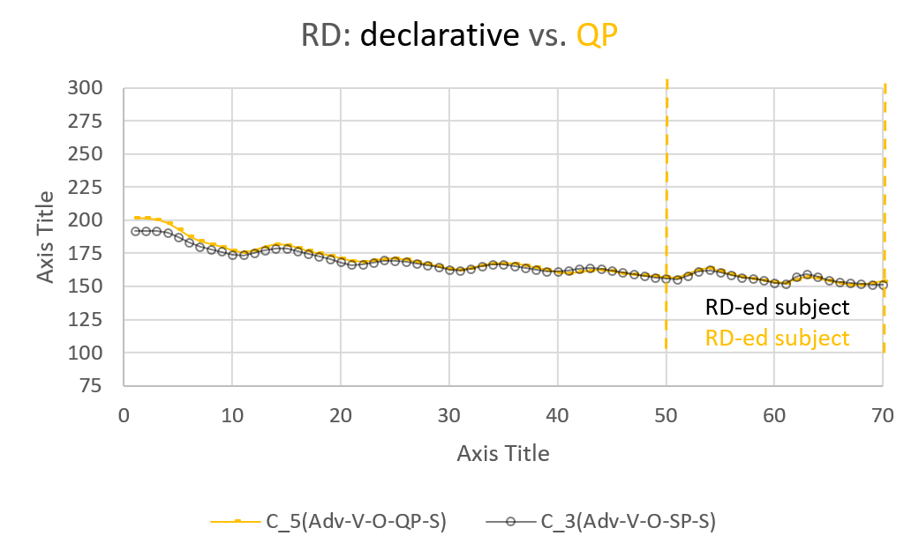
Introduction #1 RD is one I.P. #2 SFP requirement Conclusion
○ ○ ○ ○ ○ ○ ○ ○ ○ ○ ○ ○ ○ ○ ○ ○ ● ○ ○ ○ ○ ○ ○ ○ ○ ○ ○ ○ ○ ○ ○ ○

Slide 21
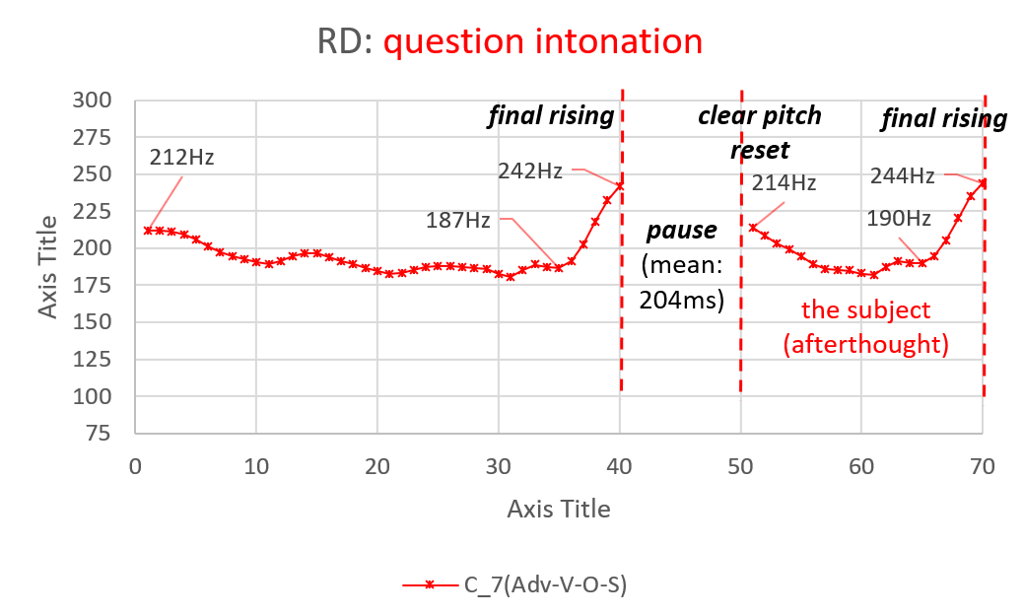
(! Not what we expected!)
Introduction #1 RD is one I.P. #2 SFP requirement Conclusion
○ ○ ○ ○ ○ ○ ○ ○ ○ ○ ○ ○ ○ ○ ○ ○ ○ ● ○ ○ ○ ○ ○ ○ ○ ○ ○ ○ ○ ○ ○ ○

Slide 22
Experiment two: discussion
 | [5]RDQP | [7]RDintonation
Pause before RD chunk | NO | YES
Pitch reset of RD chunk | NO | YES
Overall declination | YES | NO
Final rising of RD chunk | NO | YES (but also main chunk)
Take home message:
Intonations must be “copied” in RDs *(main chunk-SFP RD chunk H%)
^{OK}(main chunk H%) (RD chunk H%)
Introduction #1 RD is one I.P. #2 SFP requirement Conclusion
○ ○ ○ ○ ○ ○ ○ ○ ○ ○ ○ ○ ○ ○ ○ ○ ○ ○ ● ○ ○ ○ ○ ○ ○ ○ ○ ○ ○ ○ ○ ○

Slide 23
To realize H% in RD:
i. (main chunk H% RD chunk) → * (not boundary)
ii. (main chunk H% RD chunk H%) → * (main chunk H%) (RD chunk H%) → OK
iii. (main chunk RD chunk H%) → * (unexpected)
Prosody alone cannot account for the distribution of intonations in RD
Introduction #1 RD is one I.P. #2 SFP requirement Conclusion
○ ○ ○ ○ ○ ○ ○ ○ ○ ○ ○ ○ ○ ○ ○ ○ ○ ○ ○ ● ○ ○ ○ ○ ○ ○ ○ ○ ○ ○ ○ ○

Slide 24
Intonations as C
A syntactic explanation to (iii)
H% shows complementary distribution with question particles → can be treated as a segmentless SFP (Tang 2006, Zhang 2014) → presumably also C-head
[_{FocP} went to Thailand [_{CP} C-H% [_{TP} Sungzi _ ]]]
Upon linearization: *(went to Thailand H% Sungzi) → ruled out by prosodic restriction on boundary tones
To derive (went to Thailand Sungzi H% ), C must be lowered to TP: *[_{FocP} went to Thailand [_{CP} __ [_{TP} Sungzi-C-H% _ ]]]
Not possible!
Introduction #1 RD is one I.P. #2 SFP requirement Conclusion
○ ○ ○ ○ ○ ○ ○ ○ ○ ○ ○ ○ ○ ○ ○ ○ ○ ○ ○ ○ ● ○ ○ ○ ○ ○ ○ ○ ○ ○ ○ ○

Slide 25
Consequences
(i) RDs with “copied” intonations are not genuine RDs
Two H% → Two C-heads
Incompatible with monoclausal analysis of RDs
Recall: SFPs cannot occur twice in RDs
*Loeng go zungtau laa3 keoi zau-zo laa3 ‘He has left for two hours.’
Introduction #1 RD is one I.P. #2 SFP requirement Conclusion
○ ○ ○ ○ ○ ○ ○ ○ ○ ○ ○ ○ ○ ○ ○ ○ ○ ○ ○ ○ ○ ● ○ ○ ○ ○ ○ ○ ○ ○ ○ ○

Slide 26
Can be treated as ‘afterthoughts’ (Li & Wei 2017)
Different prosodic properties
Genuine RDs: one intonational phrase
Afterthoughts: two intonational phrases
Introduction #1 RD is one I.P. #2 SFP requirement Conclusion
○ ○ ○ ○ ○ ○ ○ ○ ○ ○ ○ ○ ○ ○ ○ ○ ○ ○ ○ ○ ○ ○ ● ○ ○ ○ ○ ○ ○ ○ ○ ○

Slide 27
Different interpretations reported by the subjects
[Context: You thought Sungzi had never travelled to Thailand, but you found a photo of the Grand Palace at Bangkok in Sungzi's Instagram. You then ask his mom:]
[5] Heoi-gwo Taaigwok maa3 Sungzi ? go-perf Thailand SFP.Q Sungzi ‘Had Sungzi been in Thailand?’
[7] #Heoi-gwo Taaigwok H% Sungzi H%? go-perf Thailand Sungzi
[7] is only felicitous if Sungzi hates Thailand very much and it is impossible for him to go to there. → Sungzi in [7] carries focus
Genuine RDs: RD chunks do not bear focus
Afterthoughts: RD chunks bear focus
Introduction #1 RD is one I.P. #2 SFP requirement Conclusion
○ ○ ○ ○ ○ ○ ○ ○ ○ ○ ○ ○ ○ ○ ○ ○ ○ ○ ○ ○ ○ ○ ○ ● ○ ○ ○ ○ ○ ○ ○ ○

Slide 28
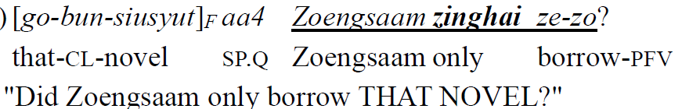
Different syntactic properties
Recall: connectivity effects → monoclausal movement account
Afterthoughts: lack connectivity effects
Just like 2 CPs
Introduction #1 RD is one I.P. #2 SFP requirement Conclusion
○ ○ ○ ○ ○ ○ ○ ○ ○ ○ ○ ○ ○ ○ ○ ○ ○ ○ ○ ○ ○ ○ ○ ○ ● ○ ○ ○ ○ ○ ○ ○

Slide 29
(ii) Predicts SFP requirement!
 | RD | Afterthoughts
Do RD chunks bear focus? | NO | YES
No. of intonational phrases | 1 | 2
No. of C-heads | 1 | 2
Connectivity effects → no. of CPs | YES → 1 | NO → 2
Take home message:
Intonations cannot occur in genuine RDs
Introduction #1 RD is one I.P. #2 SFP requirement Conclusion
○ ○ ○ ○ ○ ○ ○ ○ ○ ○ ○ ○ ○ ○ ○ ○ ○ ○ ○ ○ ○ ○ ○ ○ ○ ● ○ ○ ○ ○ ○ ○

Slide 30
Resolving puzzle #2
Why genuine RD needs SFP?
What kinds of SFP?
Outer SFPs (i.e. C-heads). Not inner SFPs (T or below T). (cf. Tang 1998)
Sik sin1 *(aa3), keoi. eat sfp sfp 3sg ‘He eats first.’
Cantonese C-heads: (i) Outer SFPs (ii) Intonations (boundary tones)
Introduction #1 RD is one I.P. #2 SFP requirement Conclusion
○ ○ ○ ○ ○ ○ ○ ○ ○ ○ ○ ○ ○ ○ ○ ○ ○ ○ ○ ○ ○ ○ ○ ○ ○ ○ ● ○ ○ ○ ○ ○

Slide 31
Assume: C-heads must have phonological realization (Feng 2015, 2017)
Given: Intonations cannot occur in genuine RDs
Syntax: *lowering of C
Prosody: *boundary tones at non-edges
Therefore: C-heads in Cantonese RDs cannot be realized as intonations, and must be realized as outer SFPs
→ SFP requirement derived!
Introduction #1 RD is one I.P. #2 SFP requirement Conclusion
○ ○ ○ ○ ○ ○ ○ ○ ○ ○ ○ ○ ○ ○ ○ ○ ○ ○ ○ ○ ○ ○ ○ ○ ○ ○ ○ ● ○ ○ ○ ○

Slide 32
Concluding remarks
…and implications

Slide 33
Conclusion
Resolving two puzzles for Cantonese RDs
Puzzle #1: one clause or two clauses?
Puzzle #2: Why are SFPs obligatory present?
One intonational phrase. Hence one clause.
Cantonese intonations: syntactically a C prosodically a boundary tone
→ cannot occur in genuine RDs. Hence C can only be realized as SFPs.
Introduction #1 RD is one I.P. #2 SFP requirement Conclusion
○ ○ ○ ○ ○ ○ ○ ○ ○ ○ ○ ○ ○ ○ ○ ○ ○ ○ ○ ○ ○ ○ ○ ○ ○ ○ ○ ○ ● ○ ○ ○

Slide 34
Implication I: Mandarin RDs
Mandarin intonations: global raising (Lee 2005, Liu & Y. Xu 2005, B. Xu & Mok 2011)
Not boundary tones.
Prediction (i): they can occur in genuine RDs
Prediction (ii): No SFP requirement
SP-less RD in (Lu 1980)
Q: Did you eat the oranges? → Acceptable in Mandarin (Lu 1980:49) A: yi-ge ye meiyou chi, wo . 一個也沒有吃, 我 one-cl also neg.perf eat 1sg “I haven’t even eat one.”
→ Ungrammatical in Cantonese A: jat-go dou mou sik *(aa3), ngo 一個都冇食*(啊)我 one-cl also neg.perf eat sp 1sg
Introduction #1 RD is one I.P. #2 SFP requirement Conclusion
○ ○ ○ ○ ○ ○ ○ ○ ○ ○ ○ ○ ○ ○ ○ ○ ○ ○ ○ ○ ○ ○ ○ ○ ○ ○ ○ ○ ○ ● ○ ○

Slide 35
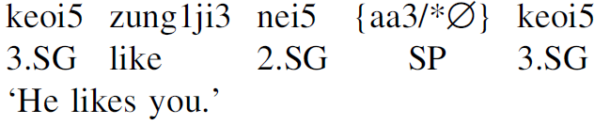
Implication II: DC
Dislocation copying: [S-V-O-SFP-S] (subject DC)
Biclausal: Cheung (2015)
Monoclausal: Lai (2019)
SFP requirement in DCs (Lai 2019)
SFP requirement in RD can only be derived if RD is one CP and one intonational phrase.
DC must also be one CP and one intonational phrase.
Introduction #1 RD is one I.P. #2 SFP requirement Conclusion
○ ○ ○ ○ ○ ○ ○ ○ ○ ○ ○ ○ ○ ○ ○ ○ ○ ○ ○ ○ ○ ○ ○ ○ ○ ○ ○ ○ ○ ○ ● ○

Slide 36
Implication III: intonations on SFPs
Recent research topic: the pitch on Cantonese SFPs is not lexical tones, but intonations (boundary tones)
Cf. Sybesma & Li (2007), Zhang & Tang (2016), Tang (2020)
Tang (2020): h-family - ho, he, haa
Carries a ↗ rising intonation
Prediction: cannot occur in RDs
keoi heoi-m-heoi ne ho↗? (佢去唔去呢嗬？) 3SG go-not-go SFP HO ‘Will he go? What do you think?’
??heoi-m-heoi ne ho↗ keoi? (去唔去呢嗬佢？)
Introduction #1 RD is one I.P. #2 SFP requirement Conclusion
○ ○ ○ ○ ○ ○ ○ ○ ○ ○ ○ ○ ○ ○ ○ ○ ○ ○ ○ ○ ○ ○ ○ ○ ○ ○ ○ ○ ○ ○ ○ ●

Slide 37
Selected references
Cheung, L. Y. L. (2009). Dislocation focus construction in Chinese. Journal of East Asian Linguistics 18: 197–232.
Feng, S. (2015). Tone, intonation and sentence final particles in Chinese. Yuyanxue Luncong [Essays on linguistics] 51:52-59.
Feng, S. (2017). On grammatical effects on interactions between intonation, stress and syntax. Yuyan Jiaoxue yu Yanjiu [Language Teaching and Linguistic Studies] 3:1-17.
Lai, J. Y. K. (2019). Parallel copying in dislocation copying: evidence from Cantonese. Journal of East Asian Linguistics 28(3): 243-277.
Lee, O.J. (2005). The Prosody of Questions in Beijing Mandarin. Ph.D. Thesis, The Ohio State University.
Liu, F., and Xu, Y. (2005). Parallel encoding of focus and interrogative meaning in Mandarin intonation. Phonetica 62: 70–87.
Xu, B. R., and P. P.-K. Mok. (2011). Final rising and global raising in Cantonese intonation. Proceedings of the Seventeenth International Congress of the Phonetic Sciences: 2173–2176.
Xu, Y. (2013). ProsodyPro — A Tool for Large-scale Systematic Prosody Analysis. In Proceedings of Tools and Resources for the Analysis of Speech Prosody (TRASP 2013), Aix-en-Provence, France. 7-10.
Zhang, L. (2014). Segmentless sentence-final particles in Cantonese: An experimental study. Studies in Chinese Linguistics 35.2: 47-60.

Slide 38
The 5th Workshop on Innovations in Cantonese Linguistics April 18-19, 2020 The Ohio State University Session 1-A
Thank you!
Comments are welcome!
Correspondence:
Ka-Fai Yip
The Chinese University of Hong Kong
kafaiyip@cuhk.edu.hk

