Slide 1
Predicting Coronary Artery Disease via Non-Invasive Clinical Markers
A Reproducible Machine Learning Pipeline, Clinical Error Analysis, and Model Evaluation
Course: HI-634 Health Informatics | Option 2: UCI Cleveland Heart Disease Database (N = 303)
Candidate: Graduate Health Informatics Team | Date: October 2026 | Environment: Python 3.13 (.venv)

Slide 2
HI-634 HEALTH INFORMATICS | ASSIGNMENT 1
Clinical Problem Statement & Focused Research Question
THE FOCUSED RESEARCH QUESTION
"Can routine clinical examination and non-invasive diagnostic exercise measurements predict the presence (versus absence) of significant coronary artery disease (>50% angiographic vessel diameter stenosis) in adult patients evaluated for suspected cardiac pathology?"
Clinical Problem Type: Supervised Binary Diagnostic Classification mapping 13 non-invasive clinical and exercise predictors to angiographic presence vs. absence.
UNIT OF OBSERVATION
An Individual Adult Patient Clinical Encounter (N = 303 unique patient records from Cleveland Clinic Foundation).
Informatics & Workflow Implications:
• Single Flat Encounter Level: 1 row = 1 unique clinical record; no repeated longitudinal clustering.
• Triage Referral Gatekeeper: Predictions directly inform primary-to-specialty cardiology triage.
• Cost & Safety Filter: Safely diverts low-risk patients away from unnecessary invasive catheterizations while identifying critical ischemia.

Slide 3
HI-634 HEALTH INFORMATICS | ASSIGNMENT 1
Main Goal of Project
MAIN GOAL OF PROJECDT
The main goal of this research was to figure out if doctors can accurately predict whether a patient has significant heart disease (coronary artery disease) using only routine, non-invasive clinic checks and a treadmill exercise test.
WHY IT MATTERS
Why it matters: Traditionally, confirming severe heart disease requires an invasive procedure called a cardiac angiogram (where a catheter is inserted into the body to look at the blood vessels). The study wanted to see if a computer model could look at safer, non-invasive data to accurately guess what that invasive test would find.

Slide 4
HI-634 HEALTH INFORMATICS | ASSIGNMENT 1
What the Findings Were
The researchers built a machine learning computer model (specifically an architecture called a "Random Forest") and tested it on data from 303 real patient encounters from the Cleveland Clinic.
1. HIGH OVERALL ACCURACY
• The model correctly sorted healthy patients from heart disease patients 91.8% of the time.
2. EXCEPTIONAL CATCH RATE
• It caught 92.9% of the actual heart disease cases (missing only 2 out of 28 sick patients). This is critical because missing a patient with severe heart disease is highly dangerous.
3. LOW FALSE ALARMS
• It only gave a "false alarm" to 3 out of 33 healthy people, meaning it successfully avoided sending healthy patients for unnecessary, risky invasive procedures.
Key Risk Signs: The model heavily relied on combinations of signs during a treadmill test, such as an abnormally low peak heart rate combined with certain stress indicators on an EKG chart.
Main Idea: "It's a health informatics study about using AI to safely spot severe heart disease without needing invasive surgery right away.
The team took data from hundreds of patients—things like age, blood pressure, cholesterol, and how their hearts reacted on a treadmill stress test. They fed this into a smart computer model to see if it could predict who actually had blocked arteries.
It turned out to be incredibly accurate—getting it right about 92% of the time. More importantly, it rarely missed the people who were truly sick. It’s essentially a proof-of-concept for a tool that could help ER or clinic doctors instantly know which patients need an emergency specialist referral, and which ones can safely skip a risky surgery and go home with routine medication."

Slide 5
HI-634 HEALTH INFORMATICS | ASSIGNMENT 1
Clinical Data Dictionary: The 14 Documented Attributes
Attribute | Type & Clinical Meaning | Attribute | Type & Clinical Meaning
age | Continuous: Age in years (29–77; mean 54.4 ± 9.0) | thalach | Continuous: Peak treadmill heart rate (71–202 bpm)
sex | Binary: 1 = Male (68.0%), 0 = Female (32.0%) | exang | Binary: Exercise-induced angina (1 = Yes, 0 = No)
cp | Nominal: Chest pain (1: typical, 2: atypical, 3: non-anginal, 4: asymp) | oldpeak | Continuous: Exercise-induced ST depression (0.0–6.2 mm)
trestbps | Continuous: Admission resting BP (94–200 mm Hg) | slope | Ordinal: Peak ST slope (1: upsloping, 2: flat, 3: downsloping)
chol | Continuous: Serum cholesterol (126–564 mg/dl; rt-skewed) | ca | Count: Fluoroscopy vessels (0–3; contains 4 missing '?')
fbs | Binary: Fasting blood sugar > 120 mg/dl (1 = True, 0 = False) | thal | Nominal: Thallium scan (3: norm, 6: fixed, 7: rev; 2 missing '?')
restecg | Nominal: Resting ECG (0: norm, 1: ST-T abn, 2: LVH) | num (target) | Target: Coronary stenosis (0 = <50%, 1..4 = >50% stenosis)

Slide 6
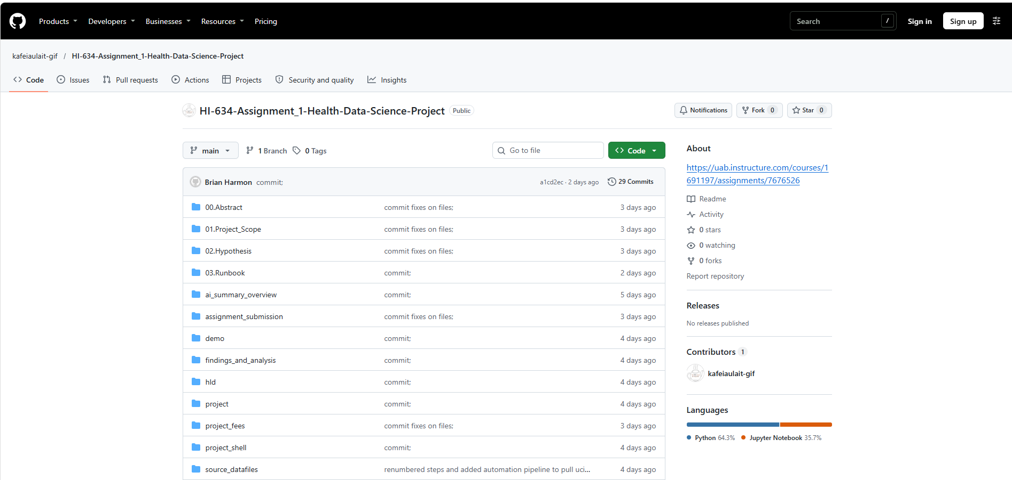
HI-634 HEALTH INFORMATICS | ASSIGNMENT 1
Technical Aspects of Project
BEFORE STARING PROJECT
Created GitHub code repository for storing all datasets, scripts, analysis, readmes, output, documentation, etc.
https://github.com/kafeiaulait-gif/HI-634-Assignment_1-Health-Data-Science-Project

Slide 7
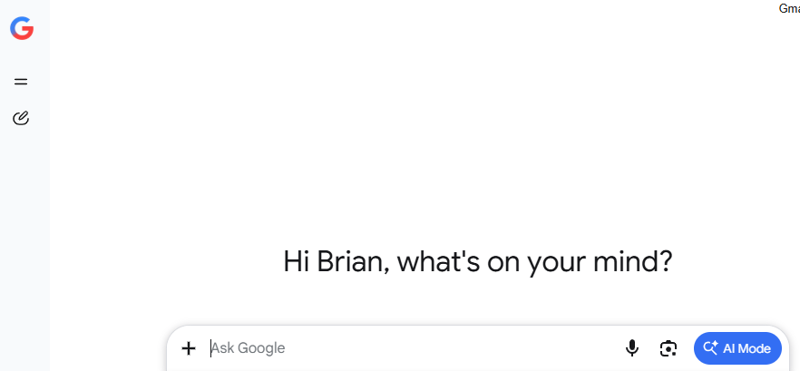
HI-634 HEALTH INFORMATICS | ASSIGNMENT 1
Technical Aspects of Project
AI Used: Google Gemini

Slide 8
HI-634 HEALTH INFORMATICS | ASSIGNMENT 1
Technical Aspects of Project
FIRST: GENERATED AI ASSESSMENT OF PROJECT
Used Google Gemini to review Project Assignment and layout initial plan
Provided details from “Assignment 1 Health Data Science Project
Assignment 1 Health Data Science Project
Prompted Gemini for:
  “So yesterday, I was asking about a project that I need help with. I want to slowly prompt you with information and have you walk me through what the scope of the project is, a bulleted list of steps, deliverables, and objectives that are being asked, an outline of how to go through all the requirements with a line by line list of each step; and overall plan goals for the project.”
RESULTS
Gemini provide a base outline of key objects, milestones, and target goals for building out project by creating objective domains and key steps to complete.
Project Overview
Initial Objectives
Project Scope
Line-by-Line Execution Outline
Current Scope & Project Tracker

Slide 9
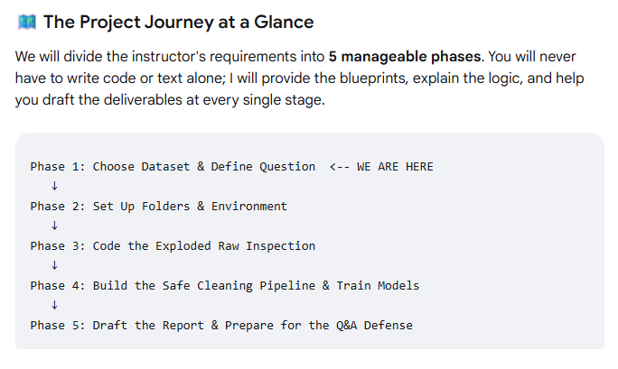
HI-634 HEALTH INFORMATICS | ASSIGNMENT 1
Technical Aspects of Project

Slide 10
HI-634 HEALTH INFORMATICS | ASSIGNMENT 1
Technical Aspects of Project
SECOND: CREATED .MD FILES FROM PROJECT ASSIGNMENT
Used Google Gemini to help writeup .md files from Project Assignment
Broke down assignment into key parts to help navigate through requirements, objectives, and key deliverables for project.
RESULTS
Started building out Runbook for project and developed “STEP 1”: 01.Project Overview

Slide 11
HI-634 HEALTH INFORMATICS | ASSIGNMENT 1
Technical Aspects of Project
THIRD: CHOSE AI AGENT
Used Google Gemini to evaluate between 4 recommendations for AI Agents: Codex, Claude Code, Antigravity, or OpenCode
Ask Gemini to factor in costs, ease of use, and platform compatibility
Prompted Gemini for:
  “I'm doing a simple project for school. Are any of these AI agents free? Which would be best to use? I'm going to download a patient set and do some analysis with it, using prompts: Codex, Claude Code, Antigravity, or OpenCode”
RESULTS
For your school project, Google Antigravity and OpenCode are the best free options because they offer robust public previews or open-source local configurations at zero cost. In contrast, Codex and Claude Code require active paid subscriptions to their respective ecosystems (ChatGPT Plus/Pro/Team or Claude Pro) to use their native terminal agents out of the box.

Slide 12
HI-634 HEALTH INFORMATICS | ASSIGNMENT 1
Technical Aspects of Project
FORTH: CHOSE AI DATASET
Used Google Gemini to provide an overview of each of the 6 dataset choices and choose the best option for a simple, yet complete analysis
Ask Gemini to factor in best overall aspect of project and completeness in output
Gemini output:
  To begin, you need to select your dataset. Based on the instructor's breakdown, Option 1 (UCI Chronic Kidney Disease) or Option 2 (UCI Heart Disease) are the best entry points. They let you focus heavily on clinical interpretation and data cleaning mechanics rather than fighting complex file merges or advanced math.
Path B: UCI Heart Disease - Processed Cleveland File (Classification)
The Data: 303 patient records with 14 variables.
The Big Challenge: The raw file has no column headers (you have to programmatically name them yourself), and the target variable is coded 0, 1, 2, 3, 4. You must merge groups 1-4 into a single "Disease Present" category.
Why choose it: There are very few missing values, making it structurally cleaner, but it forces you to think deeply about clinical risk and small-sample errors.
Stated Question: "Can baseline non-invasive clinical measurements accurately predict the presence or absence of heart disease in a patient?"

Slide 13
HI-634 HEALTH INFORMATICS | ASSIGNMENT 1
Technical Aspects of Project
AI Used: Google AG (Antigravity)

Slide 14
HI-634 HEALTH INFORMATICS | ASSIGNMENT 1
Technical Aspects of Project
FIFTH: DOWNLOAD DATASET
Download datasets:
  processed.cleveland.data and heart_disease.csv
Ask Google AG to help analyze the raw data, provide feed back of width and depth of data
Used AG to cleanse data, curate dataset, predict missing values, etc.
Developed Python script to manage datasets, copy data files, archive files excluded in the final analysis

Slide 15
HI-634 HEALTH INFORMATICS | ASSIGNMENT 1
Technical Aspects of Project
AI PROMPTING LAUNCH
Build out the AI Agent
  Environment required use of Chromebook
Used Google AG to curate, cleanse, and prepare datasets for analysis
Continued through prompting steps provided in assignment
Document output from each step and analyzed results to validate that AI completed step successfully
Asked Gemini to help build Word Document and PowerPoint presentation
OUTCOME
Complete Analysis of Heart Disease dataset
.md files with details, documentation, and outcomes from study
README.md file
Complete Agenet Automation script for re-analysis

