Slide 1
Everything of Thoughts (XoT)
Defying the Law of the Penrose Triangle for Thought Generation
Ruomeng Ding (GT) & Chaoyun Zhang, Lu Wang et al. (Microsoft)

Slide 2
Introduction and Abstract
Introduce a novel thought prompting approach called “Everything of Thoughts” - (XOT)
Achieve three key perspectives in thought generation simultaneously:
  performance, efficiency, and flexibility
Leverages pretrained reinforcement learning and Monte Carlo Tree Search (MCTS) to incorporate external domain knowledge and planning capability into thoughts, thereby enhancing LLMs’ decision-making capabilities.

Slide 3
3 Crucial Aspects of Effective Thought Design
Performance
  is the accuracy of the solution to a problem, including the precision of each thought at intermediate stages
Efficiency
  relates to the number of LLM inference calls required to solve a single problem. Minimizing this is crucial due to the high cost associated with LLM inference.
Flexibility in thought
  refers to the diverse thought structures that can be employed by LLMs for problem-solving.
  Enabling more flexible thought structures enhances LLMs’ divergent and creative thinking capability, especially those with multiple potential solutions.

Slide 4
Problem with Thought Analyst and Prompting
One prompting technique does not satisfy all the requirements to successfully answer an inquire query
There exist several through paradigms
  Chain-of-Thought
  Tree of-Thought
  Graph-of Thought
However, these paradigms each have their limitations and cannot simultaneously achieve all the three desired attributes

Slide 5
Prompting Techniques Defined
Chain-of-Thought - Explicitly instructing the model to "think step-by-step" or decompose a problem into intermediate steps before giving the final answer.
Tree of-Thought - An advanced search strategy where the model explores multiple "branches" of possibilities, evaluates the pros and cons of each, and backtracks if needed.
Graph-of Thought

Slide 6
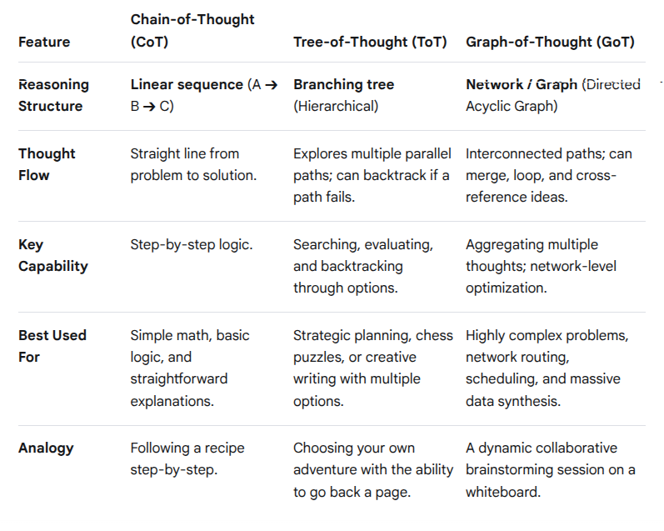
Prompting Techniques Defined
(Google, 2026)

Slide 7

Penrose Triangle Concept
x

Slide 8
Penrose Triangle for Thought Generation
Each prompting technique on it’s own satisfy one or more Crucial Aspects of Effective Thought Design, but not all three

