Slide 1
Genetic Programming for Analysing Sentiment in Text
Nathan Kaffes
Supervisor: Qi Chen

Slide 2
Sentiment Analysis
Sentiment Analysis is a problem relating to Natural Language Processing that provides metrics based on the contextual information in a piece of text
Sentiment Analysis tools are used by companies like Amazon, Apple and Google to gauge customer feedback, this is known as Opinion Farming.
Many existing solutions implement Classification-based outputs via a Deep Learning Model. These methods classify text as either Positive or Negative

Slide 3
Genetic Programming with Symbolic Regression
Genetic Programming (GP) is a subset of Evolutionary Computation (EC) models that evolve programs over time and evaluation.
Symbolic Regression (SR) is an analysis method in which programs are defined as an equation.
Combining these concepts gives us a model that evolves equations to fit a given dataset through regression.

Slide 4
Existing Solutions
CNN:
Deep Learning Model
Uses Vectors to represent Text
Heavy Computational Requirements at high usage levels
GP:
Primitive set contains nodes that perform preprocessing techniques:
Removing Links / Special Characters
Retrieve valence of words using Lexicon

Slide 5
Objective +Motivation
The objective of this project was to develop a GPSR model for Sentiment Analysis that is interpretable and produces understandable programs for use in business insight and surrounding processes.
The benefits of using GPSR for the problem of Sentiment Analysis are:
Equations provides more information than direct learned responses past their output
The continuous outputs of these equations are more applicable for detailed analysis.

Slide 6
Method
This model is divided into three sections for ease of use.
Preprocessing: Dataset is cleaned, and features are engineered manually.
Model: The GP model is initialized and trained using the preprocessed data
Evaluation: Three separate evaluation methods, Mean Squared Error, Root Mean Squared Error and R Squared Error.
The result is the defined GPSR model outlined in our objective

Slide 7
Preprocessing
Stop Words are unimportant words in any language
This section of the model loads a dataset, preprocesses it through various RegEx Functions and NLTK library processes like removing Stop words and Lemmatizing.
The preprocessed data is then used to train a Doc2Vec Vectorisation model.
This model is used to infer vectors for each piece of text, creating connections between words numerically for learning.
A LinearSVC is used to infer the sentiment classification, and this feature is collected
VADER, a rule-based Lexicon, is used to infer sentiment scores for each piece of text, these features are collected.
at, from, with, the etc.
Lemmatizing is the process of finding a base form of a word
Changing -> Change
Doc2Vec is a vectorization method in which a corpus of text is represented with connecting vectors
VADER is a lexicon that uses a set of rules to determine how skewed the sentiment of a given text is.

Slide 8
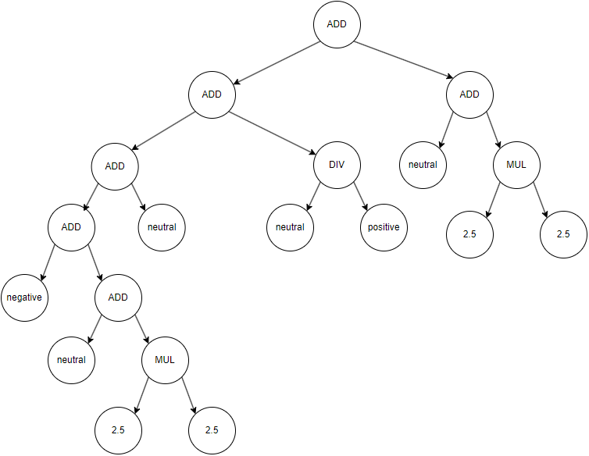
GP Model
The model itself evolves equations to fit the dataset given by the preprocessing pipeline.
Programs are evolved through crossover, mutation and selection tools to ensure that the trends of the data are fit as best as possible.
Function Set: +, -, /, *
Terminal Set: 2.5
Generations: 50
Population: 100
CX / MUT Split: 0.7 / 0.3

Slide 9
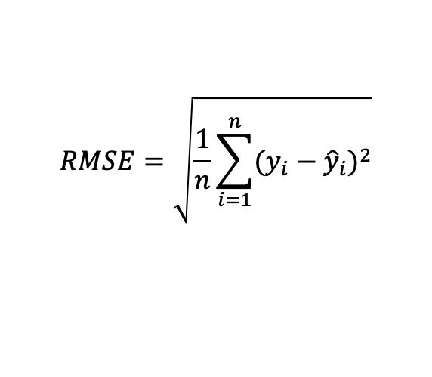
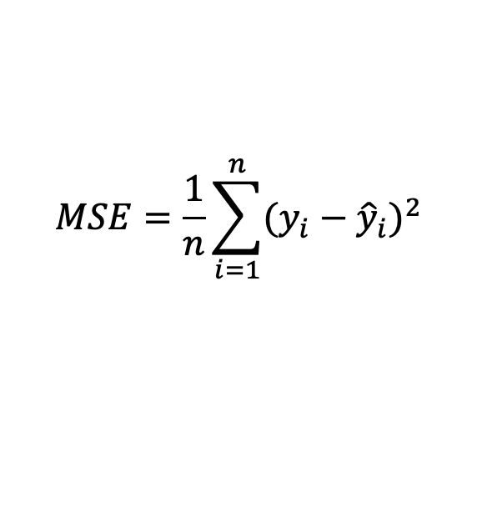
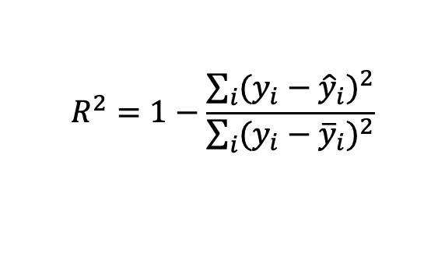
Evaluation
The evaluation functions provide evaluations for each program being currently evolved and determines the selection process for the model
Three evaluation methods were chosen for this model and were tested. These tested ensured that the model was evolving at the expected efficiency. The three methods used were:
Mean Squared Error
Root Mean Squared Error
R Squared Error
$$MSE=\frac{1}{n}\sum_{i=1}^{n}{{(y_{i}−{\hat{y}}_{i})}^{2}}$$
$$RMSE=\sqrt{\frac{1}{n}\sum_{i=1}^{n}{{(y_{i}−{\hat{y}}_{i})}^{2}}}$$
$$R^{2}=1−\frac{\sum_{i}{{(y_{i}−{\hat{y}}_{i})}^{2}}}{\sum_{i}{{(y_{i}−{\overline{y}}_{i})}^{2}}}$$

Slide 10
Experiments
The model was evaluated stochastically on each fitness function to find the optimal evaluation method
The evaluated model was then compared with a CNN to compare the sufficiency of the model within the current NLP space.

Slide 11
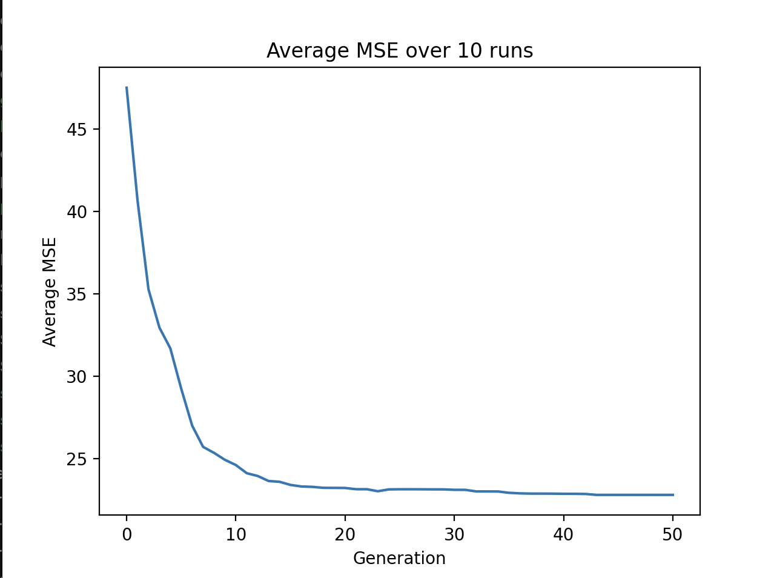
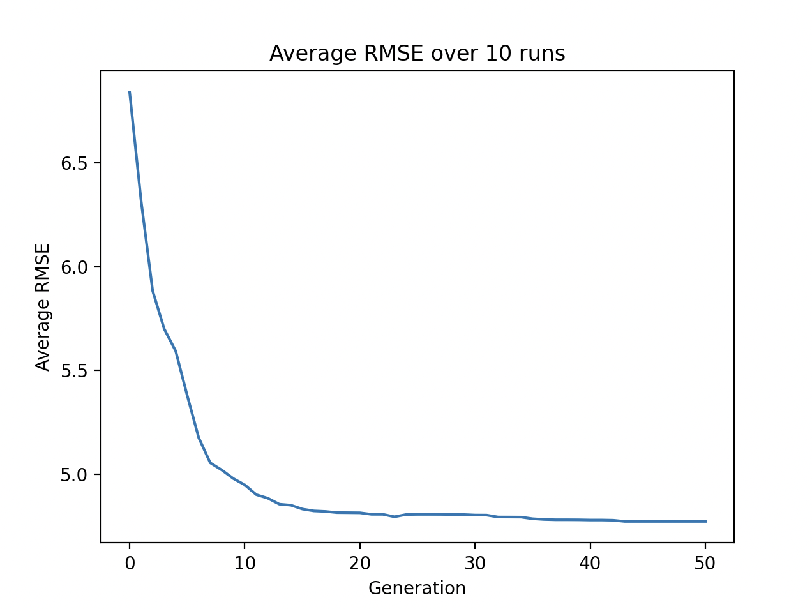
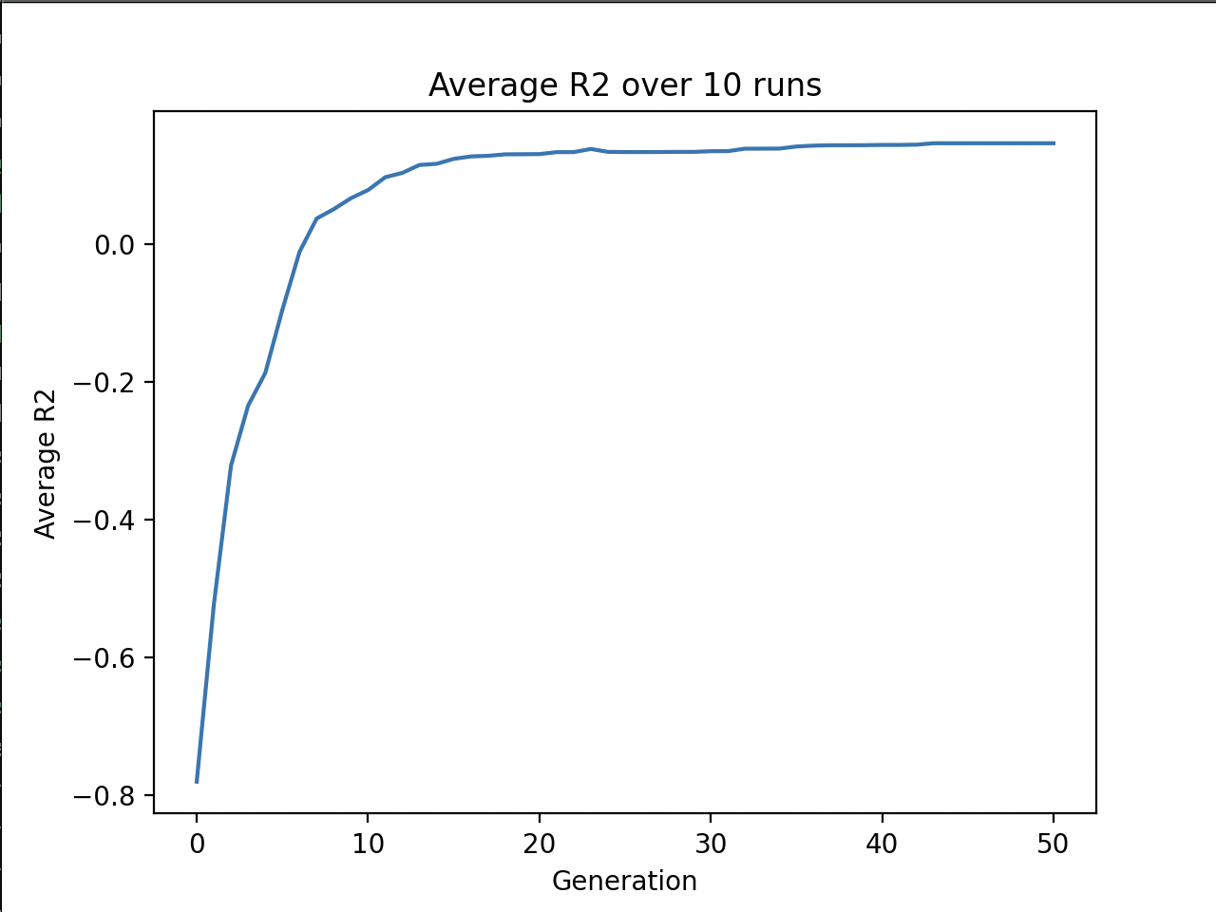
Results of Experiments
Mean Squared Error
Root Mean Squared Error
R Squared
Average Ending MSE: 22.796
Average Ending RMSE: 4.774
Average Ending R2: 0.145

Slide 12

Analysis of Experiments
Results show promise, but the model fails to pinpoint the valence.
After analysing the data and the model processes:
The LinearSVC estimates on the vectors are not always correct. This results in the vector estimates being unreliable variables.
Due to this unreliability, features get dominated and removed from programs due to the high error produced.
However, the VADER scores are consistently used in the best scoring programs, indicating their viability.

Slide 13
CNN Comparison and Analysis
By comparing the model against an existing solution through Mean Squared Error, we can evaluate this model’s fitness for purpose.
Results show that the CNN model still outperforms the GP model by a wide margin.
This is largely due to the density of features available to the CNN model using the Doc2Vec vectors directly. This aligns with our experiment findings indicating a lack of reliable features generated
Model | Training Error | Test Error
GPSR | 22.273 | 22.138
CNN | 0.145 | 0.417

Slide 14
Conclusions and Future Work
The model developed during this project aims to fit in its defined metrics. The model successfully produces an interpretable equation and uses features that directly represent understandable information. However, the model fails to compare to existing solutions in quality.
The main limitations of this model pertain to the quality of the estimate outputs and the lack of extensive features to pinpoint the valence value.
Important future work consists of improving the accuracy of the estimate feature along with expanding the feature roster or the function set to allow the model to better find the valence.

Slide 15
Questions?

