Slide 1
Sequence Alignment Problem
PRESENTED BY
1. Kafi Khan
ID: 2017-2-60-078
2. Monika Hossain
ID: 2016-2-60-127
3. Sharmin Islam
ID: 2016-2-60-088

Slide 2
Overview
INTRODUCTION
Sequence Alignment Problem
Dynamic Programming
Needleman-Wunsch Algorithm
APPLICATIONS
Bioinformatics
Biotechnology
FUNCTIONS
How to use Needleman-Wunsch Algorithm
Constructing Scoring Matrix
Backtracking
CONCLUSION

Slide 3



INTRODUCTION Sequence Alignment Problem
String 1: CGT
String 2: CA
MATCH
MISMATCH
GAP
Mismatch and Gap cause penalty.

Slide 4
INTRODUCTION Sequence Alignment Problem
String 1: AGCT
String 2: ACT
Gap Penalty: 1 Mismatch Penalty: 2
String 1: AGCT
String 2: ACT_
Penalty: 2 Mismatch + 1 Gap = 5
String 1: AGCT
String 2: A_CT
Penalty: 0 Mismatch + 1 Gap = 1

Slide 5
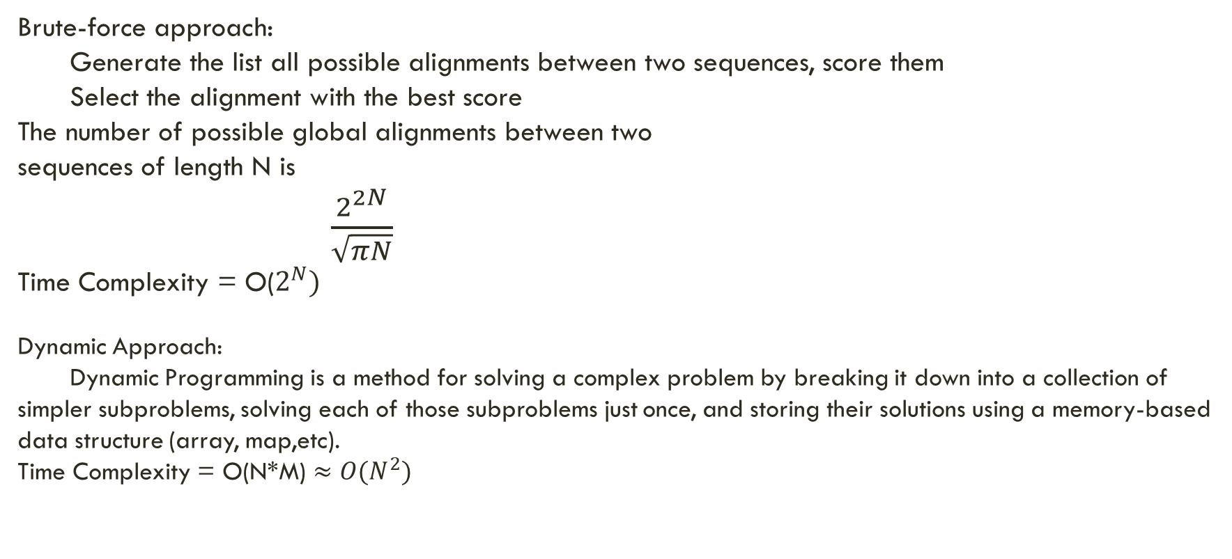
INTRODUCTION Sequence Alignment Problem
Brute-force approach:
Generate the list all possible alignments between two sequences, score them
Select the alignment with the best score
The number of possible global alignments between two
sequences of length N is
$\frac{2^{2N}}{\sqrt{πN}}$
Time Complexity = O($2^{N})$
Dynamic Approach:
Dynamic Programming is a method for solving a complex problem by breaking it down into a collection of simpler subproblems, solving each of those subproblems just once, and storing their solutions using a memory-based data structure (array, map,etc).
Time Complexity = O(N*M) $≈O(N^{2})$

Slide 6


Needleman-Wunsch Algorithm
The Needleman-Wunsch algorithm is an example of dynamic programming, it was developed by Saul B. Needleman and Christian D. Wunsch and published in 1970
The basic idea is to build up the best alignment by using optimal alignments of smaller subsequences.

Slide 7
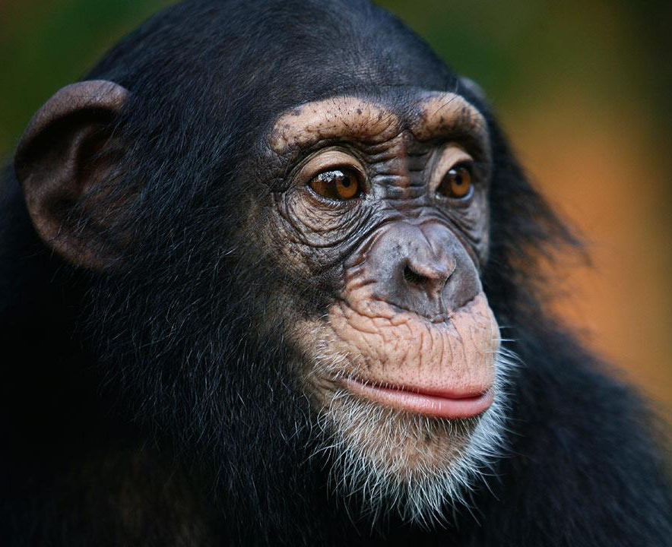

APPLICATIONS bioinformatics
In bioinformatics, a sequence alignment is a way of arranging the sequences of DNA, RNA, or protein to identify regions of similarity that may be a consequence of functional, structural, or evolutionary relationships between the sequences

Slide 8

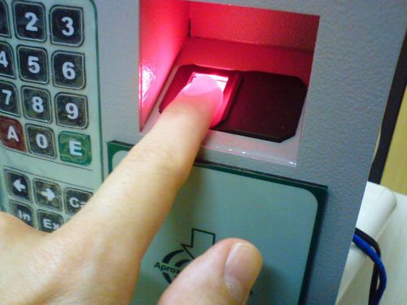
APPLICATIONS biotechnology
Fingerprint, Iris scanner etc.

Slide 9
Needleman-Wunsch Algorithm How does it work
String 1: AGGGCT String Size: 6
String 2: AGGCA String Size: 5
Gap Penalty: 1 Mismatch Penalty: 2
Match: 0

Slide 10
Needleman-Wunsch Algorithm Constructing Scoring matrix
A matrix with (6+1) rows and (5+1) columns; an extra row and column for “Gap”
 | _ | A | G | G | C | A
_
A
G
G
G
C
T

Slide 11
Needleman-Wunsch Algorithm Constructing Scoring matrix
A matrix with (6+1) rows and (5+1) columns; an extra row and column for “Gap”
Initialize
 | _ | A | G | G | C | A
_ | 0
A
G
G
G
C
T

Slide 12
Needleman-Wunsch Algorithm Constructing Scoring matrix
A matrix with (6+1) rows and (5+1) columns; an extra row and column for “Gap”
Initialize
 | _ | A | G | G | C | A
_ | 0 | 1 | 2 | 3 | 4 | 5
A | 1
G | 2
G | 3
G | 4
C | 5
T | 6

Slide 13
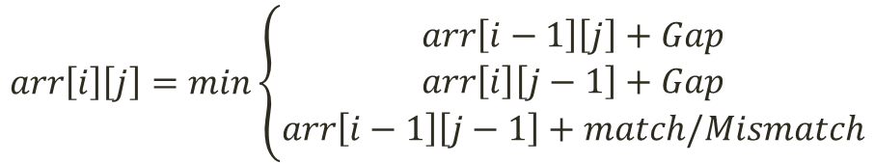
Needleman-Wunsch Algorithm Constructing Scoring matrix
$$arr\left[i\right]\left[j\right]=min\left\{\begin{aligned}arr\left[i−1\right]\left[j\right]+Gap \\ arr\left[i\right]\left[j−1\right]+Gap \\ arr\left[i−1\right]\left[j−1\right]+match/Mismatch\end{aligned}\right.$$
 | _ | A | G | G | C | A
_ | 0 | 1 | 2 | 3 | 4 | 5
A | 1
G | 2
G | 3
G | 4
C | 5
T | 6

Slide 14

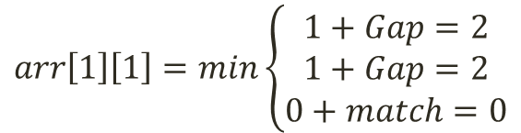
Needleman-Wunsch Algorithm Constructing Scoring matrix
$$arr\left[1\right]\left[1\right]=min\left\{\begin{aligned}1+Gap=2 \\ 1+Gap=2 \\ 0+match=0\end{aligned}\right.$$
 | _ | A | G | G | C | A
_ | 0 | 1 | 2 | 3 | 4 | 5
A | 1
G | 2
G | 3
G | 4
C | 5
T | 6
 | _ | A | G | G | C | A
_ | 0 | 1 | 2 | 3 | 4 | 5
A | 1
G | 2
G | 3
G | 4
C | 5
T | 6
$$arr\left[1\right]\left[1\right]=0$$
 | _ | A
_ | 0 | 1
A | 1

Slide 15
Needleman-Wunsch Algorithm Constructing Scoring matrix
 | _ | A | G | G | C | A
_ | 0 | 1 | 2 | 3 | 4 | 5
A | 1 | 0
G | 2
G | 3
G | 4
C | 5
T | 6
 | _ | A | G | G | C | A
_ | 0 | 1 | 2 | 3 | 4 | 5
A | 1 | 0
G | 2
G | 3
G | 4
C | 5
T | 6
 | _ | A
_ | 0 | 1
A | 1 | 0

Slide 16
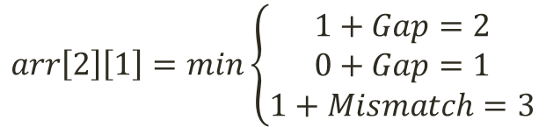
Needleman-Wunsch Algorithm Constructing Scoring matrix
$$arr\left[2\right]\left[1\right]=min\left\{\begin{aligned}1+Gap=2 \\ 0+Gap=1 \\ 1+Mismatch=3\end{aligned}\right.$$
 | _ | A | G | G | C | A
_ | 0 | 1 | 2 | 3 | 4 | 5
A | 1 | 0
G | 2 | 1
G | 3
G | 4
C | 5
T | 6
 | _ | A | G | G | C | A
_ | 0 | 1 | 2 | 3 | 4 | 5
A | 1 | 0
G | 2
G | 3
G | 4
C | 5
T | 6
 | _ | A | G | G | C | A
_ | 0 | 1 | 2 | 3 | 4 | 5
A | 1 | 0
G | 2 | 1
G | 3
G | 4
C | 5
T | 6
 | _ | A
A | 1 | 0
G | 2 | 1

Slide 17
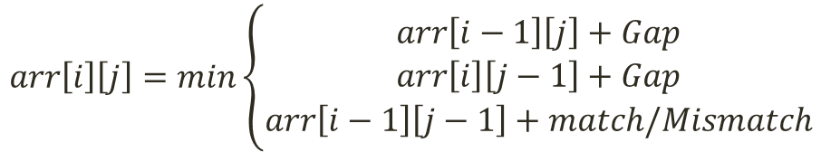
Needleman-Wunsch Algorithm Constructing Scoring matrix
$$arr\left[i\right]\left[j\right]=min\left\{\begin{aligned}arr\left[i−1\right]\left[j\right]+Gap \\ arr\left[i\right]\left[j−1\right]+Gap \\ arr\left[i−1\right]\left[j−1\right]+match/Mismatch\end{aligned}\right.$$
 | _ | A | G | G | C | A
_ | 0 | 1 | 2 | 3 | 4 | 5
A | 1 | 0 | 1 | 2 | 3 | 4
G | 2 | 1 | 0 | 1 | 2 | 3
G | 3 | 2 | 1 | 0 | 1 | 2
G | 4 | 3 | 2 | 1 | 2 | 3
C | 5 | 4 | 3 | 2 | 1 | 2
T | 6 | 5 | 4 | 3 | 2 | 3

Slide 18
Needleman-Wunsch Algorithm Constructing Scoring matrix
1. function SCORING-MATRIX()
2. arr[0][0] := 0
3. for i := 0 to T-1
4. arr[0][i] := i*Gap
5. end for
6. for i := 0 to S-1
7. arr[i][0] := i*Gap
8. end for
9. for i:=1 to S-1
10. for j:=1 to T-1
11. MIN = min(arr[i][j-1] + Gap,
arr[i-1][j] + Gap,
arr[i-1][j-1] + match/mismatch)
12. arr[i][j] = MIN
13. end for
14. end for
15. end function

Slide 19
Needleman-Wunsch Algorithm Traceback
Take the last block, and trace back to the first block
Through the opposite path
 | _ | A | G | G | C | A
_ | 0 | 1 | 2 | 3 | 4 | 5
A | 1 | 0 | 1 | 2 | 3 | 4
G | 2 | 1 | 0 | 1 | 2 | 3
G | 3 | 2 | 1 | 0 | 1 | 2
G | 4 | 3 | 2 | 1 | 2 | 3
C | 5 | 4 | 3 | 2 | 1 | 2
T | 6 | 5 | 4 | 3 | 2 | 3
Alignments: Using Stack
String 1 String 2

Slide 20
Needleman-Wunsch Algorithm Traceback
Take the last block, and trace back to the first block
Through the opposite path
 | _ | A | G | G | C | A
_ | 0 | 1 | 2 | 3 | 4 | 5
A | 1 | 0 | 1 | 2 | 3 | 4
G | 2 | 1 | 0 | 1 | 2 | 3
G | 3 | 2 | 1 | 0 | 1 | 2
G | 4 | 3 | 2 | 1 | 2 | 3
C | 5 | 4 | 3 | 2 | 1 | 2
T | 6 | 5 | 4 | 3 | 2 | 3
Alignments:
String 1 String 2
T
A

Slide 21
Needleman-Wunsch Algorithm Traceback
Take the last block, and trace back to the first block
Through the opposite path
 | _ | A | G | G | C | A
_ | 0 | 1 | 2 | 3 | 4 | 5
A | 1 | 0 | 1 | 2 | 3 | 4
G | 2 | 1 | 0 | 1 | 2 | 3
G | 3 | 2 | 1 | 0 | 1 | 2
G | 4 | 3 | 2 | 1 | 2 | 3
C | 5 | 4 | 3 | 2 | 1 | 2
T | 6 | 5 | 4 | 3 | 2 | 3
Alignments:
String 1 String 2
C
T
C
A

Slide 22
Needleman-Wunsch Algorithm Traceback
Take the last block, and trace back to the first block
Through the opposite path
 | _ | A | G | G | C | A
_ | 0 | 1 | 2 | 3 | 4 | 5
A | 1 | 0 | 1 | 2 | 3 | 4
G | 2 | 1 | 0 | 1 | 2 | 3
G | 3 | 2 | 1 | 0 | 1 | 2
G | 4 | 3 | 2 | 1 | 2 | 3
C | 5 | 4 | 3 | 2 | 1 | 2
T | 6 | 5 | 4 | 3 | 2 | 3
Alignments:
String 1 String 2
_
G
G
C
A
G
G
G
C
T

Slide 23
Needleman-Wunsch Algorithm Traceback
Take the last block, and trace back to the first block
Through the opposite path
 | _ | A | G | G | C | A
_ | 0 | 1 | 2 | 3 | 4 | 5
A | 1 | 0 | 1 | 2 | 3 | 4
G | 2 | 1 | 0 | 1 | 2 | 3
G | 3 | 2 | 1 | 0 | 1 | 2
G | 4 | 3 | 2 | 1 | 2 | 3
C | 5 | 4 | 3 | 2 | 1 | 2
T | 6 | 5 | 4 | 3 | 2 | 3
Alignments:
String 1 String 2
A
G
G
G
C
T
A
_
G
G
C
A

Slide 24
Needleman-Wunsch Algorithm Traceback
Take the last block, and trace back to the first block
Through the opposite path
 | _ | A | G | G | C | A
_ | 0 | 1 | 2 | 3 | 4 | 5
A | 1 | 0 | 1 | 2 | 3 | 4
G | 2 | 1 | 0 | 1 | 2 | 3
G | 3 | 2 | 1 | 0 | 1 | 2
G | 4 | 3 | 2 | 1 | 2 | 3
C | 5 | 4 | 3 | 2 | 1 | 2
T | 6 | 5 | 4 | 3 | 2 | 3
Now we pop everything from the both stacks
String 1: AGGGCT
String 2: A_GGCA
With minimum penalty 3

Slide 25
Needleman-Wunsch Algorithm Traceback
1. function TRACEBACKING(i, j)
2. if(i == 0 and j == 0)
3. return;
4. end if
5. if(arr[i][j] == arr[i-1][j-1] + match/mismatch)
6. stack1.push(sequence1[i-1])
7. stack2.push(sequence2[j-1])
8. TRACEBACK(i-1, j-1)
9. end if
10. else if(arr[i][j] == arr[i-1][j] + Gap)
11. stack1.push(sequence1[i-1])
12. stack2.push(‘ ’)
13. TRACEBACK(i-1, j)
14. end else if
15. else if(arr[i][j] == arr[i][j-1] + Gap)
16. stack1.push(‘ ’)
17. stack2.push(sequence2[j-1])
18. TRACEBACK(i, j-1)
19. end else if
20. end function

Slide 26
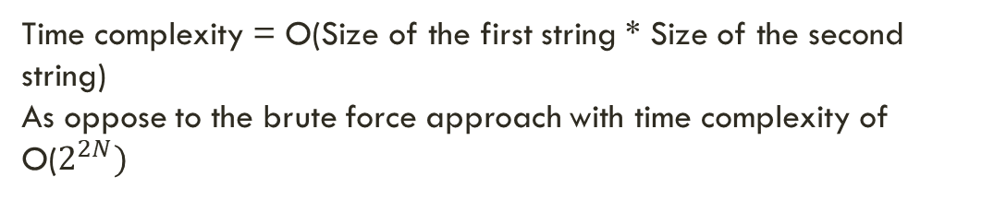
Needleman-Wunsch Algorithm Traceback
Time complexity = O(Size of the first string * Size of the second string)
As oppose to the brute force approach with time complexity of
O($2^{2N})$
 | _ | A | G | G | C | A
_ | 0 | 1 | 2 | 3 | 4 | 5
A | 1 | 0 | 1 | 2 | 3 | 4
G | 2 | 1 | 0 | 1 | 2 | 3
G | 3 | 2 | 1 | 0 | 1 | 2
G | 4 | 3 | 2 | 1 | 2 | 3
C | 5 | 4 | 3 | 2 | 1 | 2
T | 6 | 5 | 4 | 3 | 2 | 3

Slide 27
Conclusion
Sequence Alignment Problem
- It is now being wildly used in other fields like natural language processing
- Still researches are being conducted to improve the running time

Slide 28

Questions or suggestions

Slide 29
THANK YOU

