Slide 1
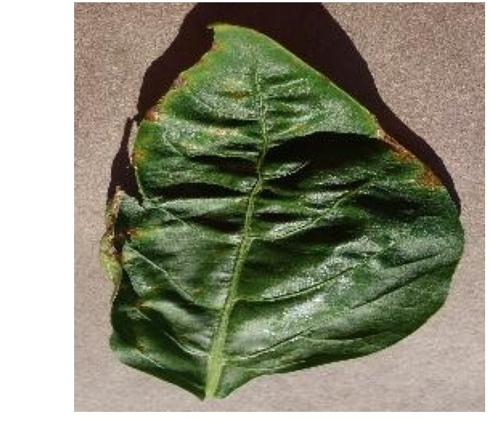
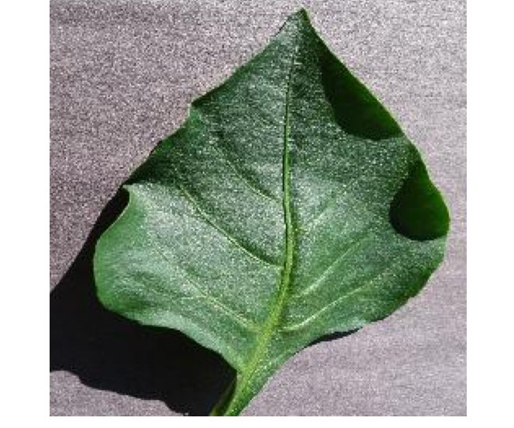
DEPARTMENT OF COMPUTER ENGINEERING
FACULTY OF ENGINEERING
AHMADU BELLO UNIVERSITY ZARIA
COEN807 — TERM PROJECT
Data-Driven Disease and Pest
Classification in Greenhouse
Bell Pepper Leaves
A supervised image classification approach using CNNs and transfer learning
Kafilat Musa
P25EGCP8001

Slide 2

PROBLEM OVERVIEW
Greenhouse pepper diseases threaten yield — and diagnosis doesn't scale
Bell pepper crops grown in greenhouses are vulnerable to fast-spreading bacterial, fungal, and physiological conditions.
Manual diagnosis by agronomists is accurate but slow, subjective, and difficult to scale across large operations.
Six target classes
Bacterial Spot
Cercospora Leaf Spot
Research question
Healthy
Leaf Curl
Given a photograph of a single bell pepper leaf, can a trained model correctly classify it into one of six health-status categories — automatically and reliably?
Nutrition Deficiency
Powdery Mildew
2

Slide 3
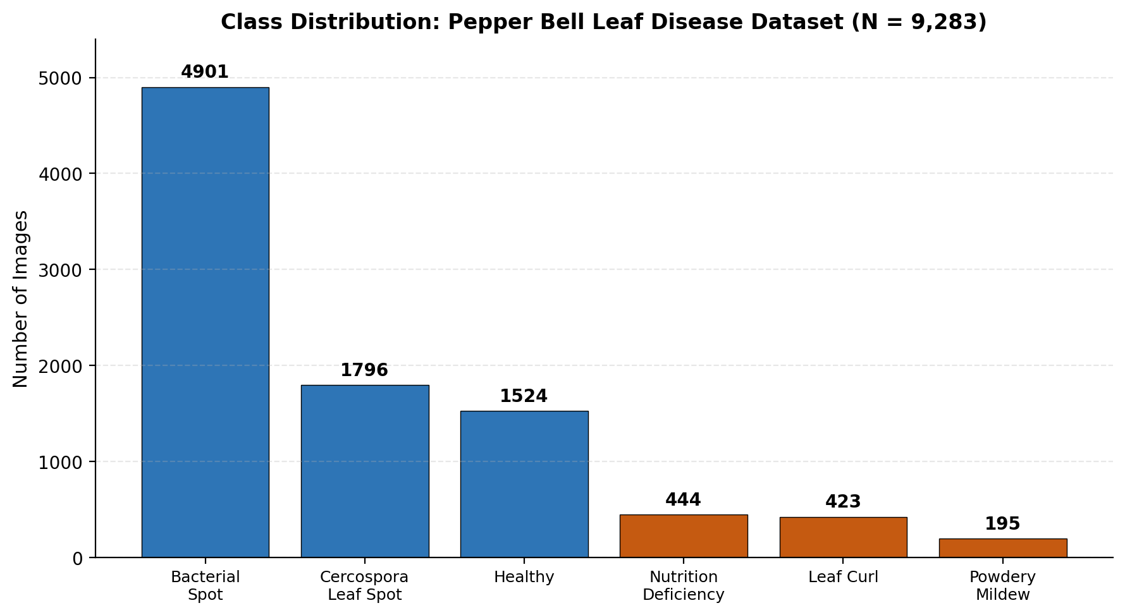
DATASET DESCRIPTION
Pepper Bell Leaf Disease — Mendeley Data
9,283
6
224×224
25:1
Total images
Disease classes
Standardised size
Max imbalance ratio
Why this dataset
Credible public source (CC BY 4.0, Mendeley Data)
Directly matches greenhouse crop monitoring domain
Realistic class imbalance reflecting field prevalence
Sized appropriately for CNN training without industrial compute
3

Slide 4
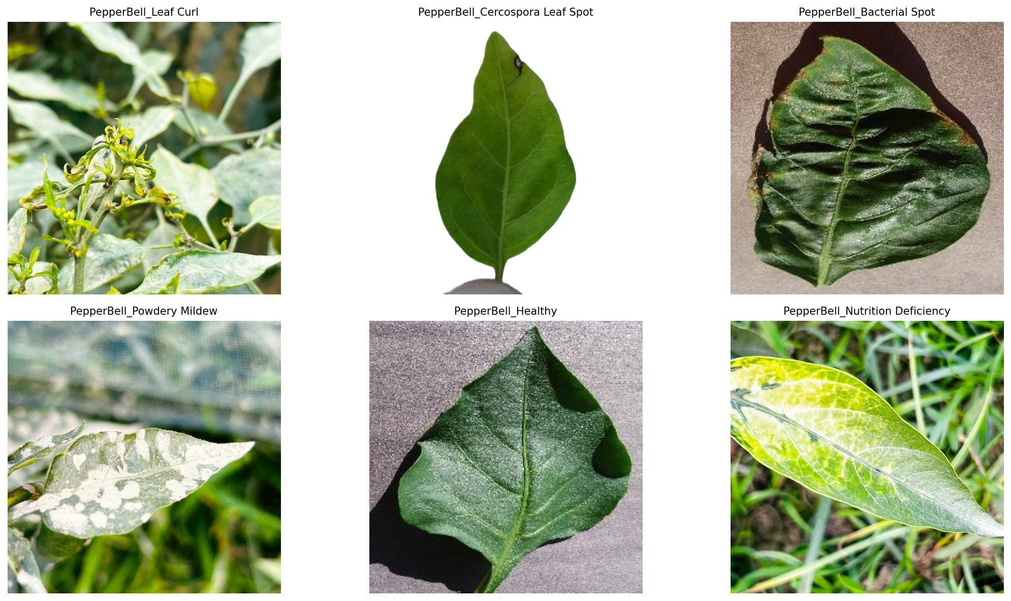
DATASET DESCRIPTION
What the six conditions look like
4

Slide 5




METHODOLOGY
Data preprocessing pipeline
1
2
3
4
Resize & normalise
Augment training data
Stratified split
Class weighting
All images standardised to 224×224 px, pixel values rescaled to 0–1 range
Rotation, shift, zoom, flip applied only to training images, not validation/test
70% train / 15% val / 15% test, class proportions preserved across all subsets
Weights inversely proportional to class frequency, 0.32 (majority) to 7.96 (minority)
5

Slide 6
METHODOLOGY
Three models, one fair comparison
Baseline CNN
MobileNetV2
ResNet50V2
Built from scratch — 4 conv blocks
Transfer learning — frozen ImageNet backbone
Transfer learning — frozen, deeper backbone
4,962,630
164,742
263,046
params total
trainable params
trainable params
Trained entirely from scratch
ImageNet-pretrained, head fine-tuned
ImageNet-pretrained, head fine-tuned
6

Slide 7
EXPERIMENTAL SETUP
Training configuration & evaluation strategy
Training setup
Data split (stratified, seed=42)
Optimiser | Adam
Loss function | Categorical cross-entropy
Batch size | 32
Max epochs | 30 (early stopping, patience 5)
Checkpointing | Best validation accuracy retained
Split | Images | %
Train | 6,495 | 69.9%
Validation | 1,390 | 15.0%
Test | 1,398 | 15.1%
Why stratified? Preserves the same class proportions across all three subsets — critical given the 25:1 imbalance.
7

Slide 8

RESULTS
Headline results across three models
Baseline CNN
ResNet50V2
MobileNetV2
93.78%
98.43%
98.50%
Test accuracy
Test accuracy
Test accuracy
Macro F1: 0.92
Macro F1: 0.99
Macro F1: 0.99
Best overall — final recommendation
8

Slide 9
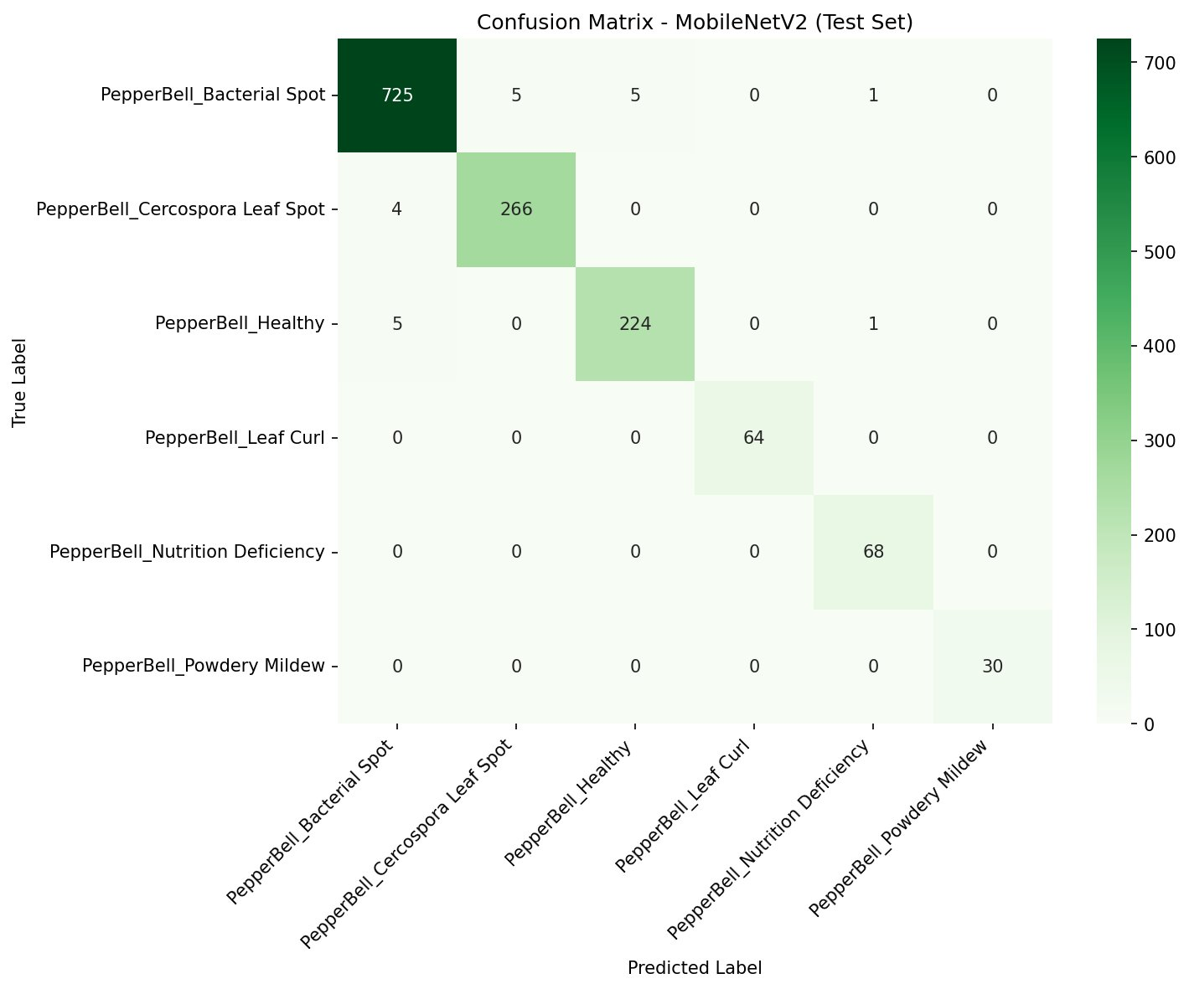



RESULTS
MobileNetV2: where the errors actually happen
Key observations
Leaf Curl, Nutrition Deficiency, and Powdery Mildew — the 3 smallest classes — classified with perfect precision & recall
Bacterial Spot → Healthy: only 5 cases (down from 37 in the baseline CNN, an 86% reduction)
Remaining confusion concentrated between visually similar spot-type diseases
9

Slide 10
COMPARATIVE ANALYSIS
Accuracy is similar — efficiency is not
Model | Test Acc. | Trainable Params | Dangerous errors*
Baseline CNN | 93.78% | 4,961,926 | 37
MobileNetV2 | 98.50% | 164,742 | 5
ResNet50V2 | 98.43% | 263,046 | 10
145×
fewer total parameters in MobileNetV2 vs ResNet50V2 — for nearly identical accuracy
*Bacterial Spot misclassified as Healthy — the most agronomically costly error type (missed disease)
Makes MobileNetV2 the practical choice for edge / mobile greenhouse deployment
10

Slide 11

HYPERPARAMETER TUNING
Fine-tuning was tested — and rejected
What we tried
Why this is a valid finding, not a failure
Unfroze the final 20 of 154 MobileNetV2 layers
Reduced learning rate 100× (1×10⁻⁵) per fine-tuning best practice
Retrained for up to 15 additional epochs
Frozen ImageNet features already generalise well to leaf imagery — little room left for fine-tuning to add value
6,495 training images is modest relative to the newly unfrozen parameters — raising overfitting risk
Demonstrates that optimisation techniques must be empirically validated, not assumed to help
Result: best epoch was epoch 1 (97.27% val. acc.), then declined — test accuracy fell to 97.00%, below the frozen baseline's 98.50%.
11

Slide 12


KEY FINDINGS
What this project demonstrates
Transfer learning wins decisively
Class weighting handles severe imbalance
+4.7pp accuracy and far more stable training than learning from scratch
Minority classes (Powdery Mildew, Leaf Curl) reach perfect F1 despite <5% representation
Efficiency can match depth
Not every optimisation helps
MobileNetV2 matches ResNet50V2's accuracy with 145× fewer parameters
Fine-tuning underperformed the frozen model — a documented, deliberate finding
12

Slide 13
CHALLENGES & LESSONS LEARNED
Limitations worth being upfront about
Dataset limitations
Methodological limitations
Severe 25:1 class imbalance remains a structural dataset limitation despite mitigation
Images captured under varied, uncontrolled backgrounds and lighting conditions
Single-label assumption — real leaves may show co-occurring conditions
Single train/test split used rather than k-fold cross-validation
Hyperparameter search limited to one fine-tuning strategy, not exhaustive
Best used as a decision-support aid, not a fully autonomous replacement for expert judgement
13

Slide 14
CONCLUSION & FUTURE WORK
MobileNetV2 delivers accurate, deployable disease detection
Final recommendation
Future work
Frozen MobileNetV2 achieves 98.50% test accuracy and 0.99 macro F1, the fewest dangerous misclassifications, and a parameter count suited to edge deployment on greenhouse monitoring hardware.
K-fold cross-validation for more robust minority-class estimates
Collect additional Powdery Mildew & Leaf Curl images
Mobile-optimised conversion (e.g. TensorFlow Lite) for real deployment testing
Multi-label framing to capture co-occurring conditions
98.50% test accuracy · 0.99 macro F1 · 164,742 trainable params
14

Slide 15
References
Elvsava, R. (2026). Pepper Bell Leaf Disease [Data set]. Mendeley Data, V1. https://doi.org/10.17632/w9drvtxg9g.1
Howard, A. G., Zhu, M., Chen, B., Kalenichenko, D., Wang, W., Weyand, T., Andreetto, M., & Adam, H. (2017). MobileNets: Efficient convolutional neural networks for mobile vision applications. arXiv preprint arXiv:1704.04861.
He, K., Zhang, X., Ren, S., & Sun, J. (2016). Identity mappings in deep residual networks (ResNet50V2). In European Conference on Computer Vision (ECCV).
Pedregosa, F., et al. (2011). Scikit-learn: Machine learning in Python. Journal of Machine Learning Research, 12, 2825–2830.
Abadi, M., et al. (2015). TensorFlow: Large-scale machine learning on heterogeneous systems. https://www.tensorflow.org/

