Slide 1
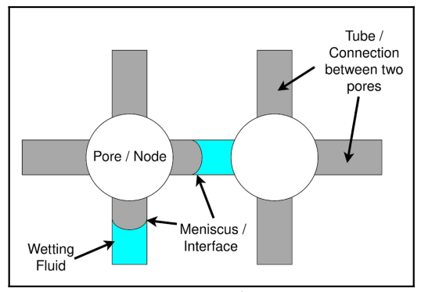
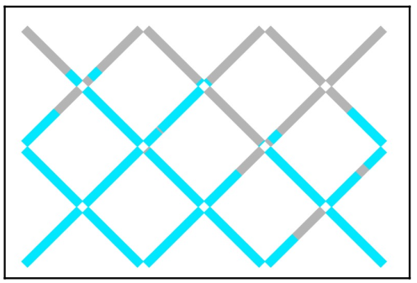
Conference Presentation: Model of Two-Phase Flow in Porous Media
Full title of the work: Simulation of Two-Phase Flow in Porous Media using a Two-Dimensional Network Model
Author: Kafi Ul Shabbir / Шаббир Кафи Ул Carried out under the supervision of: Izvekov O.Y. and Konyukhov A.V.
Organization: Moscow Institute of Physics and Technology
Presented at: 65 MIPT Conference, Dolgoprudny
Date: 08.04.2023

Slide 2
Contents
Introduction
Aim
Methods
Work
Conclusion
References, acknowledgments

Slide 3
Part-1 Introduction
Network Model:
Flow of phases in porous media
Determination of pressure
Determination of flow Rate
Updating step by step
Practical Applications:
Oil recovery
Hydrology
Electricity production (pressurized water through heated pipes -> into steam)

Slide 4
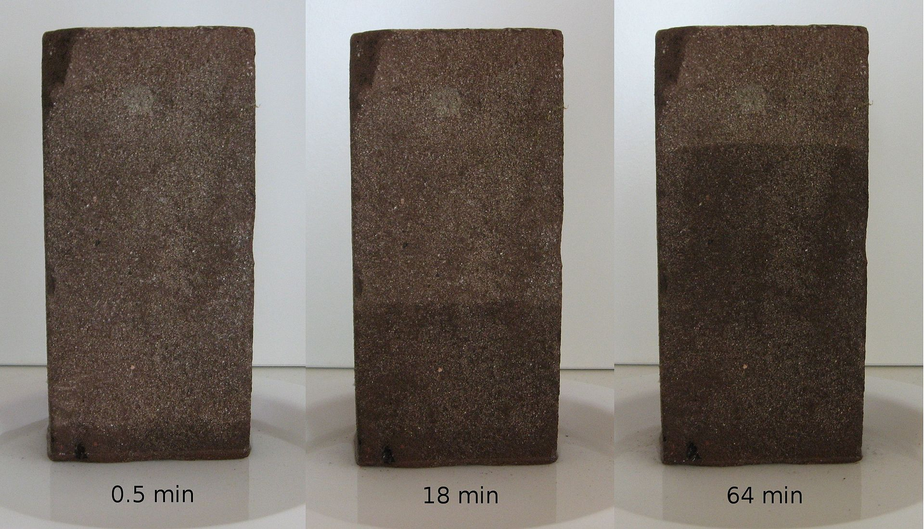
Part-1 Introduction

Slide 5
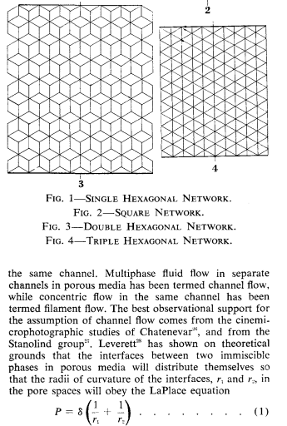
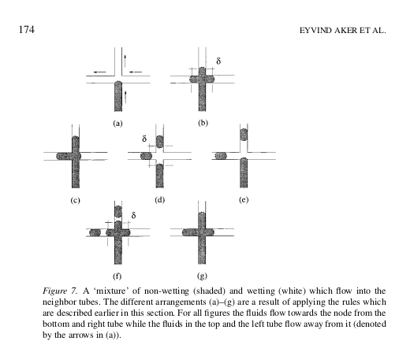
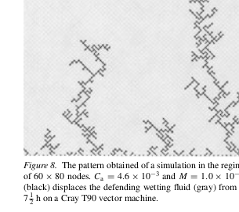
Part-1 Other Models
Aker, E., Måløy, K.J., Hansen, A., Batrouni, G.G. A two-dimensional network simulator for two-phase flow in porous media // Transp. Porous Med. 1998 V. 32 P. 163
[1] Fatt I. The network model of porous media: Model using Resistors 1956

Slide 6
Part-2 General Aim
The algorithm can be used to simulate:
Saturation of a phase with respect to time
Model imbibition
The Hysteresis Curve [the pressure across the porous body reversed, total capillary pressure =f(saturation)]
Determination of permeability (Darcy’s law)

Slide 7
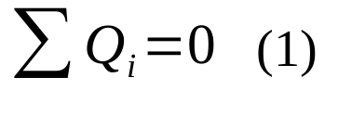
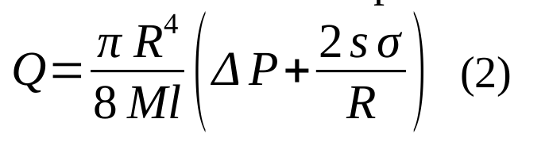
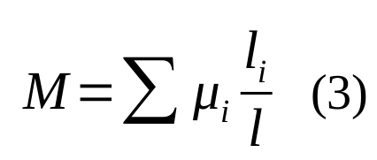
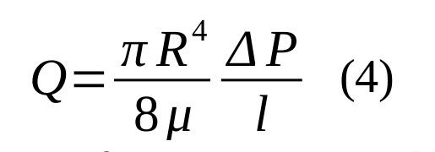
Part-4 Work: Equations

Slide 8
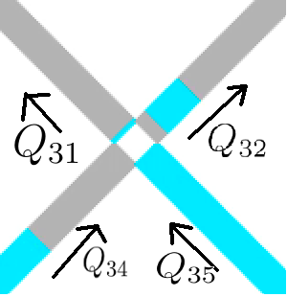
Part-4 Work: Algorithm [3]
From (1), relates five pressures.
N(equations) = N(nodes in network model)
Equations solved using Gauss-Jordan Elimination.
Flow rates calculated using (2)
Time step is chosen according to the nearest meniscus reaching the node.
At each of the nodes the flow is distributed to the outgoing tubes such that the tube with the smallest radius is filled first with the wetting fluid, this is due to the favor of energy.
[3] Aker, E. et al, A two-dimensional network simulator for two-phase flow in porous media

Slide 9
Part-2 Aim and Task
Model imbibition
Wetting fluid displaces non-wetting, thinner capillaries
Description of the particular problem presented today
Area-1 non wetting
Area-2 wetting
Volume-1 = Volume-2
Radius-1 = Radius-2 / 3

Slide 10
Part-3 Tools and Methods Used
Computer Simulation
Input Files:
Radius distribution
Phase Distribution
Compiled C++ Program processes
Solution of linear equations
Euler Method of Integration
Only simple Data Structures used, no external libraries

Slide 11

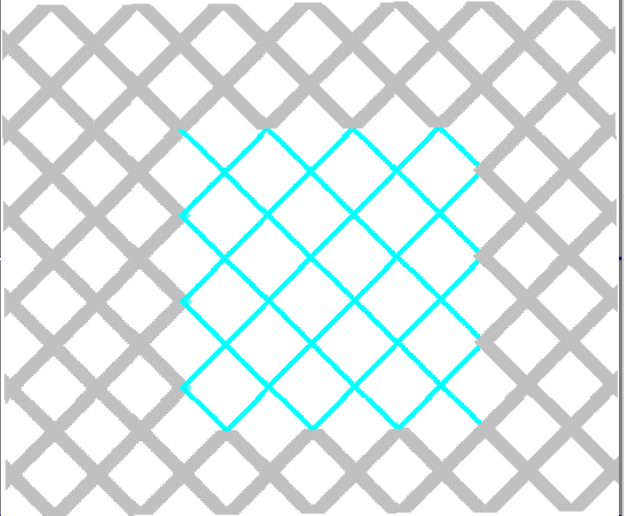

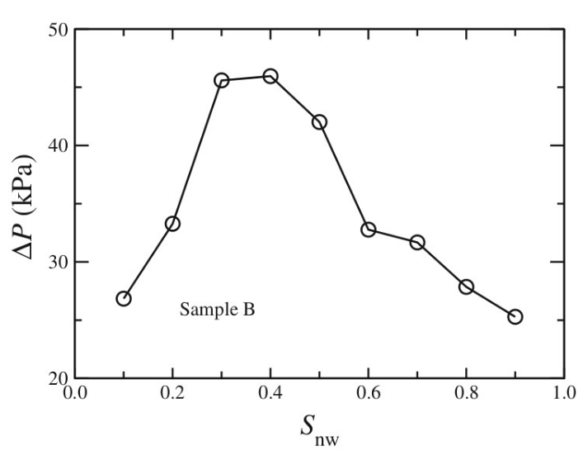
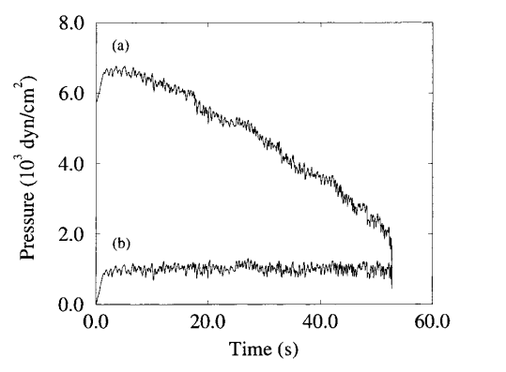
Part-4 Work: Results
Area-2
Area-1
Expected Graphs

Slide 12


Slide 13
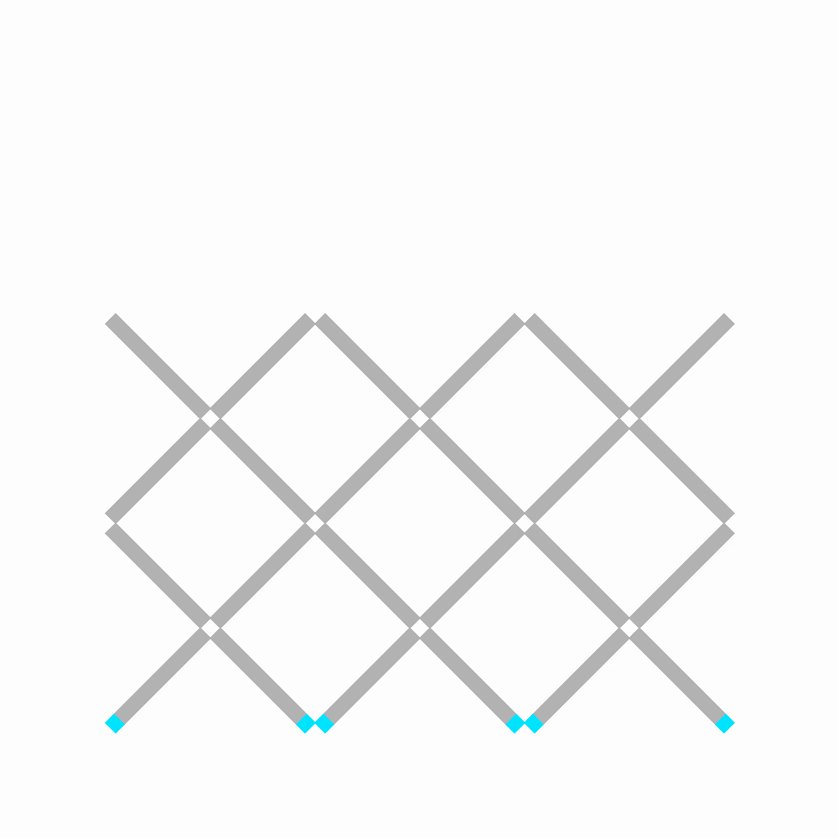

Slide 14
Part-5 Conclusion
Adjusting radius distribution, coefficient of capillary force, and viscosity: explains physical phenomena.
Modified to the case where there are more than 4 tubes connected to a node. Example: Hexagonal Structure, 3D model[2]
All Equations and Integration steps are linear and large network models (100 x 100) can be simulated on a personal computer.
[2] S. Sinha et al. Effective rheology of two-phase flow in three-dimensional porous media

Slide 15
Part-6 References
Fatt I. The network model of porous media 3, dynamic properties of networks with tube radius distribution Petroleum Trans. AIME 1956. V. 207. P. 164
S. Sinha et al. Effective rheology of two-phase flow in three-dimensional porous media: experiment and simulation // Transp. Porous Med. 2017. V. 119. P. 77
Aker, E., Måløy, K.J., Hansen, A., Batrouni, G.G. A two-dimensional network simulator for two-phase flow in porous media // Transp. Porous Med. 1998 V. 32 P. 163
Raoof A., Hassanizadeh S. A new method for generating pore-network models of porous media // Transp. Porous Med. 2010. V. 81. P. 391

Slide 16
Thank you for your attention!
I express my gratitude to Oleg Yaroslavovich Izvekov and Andrey Viktorovich Konyukhov for setting the task and helping with the work.
Support received from: РНФ №23-21-00175

