Slide 1
AI & Machine Learning
Sumanth bodapati

Slide 2
Disclaimer
This presentation serves as a concise yet informative overview of AI and ML , providing you with valuable insights and laying foundation for your journey into this exciting field. Please note that it may not cover all intricate technical details in depth.

Slide 3
Let’s get started..
What is it ?
Why do we need it?
How do we do it?

Slide 4
What is AI
Artificial:
Produced by human art or effort, rather than originating naturally.
Intelligence:
Is the ability to acquire knowledge and use it
So AI was defined as:
AI is the study of ideas that enable computers to be intelligent.
AI is the part of computer science concerned with design of computer systems that exhibit human intelligence(From the Concise Oxford Dictionary)
Notes:
From the above two definitions, we can see that AI has two major roles:
Study the intelligent part concerned with humans.
Represent those actions using computers.

Slide 5
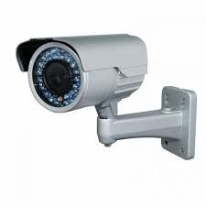
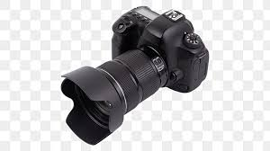
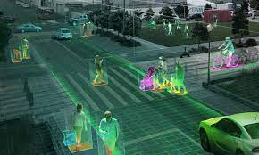
Why do we need AI
To make computers more useful by letting them take over dangerous or tedious tasks from human
Understand principles of human intelligence
Example: Detect the counts of Humans , animals, types of vehicle's etc. crossing a road.
VS
Non Intelligent
Intelligent

Slide 6
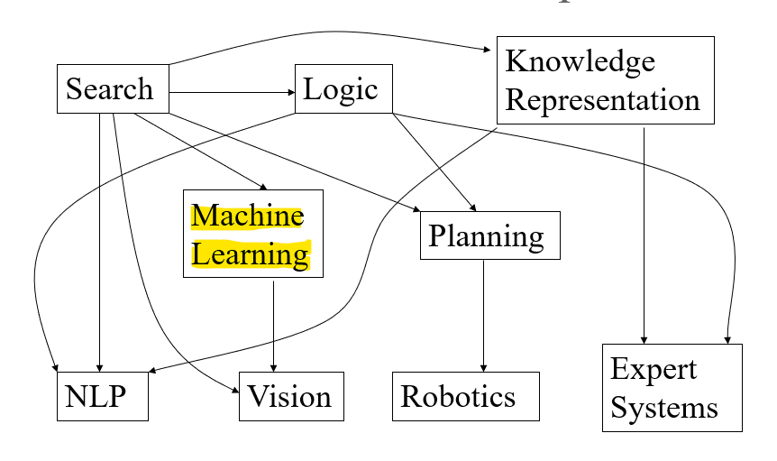
How do we do that

Slide 7
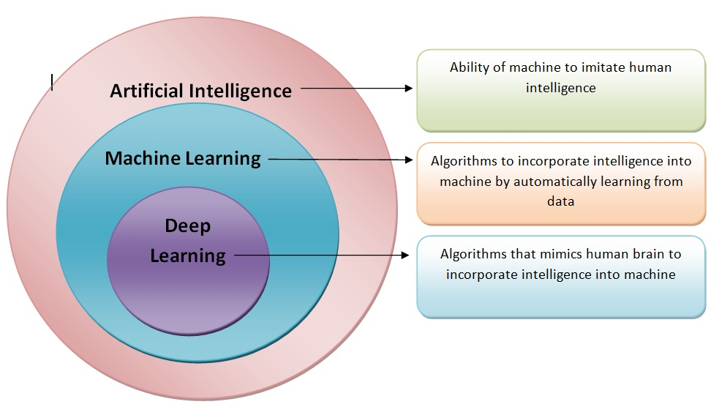
Machine Learning
ML is one of the technique to achieve the AI
Notes:
To understand ML we need to go though some background of Software Programming

Slide 8
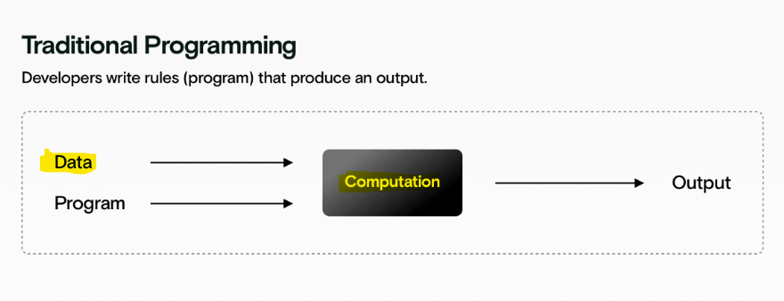
Programming

Slide 9
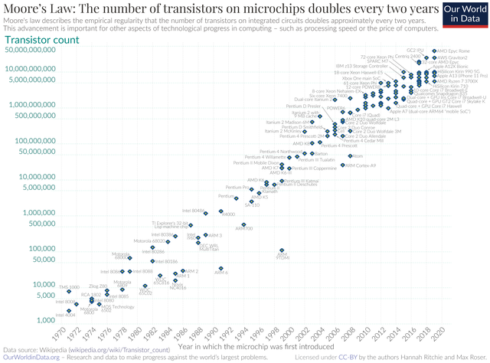
Moore’s Law
@Wikipedia

Slide 10
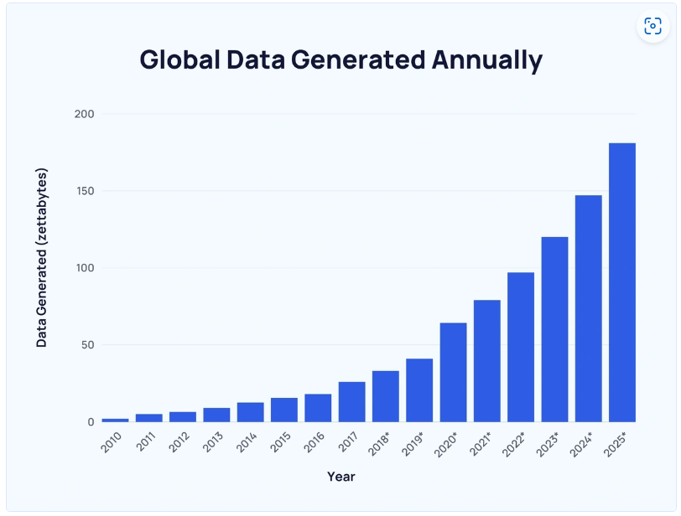
Data

Slide 11
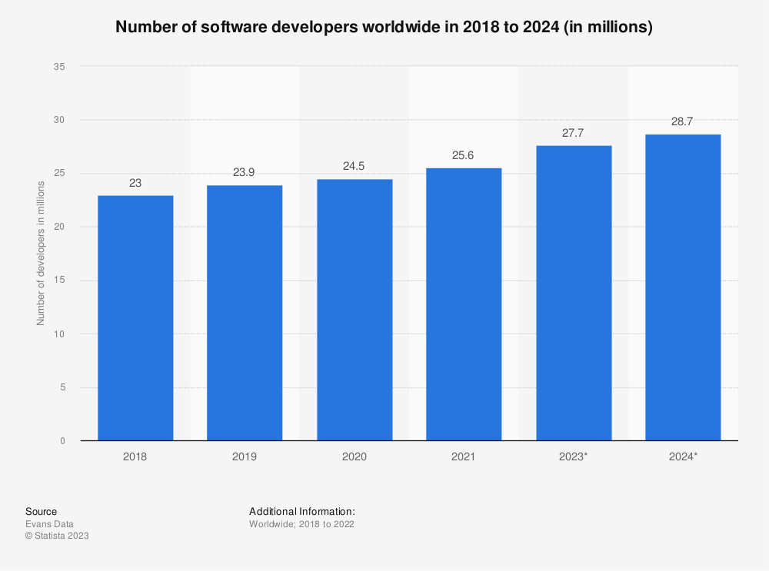
Developers

Slide 12
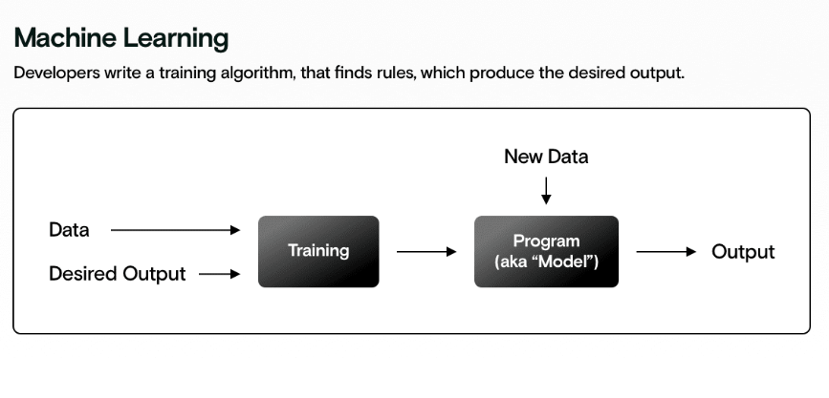
ML to rescue

Slide 13
ML
“Technique to learn from data through training and then apply learning to make an informed decision”

Slide 14
Steps
Define the Problem
Gather and Prepare Data
Split the Data
Select a Model
Train the Model
Evaluate and Tune the Model
Test the Model
Deploy the Model
Monitor and Maintain
Iterate and Improve

Slide 15
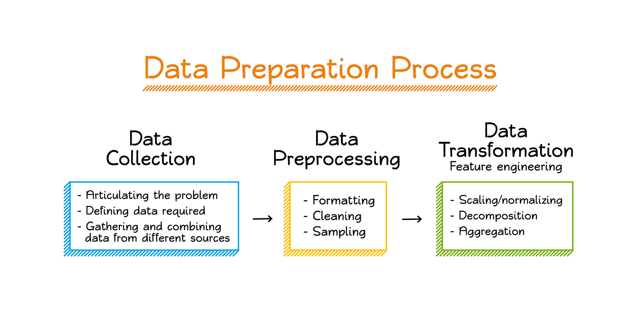
Data

Slide 16
Model
Select a Model
Train the Model
Evaluate and Tune the Model
Test the Model

Slide 17
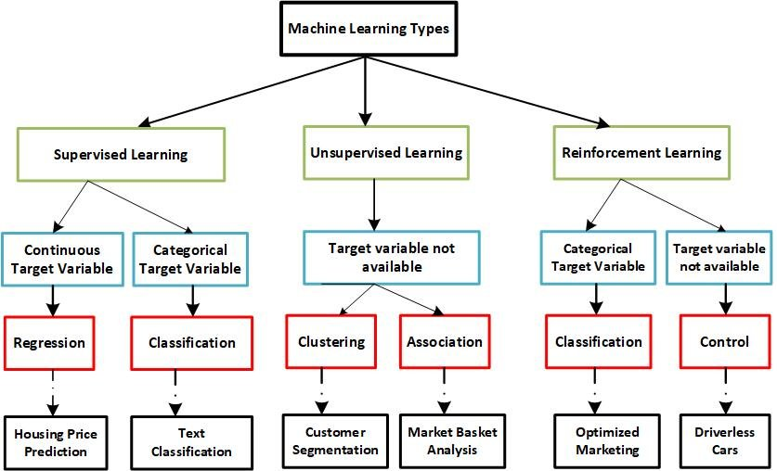
Types

Slide 18
Use
Deploy the Model
Monitor and Maintain
Iterate and Improve

Slide 19
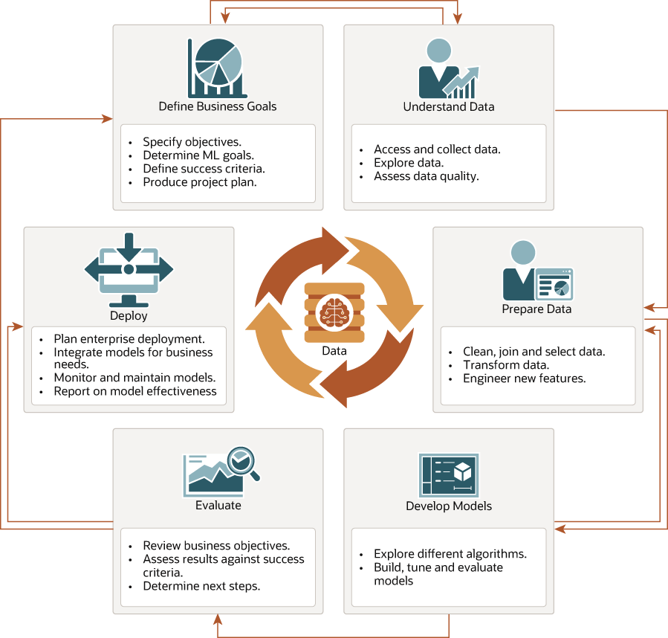

Slide 20
Demo

Slide 21
GitHub - jigzz18/Predicting-revenue-using-simple-linear-regression: In this project, We have created a model which will predict the revenue in dollars.
GitHub - nickbiso/SkLearn-50k-Salary-Prediction: Predicting salaries using machine learning
GitHub - ROHAN0011/Salary-Prediction-System: Demo

