Slide 1


An Introduction to Kubernetes
8.10.2016
Premys Kafka
premysl.kafka@hpe.com kafkapre https://github.com/kafkapre

Slide 2
{ History }
???? - Virtual Machines
2008 - Linux containers (LXC)
2013 - Docker
2013 - CoreOS stack
2014 - Kubernetes

Slide 3
{ Distributed systems }
Collection of computers that act, work, and appear as one large computer
Advantages:
scalable horizontally, reliable, extensible, cheaper computers, geographic distribution, …
Problems:
network can fail, bandwidth, consistency, workload allocation, security issues, …

Slide 4

{ Overview }
Kubernetes is an open-source system for automating deployment, scaling, and management of containerized applications.
Name Kubernetes is from Greek word kybernētēs which means "helmsman" or "governor“
Firstly announced by Google in 2014
Influenced by Google's Borg
Many contributors (Google, RedHat, IBM, Cisco, VMware)

Slide 5
{ Overview }
Commonly referred to as "k8s"
Apache License 2.0
Written in Go
Cross-platform (POC for Windows)
Kubernetes v1.0 was released on July 21, 2015
Google Container Engine runs k8s

Slide 6
{ Features }
Automatic binpacking
Horizontal scaling
Self-healing
Storage orchestration
Service discovery and load balancing
Secret and configuration management

Slide 7
{ Pod }
A group of one or more containers with shared storage
Containers also share an IP address and port space, and can find each other via localhost
Treated as one logical object
Deployed on one machine together
Life cycle
Bound to a node, restart in place
Can die, cannot be reborn with same ID

Slide 8
{ Replication Controller }
Creates and destroys Pods dynamically
Ensures that a pod or particular set of pods are always up and available
pods are automatically replaced if they fail
Scaling Pods
Recommend to use Replication Controller even when you want to create one Pod

Slide 9
{ Service }
An abstraction which defines a logical set of Pods and a policy by which to access them
Pods are targeted and determined by a Label Selector

Slide 10
{ Service Types }
ExternalName: map the service to the contents of the externalName field e.g. example.com
ClusterIP: use a cluster-internal IP only
NodePort: on top of having a cluster-internal IP, expose the service on a port on each node of the cluster
LoadBalancer: on top of having a cluster-internal IP and exposing service on a NodePort also, ask the cloud provider for a load balancer which forwards to the Service

Slide 11
{ Labels }
Key/value pairs that are attached to objects, such as pods
Can be used to organize and to select subsets of objects
Each Key must be unique for a given object
Loose coupling
Can be added dynamically

Slide 12
{ Architecture }
Two types of nodes
Master node: Master components (APIs, scheduler, etc) are there
Worker node: Kubelet and containers are there
Kubelet: takes a set of PodSpecs and ensures that the containers described are running and healthy
Kube-proxy: reflects services on each node and can do simple TCP,UDP stream or round robin TCP,UDP forwarding across a set of backends
API Server: Do business logic implemented in separate components or in plug-ins. Also processes REST operations, validates them, and updates the corresponding objects in persistence (Etcd)

Slide 13
{ Architecture }
Scheduler: binds unscheduled pods to node
Control Manager: processes controllers like DaemonSet Controller, Replication Controller
Etcd: distributed storage
Kubectl: command line client

Slide 14
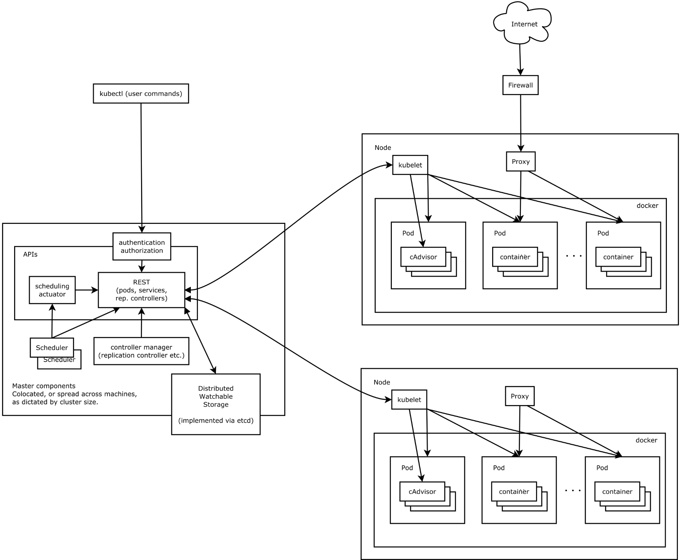
{ Architecture }

Slide 15
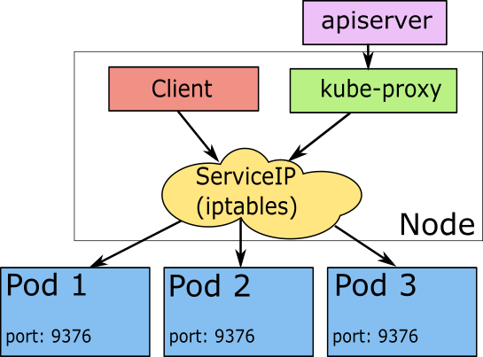
{ Service Schema }

Slide 16
{ Other Features }
Volumes (Git, NFS, Flocker, some cloud provider storage )
Namespaces
DaemonSet
Jobs
Secrets
ConfigMaps
Autoscaling
Resource limitation

Slide 17
{ Try Kubernetes }
Install it
Minikube – runs virtual machine with k8s
Kubeadm – installs k8s on your machine
Model your application in k8s yamls
Deploy and manage your application

Slide 18
{ Alternatives }
Mesos
Docker Swarm

Slide 19
K8S DEMO see: https://github.com/kafkapre/linuxdays2016-kubernetes-example
{ Demo }

Slide 20
Thank you! Q & A
premysl.kafka@hpe.com kafkapre https://github.com/kafkapre

