Slide 1
PocketDRS
A Single-View 3D Trajectory Reconstruction and
Decision Review System (DRS) for Cricket
Niraj Kafle, BIT 7th Semester, ID LC0003001674
Supervisor: Mr. Saishab Bhattarai
Phoenix College of Management, Lincoln University College

Slide 2
Agenda
01 Introduction and the Problem
02 Objectives and Requirements
03 System Analysis and Design
04 The Five-Step Algorithm
05 Key Terms
06 Implementation and Tools
07 Results and Validation
08 Limitations and Conclusion
2

Slide 3
Introduction
Ball-tracking review for everyday cricket, from a single phone.
▪ Leg Before Wicket (LBW): cricket's hardest call, judged live from one angle.
▪ Hawk-Eye needs six to eight synced high-speed cameras and costly hardware.
▪ Out of reach for schools, clubs, and training grounds.
▪ PocketDRS rebuilds the delivery in 3D from one phone clip and supports the call.
3

Slide 4
INTRODUCTION
Problem Statement
Recover a true 3D ball path from a single flat (2D) video.
▪ An umpire judges line, length, height, and impact at once, in real time.
▪ Multi-camera rigs are accurate but unaffordable for grassroots cricket.
▪ One phone gives flat 2D only: unknown depth, motion blur.
▪ Goal: a 3D flight and a clear, explained verdict from one viewpoint.
4

Slide 5
INTRODUCTION
Objectives
A phone-only pipeline: from clip to verdict.
▪ Recover the camera position from the marked stumps (Perspective-n-Point, PnP).
▪ Detect and track the ball (motion + colour + a trained YOLO detector).
▪ Link the detections into one smooth path (Random Sample Consensus, RANSAC).
▪ Rebuild the 3D path with projectile physics; apply the three ICC Rule 36 checks.
5

Slide 6
Functional Requirements
Capture, calibrate, analyse, visualise.
▪ Record or upload a clip and tap the four pitch corners to calibrate.
▪ Detect the ball per frame and link it into one trajectory.
▪ Recover the camera position and rebuild the path in real-world 3D.
▪ Return an LBW verdict with a 2D overlay and an interactive 3D view.
6

Slide 7
Non-functional Requirements
Fast, easy, clear, and portable, with no special hardware.
▪ Speed: a delivery analysed in about thirty seconds.
▪ Ease of use: four taps, no setup, no special hardware.
▪ Transparency: every verdict shows all three checks and the predicted impact.
▪ Portability: a normal Android or iPhone plus a small cloud server.
7

Slide 8
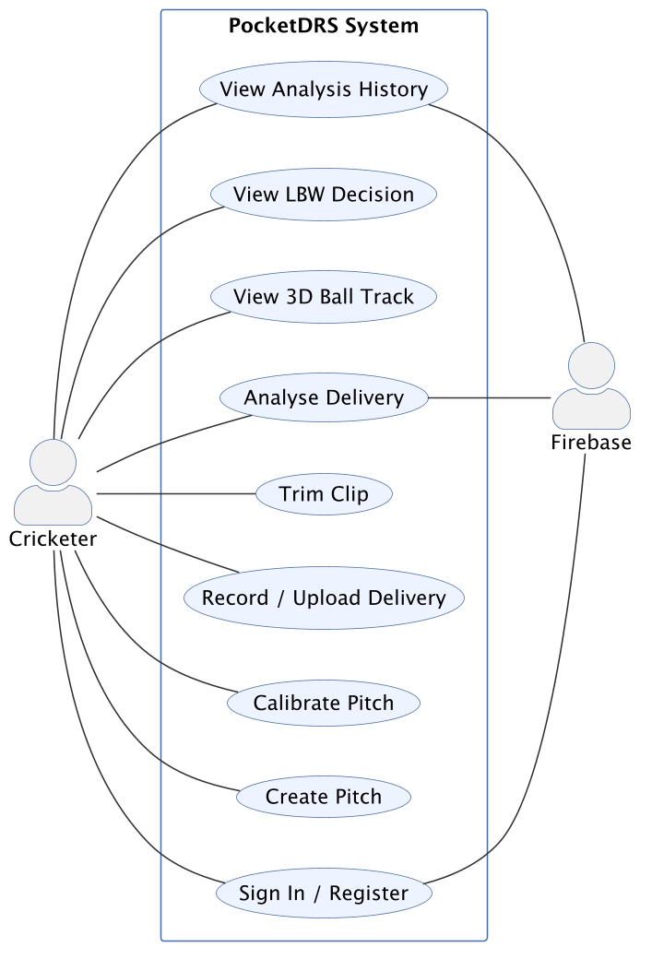
ANALYSIS & DESIGN
Use-Case Diagram
8

Slide 9
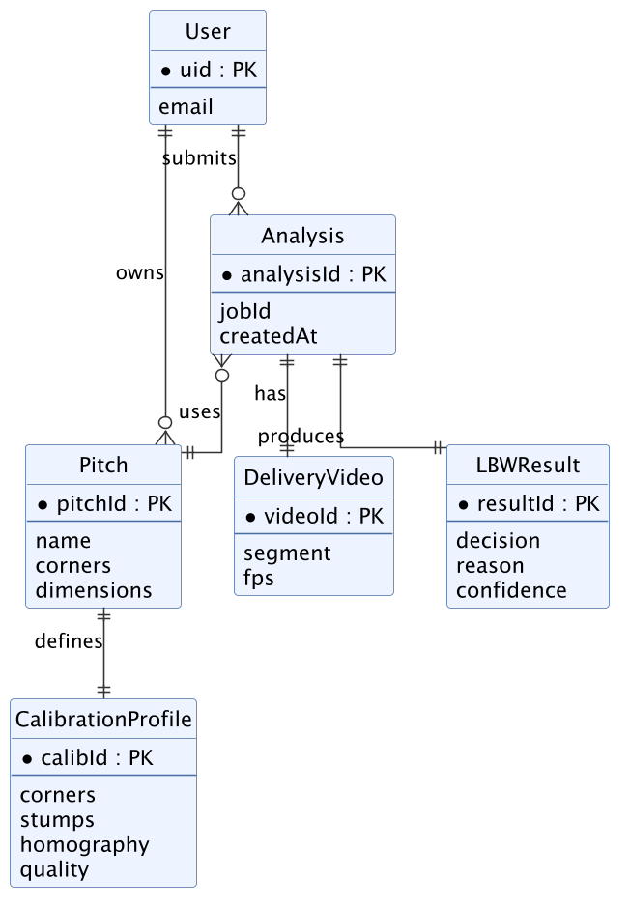
ANALYSIS & DESIGN
Data Model: Entity-Relationship (ER) Diagram
9

Slide 10
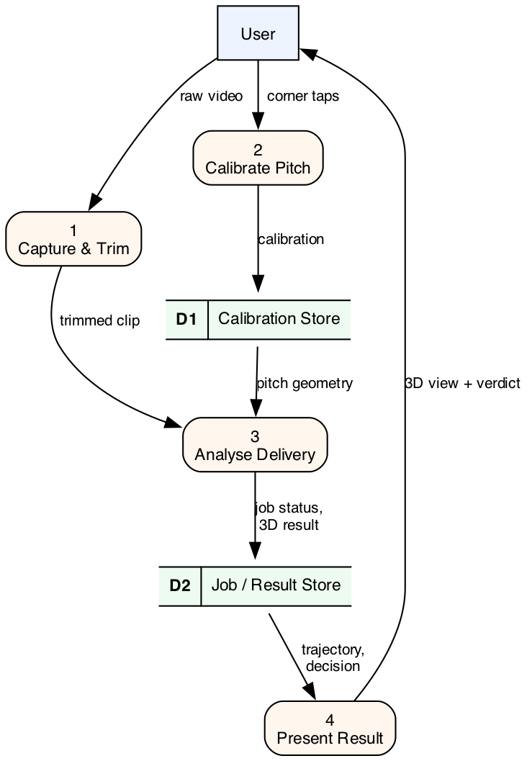
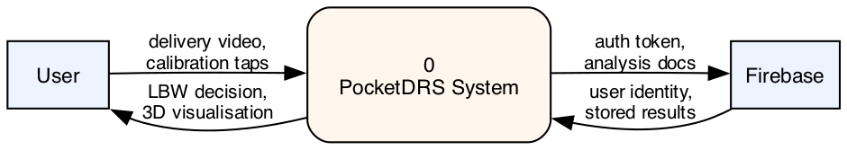
ANALYSIS & DESIGN
Process Model: Data Flow Diagrams (DFD)
Level 0 (context)
Level 1
10

Slide 11
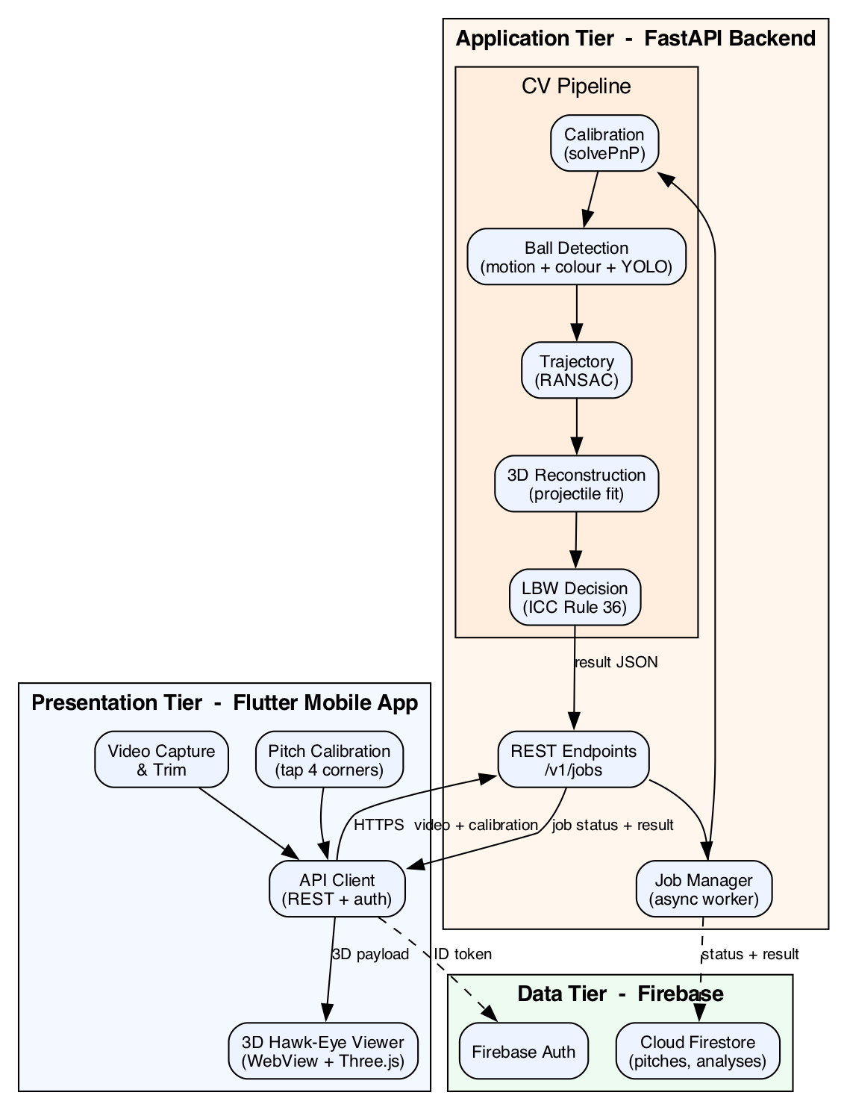
ANALYSIS & DESIGN
System Architecture
11

Slide 12
Algorithm: The Five-Step Pipeline
Five steps turn one phone clip into an LBW verdict.
›
›
›
›
1
2
3
4
5
Calibrate
Marked stumps reveal the camera position (PnP).
Detect
Find the ball each frame: motion, colour, YOLO.
Link
RANSAC fits one curve, drops false detections.
Reconstruct
Gravity-based fit lifts the track to a 3D arc.
Decide
Three ICC Rule 36 checks give the verdict.
12

Slide 13
Key Terms (1 of 2)
The standard computer-vision tools behind the pipeline.
Camera pose (PnP)
Finds where the phone stood, from the marked stumps.
Homography
Maps any flat-pitch point in the photo to real metres.
RANSAC
Fits the ball's path while ignoring wrong detections.
Projectile motion
Gravity's curve; forces a real ball flight, not noise.
13

Slide 14
Key Terms (2 of 2)
How the ball is found and depth recovered from one view.
MOG2
Separates the moving ball from the still background.
HSV colour
A colour space that isolates one ball colour despite light.
YOLO
A trained network that spots the cricket ball in a frame.
Depth-from-size
Smaller ball looks farther; recovers 3D from one camera.
14

Slide 15
Implementation Tools
An open-source phone-to-cloud stack, with no paid software.
▪ Flutter + Dart: the cross-platform mobile app.
▪ FastAPI (Python): the analysis server, over a REST web interface.
▪ OpenCV, NumPy, SciPy: the computer-vision maths.
▪ YOLO + PyTorch: the trained ball detector. Three.js: the 3D viewer. Firebase: sign-in and storage.
15

Slide 16
IMPLEMENTATION
Module Details
One module per pipeline step, each small and testable.
▪ Calibration: camera position from the tapped stumps; also gives pitch length.
▪ Detection: motion + colour + YOLO inside the pitch area.
▪ Trajectory: RANSAC seed, refine, then merge the pre- and post-bounce arcs.
▪ Reconstruction + decision: lift to 3D, predict to the stumps, apply ICC Rule 36.
16

Slide 17
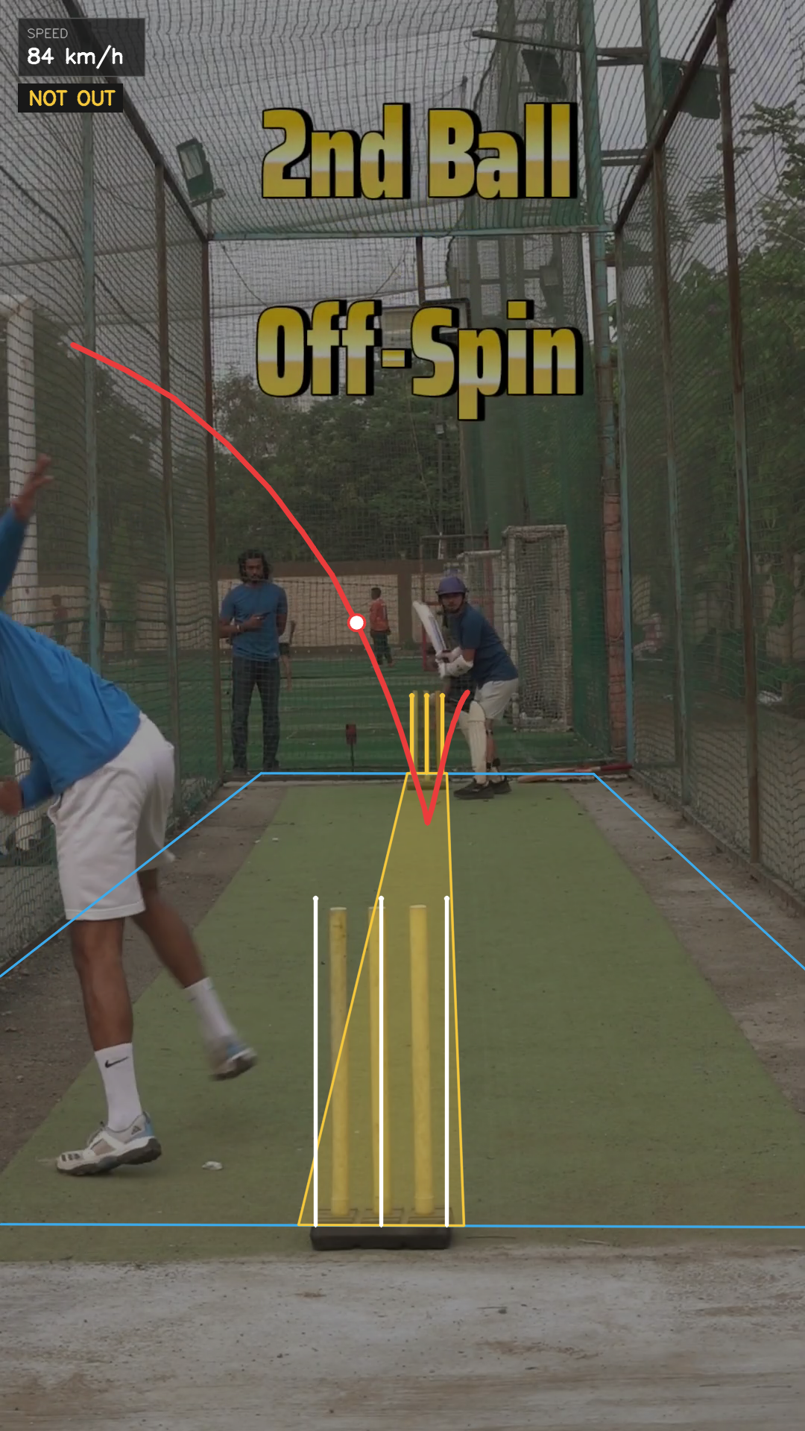
RESULTS
Real-Video Test: test3.mp4
A real handheld off-spin clip, tracked end to end (full 20.12 m pitch).
29
ball detections (28 fit the path)
10.55 px
calibration error
84.0 km/h
release speed
2.3°
off-break turn (spin)
NOT OUT · predicted to miss the stumps
17

Slide 18
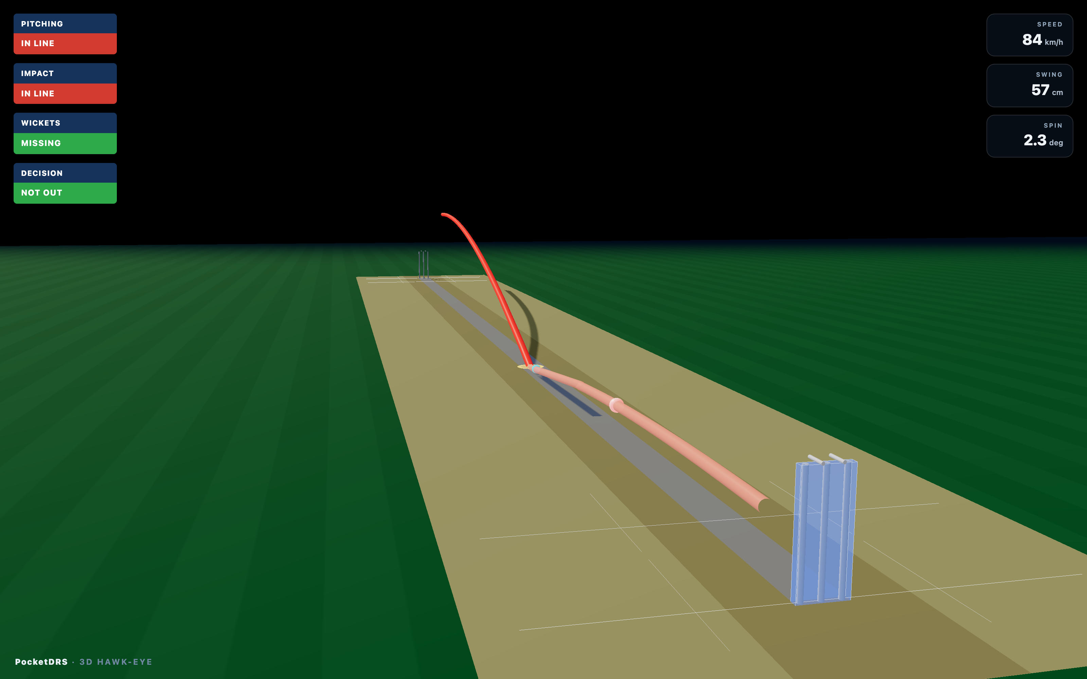
RESULTS
Interactive 3D Ball-Path View: test3
18

Slide 19
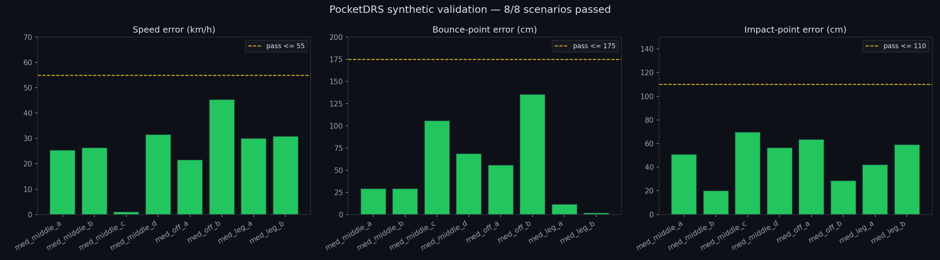
RESULTS
Synthetic Validation: 8 Scenarios
8/8
scenarios passed
▪ Controlled deliveries: medium pace, middle-stump line, full length.
▪ Camera position recovered correctly in every scene.
▪ All within honest single-camera limits (speed, bounce, impact).
▪ Every delivery was truly OUT; the system returned OUT for all eight.
19

Slide 20
Limitations
Honest about what one camera can and cannot do.
▪ One phone cannot triangulate depth like six to eight synced Hawk-Eye cameras.
▪ Depth from ball size is good to a few tens of centimetres, not millimetres.
▪ The 8/8 passes are within single-camera limits, not broadcast limits.
▪ Built as decision support for nets and clubs, not an official broadcast replacement.
20

Slide 21
Conclusion
One phone, a known pitch, and simple physics: enough for usable LBW support.
▪ A full pipeline: calibrate, detect, track, reconstruct, decide.
▪ Validated on synthetic deliveries (8/8) and real footage.
▪ Refuses to invent a verdict on unusable clips: it fails clearly, not silently.
▪ Future work: two-phone capture, learned bounce model, and on-phone detection.
21

Slide 22
Thank You
Questions and Discussion
Niraj Kafle, PocketDRS, BIT Final-Year Project
22

