Slide 1
Statistics and Machine Learning Toolbox
BY KAFLE SUJAN

Slide 2
Statistics and Machine Learning Toolbox
Statistics and Machine Learning Toolbox provides functions and apps to describe, analyze, and model data. You can use descriptive statistics and plots for exploratory data analysis, fit probability distributions to data, generate random numbers for Monte Carlo simulations, and perform hypothesis tests. Regression and classification algorithms let you draw inferences from data and build predictive models.
For multidimensional data analysis, Statistics and Machine Learning Toolbox provides feature selection, stepwise regression, principal component analysis (PCA), regularization, and other dimensionality reduction methods that let you identify variables or features that impact your model.
The toolbox provides supervised and unsupervised machine learning algorithms, including support vector machines (SVMs), boosted and bagged decision trees, k-nearest neighbor, k-means, k-medoids, hierarchical clustering, Gaussian mixture models, and hidden Markov models. Many of the statistics and machine learning algorithms can be used for computations on data sets that are too big to be stored in memory.

Slide 3
Basics of Statistics and Machine Learning Toolbox
Descriptive Statistics and Visualization
Data import and export, descriptive statistics, visualization
Probability Distributions
Data frequency models, random sample generation, parameter estimation
Hypothesis Tests
t-test, F-test, chi-square goodness-of-fit test, and more
Cluster Analysis
Unsupervised learning techniques to find natural groupings and patterns in data

Slide 4
ANOVA
Analysis of variance and covariance, multivariate ANOVA, repeated measures ANOVA
Regression
Linear, generalized linear, nonlinear, and nonparametric techniques for supervised learning
Classification
Supervised learning algorithms for binary and multiclass problems
Dimensionality Reduction and Feature Extraction
PCA, factor analysis, feature selection, feature extraction, and more
Industrial Statistics
Design of experiments (DOE); survival and reliability analysis; statistical process control
Analysis of Big Data with Tall Arrays
Analyze out-of-memory data
Speed Up Statistical Computations
Parallel or distributed computation of statistical functions
Code Generation
Generate C/C++ code and MEX functions for Statistics and Machine Learning Toolbox functions

Slide 5
Descriptive Statistics and Visualization
Managing Data Data import and export, grouping variables
Descriptive Statistics Numerical summaries and associated measures
Statistical Visualization View data patterns and trends

Slide 6
Exploratory Data Analysis Basics
Distribution Plots
Data with Missing Values
Grouping Variables
Supported Data Types

Slide 7
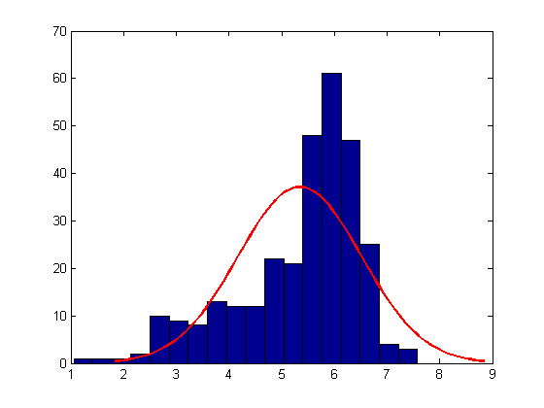
Descriptive Statistics and Visualization
Explore data numerically by generating summary statistics, including measures of central tendency, dispersion, shape, and correlation. Statistics and Machine Learning Toolbox allows you to compute summary statistics for sample data that contains missing (NaN) values. Visualize your data using univariate, bivariate, and multivariate plots. Available options include box plots, histograms, and probability plots. Find natural groupings in your data using cluster analysis techniques such as hierarchical clustering and k-Means clusterin

Slide 8
Managing Data
Move data into and out of MATLAB using several different file formats.
1.Valid formats include tabular data, tab-delineated files, Microsoft Excel spreadsheets, and SAS XPORT files.
2.Statistics and Machine Learning Toolbox provides additional data types for working with grouping variables and categorical data.
3.The toolbox also supports many, but not all, of the data types available in MATLAB.

Slide 9
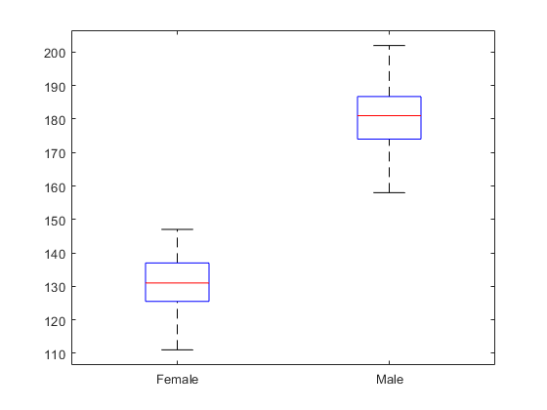
Managing Data
caseread | Read case names from file
casewrite | Write case names to file
export | Write dataset array to file
tblread | Read tabular data from file
tblwrite | Write tabular data to file
tdfread | Read tab-delimited file
xlsread | Read Microsoft Excel spreadsheet file
xptread | Create table from data stored in SAS XPORT format file
Topics
Data Import and Export Move data into and out of MATLAB
Data Types Grouping variables, categorical data, and dataset arrays

Slide 10
Descriptive Statistics
Exploratory Analysis of Data
Explore the distribution of data using descriptive statistics.
Data with Missing Values
Compute descriptive statistics while ignoring missing values.
Measures of Central Tendency
Locate a distribution of data along an appropriate scale.
Measures of Dispersion
Find out how spread out the data values are on the number line.
Quantiles and Percentiles
Learn how the Statistics and Machine Learning Toolbox computes quantiles and percentiles.
Grouping Variables
Grouping variables are utility variables used to group or categorize observations.

Slide 11
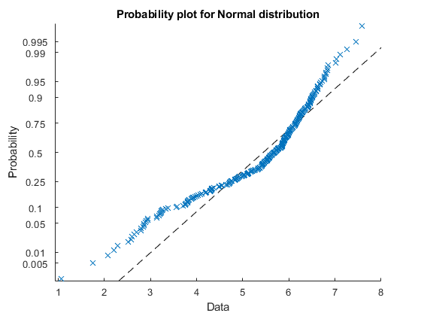
Obtain a normal probability plot.
Obtain a normal probability plot. This plot provides another way to visually compare the sample data to a normal distribution fitted to the data.

Slide 12
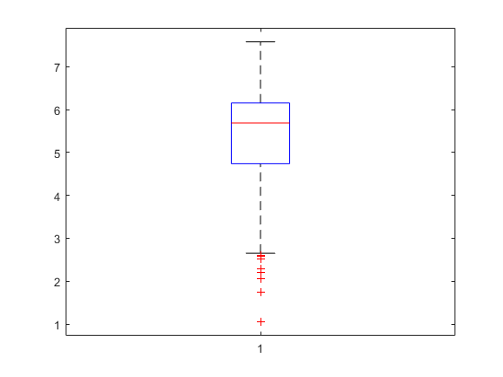
Compute the quantiles.
The box plot shows the 0.25, 0.5, and 0.75 quantiles. The long lower tail and plus signs show the lack of symmetry in the sample data values.

Slide 13
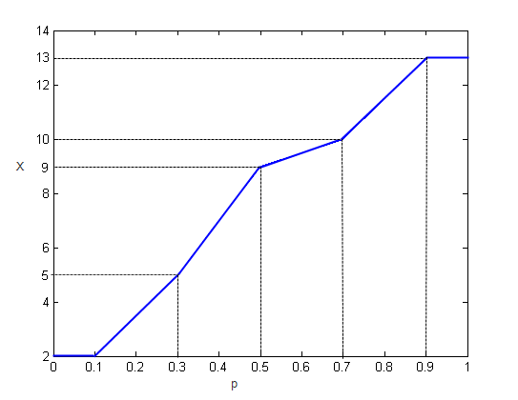
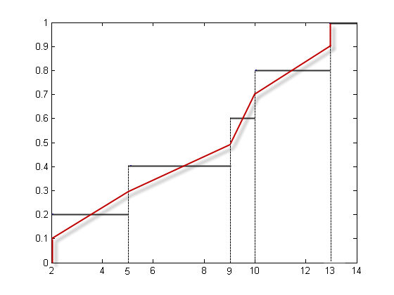
Quantiles of X
Assigning Observations to Quantiles
By switching the axes, as the next figure, you can see the values of the variable X that correspond to the p qauantiles.

Slide 14
Statistical Visualization
Box Plots
Compare data distributions using median, interquartile range, and percentiles.
Create Scatter Plots Using Grouped Data
Compare data distributions and relationships between groups.
Visualizing Multivariate Data
This example shows how to visualize multivariate data using various statistical plots.

Slide 15
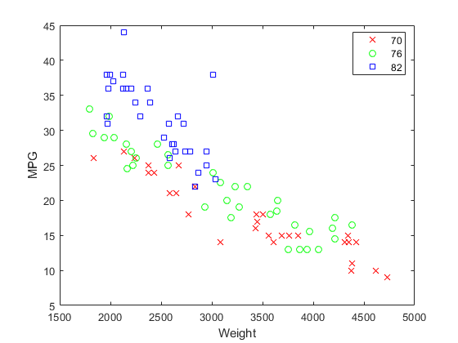
Create Scatter Plots Using Grouped Data
This shows that not only is there a strong relationship between the weight of a car and its mileage, but also that newer cars tend to be lighter and have better gas mileage than older cars.

Slide 16
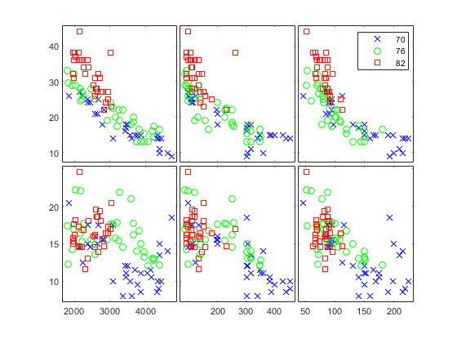
xvars = [Weight Displacement Horsepower];
yvars = [MPG Acceleration]; gplotmatrix(xvars,yvars,Model_Year,'','xos')
gscatter and gplotmatrix produce grouped versions of these plots
The upper right subplot displays MPG against Horsepower, and shows that over the years the horsepower of the cars has decreased but the gas mileage has improved

Slide 17
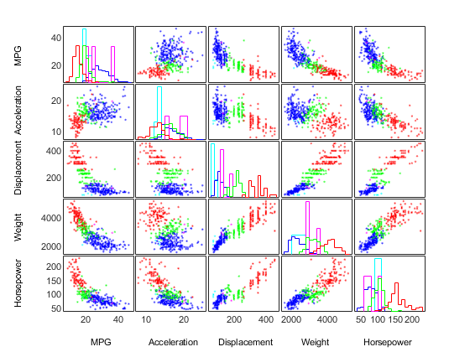
Visualizing Multivariate Data
Scatterplot Matrices

Slide 18
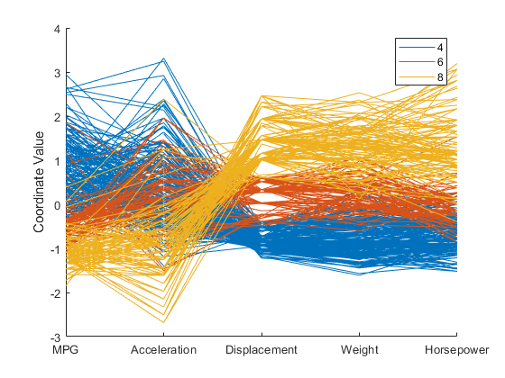
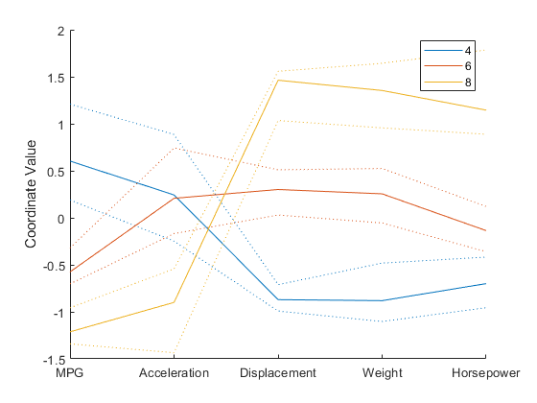
Parallel Coordinates Plots
plot of all the cars with 4, 6, or 8 cylinders, and color observations by group.

Slide 19
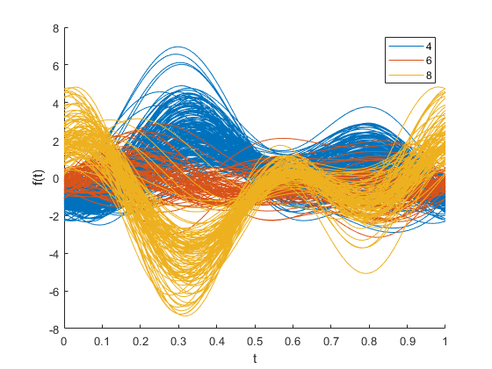
Andrews Plots
This plot represents each observation as a smooth function over the interval [0,1].

Slide 20
THANKS ALL

