Slide 1
IDEAL CLIMATE CHANGE
Michael Steele, Somn Kafley, Samyak Singh
CS 4624, Virginia Tech, Blacksburg
Instructor - Edward A. Fox
Client - Mohamed M. Gharib Farag

Slide 2
OBJECTIVE
Provide a digital library and search-engine for graduate students, researchers, and anybody interested in Climate Change.

Slide 3
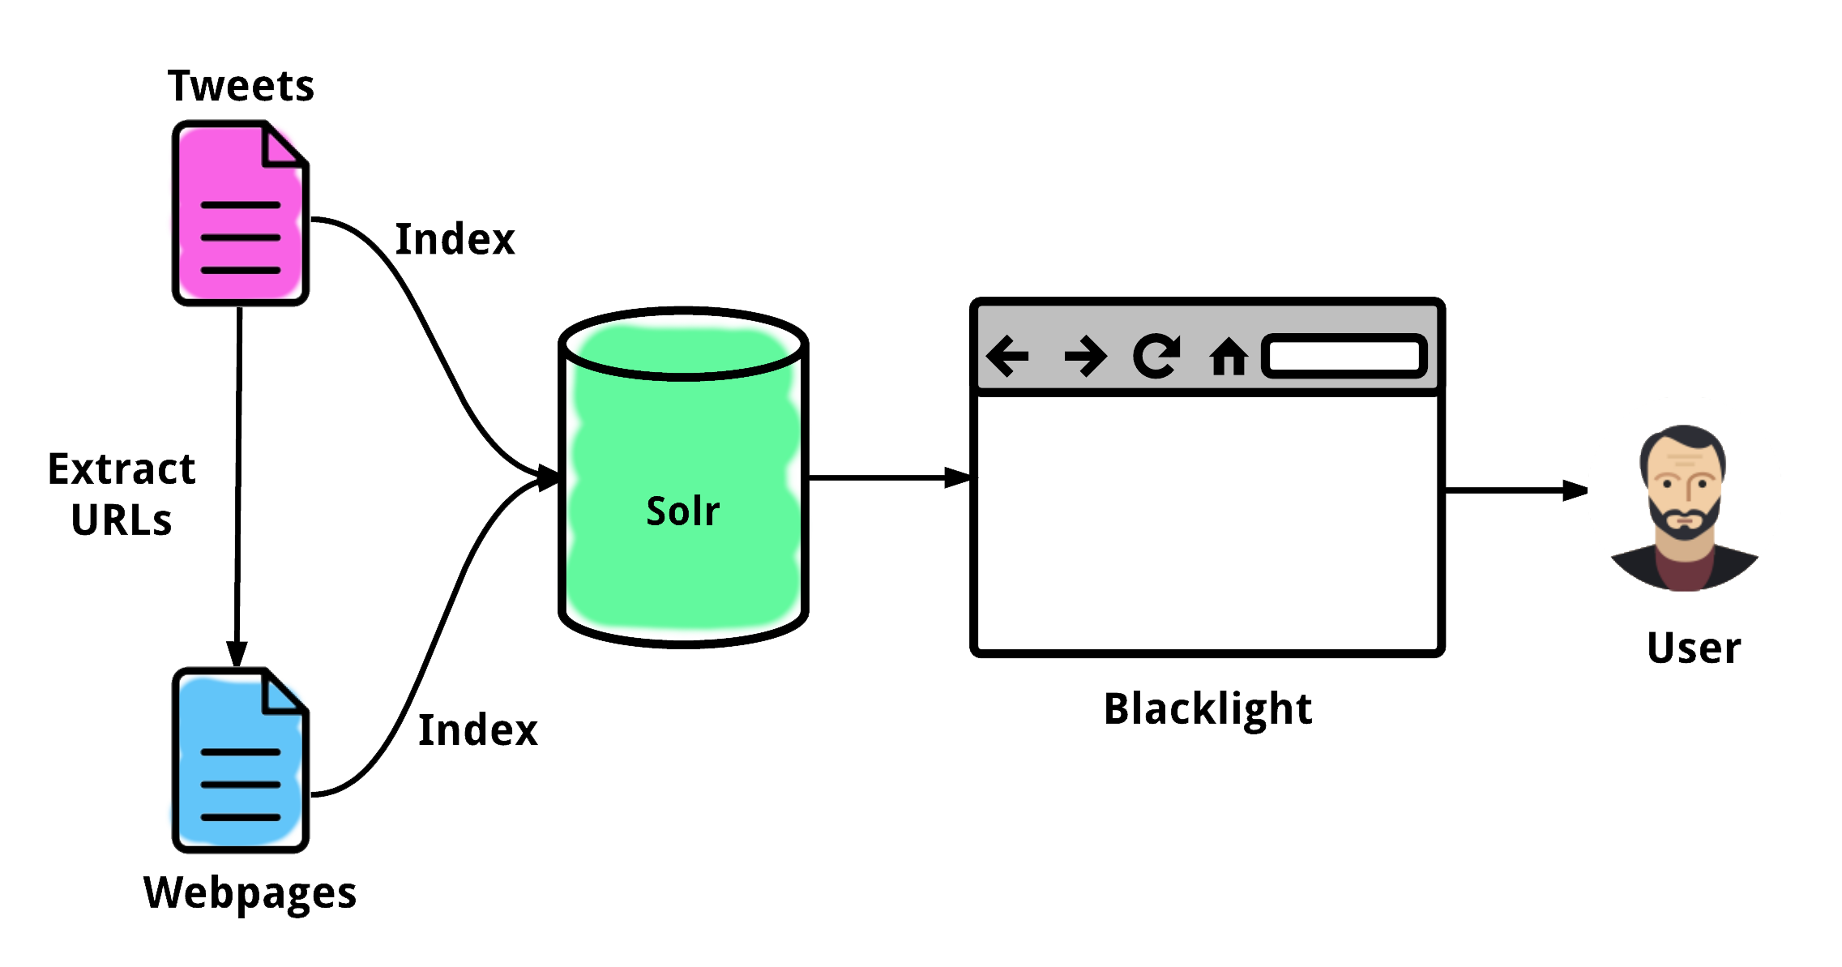
SYSTEM MAP

Slide 4
FUNCTIONALITY

Slide 5
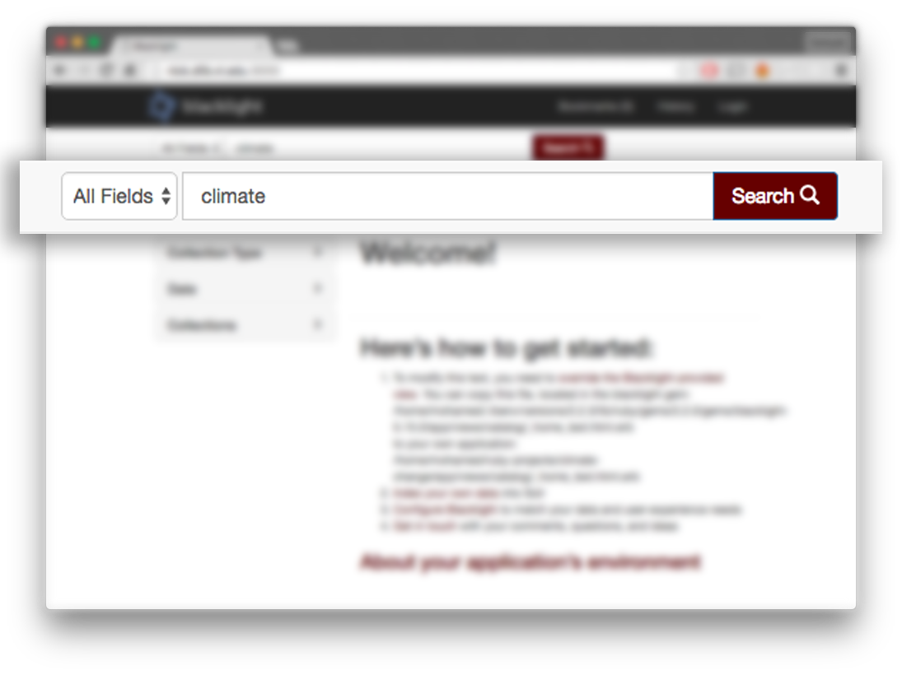
SEARCH

Slide 6
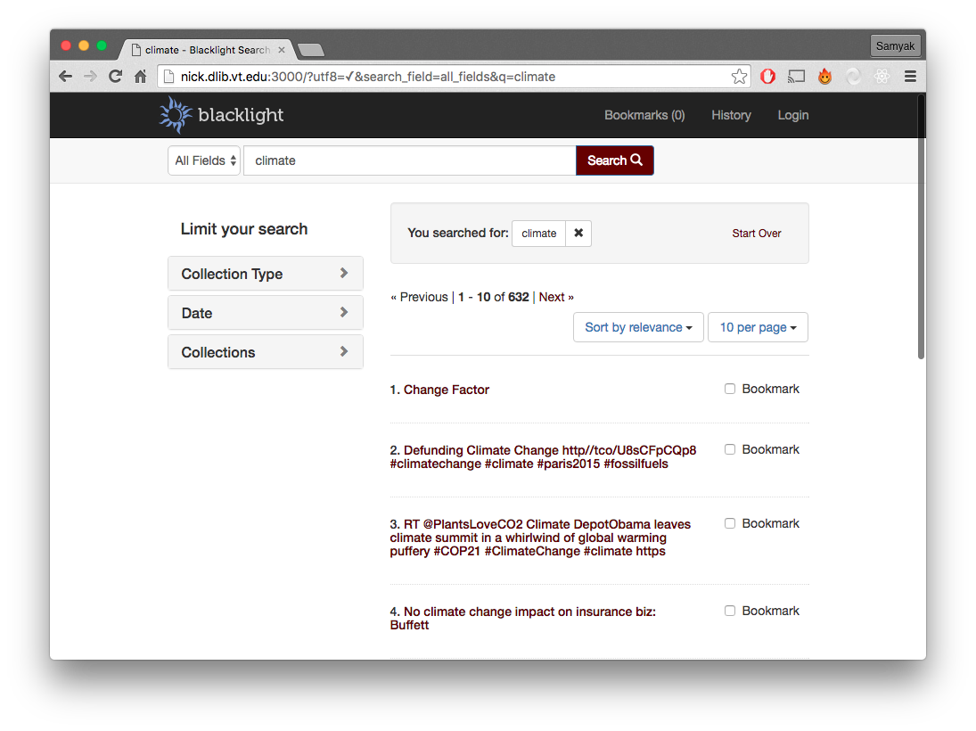
SEARCH

Slide 7
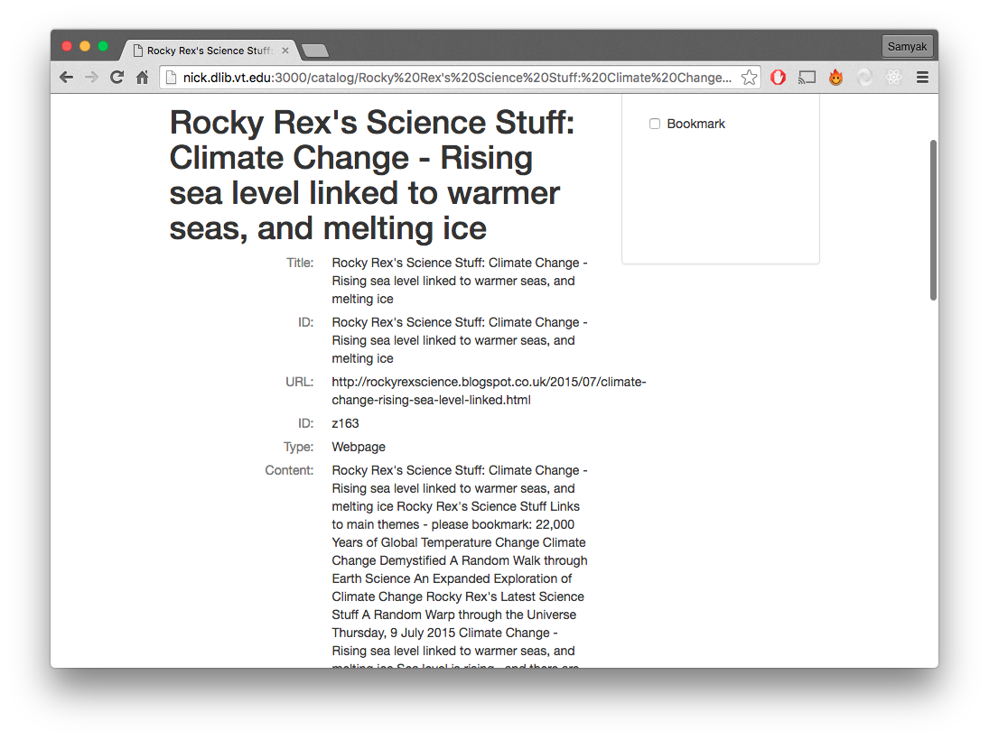
SEARCH

Slide 8
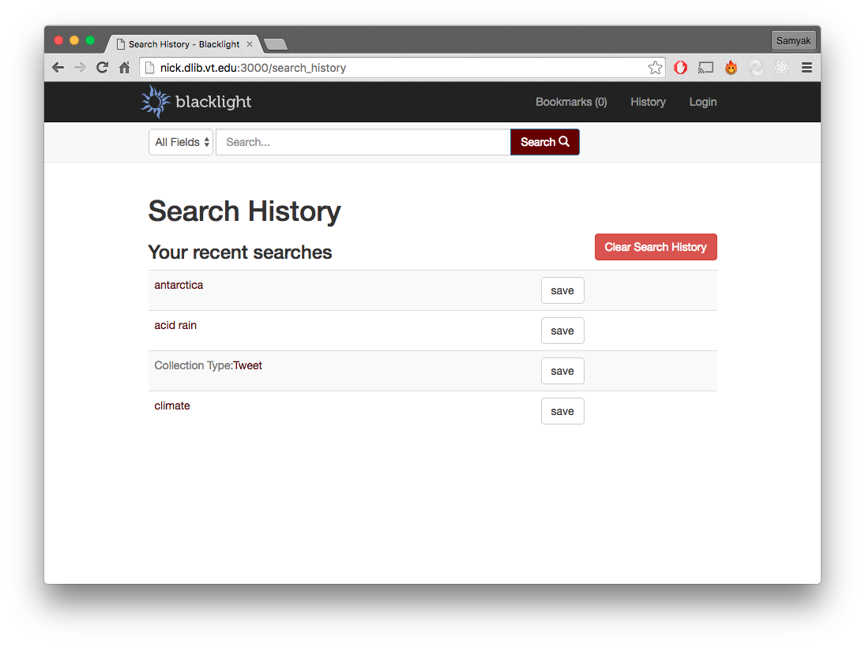
SEARCH
HISTORY

Slide 9
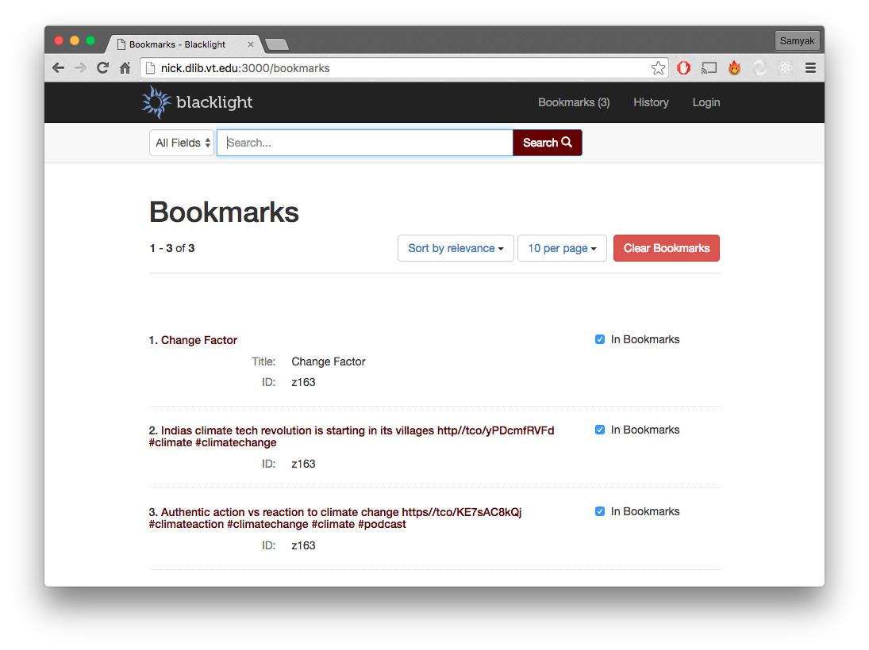
BOOKMARKS

Slide 10
TESTING
Black Box testing for usability by students.
Functionality testing for search by Somn, Sam, and Michael.

Slide 11
FUTURE WORK
Python-configuration files for scalability.
Upgrade Python to 3.5.
Continue to upload more data.

Slide 12
THANK YOU!

