Slide 1
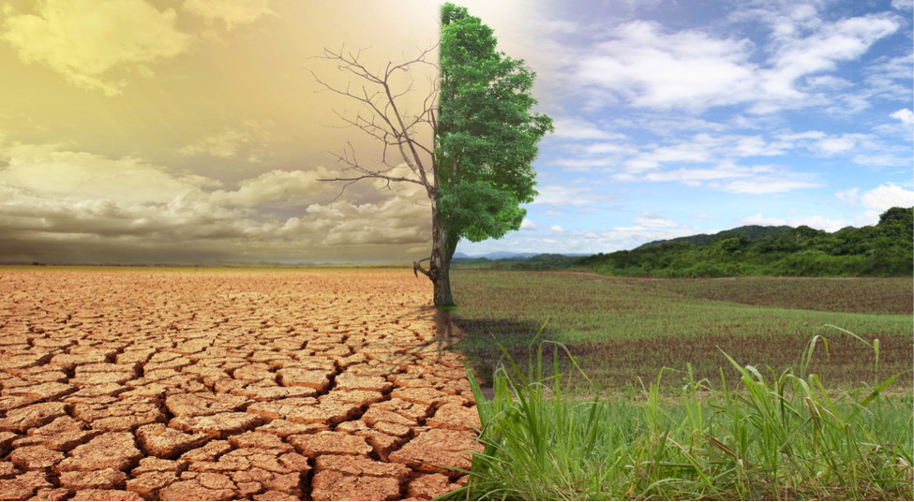
IDEAL CLIMATE CHANGE
Client
Mohammed M. Gharib Farag
Project Members
Michael D. Steele, Somn Kafley, Samyak Singh

Slide 2
Project Description
A digital library and search engine project
To create a web engine for non-technical users to search topic related to climate change.
The project serves as a tool for researchers

Slide 3
Essential Components
Get archived tweets and web pages file
Run python scripts on the archived file to extract information
Index obtained files from running python scripts to Solr search engine
Demonstrate search engine through a web interface using Backlight

Slide 4
Project’s Phases
Design
Implementation
Prototype
Testing
Final Deliverable

Slide 5
Software & Hardware used
Ruby Version 1.9 or higher
Rails 3.2 or 4.x
Java Version 1.7 or higher
Apache SOLR
Blacklight
Terminal or Command Prompt
Personal Computers
Internet Access

Slide 6
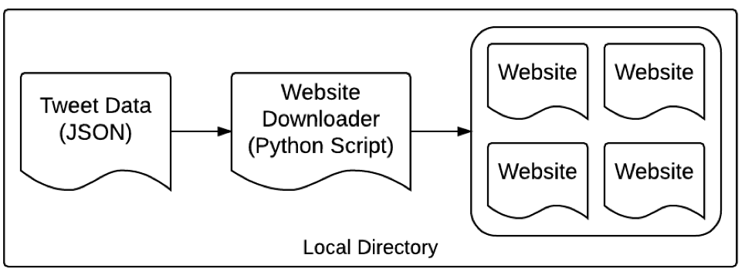
Prototype

Slide 7
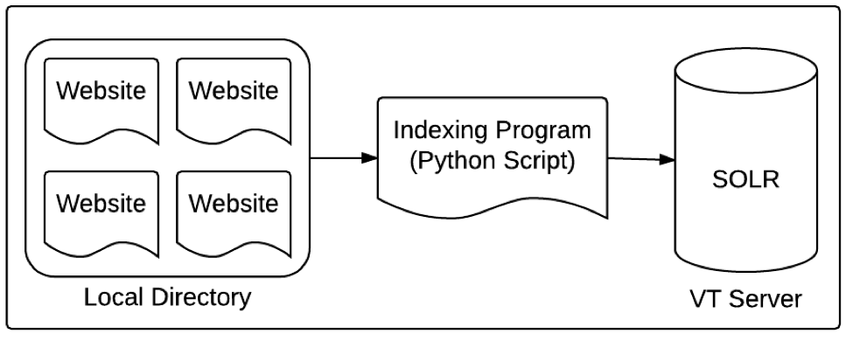

Slide 8
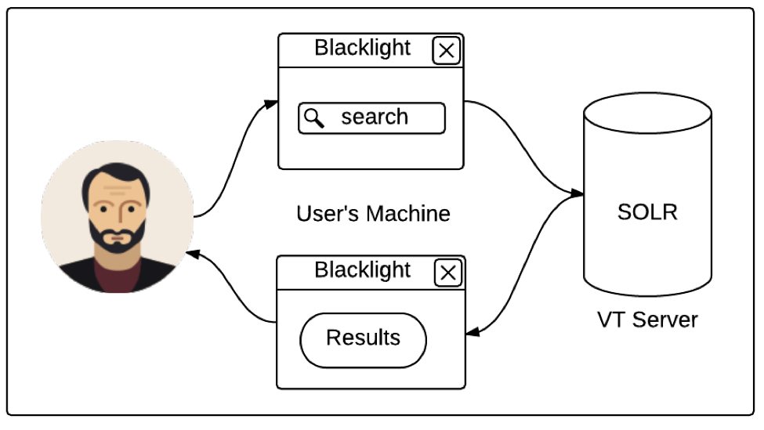
Prototype

Slide 9
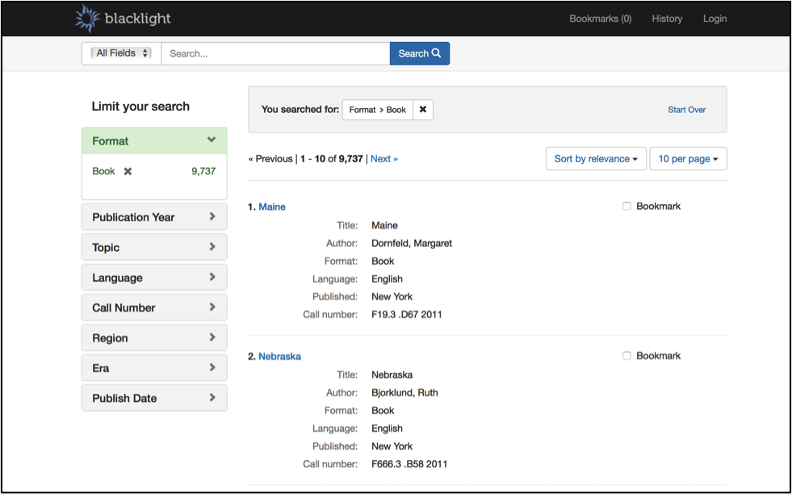
Sample

Slide 10
Questions
???

