Slide 1
IDEAL CLIMATE CHANGE
Client
Mohammed M. Gharib Farag
Project Members
Michael D. Steele, Somn Kafley, Samyak Singh

Slide 2
Project Description
A digital library and search engine project
To create a web engine for non-technical users to search topic related to climate change.
The project serves as a tool for researchers

Slide 3
Scope of the Project
Facilitate ongoing climate change research
Allow users to see social trends about climate change
Assist researchers to get access those trends and study about it
Make easy access of climate change trends to technical user who are not technical in computer field

Slide 4
Essential Components
Get archived tweets and web pages file
Run python scripts on the archived file to extract information
Index obtained files from running python scripts to Solr search engine
Demonstrate search engine through a web interface using Backlight

Slide 5
Web App Design
As per the client suggestions, for our interface we like to use blacklight interface.
Climate change web app should have search box
The search results should show following components:
Collections Type
Webpages
Tweets
Date
Collections
Display title of tweets or webpages in the main page

Slide 6
Implementation
Write Python Scripts from skeleton provided
Run Python scripts on archived JSON file
Extract information from tweets related to python scripts
Save those extracted information to .txt files
Indexed those files to SOLR
Incorporate SOLR with Blacklight Interface
Use Blacklight interface to search tweets and website

Slide 7
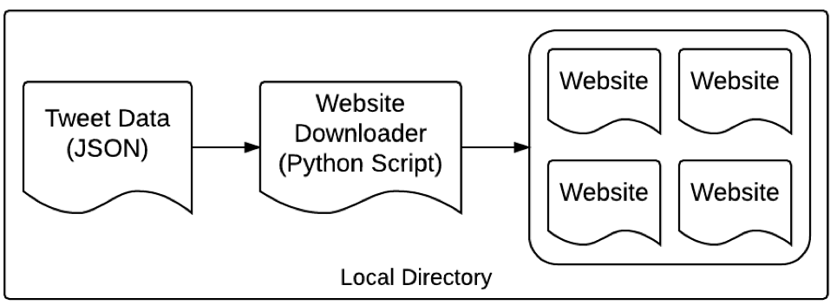
Prototype

Slide 8
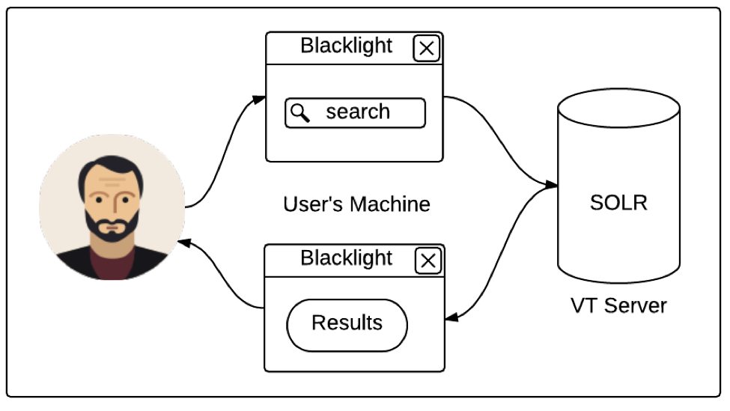
Prototype

Slide 9
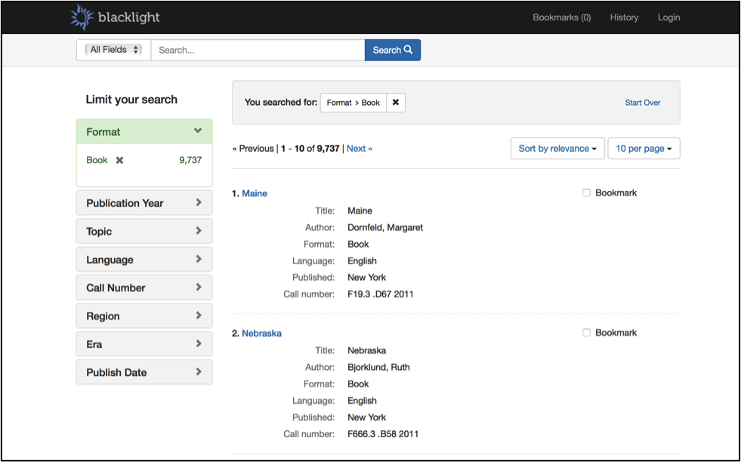
Sample

Slide 10
Demo
Mike will demo the web app

Slide 11
Testing
Objective
Test the user interface and functionality of the application
How well an end-user could execute a search
How well an end-user could read the results
Types of Testing Performed
Black Box Testing
Functional Testing
Developers tested the search functionality
Developers tested the page ranking functionality

Slide 12
Test Result
Get usability of the application
From the functional testing
Confirm that there is only one result for the search query
Files with highest number of keyword appear on top
Help determined app is working properly.

Slide 13
Future Work
Unlike other projects, climate change is ongoing project
Someone should take charge from where we left.
Have access to JSON file or
Instead of getting JSON file from clients, figure out better way to download tweets and webpages.
Blacklight interface need to change to reflect all tweets and webpages inquiries

Slide 14
Questions
???

