Slide 1

Winning at Blackjack
The riscufefeian way
Casino clan

Slide 2


Slide 3
This is purely imaginative

Slide 4
This is purely imaginative
No client ever used JS Math.random() to setup keys for encrypting database containing sensitive data

Slide 5
While browsing vbulletin forum for educational purposes

Slide 6
While browsing vbulletin forum for educational purposes
on top you find a banner stating "Win at blackjack, win at life"

Slide 7
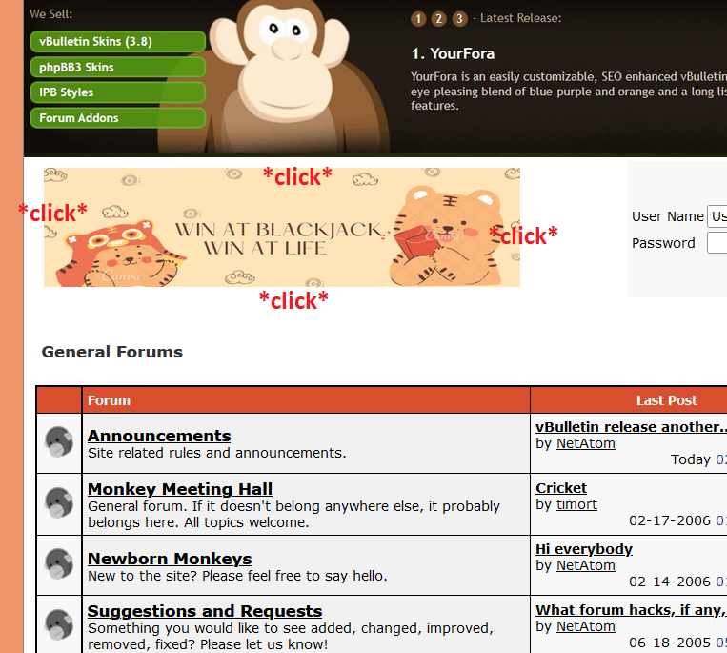
While browsing vbulletin forum for educational purposes
on top you find a random banner boldly stating "Win at blackjack, win at life"

Slide 8
You think to yourself
A little blackjack didn’t hurt nobody

Slide 9
You think to yourself
A little blackjack didn’t hurt nobody
*click*

Slide 10
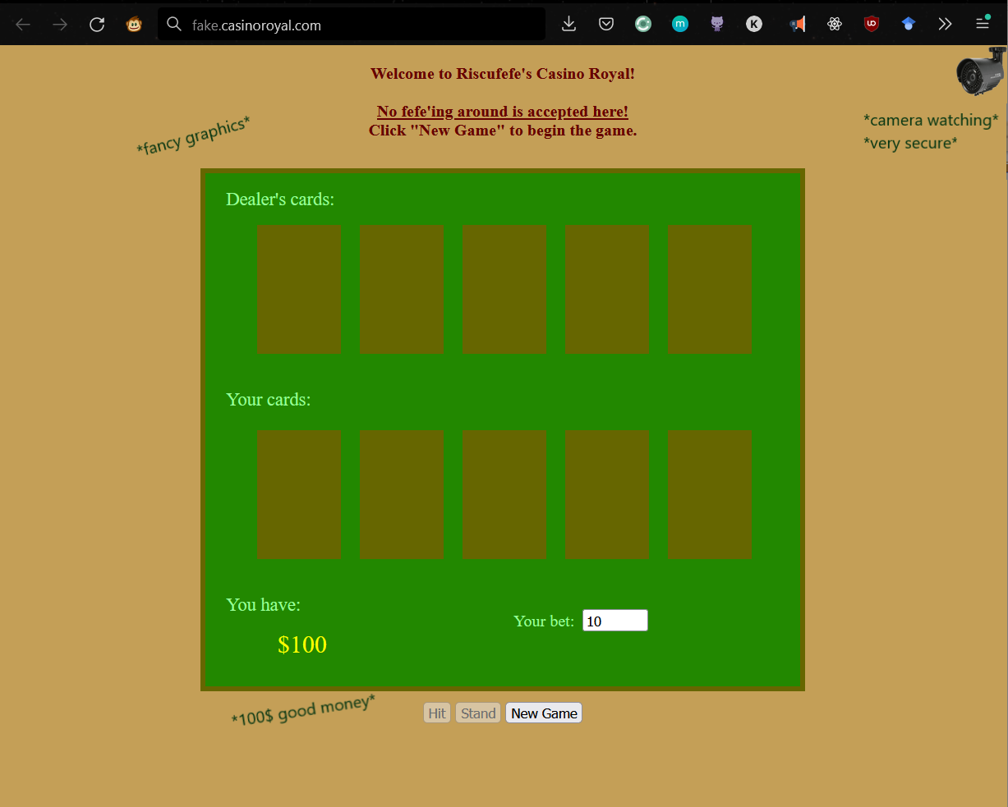
You think to yourself
A little blackjack didn’t hurt nobody

Slide 11
impressed

Slide 12
impressed
you decide to play

Slide 13
You notice it is made in Javascript

Slide 14
You notice it is made in Javascript
You wonder how it is running

Slide 15
You notice it is made in Javascript
You wonder how it is running
*Ctrl + Shift + K*

Slide 16
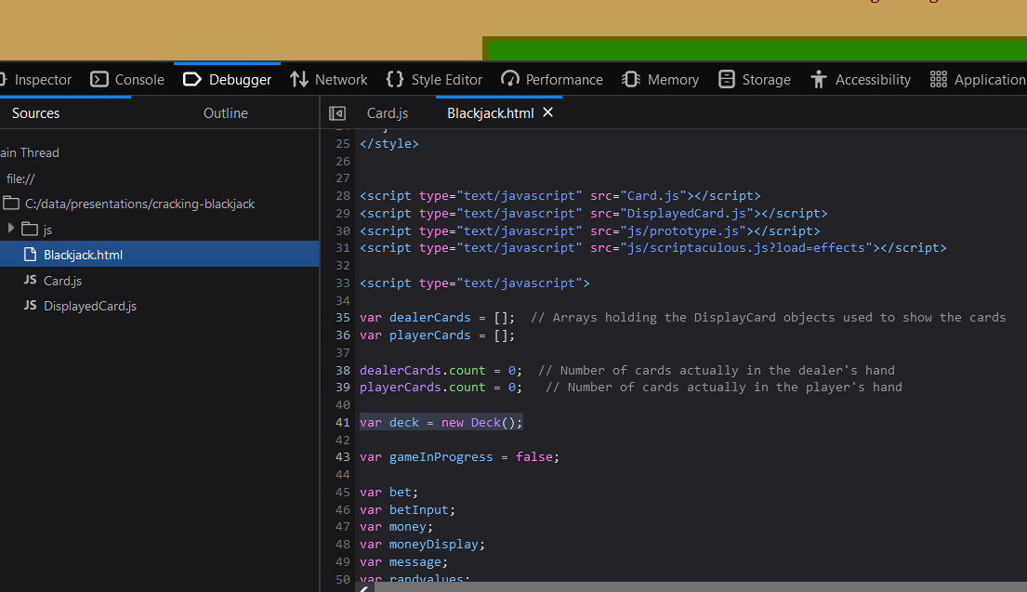
You notice it is made in Javascript
You wonder how it is running
*Ctrl + Shift + K*

Slide 17
You notice it is made in Javascript
You wonder how it is running
*Ctrl + Shift + K*
Deck setup here

Slide 18
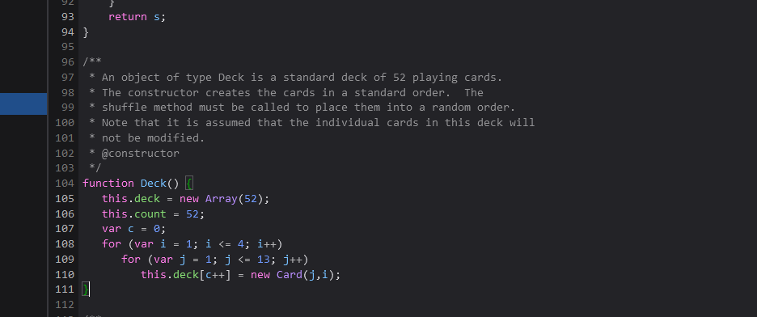
You notice it is made in Javascript
You wonder how it is running
*Ctrl + Shift + K*
A deck is 52 cards
Deck setup here

Slide 19
You notice it is made in Javascript
You wonder how it is running
*Ctrl + Shift + K*
A deck is 52 cards
13 card for each suit
Deck setup here

Slide 20
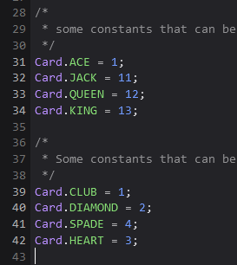
You notice it is made in Javascript
You wonder how it is running
*Ctrl + Shift + K*
A deck is 52 cards
13 card for each suit
Deck setup here

Slide 21
You notice it is made in Javascript
You wonder how it is running
*Ctrl + Shift + K*
A deck is 52 cards
13 card for each suit
With
i refers to suit
j refers to card value
Deck setup here

Slide 22
You notice it is made in Javascript
You wonder how it is running
*Ctrl + Shift + K*
A deck is 52 cards
13 card for each suit
With
i refers to suit
j refers to card value
Initially setup in ascending order
Deck setup here

Slide 23
Cool, so how the game goes?

Slide 24
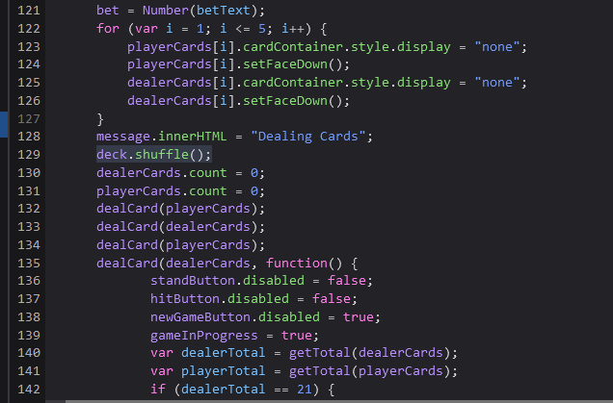
Cool, so how the game goes?
At the start of the game the deck gets shuffled
<- deck gets shuffled

Slide 25
Cool, so how the game goes?
At the start of the game the deck gets shuffled
<- deck gets shuffled
<-
<-
Cards dealt from top to bottom from the shuffled deck

Slide 26
But how the shuffling is done?

Slide 27
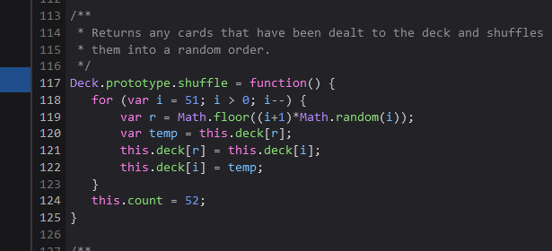
But how the shuffling is done?
51 iterations

Slide 28
But how the shuffling is done?
51 iterations
Goes through the deck from bottom to top

Slide 29
But how the shuffling is done?
51 iterations
Goes through the deck from bottom to top
Uses math.Random() to get random card from the deck

Slide 30
But how the shuffling is done?
51 iterations
Goes through the deck from bottom to top
Uses math.Random() to get random card from the deck
Selected card at hand is swapped with the randomly selected card previously

Slide 31
I am not a crypto guy

Slide 32
I am not a crypto guy
But I have always seen Math.random() being frowned upon

Slide 33
I am not a crypto guy
But I have always seen Math.random() being frowned upon
How secure Math.random() actually is?

Slide 34
*furious googling*

Slide 35
*furious googling*
Turns out JS doesn’t decide how Math.random() gets implemented

Slide 36
*furious googling*
Turns out JS doesn’t decide how Math.random() gets implemented
Your browser does

Slide 37
*furious googling*
Turns out JS doesn’t decide how Math.random() gets implemented
Your browser does
In 2015 pretty much every browser started using xorshift128+

Slide 38
*furious googling*
Turns out JS doesn’t decide how Math.random() gets implemented
Your browser does
In 2015 pretty much every browser started using xorshift128+
how is it done?

Slide 39
*furious googling*

Slide 40
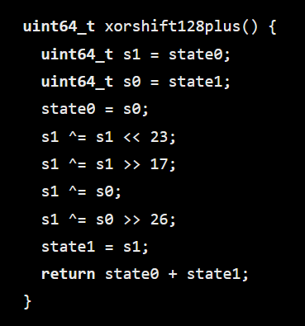

Slide 41
Initial couple of states (seeds)

Slide 42
Initial couple of states (seeds)
Shifting magic

Slide 43
Initial couple of states (seeds)
Shifting magic
XOR magic on resulting states

Slide 44
Initial couple of states (seeds)
Shifting magic
XOR magic on resulting states
Sum values

Slide 45
Initial couple of states (seeds)
Shifting magic
XOR magic on resulting states
Sum values
Riscufefe

Slide 46
We realize that the random generation is deterministic

Slide 47
We realize that the random generation is deterministic
Getting the right state of the PRNG results in predicting the previous and next states

Slide 48
Seems like with known outputs we may symbolically get the PRNG state

Slide 49
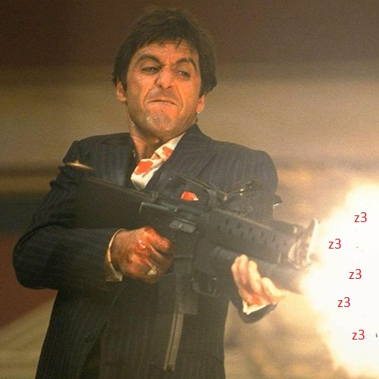
Seems like with known outputs we may symbolically get the PRNG state

Slide 50
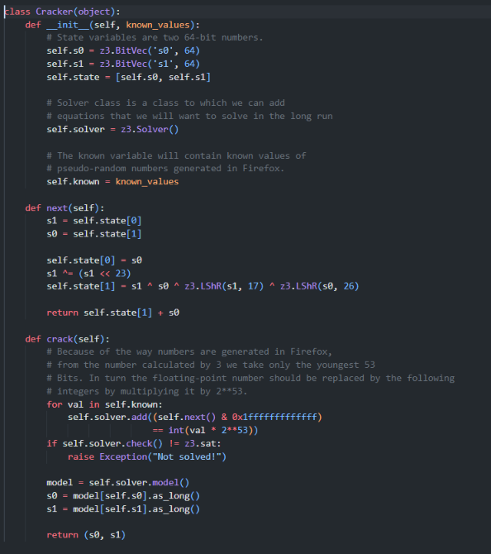

Slide 51
1. Symbolize our states as 64 bit values

Slide 52
1. Symbolize our states as 64 bit values
2. Exact implementation of xorshift128plus()
over the symbolic states

Slide 53
1. Symbolize our states as 64 bit values
2. Exact implementation of xorshift128plus()
over the symbolic states
3. Iterate over previously known values
let z3 find a valid succession of values
exactly as our known values

Slide 54
*Seems fair*

Slide 55
*Seems fair*
But we want the Blackjack money

Slide 56
*Seems fair*
But we want the Blackjack money
That means we can predict the exact state of the shuffled deck

Slide 57
*Seems fair*
But we want the Blackjack money
That means we can predict the exact state of the shuffled deck
*About time to win*

Slide 58
*Seems fair*
But we want the Blackjack money
51 calls to Math.random()
That means we can predict the exact state of the shuffled deck

Slide 59
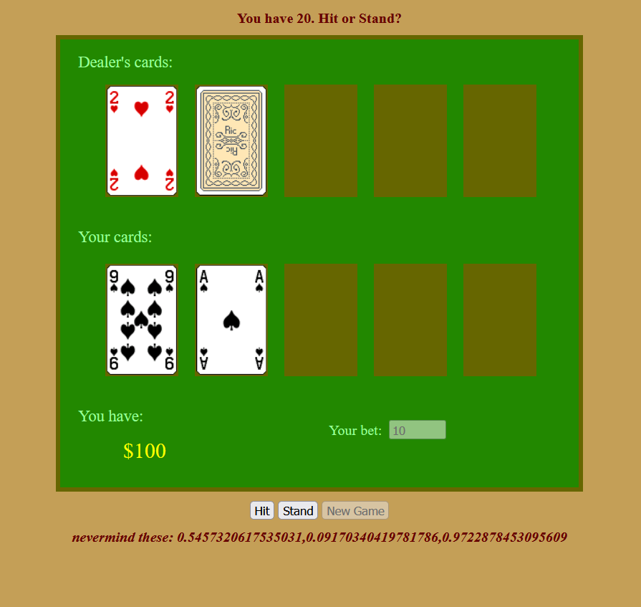
*Seems fair*
But we want the Blackjack money
51 calls to Math.random()

Slide 60
*Seems fair*
But we want the Blackjack money
51 calls to Math.random()
We got here first consecutive 3 calls to Math.random()
-> To help us get the state of the PRNG

Slide 61
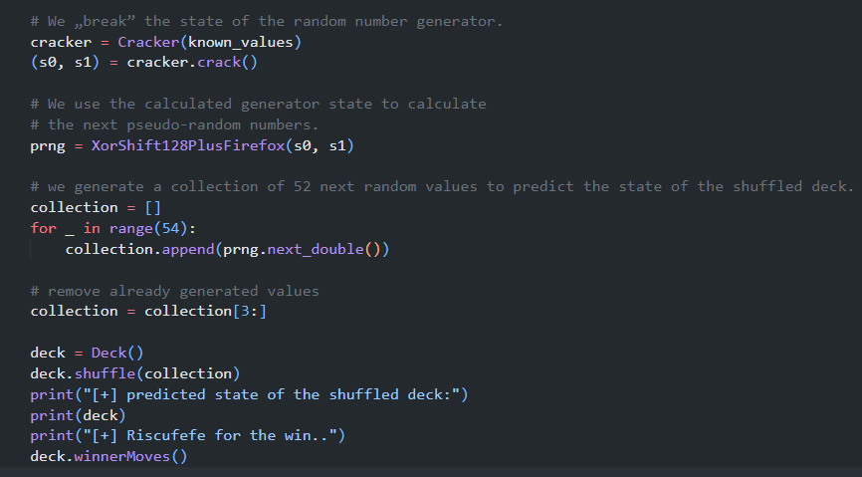
1. Solve the PRNG state
*Seems fair*
But we want the Blackjack money
51 calls to Math.random()

Slide 62
1. Solve the PRNG state
*Seems fair*
2. Generate next 51 randoms
But we want the Blackjack money
51 calls to Math.random()

Slide 63
1. Solve the PRNG state
*Seems fair*
2. Generate next 51 randoms
But we want the Blackjack money
51 calls to Math.random()
3. Shuffle the deck in the predicted state

Slide 64
1. Solve the PRNG state
*Seems fair*
2. Generate next 51 randoms
But we want the Blackjack money
51 calls to Math.random()
3. Shuffle the deck in the predicted state
4. win

Slide 65
*run solver*

Slide 66
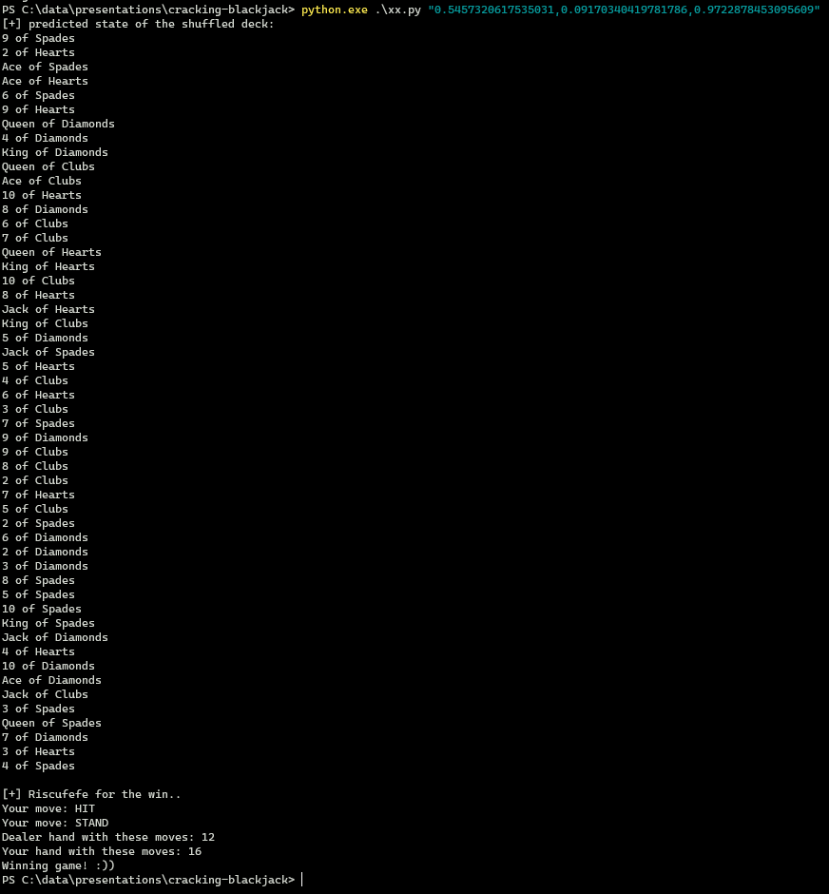
*run solver*

Slide 67
*run solver*

Slide 68
*run solver*

Slide 69
*run solver*

Slide 70
*run solver*

Slide 71
Dealers card should be Ace of hearts
*run solver*

Slide 72
Dealers card should be Ace of hearts
*run solver*

Slide 73
Dealers card should be Ace of hearts
*run solver*
Our little program suggests some moves based on calculation of both of our hands values

Slide 74
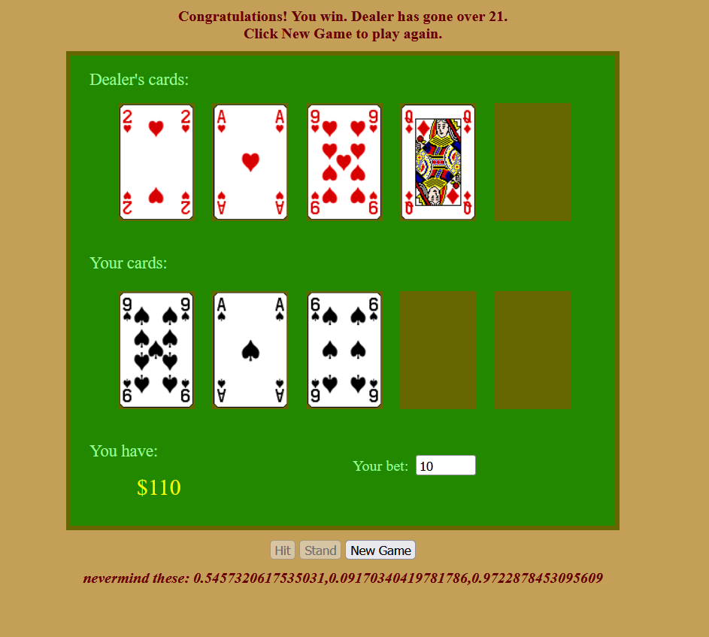
Dealers card should be Ace of hearts
*run solver*
Our little program suggests some moves based on calculation of both of our hands values

Slide 75
Dealers card should be Ace of hearts
*Ez Pz*
*free money*
*run solver*
Our little program suggests some moves based on calculation of both of our hands values

Slide 76
Hope you enjoyed my little presentation

Slide 77
Links

Slide 78
Links
https://hackernoon.com/how-does-javascripts-math-random-generate-random-numbers-ef0de6a20131
https://research.securitum.com/calculation-of-pseudo-random-numbers-generator-state-on-the-example-of-math-random-from-firefox/
https://kaftejiman.github.io/blackjack

Slide 79
Riscure B.V.
Frontier Building, Delftechpark 49
2628 XJ Delft
The Netherlands
Phone: +31 15 251 40 90
www.riscure.com
Riscure North America
550 Kearny St., Suite 330
San Francisco, CA 94108 USA
Phone: +1 650 646 99 79
inforequest@riscure.com
Riscure China
Room 2030-31, No. 989, Changle Road,
Shanghai 200031
China
Phone: +86 21 5117 5435
inforcn@riscure.com

