Slide 1

Microsoft Film Industry Analysis
Dan Kagan
February 1st, 2021
Self-Paced

Slide 2
Methodology
The following analysis was drawn from 8 different Excel files, which contained different datasets regarding films’ budgets, gross profits, popularity and more. The sources for these datasets include IMDB, The Movie Database and Box Office Mojo.
For this analysis, visualizations and calculations were executed using multiple Python libraries. These include Pandas, NumPy, and MatPlotLib.
Additional resources used for research are included at the end of this presentation.

Slide 3
Intro
Prompt: Microsoft sees all the big companies creating original video content, and they want to get in on the fun. They have decided to create a new movie studio, but the problem is they don’t know anything about creating movies.
They have hired you to help them better understand the movie industry. Your team is charged with doing data analysis and creating a presentation that explores what type of films are currently doing the best at the box office.
You must then translate those findings into actionable insights that the CEO can use when deciding what type of films they should be creating.

Slide 4
Table of Contents
1) What are the most popular films?
2) What are the most lucrative films?
3) What are the most expensive films?
4) Conclusion
5) Recommendations

Slide 5
What are the most popular films?
Film Title | Popularity Rating
Avengers: Infinity War | 80.7
John Wick | 78.1
Spider-Man: Into the Spider-Verse | 60.5
The Hobbit: The Battle of the Five Armies | 53.8
The Avengers | 50.3
Guardians of the Galaxy | 49.6
Blade Runner 2049 | 48.6
Fantastic Beasts: The Crimes of Grindelwald | 48.5
Ralph Breaks the Internet | 48.1
Spider-Man: Homecoming | 46.8
The most popular genres of films are Super Hero movies, Well-Known Series (LOTR, Star Wars, etc.), and Children's movies.
60% of the top 25 are Super Hero movies
16% of the top 25 are Well-Known Series
Difficult to compete by making one-off films
Notes:
Unfortunately, Microsoft is late to this strategy and would thus have to be creative about how they could participate in creating these movies when Marvel Comic Universe, Sony, Universal and Disney all own the vast majority of intellectual property rights for these film series.

Slide 6
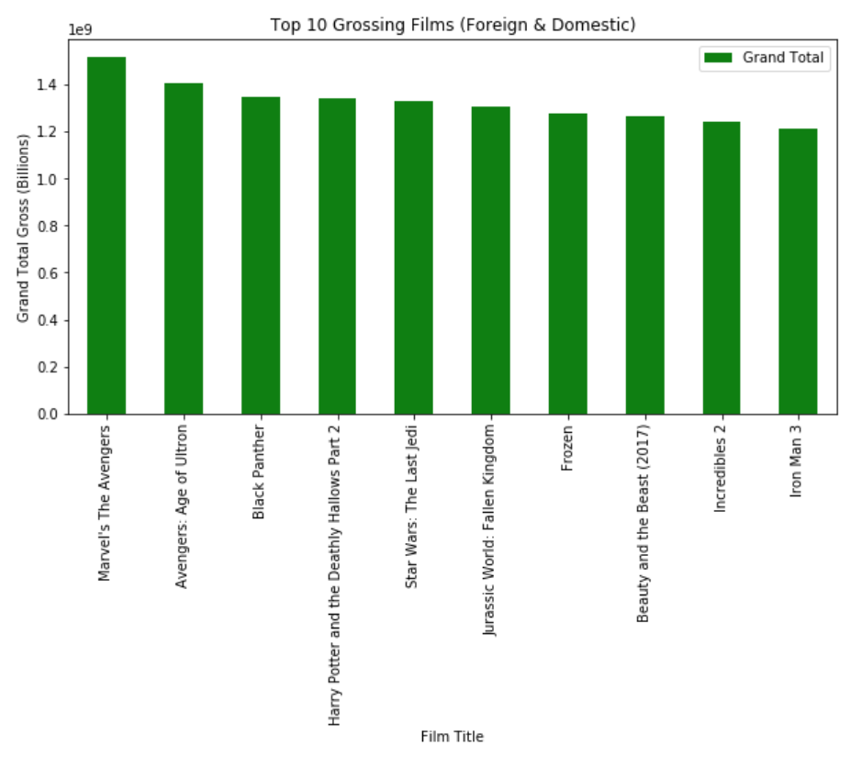
What are the most lucrative films?
- Most popular film categories are also the ones that make the most money.
- 40% (4) Super Hero Movies 40% (4) Well-Known Series 20% (2) Children's Movies

Slide 7
What are the most expensive films?
Film Title | Production Budget
Avatar | $425,000,000
Pirates of the Caribbean: On Stranger Tides | $410,600,000
Dark Phoenix | $350,000,000
Avengers: Age of Ultron | $330,600,000
Star Wars Ep. VIII: The Last Jedi | $317,000,000
Star Wars Ep. VII: The Force Awakens | $306,000,000
Avengers: Infinity War | $300,000,000
Pirates of the Caribbean: At World’s End | $300,000,000
Justice League | $300,000,000
Spectre | $300,000,000
Same three categories as the most lucrative and popular films - Well-Known series, Super Hero movies, or Children's movies.
100% of the top ten most expensive films fall into two of the above three categories

Slide 8
Conclusion
Microsoft does not own the intellectual property for any of the major film series that consistently make a large profit
It is extremely expensive to create a movie that can be reliably successful
Despite having sufficient capital to make competitive films, there is a significant opportunity cost to moving in a new direction
There is a low chance of Microsoft creating a successful film on their own

Slide 9
Recommendations
I recommend that Microsoft does not get involved in creating new movie content, nor streaming because it is too expensive and risky to take the chance.
Microsoft should continue spending capital on trying to improve their other services that are already dominant, such as GitHub, Windows, Teams, etc.
Something worth considering
Roughly 90 million people own an Xbox device (original, 360, One, & Series X). In this way, Microsoft is already in many peoples' living rooms. As a result of this competitive advantage, there may be a lucrative solution through utilizing them.
Notes:
Within the context of joining the film industry, I believe that Microsoft's most valuable asset is that roughly 50-60 million people own some kind of an Xbox device (original, 360, One, & Series X). In this way, they are already in many peoples' living rooms. As a result of this competitive advantage, there may be a lucrative solution for them,
- Streaming, which seemingly has a smaller barrier to entry than filmmaking, but is still extremely competitive.

Slide 10
Thank You!!

Slide 11
Additional Resources
https://www.digitalspy.com/movies/a870469/marvel-rights-characters-disney/
https://www.statista.com/statistics/531063/xbox-live-mau-number/
tmdb.movies.csv
bom.movie_gross.csv
tn.movie_budgets.csv

