Slide 1
Day 4: High Performance Computing CMT106
David W. Walker
Professor of High Performance Computing
Cardiff University
http://www.cardiff.ac.uk/people/view/118172-walker-david

Slide 2
Day 4
9:30 – 10:30am: Lecture on application topologies, the vibrating string example code, and its performance analysis.
10:30 – 10:50am: Break.
10:50am – 12:00pm: Lecture on the Laplace equation example code, and its performance analysis.
12:00 – 1:30pm: Lunch break.
1:30 – 3:15pm: Lab session, try out the example codes yourself (includes 15min break). Use the Linux lab, or else install MPI on your own system, for example from http://www.mpich.org/.
3:15 – 3:45pm: Review of the lab session.
3:45pm – 4:00pm: Overview of the second piece of coursework.
4:00pm – 5:00pm: Lecture and wrap-up.

Slide 3
Topics Covered on Days 1-4
Day 1: Introduction to parallelism; motivation; types of parallelism; Top500 list; classification of machines; SPMD programs; memory models; shared and distributed memory; OpenMP; example of summing numbers.
Day 2: Interconnection networks; network metrics; classification of parallel algorithms; speedup and efficiency.
Day 3: Scalable algorithms; Amdahl's law; sending and receiving messages; programming with MPI; collective communication; integration example.
Day 4: Regular computations and simple examples – the wave equation and Laplace’s equation.

Slide 4
Topics Covered on Days 5-7
Day 5: Programming GPUs with CUDA; CUDA device memory architecture; simple programming examples.
Day 6: Dynamic communication and the molecular dynamics example; irregular computations; the WaTor simulation .
Day 7: Load balancing strategies; message passing libraries; block-cyclic data distribution.

Slide 5
Application Topologies
In many applications, processes are arranged with a particular topology, e.g., a regular grid.
MPI supports general application topologies by a graph in which communicating processes are connected by an arc.
MPI also provides explicit support for Cartesian grid topologies. Mostly this involves mapping between a process rank and a position in the topology.

Slide 6
Cartesian Application Topologies
int MPI_Cart_create (MPI_Comm comm_old, int ndims, int *dims, int *period, int reorder, MPI_Comm *comm_cart)
Periodicity in each grid direction may be specified.
Inquiry routines transform between rank in group and location in topology
For Cartesian topologies, row-major ordering is used for processes, i.e., (i,j) means row i, column j.

Slide 7
Topological Inquiries
Can get information about a Cartesian topology:
int MPI_Cart_get(MPI_Comm comm, int maxdims, int *dims, int *periods, int *coords)
This gives information about a Cartesian topology:
int *dims; // number of processes in each dimension
int *periods; // periodicity of each dimension
int *coords; // coordinates of calling process

Slide 8
Mapping Between Rank and Position
The rank of a process at a given location:
int MPI_Cart_rank(MPI_Comm comm, int *coords, int *rank)
The location of a process of a given rank:
int MPI_Cart_coords(MPI_Comm comm, int rank, int maxdims, int *coords)

Slide 9
Uses of Topologies
Knowledge of application topology can be used to efficiently assign processes to processors.
Cartesian grids can be divided into hyperplanes by removing specified dimensions.
MPI provides support for shifting data along a specified dimension of a Cartesian grid.
MPI provides support for performing collective communication operations along a specified grid direction.

Slide 10
Topologies and Data Shifts
Consider the following two types of shift for a group of N processes:
Circular shift by J. Data in process K is sent to process mod((J+K),N)
End-off shift by J. Data in process K is sent to process J+K if this is between 0 and N-1. Otherwise, no data are sent.

Slide 11
Topologies and Data Shifts 2
Topological shifts are performed using
int MPI_Sendrecv(…)
The ranks of the processes that a process must send to and receive from when performing a shift on a topological group are returned by:
int MPI_Cart_shift(MPI_Comm comm, int direction, int disp, int *rank_source, int *rank_dest)

Slide 12
Shifts
Circular:
N = 8, J = 1
N = 8, J = 2
0
0
7
1
7
1
6
2
6
2
5
3
5
3
4
4
End-off:
0
1
2
3
4
5
6
7
0
1
2
3
4
5
6
7

Slide 13
Send/Receive Operations
In many applications, processes send to one process while receiving from another.
Deadlock may arise if care is not taken.
MPI provides routines for such send/receive operations.
For distinct send/receive buffers:
int MPI_Sendrecv(…)
For identical send/receive buffers:
int MPI_Sendrecv_replace(…)

Slide 14
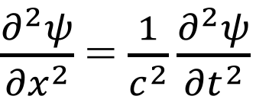
Vibrating String Problem
We shall now study the vibration of waves on a string, and design a parallel MPI program to solve the partial differential equation that describes the problem mathematically.
$\frac{∂^{2}ψ}{{∂x}^{2}}$ = $\frac{1}{c^{2}}\frac{∂^{2}ψ}{{∂t}^{2}}$
In this equation 𝜓 is the displacement of the string, x is distance along the string, t is time, and c is the wave velocity.

Slide 15
Problem Statement
Problem
A string of length L and fixed at each end is initially given a known displacement. What is the displacement at later times?
Introduce coordinate x so that one end of the string is at x=0 and the other end is at x=L.
Denote the displacement of the string at position x and time t by ψ(x,t).
We want to know ψ(x,t).

Slide 16
The Wave Equation
Mathematically the vibrating string problem is described by the wave equation.
We shall solve this problem numerically by approximating the solution at a number of equally-spaced values of x.
Displacement
x = L
x = 0

Slide 17
Method of Solution
We find the solution at a series of time steps, t₀, t₁, t₂, etc.
At each time step we find the displacement at the points x₀, x₁,…, x_{n-1}, where x₀=0 and x_{n-1}=L
At t₀ = 0 we assume the string has a known shape, i.e., we know ψ(x,0).
Given the solution at position x_{i} at time t_{j}, the value there at the next time step depends on the current and previous values at that point, and on current values at the neighbouring points.

Slide 18
Numerical Solution
Approximate partial derivative at x_{i} and t_{j} as follows:
$$\frac{∂ψ}{∂x}≈\frac{ψ_{i+1/2,j}−ψ_{i−1/{2,j}}}{δx}$$
Then:
$$\frac{∂^{2}ψ}{{∂x}^{2}}≈\frac{{(ψ}_{i+1,j}−ψ_{i,j})−{(ψ}_{i,j}−ψ_{i−1,j}) }{{δx}^{2}}\text{ =} \frac{ψ_{i+1,j}−2ψ_{i,j}+ψ_{i−1,j}}{{δx}^{2}}$$
$$\frac{∂^{2}ψ}{{∂t}^{2}}≈\frac{{(ψ}_{i,j+1}−ψ_{i,j})−{(ψ}_{i,j}−ψ_{i,j−1}) }{{δt}^{2}}\text{ =} \frac{ψ_{i,j+1}−2ψ_{i,j}+ψ_{i,j−1}}{{δt}^{2}}$$
𝜓_{i,j} is the value of 𝜓 at x_{i} at time t_{j}
𝜓_{i+1/2,j} is the value of 𝜓 at x_{i}+𝛿x/2 at time t_{j}

Slide 19
Numerical Solution (continued)
Substitute into the wave equation:
$\frac{ψ_{i+1,j}−2ψ_{i,j}+ψ_{i−1,j}}{{δx}^{2}}$ $≈\frac{1}{c^{2}}\left(\frac{ψ_{i,j+1}−2ψ_{i,j}+ψ_{i,j−1}}{{δt}^{2}}\right)$
Rearranging gives:
$$ψ_{i,j+1}≈2ψ_{i,j}−ψ_{i,j−1}{+τ}^{2}\left(ψ_{i+1,j}−2ψ_{i,j}+ψ_{i−1,j}\right)$$
where
$$τ=c\left(\frac{δt}{δx}\right)$$

Slide 20
Data Distribution
Give each process a block of points on the string.
Each process should have approximately the same number of points to ensure good load balance.
0
1
2
3
Displacement
x = 0
x = L

Slide 21
Communication Requirements
Given the solution at position x_{i} at time t_{j}, the value there at the next time step depends on the current and previous values at that point, and on current values at the neighbouring points.
So to update a point we need to know the displacement at neighbouring points. This entails communication.
Each process needs to communicate the displacement values for its first and last points before updating its points
0
1
2
3

Slide 22
Outline of Parallel Code
Initialise data distribution
Find position of each process to determine which block of points it handles.
Find out the node numbers of processes to left and right.
Initialise arrays
Determine how many points each process handles and the index of the first point in each.
Set the psi and oldpsi arrays.
Perform Update
Communicate end points.
Do update locally.
Output results

Slide 23
Displacement Arrays
Each process needs to store the endpoint values received from the neighbouring processes. These are stored at the 0 and nlocal+1 positions in the displacement arrays.
Thus, the displacement arrays need two “extra” entries at each end.
nlocal = 5
0
1
2
3
4
5
6

Slide 24
Outline MPI Code
#include <stdio.h>
#include <stdlib.h>
#include <math.h>
#include <mpi.h>
int main (int argc, char *argv[]){
MPI_Init (&argc, &argv);
MPI_Finalize();
}
Code for initialising data distribution goes here
Code for initialising arrays goes here
Code for update loop goes here
Code for output phase goes here

Slide 25
Initialising the Data Distribution
int rank, nprocs, mypos, periods=0, reorder=1;
MPI_Comm new_comm;
MPI_Comm_size (MPI_COMM_WORLD, &nprocs);
MPI_Comm_rank (MPI_COMM_WORLD, &rank);
MPI_Cart_create (MPI_COMM_WORLD, 1, &nprocs, &periods,
reorder,&new_comm);
MPI_Cart_coords (new_comm, rank, 1, &mypos);
MPI_Cart_shift (new_comm, 0, 1, &left, &right);
new_comm is a new communicator with a 1D Cartesian topology.
mypos array gives the position of a process in the topology.
MPI_Cart_shift( ) allows us to find the left and right neighbours of a process.

Slide 26
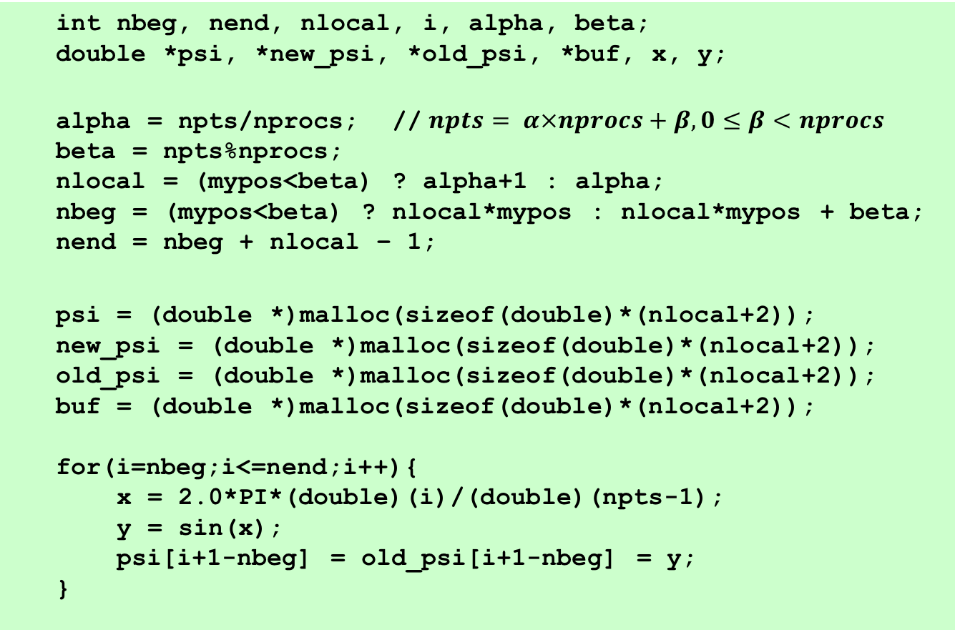
Initialising the Arrays
int nbeg, nend, nlocal, i, alpha, beta;
double *psi, *new_psi, *old_psi, *buf, x, y;
alpha = npts/nprocs; // $npts= α×nprocs+β, 0≤β<nprocs$
beta = npts%nprocs;
nlocal = (mypos<beta) ? alpha+1 : alpha;
nbeg = (mypos<beta) ? nlocal*mypos : nlocal*mypos + beta;
nend = nbeg + nlocal – 1;
psi = (double *)malloc(sizeof(double)*(nlocal+2));
new_psi = (double *)malloc(sizeof(double)*(nlocal+2));
old_psi = (double *)malloc(sizeof(double)*(nlocal+2));
buf = (double *)malloc(sizeof(double)*(nlocal+2));
for(i=nbeg;i<=nend;i++){
x = 2.0*PI*(double)(i)/(double)(npts-1);
y = sin(x);
psi[i+1-nbeg] = old_psi[i+1-nbeg] = y;
}

Slide 27
Initialising the Arrays
Let npts = α * nprocs + β.
If the number of points is exactly divisible by nprocs, then each process has α intervals.
Otherwise the first β processes have α+1 points, and the rest of the processes have α points.
nbeg is the index of the first point in each process, i.e., it is the global index corresponding to local index 1.
We initialise the arrays for indices 1 up to nlocal. Indices 0 and nlocal+1 will be used later to store values received from neighbouring processes.

Slide 28
Update Loop
double tau = 0.05;
int istart, iend, tag = 111, nsteps = 500, j;
MPI_Status status;
istart = (mypos==0) ? 2 : 1;
iend = (mypos==nprocs-1) ? nlocal-1 : nlocal;
for(j=0;j<nsteps;j++){
MPI_Sendrecv (&psi[1], 1, MPI_DOUBLE, left, tag,
&psi[nlocal+1], 1, MPI_DOUBLE, right, tag,
new_comm, &status);
MPI_Sendrecv (&psi[nlocal], 1, MPI_DOUBLE, right, tag,
&psi[0], 1, MPI_DOUBLE, left, tag,
new_comm, &status);
for(i=istart;i<=iend;i++)
new_psi[i] = 2.0*psi[i] - old_psi[i] +
tau*tau*(psi[i-1]-2.0*psi[i]+psi[i+1]);
for(i=1;i<=nlocal;i++){
old_psi[i] = psi[i];
psi[i] = new_psi[i];
}
}

Slide 29
Notes on Update Loop
The update phase has 3 main parts:
Communicate endpoints between neighbours
Update points locally
Copy arrays ready for next update step

Slide 30
Communication Code: Left Shift
All processes send psi[1] to the process to the left, and receive data from the process to the right, storing it in psi[nlocal+1].
MPI_Sendrecv(&psi[1], 1, MPI_DOUBLE, left, tag,
&psi[nlocal+1], 1, MPI_DOUBLE, right, tag,
new_comm, &status);

Slide 31
Communication Code: Right Shift
All processes send psi[nlocal] to the process to the right, and receive data from the process to the left, storing it in psi[0].
MPI_Sendrecv (&psi[nlocal], 1, MPI_DOUBLE, right, tag,
&psi[0], 1, MPI_DOUBLE, left, tag,
new_comm, &status);

Slide 32
Output Phase
We assume the results are output to a file and/or a visualisation device.
We won’t look at this as its mostly a C coding issue.
One parallel computing issue that arises is whether all processes have access to the file system. Usually they do, but this is not required by MPI.

Slide 33
Performance Analysis
To analyse the performance of the parallel wave equation code we just look at the update phase.
To update each point requires 6 floating-point operations in the parallel and sequential codes.
In the parallel code each process sends and receives two floating-point numbers in each update step.
We ignore the time to copy to the arrays old_psi and psi.

Slide 34
Performance Analysis 2
The speed-up is:
6nt_{calc}
N
S(N) =
=
(6n/N)t_{calc} + 2t_{comm}
1 +
τ/(3g)
where N is the number of processes, n is the number of points, g = n/N is the grain size, and τ = t_{comm}/t_{calc}.

Slide 35
Performance Analysis 3
The efficiency is
1
ε(N) =
1 + τ/(3g)
so the overhead is f(N) = τ/(3g).
Since the efficiency depends on g but not independently on N the parallel algorithm is perfectly scalable.

Slide 36
Visualizing the Output

Slide 37
Laplace Equation Problem
Potential = 0
The next problem we shall look at may be used to determine the electric field around a conducting object held at a fixed electrical potential inside a box also at a fixed electrical potential.
As with the vibrating string problem, this problem can also be expressed mathematically as a partial differential equation, known as the Laplace equation.
We shall design a parallel MPI program to solve the partial differential equation.
Potential = 1

Slide 38
Laplace Equation 2
This is a 2-D problem whereas the vibrating string was a 1-D problem.
We divide the problem domain into a regular grid of points, and find an approximation to the solution at each of these points.
We start with an initial guess at the solution, and perform a series of iterations that get progressively closer to the solution.

Slide 39
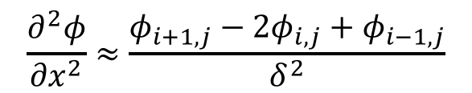
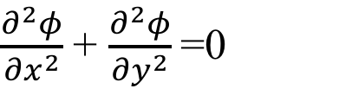
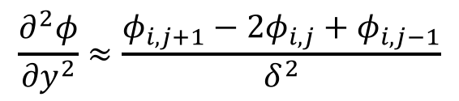
Numerical Solution
The 2D Laplace equation is:
$\frac{∂^{2}φ}{{∂x}^{2}}$ + $\frac{∂^{2}φ}{{∂y}^{2}}$=0
Assume equal spacing, 𝛿, in x and y points:
$$\frac{∂^{2}φ}{{∂x}^{2}}≈\frac{φ_{i+1,j}−2φ_{i,j}+φ_{i−1,j}}{δ^{2}}$$
and
$$\frac{∂^{2}φ}{{∂y}^{2}}≈\frac{φ_{i,j+1}−2φ_{i,j}+φ_{i,j−1}}{δ^{2}}$$
Substituting into Laplace equation and re-arranging gives:
$φ_{i,j}$ = $\frac{1}{4}$ $\left(φ_{i+1,j}+φ_{i−1,j}+φ_{i,j+1}+φ_{i,j−1}\right)$
𝜙_{i,j} is the value of 𝜙 at position (x_{i} ,y_{j})

Slide 40
Data Distribution
Give each process a 2D block of points.
Each process should have approximately the same number of points to ensure good load balance.
Use a MPI's topology routines to map each block of points to a process.

Slide 41
Data Distribution 2
0
1
2
3
0
1
2
3

Slide 42
Communication Requirements
The update formula replaces the solution at a point by the average of the 4 neighbouring points from the previous iteration.
Points lying along the boundary of a process need data from neighbouring processes.
Each process needs to communicate the points lying along its boundary before performing an update.

Slide 43
Communication Requirements 2
To update a red point we need to know the values of the points in the shaded region.
For points on the edge this requires communication

Slide 44
Outline of Parallel Code
Initialise data distribution
Find position of each process to determine which block of points it handles.
Find out the node numbers of processes in the left, right, up, and down directions.
Initialise arrays
Determine how many points each process handles.
Set the phi and mask arrays.
Perform update
Copy phi array to oldphi array.
Communicate boundary points.
Do update locally.
Output results

Slide 45
Array Declarations
Each process needs to be able to store the boundary values received from its neighbours.
These are stored in rows 0 and nlocaly+1 and in columns 0 and nlocalx+1 of the phi array.
(5,0)
(5,1)
(5,2)
(5,3)
(5,4)
(5,5)
(4,0)
(4,1)
(4,2)
(4,3)
(4,4)
(4,5)
nlocalx = 4
nlocaly = 4
(3,0)
(3,1)
(3,2)
(3,3)
(3,4)
(3,5)
(2,0)
(2,1)
(2,2)
(2,3)
(2,4)
(2,5)
(1,0)
(1,1)
(1,2)
(1,3)
(1,4)
(1,5)
(0,0)
(0,1)
(0,2)
(0,3)
(0,4)
(0,5)

Slide 46
Array Initialisation
There are 3 arrays:
phi : the current values of the solution
oldphi : the values of the solution for the previous iteration.
mask : equals false on boundaries and true elsewhere.
0 0 0 0 0 0 0 0
F F F F F F F F
0 0 0 0 0 0 0 0
F T T T T T T F
0 0 0 0 0 0 0 0
F T T T T T T F
0 0 0 1 1 0 0 0
F T T F F T T F
0 0 0 1 1 0 0 0
F T T F F T T F
0 0 0 0 0 0 0 0
F T T T T T T F
0 0 0 0 0 0 0 0
F T T T T T T F
0 0 0 0 0 0 0 0
F F F F F F F F
phi
mask

Slide 47
Outline MPI Code
#include <stdio.h>
#include <stdlib.h>
#include <math.h>
#include <mpi.h>
int main (int argc, char *argv[]) {
MPI_Init (&argc, &argv);
MPI_Finalize();
}
}
Code for initialising data distribution goes here
Code for initialising arrays goes here
Code for update loop goes here
Code for output phase goes here

Slide 48
Initialising the Data Distribution
int rank, nprocs, mypos;
int nprocx, nprocy, periods[2], dims[2], coords[2], reorder=1;
MPI_Comm new_comm;
MPI_Comm_size (MPI_COMM_WORLD, &nprocs);
MPI_Comm_rank (MPI_COMM_WORLD, &rank);
dims[0] = dims[1] = 0;
MPI_Dims_create (nprocs, 2, dims);
nprocy = dims[0];
nprocx = dims[1];
periods[0] = periods[1] = 0;
MPI_Cart_create (MPI_COMM_WORLD, 2, dims, periods, 1,&new_comm);
MPI_Cart_coords (new_comm, rank, 2, coords);
myposy = coords[0];
myposx = coords[1];
MPI_Cart_shift (new_comm, 0, 1, &down, &up);
MPI_Cart_shift (new_comm, 1, 1, &left, &right);

Slide 49
Initialising the Data Distribution 2
dims[0] and dims[1] are the number of processes in the process grid in each direction. We make the grid as square as possible using MPI_Dims_create().
This time we set up a 2D communicator, new_comm.
The MPI_Cart_coords() method gives the position in the topology of each process.
Calls to MPI_Cart_shift() give the ranks of the neighbouring processes in the four directions.

Slide 50
Allocating the Arrays
int nptsx = 200, nptsy = 200, nsizex, nsizey, bufsize, k;
double *sbuf, *rbuf;
double **phi, **old_phi;
int **mask;
nsizex = (nptsx-1)/nprocx + 1;
nsizey = (nptsy-1)/nprocy + 1;
bufsize = (nsizex>nsizey) ? nsizex : nsizey;
sbuf = (double *)malloc((sizeof(double)*bufsize));
rbuf = (double *)malloc((sizeof(double)*bufsize));
phi = (double **)malloc((sizeof(double*)*(nsizey+2)));
oldphi = (double **)malloc((sizeof(double*)*(nsizey+2)));
mask = (int **)malloc((sizeof(int*)*(nsizey+2)));
for (k=0;k<nsizey+2;k++){
phi[k] = (double *)malloc(sizeof(double)*(nsizex+2));
oldphi[k] = (double *)malloc(sizeof(double)*(nsizex+2));
mask[k] = (int *)malloc(sizeof(int)*(nsizex+2));
}

Slide 51
Initialising phi and mask Arrays
Set all of phi to 0, and all of mask to true.
For processes in row 0 of the process mesh we must set row 1 of the mask array to false.
For processes in the last row of the process mesh we must set row nlocaly of the mask array to false.
For processes in column 0 of the process mesh we must set column 1 of the mask array to false.
For processes in the last column of the process mesh we must set column nlocalx of the mask array to false.
For the 4 points in the centre we must set the phi and mask entries to 1 and false, respectively, in the processes containing them.

Slide 52
Initialisation of Arrays
int i, j, nlocalx, nlocaly;
nlocalx = (myposx==nprocx-1) ? nptsx-nsizex*(nprocx-1) : nsizex;
nlocaly = (myposy==nprocy-1) ? nptsy-nsizey*(nprocy-1) : nsizey;
for(j=0;j<=nlocaly+1;j++)
for(i=0;i<=nlocalx+1;i++){
phi[j][i] = 0.0;
mask[j][i] = 1;
}
if (myposy == 0)
for(i=0;i<=nlocalx+1;i++) mask[1][i] = 0;
if (myposy == nprocy-1)
for(i=0;i<=nlocalx+1;i++) mask[nlocaly][i] = 0;
if (myposx == 0)
for(j=0;j<=nlocaly+1;j++) mask[j][1] = 0;
if (myposx == nprocx-1)
for(j=0;j<=nlocaly+1;j++) mask[j][nlocalx] = 0;

Slide 53
Initialisation of Arrays 2
int globalx, globaly;
for(j=1;j<=nlocaly;j++){
global_y = nlocaly*myposy + j - 1;
if (global_y == nptsy/2 || global_y == nptsy/2-1){
for(i=1;i<=nlocalx;i++){
global_x = nlocalx*myposx + i - 1;
if (global_x == nptsx/2 || global_x == nptsx/2-1){
mask[j][i] = 0;
phi[j][i] = 1.0;
}
}
}
}

Slide 54
Update Phase
The update phase has three main parts.
Copy phi to oldphi array.
Communicate boundary data.
Update points locally.

Slide 55
Update Phase 2
int nsteps = 500;
for(k=1;k<=nsteps;k++){
for(j=1;j<=nlocaly;j++)
for(i=1;i<=nlocalx;i++)
oldphi[j][i] = phi[j][i];;
for(j=1;j<=nlocaly;j++)
for(i=1;i<=nlocalx;i++)
if (mask[j][i]) phi[j][i] = 0.25*(oldphi[j][i-1] +
oldphi[j][i+1] + oldphi[j-1][i] + oldphi[j+1][i]);
}
Shift up
Shift down
Shift right
Shift left

Slide 56
Communication
Communication takes place by shifting data in each of the four directions (left, right, up, and down).
Before communicating in any direction we must explicitly buffer the data to be sent, and unpack it when it is received.

Slide 57
Shift Up
MPI_Status status;
MPI_Sendrecv (&oldphi[nlocaly][1],nlocalx,MPI_DOUBLE, up,tag,
&oldphi[0][1], nlocalx, MPI_DOUBLE,down, tag,
new_comm, &status);

Slide 58
Shift Down
MPI_Sendrecv (&oldphi[1][1], nlocalx, MPI_DOUBLE, down, tag,
&oldphi[nlocaly+1][1], nlocalx, MPI_DOUBLE, up, tag,
new_comm, &status);

Slide 59
Shift Right
for(i=1;i<=nlocaly;i++) sbuf[i-1] = oldphi[i][nlocalx];
MPI_Sendrecv (sbuf, nlocaly, MPI_DOUBLE, right, tag,
rbuf, nlocaly, MPI_DOUBLE, left, tag,
new_comm, &status);
for(i=1;i<=nlocaly;i++) oldphi[i][0] = rbuf[i-1];

Slide 60
Shift Left
for(i=1;i<=nlocaly;i++) sbuf[i-1] = oldphi[i][1];
MPI_Sendrecv (sbuf, nlocaly, MPI_DOUBLE, left, tag,
rbuf, nlocaly, MPI_DOUBLE, right,tag,
new_comm, &status);
for(i=1;i<=nlocaly;i++) oldphi[i][nlocalx+1] = rbuf[i-1];

Slide 61
Performance Analysis
The update formula requires 4 floating-point operations per grid point.
The number of grid points per processor shifted in the left/right direction is n/P, where n x n is the size of the grid and P is the number of processors in one column of the processor mesh.
The number of grid points per processor shifted in the up/down direction is n/Q, where Q is the number of processors in one row of the processor mesh.

Slide 62
Speed Up
The speed-up is:
4n²t_{calc}
S(N) =
(4n²/N)t_{calc} + (2n/Q)t_{shift} + (2n/P)t_{shift}
N
=
1 + (P+Q) τ/(2n)
N
=
1 + (Q/n)(1+α)τ/2
where M=n x n is the size of the grid, P x Q is the processor mesh, P=αQ, and τ=t_{shift}/t_{calc}.

Slide 63
Efficiency and Overhead
Since N=PQ=αQ² and M=n² is the number of points, the efficiency is given by:
1
ε (N) =
1 + (1+α)/(2√α)(τ/√g)
where g = M/N is the grain size.
Since the efficiency depends only on g, and not independently on n and N, the algorithm is perfectly scalable.

Slide 64

Visualizing the Output

Slide 65
CUDA
“Compute Unified Device Architecture” introduced by NVidia in 2007.
General purpose programming model
User kicks off batches of threads on the GPU
GPU = dedicated super-threaded, massively data parallel co-processor
Targeted software stack
Compute oriented drivers, language, and tools
Driver for loading computation programs into GPU
Standalone Driver - Optimized for computation
Interface designed for compute – graphics-free API
Guaranteed maximum download & readback speeds
Explicit GPU memory management

Slide 66
Useful CUDA Resources
Textbook: “Programming Massively Parallel Processors,” David B. Kirk and Wen-mei W. Hwu, third edition, pub. Morgan Kaufmann, 2016. ISBN 978-0-12-811986-0. https://www.elsevier.com/books/programming-massively-parallel-processors/kirk/978-0-12-811986-0
NVidia CUDA Programming Guide, available at http://docs.nvidia.com/cuda/cuda-c-programming-guide/index.html - this is for v9.0.

Slide 67
Can You Run CUDA?
If you have a laptop with an Nvidia GPU, then you may be able to run CUDA on it.
Find out what GPU your Laptop has and then check if it supports CUDA at:
https://developer.nvidia.com/cuda-gpus
If you can run CUDA then you can download it from:
https://developer.nvidia.com/cuda-toolkit

Slide 69
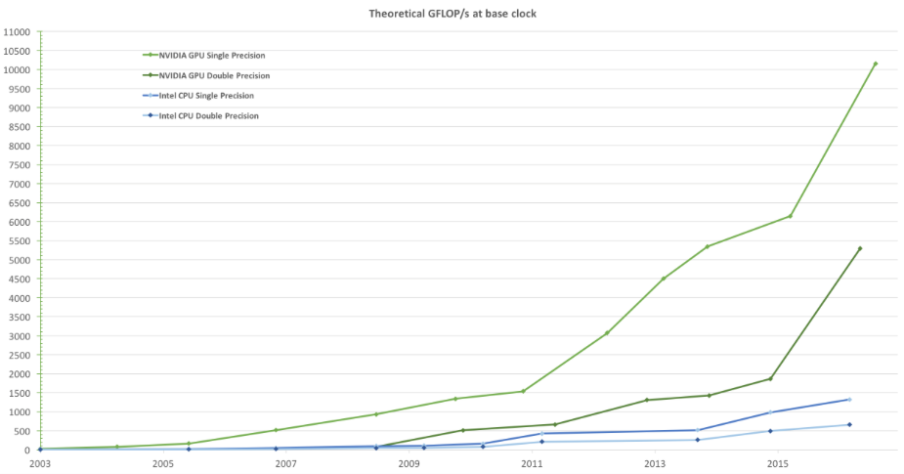
Why Massively Parallel Processing
A quiet revolution and potential build-up
Calculation: 1 TFLOPS vs. 32 GFLOPS
Memory Bandwidth: 100 GB/s vs. 8.4 GB/s
GPU in every PC and workstation – massive volume and potential impact

Slide 70
CPUs and GPUs have fundamentally different design philosophies
Control
ALU
ALU
ALU
ALU
Cache
DRAM
DRAM
CPU
GPU

Slide 71
Architecture of a CUDA-capable GPU
Host
Streaming multiprocessor containing 8 streaming processors
Input Assembler
Thread Execution Manager
Cache
Cache
Cache
Cache
Cache
Cache
Cache
Cache
Texture
Texture
Texture
Texture
Texture
Texture
Texture
Texture
Texture
Load/store
Load/store
Load/store
Load/store
Load/store
Load/store
Global Memory

Slide 72
Structure of a CUDA Program
CUDA programs involve coordination between a host (CPU) and one or more devices (GPUs).
A CUDA source file may consist of both host and device code.
Can add device functions and data declarations to any traditional C code.

Slide 73
Structure of a CUDA Program
CUDA source files have .cu suffix.
Device code is marked with CUDA keywords for labelling data-parallel functions called kernels.
Source file is compiled with nvcc compiler which gives standard host executable and device code in PTX format.
PTX is a low-level parallel thread execution virtual machine and instruction set architecture.

Slide 74
Integrated C programs with CUDA extensions
NVCC Compiler
Host code
Device code (PTX)
Host C preprocessor, compiler/linker
Device just-in-time compiler
Heterogeneous computing platform with CPUs, GPUs

Slide 75
Execution of a CUDA Program
Serial Code (host)‏
Parallel Kernel (device)‏
KernelA<<< nBlk, nTid >>>(args);
. . .
Serial Code (host)‏
Parallel Kernel (device)‏
KernelB<<< nBlk, nTid >>>(args);
. . .
Host launches KernelA and then KernelB on the GPU.
All the threads generated by a kernel launch are collectively called a grid.

Slide 76
Thread Generation
Launching a kernel typically launches a large number of threads to exploit data parallelism.
Can assume that these threads take very few clock cycles to generate and schedule due to efficient hardware support.
This contrasts with traditional CPU threads that typically take thousands of clock cycles to generate and schedule.

Slide 77
Lab Equipment
We shall use the Linux lab machines in C/2.08.
Most of these have one NVidia GeForce RTX 2700 GPU with 2 GB of memory.
Using CUDA 10.0
Compile with nvcc:
nvcc –o code code.cu

Slide 78
Device Properties
CUDA library provides routines for finding out the number of GPUs in a system, and their properties.
cudaGetDeviceCount(int *dev_count);
cudaGetDeviceProperties(cudaDeviceProp *dev_prop, int n)
cudaGetDeviceProperties populates a C struct with properties of the GPU.
cudaSetDevice(n) selects GPU n for use.

Slide 79
query.cu
#include <cuda.h>
#include <stdio.h>
int main (int argc, char **argv){
int ndev, maxtpb;
cudaGetDeviceCount(&ndev);
printf("Number of GPUs = %4d\n",ndev);
for(int i=0;i<ndev;i++){
cudaDeviceProp deviceProps;
cudaGetDeviceProperties(&deviceProps, i);
maxtpb = deviceProps.maxThreadsPerBlock;
printf("GPU device %4d:\n\tName: %s:\n", i,deviceProps.name);
printf("\tCompute capabilities: SM %d.%d\n",
deviceProps.major, deviceProps.minor);
printf("\tMaximum number of threads per block: %4d\n”,maxtpb);
printf("\tMaximum number of threads per SM: %4d\n",
deviceProps.maxThreadsPerMultiProcessor);
printf("\tNumber of streaming multiprocessors: %4d\n",
deviceProps.multiProcessorCount);
printf("\tClock rate: %d KHz\n",deviceProps.clockRate);
printf("\tGlobal memory: %lu bytes\n",
deviceProps.totalGlobalMem);
}
cudaSetDevice(0);
}

Slide 80
Output on labx03
Number of GPUs = 1
GPU device 0:
Name: GeForce GTX 2700:
Compute capabilities: SM 7.5
Maximum number of threads per block: 1024
Maximum number of threads per SM: 1024
Number of streaming multiprocessors: 36
Clock rate: 1620000 KHz
Global memory: 8335327232 bytes
Can also get GPU information using nvidia-smi at command line

