Slide 1
Day 1: High Performance Computing CMT106
David W. Walker
Professor of High Performance Computing
Cardiff University
http://www.cardiff.ac.uk/people/view/118172-walker-david

Slide 2
Module Outline
Seven all-day sessions held in S/1.29 from 9:30am to 5:00pm (apart from labs in C/2.08):
Week 5: Tuesday, 29 October 2019
Week 6: Tuesday, 5 November 2019
Week 7: Tuesday, 12 November 2019
Week 8: Tuesday, 19 November 2019
Week 9: Tuesday, 26 November 2019
Week 10: Tuesday, 3 December 2019
Week 11: Tuesday, 10 December 2019
Sessions will be mix of lectures, informal labs, and discussion of papers and articles.

Slide 3
Assessment
Exam (2 hours) = 70%
2 pieces of coursework each worth 15%:
Must do OpenMP coursework, and either MPI or CUDA coursework.
Coursework set in weeks 6 (OpenMP), 8 (MPI), and 9 (CUDA)
Coursework due at 9:30am on Friday of week 11
Module description is at
http://handbooks.data.cardiff.ac.uk/module/CMT106.html

Slide 4
Day 1
9:00-approx. 11:00: lecture on introduction to C
11:00-12:50: lecture on introduction to parallelism; motivation; types of parallelism; Flynn’s taxonomy; shared and distributed memory
Afternoon: self-study:
find 3 interesting/important things about the Top500 list
read “Back to thin-core massively parallel processors”

Slide 5
Topics Covered on Days 2-4
Day 2: Programming with OpenMP; interconnection networks; network metrics; classification of parallel algorithms; speedup and efficiency.
Day 3: Scalable algorithms; Amdahl's law; sending and receiving messages; programming with MPI; collective communication.
Day 4: Integration example; regular computations and another simple example.

Slide 6
Topics Covered on Days 5-7
Day 5: Programming GPUs with CUDA; regular two-dimensional problems and an example.
Day 6: Dynamic communication and the molecular dynamics example; irregular computations; the WaTor simulation .
Day 7: Load balancing strategies; message passing libraries; block-cyclic data distribution.

Slide 7
Books
“Introduction to Parallel Programming,” Peter Pacheco, published by Morgan Kaufmann, 2011.
http://store.elsevier.com/product.jsp?isbn=9780123742605
“Using MPI,” Gropp, Lusk, and Skjellum, published by MIT Press, 1994.
“Programming Massively Parallel Processors,” David B. Kirk and Wen-mei W. Hwu, third edition, pub. Morgan Kaufmann, 2016. ISBN 978-0-12-811986-0. https://www.elsevier.com/books/programming-massively-parallel-processors/kirk/978-0-12-811986-0
“Parallel Programming,” B. Wilkinson and M. Allen, published by Prentice Hall, 1999. ISBN 0-13-671710-1.
“Solving Problems on Concurrent Processors, Volume 1,” Fox, Johnson, Lyzenga, Otto, Salmon, and Walker, published by Prentice-Hall, 1988.

Slide 8
Web Sites
For the module: http://learningcentral.cf.ac.uk.
For MPI: http://www.mcs.anl.gov/mpi/
For OpenMP: https://computing.llnl.gov/tutorials/openMP/
For information on the World’s fastest supercomputers: http://www.top500.org/

Slide 9
What is Parallelism?
Parallelism refers to the simultaneous occurrence of events on a computer.
An event typically means one of the following:
An arithmetical operation
A logical operation
Accessing memory
Performing input or output (I/O)

Slide 10
Types of Parallelism 1
Parallelism can be examined at several levels.
Job level: several independent jobs simultaneously run on the same computer system.
Program level: several tasks are performed simultaneously to solve a single common problem.

Slide 11
Types of Parallelism 2
Instruction level: the processing of an instruction, such as adding two numbers, can be divided into sub-instructions. If several similar instructions are to be performed their sub-instructions may be overlapped using a technique called pipelining.
Bit level: when the bits in a word are handled one after the other this is called a bit-serial operation. If the bits are acted on in parallel the operation is bit-parallel.
In this parallel processing course we shall be mostly concerned with parallelism at the program level.
Concurrent processing is the same as parallel processing.

Slide 12
Scheduling Example
Time | Jobs running | Utilisation
1 | S, M | 75%
2 | L | 100%
3 | S, S, M | 100%
4 | L | 100%
5 | L | 100%
6 | S, M | 75%
7 | M | 50%
Average utilisation is 85.7%
Time to complete all jobs is 7 time units.

Slide 13
A Better Schedule
A better schedule would allow jobs to be taken out of order to give higher utilisation.
S M L S S M L L S M M
Allow jobs to “float” to the front to the queue to maintain high utilisation.
Time | Jobs running | Utilisation
1 | S, M, S | 100%
2 | L | 100%
3 | S, M, S | 100%
4 | L | 100%
5 | L | 100%
6 | M, M | 100%

Slide 14
Notes on Scheduling Example
In the last example:
Average utilisation is 100%.
Time to complete all jobs is 6 time units.
Actual situation is more complex as jobs may run for differing lengths of time.
Real job scheduler must balance high utilisation with fairness (otherwise large jobs may never run).

Slide 15
Parallelism Between Job Phases
Parallelism also arises when different independent jobs running on a machine have several phases, e.g., computation, writing to a graphics buffer, I/O to disk or tape, and system calls.
Suppose a job is executing and needs to perform I/O before it can progress further. I/O is usually expensive compared with computation, so the job currently running is suspended, and another is started. The original job resumes after the I/O operation has completed.
This requires special hardware: I/O channels or extra processor for I/O.
The operating system controls how different jobs are scheduled and share resources.

Slide 16
Program Level Parallelism
This is parallelism between different parts of the same job.
Example
A robot has been programmed to look for electrical sockets when it runs low on power. When it finds one it goes over to it and plugs itself in to recharge. Three subsystems are involved in this - the vision, manipulation, and motion subsystems. Each subsystem is controlled by a different processor, and they act in parallel as the robot does different things.

Slide 17
Robot Example
Task | Vision | Manipulation | Motion
1. Looking for electrical socket | ❒ |  | ❒
2. Going to electrical socket | ❒ |  | ❒
3. Plugging into electrical socket | ❒ | ❒

Slide 18
Notes on Robot Example
The subsystems are fairly independent, with the vision subsystem guiding the others.
There may also be a central “brain” processor.
This is an example of task parallelism in which different tasks are performed concurrently to achieve a common goal.

Slide 19
Domain Decomposition
A common form of program-level parallelism arises from the division of the data to be programmed into subsets.
This division is called domain decomposition.
Parallelism that arises through domain decomposition is called data parallelism.
The data subsets are assigned to different computational processes. This is called data distribution.
Processes may be assigned to hardware processors by the program or by the runtime system. There may be more than one process on each processor.

Slide 20
Data Parallelism
 |  |  |  |  |  |  |  |  |  |  |  |  |  |  | 
 |  |  |  |  |  |  |  |  |  |  |  |  |  |  | 
 |  |  |  |  |  |  |  |  |  |  |  |  |  |  | 
 |  |  |  |  |  |  |  |  |  |  |  |  |  |  | 
 |  |  |  |  |  |  |  |  |  |  |  |  |  |  | 
 |  |  |  |  |  |  |  |  |  |  |  |  |  |  | 
 |  |  |  |  |  |  |  |  |  |  |  |  |  |  | 
 |  |  |  |  |  |  |  |  |  |  |  |  |  |  | 
 |  |  |  |  |  |  |  |  |  |  |  |  |  |  | 
 |  |  |  |  |  |  |  |  |  |  |  |  |  |  | 
 |  |  |  |  |  |  |  |  |  |  |  |  |  |  | 
 |  |  |  |  |  |  |  |  |  |  |  |  |  |  | 
 |  |  |  |  |  |  |  |  |  |  |  |  |  |  | 
 |  |  |  |  |  |  |  |  |  |  |  |  |  |  | 
 |  |  |  |  |  |  |  |  |  |  |  |  |  |  | 
 |  |  |  |  |  |  |  |  |  |  |  |  |  |  | 
Consider an image digitised as a square array of pixels which we want to process by replacing each pixel value by the average of its neighbours.
The domain of the problem is the two-dimensional pixel array.

Slide 21
Domain Decomposition
Suppose we decompose the problem into 16 subdomains
We then distribute the data by assigning each subdomain to a process.
The pixel array is a regular domain because the geometry is simple.
This is a homogeneous problem because each pixel requires the same amount of computation (almost - which pixels are different?).
 |  |  |  |  |  |  |  |  |  |  |  |  |  |  | 
 |  |  |  |  |  |  |  |  |  |  |  |  |  |  | 
 |  |  |  |  |  |  |  |  |  |  |  |  |  |  | 
 |  |  |  |  |  |  |  |  |  |  |  |  |  |  | 
 |  |  |  |  |  |  |  |  |  |  |  |  |  |  | 
 |  |  |  |  |  |  |  |  |  |  |  |  |  |  | 
 |  |  |  |  |  |  |  |  |  |  |  |  |  |  | 
 |  |  |  |  |  |  |  |  |  |  |  |  |  |  | 
 |  |  |  |  |  |  |  |  |  |  |  |  |  |  | 
 |  |  |  |  |  |  |  |  |  |  |  |  |  |  | 
 |  |  |  |  |  |  |  |  |  |  |  |  |  |  | 
 |  |  |  |  |  |  |  |  |  |  |  |  |  |  | 
 |  |  |  |  |  |  |  |  |  |  |  |  |  |  | 
 |  |  |  |  |  |  |  |  |  |  |  |  |  |  | 
 |  |  |  |  |  |  |  |  |  |  |  |  |  |  | 
 |  |  |  |  |  |  |  |  |  |  |  |  |  |  | 

Slide 22
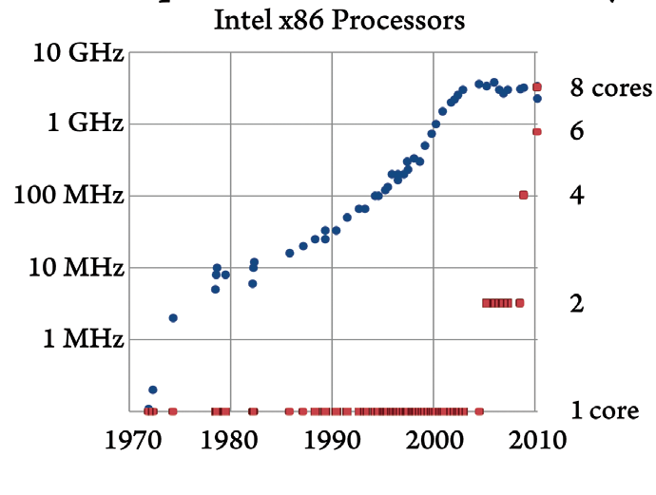
Pervasive Parallelism
Increases in clock frequency stopped in about 2003 due to power consumption and cooling problems.
Chip designers now put multiple processing cores on a single chip.
These cores can be used in parallel for a variety of tasks.
GPUs can also be used to exploit parallelism.

Slide 23
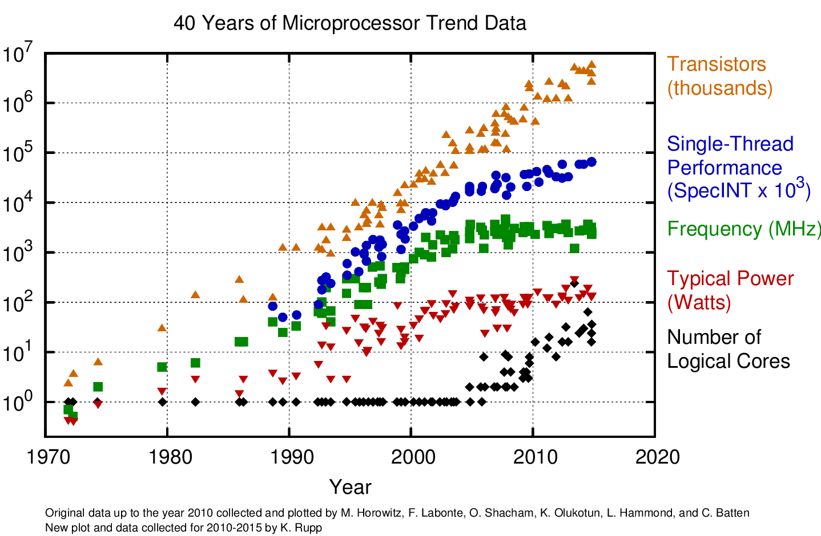
Moore’s Law

Slide 24
Why Use Parallelism?
Better utilisation of resources. Want to keep hardware busy.
Want to run programs faster by spreading work over several processors.
Measure of speed in (most) scientific problems:
Floating point operations per second. 1 Mflop/s is one million floating point operations per second.
High performance workstation ≈ 200-500 Gflop/s
GPU ≈ 1-2 Tflop/s
Current best supercomputer ≈ 122.3 Pflop/s
Mega
Mflop/s
Giga
Gflop/s
Tera
Tflop/s
Peta
Pflop/s
Exa
Eflop/s
Zetta
Zflop/s
Yotta
Yflop/s
10⁶
10⁹
10¹²
10¹⁵
10¹⁸
10²¹
10²⁴

Slide 25
Parallelism and Memory
Want more memory to solve bigger or more complex problems.
Typical PCs/workstations have 4 Gbytes of RAM, expandable to 32 Gbytes. Can fit an 65,536 × 65,536 array of doubles into 32 Gbytes of memory.
The “Summit” parallel computer at Oak Ridge National Lab in the USA has 2,414,592 cores with a total of 2.8 Pbyte of memory. Can fit a 18,708,286 × 18,708,286 array into memory. See https://www.top500.org/system/179397.

Slide 26
Parallelism and Supercomputing
Parallelism is exploited on a variety of high performance computers, in particular massively parallel processors (MPPs) and clusters.
MPPs, clusters, and high-performance vector computers are termed supercomputers.
Currently supercomputers have peak performance in the range of 10-100 Pflop/s, and memory of 1 to 2 Pbytes. They cost about 100-200 million pounds.
Supercomputers are leading to a new methodology in science called computational science joining theoretical and experimental approaches.

Slide 27
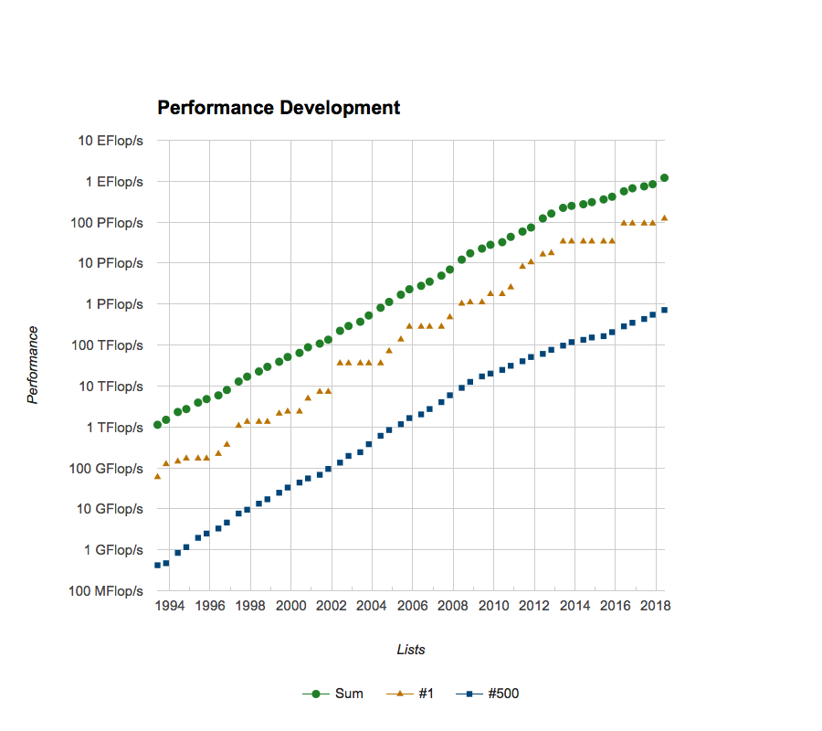
Performance Development
Peak at June 2019:
148.6 Pflop/s
2,414,592 cores
Oak Ridge National Lab, USA
Source: www.top500.org

Slide 28
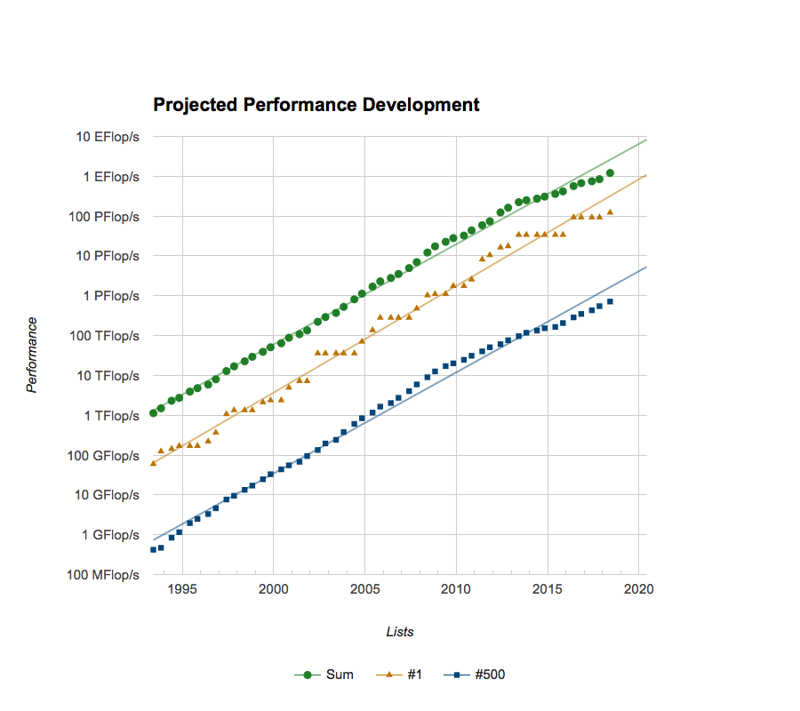
Projected Performance Development
Source: www.top500.org

Slide 29
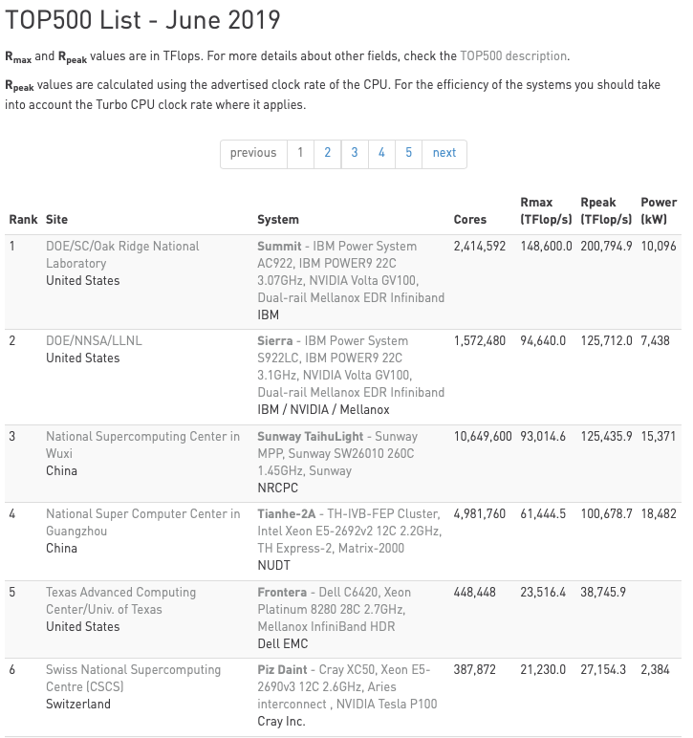

Slide 30
Top500 Data
It is interesting to use the sublist generator to look at different views of the data.
By country – how does your country feature in the list?
Who are the leading vendors of HPC systems?

Slide 31
SC14 Video about HPC
https://www.youtube.com/watch?v=zJybFF6PqEQ
Produced for the Supercomputing 2014 (SC14) conference. This is the premier HPC-related conference series. It attracts over 10000 attendees and takes place every November is the USA.

Slide 32
Video about Advanced Computing from the USA
https://astrocompute.wordpress.com/2011/08/13/why-advanced-computing-matters/
Produced by the Council on Competitiveness, a US non-governmental organization that works “to ensure US prosperity” and “address America's long-term competitiveness challenges.”
Key message:
“The country that out-computes will be the one that out-competes”.

Slide 33
Uses of Parallel Supercomputers
Weather forecasting. Currently forecasts are usually accurate up to about 5 days. This should be extended to 8 to 10 days over the next few years. Researchers would like to better model local nonlinear phenomena such as thunderstorms and tornadoes.
Climate modelling. Studies of long-range behaviour of global climate. This is relevant to investigating global warming.
Engineering. Simulation of car crashes to aid in design of cars. Design of aircraft in “numerical wind tunnels.‘”
Material science. Understanding high temperature superconductors. Simulation of semiconductor devices. Design of lightweight, strong materials for construction.
Drug design. Prediction of effectiveness of drug by simulation. Need to know configuration and properties of large molecules.

Slide 34
More Uses of Parallelism
Plasma physics. Investigation of plasma fusion devices such as tokamaks as future source of cheap energy.
Economics. Economic projections used to guide decision-making. Prediction of stock market behaviour. See http://spectrum.ieee.org/computing/it/financial-trading-at-the-speed-of-light
Defense. Tracking of multiple missiles. Event-driven battlefield simulations. Code cracking.
Astrophysics. Modeling internal structure of stars. Simulating supernova. Modeling the structure of the universe. See http://news.ucsc.edu/2011/09/bolshoi-simulation.html
Virtual worlds. Simulation and rendering.

Slide 35
Computational Astrophysics
Astrophysics. Modeling internal structure of stars. Simulating supernovae. Modeling the structure of the universe. See http://hipacc.ucsc.edu/Bolshoi/ and/or http://news.ucsc.edu/2011/09/bolshoi-simulation.html
Professor Joel R. Primack, director of the High-Performance AstroComputing Center at the University of California at Santa Cruz:
“Back in the early 1980’s pencil and paper were the tools of choice for cosmologists. Now high performance computers have become vital. They’ve helped transform cosmology from philosophical speculation into what’s almost an experimental science.”
View fly-through video of Bolshoi simulation:
http://hipacc.ucsc.edu/Bolshoi/Movies.html#bsim

Slide 36

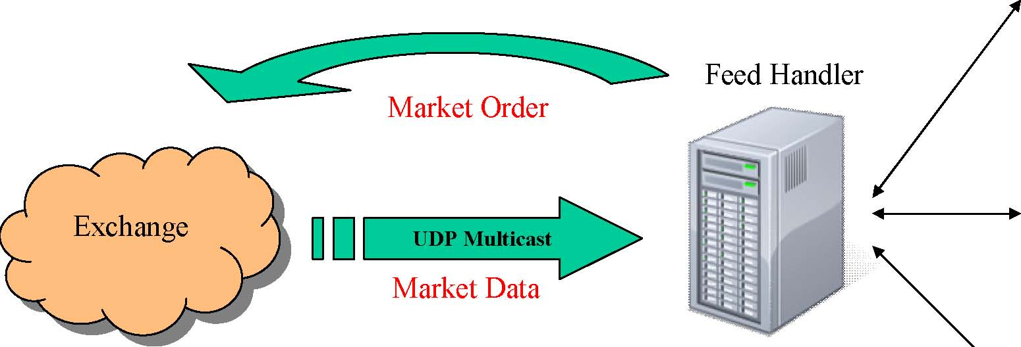

Financial Trading .
Problem: trade faster than the other guys
Metric: latency.
Solution: fast network.
Order Ack

Slide 37

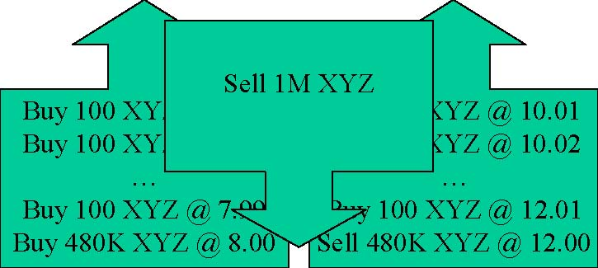

High Frequency Trading
Computers make elaborate decisions to initiate orders based on information that is received electronically, before human traders are capable of processing the information they observe
Seller
Buyer

Slide 38
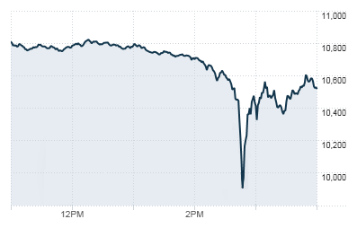
“Flash Crash” of May 2010
An automated trade execution system has been blamed for the 6 May 2010 stock market "flash crash" that affected trading worldwide.

Slide 39
Classification of Parallel Machines
To classify parallel machines we must first develop a model of computation. The approach we follow is due to Flynn (1966).
Any computer, whether sequential or parallel, operates by executing instructions on data.
a stream of instructions (the algorithm) tells the computer what to do.
a stream of data (the input) is affected by these instructions.

Slide 40
Classification of Parallel Machines
Depending on whether there is one or several of these streams we have 4 classes of computers.
Single Instruction Stream, Single Data Stream: SISD
Multiple Instruction Stream, Single Data Stream: MISD
Single Instruction Stream, Multiple Data Stream: SIMD
Multiple Instruction Stream, Multiple Data Stream: MIMD

Slide 41
SISD Computers
This is the standard sequential computer.
A single processing unit receives a single stream of instructions that operate on a single stream of data
Instruction
Data
Control
Processor
Memory
stream
stream
Example:
To compute the sum of N numbers a₁,a₂,…,a_{N} the processor needs to gain access to memory N consecutive times. Also N-1 additions are executed in sequence. Therefore the computation takes O(N) operations
Algorithms for SISD computers do not contain any process parallelism since there is only one processor.

Slide 42
MISD Computers
N processors, each with its own control unit, share a common memory.
Data
stream
Instruction
streams
Processor 1
Control 1
1
Memory
Processor 2
Control 2
2
Processor N
Control N
N

Slide 43
MISD Computers (continued)
There are N streams of instructions (algorithms/programs) and one stream of data. Parallelism is achieved by letting the processors do different things at the same time to the same data.
MISD machines are useful in computations where the same input is to be subjected to several different operations.

Slide 44
MISD Example
Checking whether a number Z is prime. A simple solution is to try all possible divisions of Z. Assume the number of processors is N=Z-2. All processors take Z as input and each tries to divide it by its associated divisor. So it is possible in one step to check if Z is prime. More realistically, if N<Z-2 then a subset of divisors is assigned to each processor.
For most applications MISD computers are very awkward to use and no commercial machines exist with this design.

Slide 45
SIMD Computers
All N identical processors operate under the control of a single instruction stream issued by a central control unit.
There are N data streams, one per processor, so different data can be used in each processor.
Shared memory or interconnection network
Data
streams
1
2
N
Processor 1
Processor 2
Processor N
Instruction stream
Control

Slide 46
Notes on SIMD Computers
The processors operate synchronously and a global clock is used to ensure lockstep operation, i.e., at each step (global clock tick) all processors execute the same instruction, each on a different datum.
Early array processors such as the ICL DAP, Connection Machine CM-200, and MasPar were SIMD computers (1980-1995).
Later companies such as ClearSpeed marketed commercial SIMD products, for example, the CSX700 released in 2008 had 192 SIMD processors.

Slide 47
Notes on SIMD Computers
SIMD machines are useful at exploiting data parallelism to solve problems having a regular structure in which the same instructions are applied to subsets of data, e.g., graphics processing.
Advanced Vector Extensions (AVX): an SIMD instruction set extension to the x86 architecture from Intel, and introduced in 2008.
Modern GPUs can be viewed as SIMD processors, resulting in the Single Instruction Multiple Threads (SIMT) execution model for GPUs.

Slide 48
SIMD Example
Problem: add two 2×2 matrices on 4 processors.
a₁₁ | a₁₂
a₂₁ | a₂₂
b₁₁ | b₁₂
b₂₁ | b₂₂
c₁₁ | c₁₂
c₂₁ | c₂₂
+
=
The same instruction is issued to all 4 processors (add two numbers), and all processors execute the instructions simultaneously. It takes one step to add the matrices, compared with 4 steps on a SISD machine.

Slide 49
Notes on SIMD Example
In this example the instruction is simple, but in general it could be more complex such as merging two lists of numbers.
The data may be simple (one number) or complex (several numbers).
Sometimes it may be necessary to have only a subset of the processors execute an instruction, i.e., only some data needs to be operated on for that instruction. This information can be encoded in the instruction itself indicating whether
the processor is active (execute the instruction)
the processor is inactive (wait for the next instruction)

Slide 50
MIMD Computers
This is the most general and most powerful of our classification. We have N processors, N streams of instructions, and N streams of data.
Shared memory or interconnection network
Data
streams
1
2
N
Processor 1
Processor 2
Processor N
Instruction streams
1
2
N
Control 1
Control 2
Control N

Slide 51
Notes on MIMD Computers
The processors can operate asynchronously, i.e., they can do different things on different data at the same time.
As with SIMD computers, communication of data or results between processors can be via shared memory or an interconnection network.

Slide 52
Notes on SIMD and MIMD
In most problems to be solved on SIMD and MIMD computers it is useful for the processors to be able to communicate with each other to exchange data or results. This can be done in two ways
by using a shared memory and shared variables, or
using an interconnection network and message passing (distributed memory)
MIMD computers with shared memory are known as multiprocessors. An example is the Onyx 300 produced by Silicon Graphics Inc.
MIMD computers with an interconnection network are known as multicomputers. An example is the E6500 produced by Sun Microsystems.
Clusters are multicomputers composed of off-the-shelf components

Slide 53
Potential of the 4 Classes
SISD
+
*
A B
MISD
A+B
+
A B
A+B
A*B
+
A B
C D
SIMD
A+B
+
*
A B
C D
MIMD
A+B
C+D
C*D

Slide 54
Single Program Multiple Data
An MIMD computer is said to be running in SPMD mode if the same program is executing on each process.
SPMD is not a hardware paradigm, so it is not included in our 4 classifications.
It is a software paradigm for MIMD machines.
Each processor executes an SPMD program on different data so it is possible that different branches are taken, leading to asynchronous parallelism. The processors no longer do the same thing (or nothing) in lockstep as they do on an SIMD machine. They execute different instructions within the same program.

Slide 55
SPMD Example
Suppose X is 0 on processor 1, and 1 on processor 2. Consider
IF X = 0
THEN S1
ELSE S2
Then processor 1 executes S1 at the same time that processor 2 executes S2.
This could not happen on an SIMD machine.

Slide 56
Interprocessor Communication
Usually a parallel program needs to have some means of sharing data and results processed by different processors. There are two main ways of doing this
Shared Memory
Message passing
Shared memory consists of a global address space. All processors can read from and write into this global address space.

Slide 57
Global Shared Memory
PROCESSOR
PROCESSOR
PROCESSOR
PROCESSOR
GLOBAL MEMORY
PROCESSOR
PROCESSOR

Slide 58
Shared Memory Conflicts
The shared memory approach is simple but can lead to problems when processors simultaneously access the same location in memory.
Example:
Suppose the shared memory initially holds a variable x with value 0. Processor 1 adds 1 to x and processor 2 adds 2 to x. What is the final value of x?
You should have met this problem before when studying locks and critical sections in the operating systems module.

Slide 59
Shared Memory Conflicts 2
Shared memory
X = 0
This is an example of non-determinism or non-determinancy
Processor 1
X = X + 1
Processor 2
X = X + 2
The following outcomes are possible
If P1 executes and completes x=x+1 before P2 reads the value of x from memory then x is 3. Similarly, if P2 executes and completes x=x+2 before P1 reads the value of x from memory then x is 3.
If P1 or P2 reads x from memory before the other has written back its result, then the final value of x depends on which finishes last.
if P1 finishes last the value of x is 1
if P2 finishes last the value of x is 2

Slide 60
Non-Determinancy
Non-determinancy is caused by race conditions.
A race condition occurs when two statements in concurrent tasks access the same memory location, at least one of which is a write, and there is no guaranteed execution ordering between accesses.
The problem of non-determinancy can be solved by synchronising the use of shared data. That is if x=x+1 and x=x+2 were mutually exclusive then the final value of x would always be 3.
Portions of a parallel program that require synchronisation to avoid non-determinancy are called critical sections.

Slide 61
Locks and Mutual Exclusion
In shared memory programs locks can be used to give mutually exclusive access.
Processor 1:
LOCK (X)
X = X + 1
UNLOCK (X)
Processor 2:
LOCK (X)
X = X + 2
UNLOCK (X)

Slide 62
Limits on Shared Memory
Shared memory computers are often implemented by incorporating a fast bus to connect processors to memory.
Shared Memory
Bus
Processor
Processor
Processor
However, because the bus has a finite bandwidth, i.e., it can carry only a certain maximum amount of data at any one time, then as the number of processors increase the contention for the bus becomes a problem. So it is feasible to build shared memory machines with up to only about 100 processors.

Slide 63
Interconnection Networks and Message Passing
In this case each processor has its own private (local) memory and there is no global, shared memory. The processors need to be connected in some way to allow them to communicate data.
Processor
+ memory
Processor
+ memory
Processor
+ memory
Interconnection
Network
Processor
+ memory
Processor
+ memory

Slide 64
The Message Passing Paradigm
Each process has its own address space.
Processes cooperate to perform a task by independently computing with their local data, and communicating data between processes by explicitly exchanging messages.

Slide 65
Message Passing
If a processor requires data contained on a different processor then it must be explicitly passed by using communication instructions, e.g., send and receive.
P1 | P2
receive (x, P2) | send (x, P1)
The value x is explicitly passed from P2 to P1. This is known as message passing.

Slide 66
Communicating Sequential Processes
CSP is a formal language used to described the interactions of concurrent processes.
Described by Prof C. A. R. Hoare (University of Oxford) in 1978.
CSP underpins the message passing paradigm.
Inspired the development of the Occam language for parallel processing.
Led to the Transputer family of processors manufactured by INMOS.

Slide 67
Basic CSP Concepts
CSP program = parallel composition of a fixed number of sequential processes communicating with each other strictly through synchronous message-passing.
Each process has an explicit name, and the source or destination of a message is defined by specifying the name of the sending or receiving process.

Slide 68
Introduction to Occam
A coordination language based on CSP.
Explicit message passing via channels
Uni-directional
Typed
Synchronous
Assembly language of the transputer.
Can check for deadlock and non-determinism.

Slide 69
The PAR Construct
In Occam parallelism is expressed through the PAR construct:
PAR
process 1
process 2
process 3
This indicates that the 3 processes may be executed in parallel.
Similarly, the SEQ construct is used to specify the sequential execution of a set of processes.

Slide 70
Simple Use of a Typed Channel
CHAN OF INT chan :
PAR
chan ! 2
INT x, z :
SEQ
chan ? x
z := x
This defines the typed channel named chan
This is a primitive process that sends the number 2 on chan
This is a compound process
Receive a value on chan and store it in x
Set z equal to x

Slide 71
Deadlock
Synchronous message passing can result in deadlock.
CHAN OF INT chan1, chan2 :
PAR
INT x :
SEQ
chan1 ! 2
chan2 ? x
INT s :
SEQ
chan2 ! 4
chan1 ? s
This defines the typed channels chan1 and chan2
This means processes defined below by SEQ run in parallel
This defines a sequential process
This means 2 is sent on channel chan1
This means value received on channel chan2 is stored in x
This defines another sequential process
Deadlock arises because Process A can’t send 2 on chan1 until process B is ready to receive it into s. Similarly for chan2.
Process A
Process B
chan1
2
s
x
4
chan2

Slide 72
Non-Deterministic Communication
This occurs if the receive on the receiving process can be matched by one of several potential send operations on other processes.
Non-deterministic communication may be used to improve parallel performance by ensuring that the receiving process is supplied with enough data to keep it busy.
However, non-determinism may be introduced into a program unintentionally, in which case it is a bug. It may cause intermittent failures.

Slide 73
The ALT Construct
In Occam non-deterministic communication is introduced using the ALT construct.
CHAN OF INT chan1, chan2, chan3 :
INT x, y :
ALT
chan1 ? x
SEQ
y := 2*x + 1
chan3 ! y
chan2 ? x
SEQ
y := 2*x
chan3 ! y
This defines the typed channels chan1, chan2 and chan3
Monitor chan1 and chan2
Waiting to receive input on chan1 into x
This only shows the code for process C
Process associated with chan1
Compute y using x received on chan1
Send y on chan3
Waiting to receive input on chan2 into x
Process associated with chan2
Compute y using x received on chan2
Send y on chan3
A
An ALT construct monitors several channels, each of which is associated with a process. Only the channel associated with the channel that first produces an input will be executed.
C
D
chan1
x
chan3
y
chan2
B

Slide 74
Occam Replicators
Occam also has IF and WHILE constructs for controlling program flow.
SEQ, PAR, ALT, and IF constructs can all be replicated. For example to get multiple similar sequential processes:
CHAN OF INT chan1 :
INT x :
VAL n IS 100 :
SEQ i = 0 FOR n-1
chan1 ? x

Slide 75
Occam Replicators
Replicated PAR creates array of similar processes – used for SPMD style parallelism.
Replicated ALT can be used to monitor array of channels and act according to which one receives input first.
Replicated IF can be used to create conditional with similar choices.

Slide 76
Main Points of Occam
Primitive input, output, and assignment processes.
Basic constructs:
SEQ for sequential processes
PAR for parallel processes
ALT for non-determinism
IF conditional construct
WHILE loop construct
Synchronous communication by typed channels
Single datatypes,
Can also handle mixed datatypes, fixed and variable length arrays,
Replicators for SEQ, PAR, ALT, and IF.

Slide 77
Hybrid Computers
In addition to the cases of shared memory and distributed memory there are possibilities for hybrid designs that incorporate features of both.
Clusters of processors are connected via a high speed bus for communication within a cluster, and communicate between clusters via an interconnection network.
Bus
Interconnection
network

Slide 78
Comparison of Shared and Distributed Memory
Distributed memory | Shared memory
Large number of processors (100’s to 1000’s, or more) | Moderate number of processor (10’s to 100)
High peak performance | Modest peak performance
Unlimited expansion | Limited expansion
Difficult to fully utilise | Relatively easy to fully utilise
Revolutionary parallel computing | Evolutionary parallel computing

Slide 79
Memory Hierarchy 1
P0
P1
Registers
Cache(s)
Faster access
More memory
Main memory
Data sharing between processes
In general, certain memory locations have a greater affinity for certain processes.
Parallel programming language may make distinction between “near” and “far” memory, but will not fully represent the memory hierarchy.

Slide 80
Typical Quad-Core Chip
Shared Memory
L2 cache
L2 cache
L1 cache
L1 cache
L1 cache
L1 cache
Instruction cache
Instruction cache
Instruction cache
Instruction cache
CPU
CPU
CPU
CPU

Slide 81
Summing m Numbers
Example: summing m numbers
On a sequential computer we have,
sum = a[0];
for (i=1;i<m;i++) {
sum = sum + a[i];
}
We would expect the running time be roughly proportional to m. We say that the running time is Θ(m).

Slide 82
Summing m Numbers in Parallel
What if we have N processors, with each calculating the m/N numbers assigned to it?
We must add these partial sums together to get the total sum.

Slide 83
Summing Using Shared Memory
The m numbers, and the global sum, are held in global shared memory.
global_sum = 0;
for (each processor){
local_sum = 0;
calculate local sum of m/N numbers
LOCK
global_sum = global_sum + local_sum;
UNLOCK
}

Slide 84
Notes on Shared Memory Algorithm
Since global_sum is a shared variable each processor must have mutually exclusive access to it – otherwise the final answer may be incorrect.
The running time (or algorithm time complexity) is
Θ(m/N)+ Θ (N)
where
m/N comes from finding the local sums in parallel
N comes from adding N numbers in sequence

Slide 85
Summing Using Distributed Memory
Suppose we have a square mesh of N processors.
The algorithm is as follows:
Each processor finds the local sum of its m/N numbers
Each processor passes its local sum to another processor in a coordinated way
The global sum is finally in processor P₁₁.
P₁₁
P₁₂
P₁₃
P₂₁
P₂₂
P₂₃
i
P₃₁
P₃₂
P₃₃
j

Slide 86
Distributed Memory Algorithm
The algorithm proceeds as follows:
Each processor finds its local sum.
Sum along rows:
If the processor is in the rightmost column it sends its local sum to the left.
If the processor is not in the rightmost or leftmost column it receives the number form the processor on its right, adds it to its local sum, and sends the result to the processor to the left.
If the processor is in the leftmost column it receives the number from the processor on its right and adds it to its local sum to give the row sum.
Leftmost column only – sum up the leftmost column:
If the processor is in the last row send the row sum to the processor above
If the processor is not in the last or first row receive the number from the processor below, add it to the row sum, and send result to processor above
If the processor is in the first row receive the number from the processor below and add it to the row sum. This is the global sum.

Slide 87
Summing Example
There are √N-1 additions and √N-1 communications in each direction, so the total time complexity is
Θ(m/N) + Θ(√N) + C
where C is the time spent communicating.
10 | 12 | 7
6 | 9 | 17
9 | 11 | 18
10 | 19
6 | 26
9 | 29
29
32
38
29
70
99
Initially
Shift left and sum
Shift left and sum
Shift up and sum
Shift up and sum

