Slide 1
Day 6:
High Performance Computing
CMT106
David W. Walker
Professor of High Performance Computing
Cardiff University
http://www.cardiff.ac.uk/people/view/118172-walker-david

Slide 2
Day 6
9:30 – 10:30am: Lecture covering dynamic communication and the molecular dynamics example (MPI).
10:30 – 10:50am: Break.
10:50am – 12:00pm: Lecture on molecular dynamics simulation with OpenMP and CUDA.
12:00 – 1:30pm: Lunch break.
1:30 – 2:00pm: Lecture, introduction to the Wator code.
2:00 – 3:00pm: Lab session, try out the Wator example code yourself and consider how to parallelize it (includes 15min break).
3:00 – 3:15pm: Review of the lab session.
3:15pm – 4:00pm: Lecture, parallel implementation of the Wator code and other cellular automata.
4:00pm – 5:00pm: Self study, do your coursework.

Slide 3
Topics Covered on Days 1-4
Day 1: Introduction to parallelism; motivation; types of parallelism; Top500 list; classification of machines; SPMD programs; memory models; shared and distributed memory; OpenMP; example of summing numbers.
Day 2: Interconnection networks; network metrics; classification of parallel algorithms; speedup and efficiency.
Day 3: Scalable algorithms; Amdahl's law; sending and receiving messages; programming with MPI; collective communication; integration example.
Day 4: Regular computations and simple examples – the wave equation and Laplace’s equation.

Slide 4
Topics Covered on Days 5-7
Day 5: Programming GPUs with CUDA; CUDA device memory architecture; simple programming examples.
Day 6: Dynamic communication and the molecular dynamics example; irregular computations; the WaTor simulation.
Day 7: Load balancing strategies; message passing libraries; block-cyclic data distribution.

Slide 5
Irregular Communication
In the wave equation and Laplace equation problems the communication is very regular. Once we set the number of processes and the size of the problem the communication requirements of the algorithm are fully determined.
We shall now consider a parallel molecular dynamics simulation. In this simulation we know that data may need to be communicated between processes at a particular point in the program, but we do not know which data it will be. In this example the communication is slightly irregular.

Slide 6
Molecular Dynamics Simulations
We have n particles in a periodic square domain.
The particles interact in a known pairwise way. Each particle exerts a force on the other particles so that
  if the particles are close enough they repel each other
  if the particles are far enough apart they are attracted to each other
  if the particles are more than some distance, r₀, apart they do not influence each other.

Slide 7
Molecular Dynamics Simulations 2
This sort of interaction is typical of many molecules.
Given initial positions and velocities for the particles, we follow the movement of the particles at a series of discrete time steps.
Usually we are interested in the macroscopic properties of such particle systems, such as temperature, energy, etc.

Slide 8
Cut-Off Distance
We could find the force on particle i by summing over all the other particles,
where f_{ij} is the force exerted by particle j on particle i. This results in an O(n²) algorithm.
We can improve the running time if we make use of the fact that the force f_{ij} is zero for particles more than distance r₀ apart.

Slide 9
Cut-Off Distance 2
If we divide the domain of the problem into cells of size r₀ x r₀ each particle only interacts with the particles in its own cell and the 8 neighbouring cells.

Slide 10
Data Structures
The particle data structure contains a particles position, velocity, and other data such as particle type, etc.
Particles can be stored in an array.
The cell data structure contains a list of the particles it contains, i.e., a list of the array index for each of its particles.
The cell data can be stored as a linked list.
There is a 2D array of cells.

Slide 11
Cell Data Structure
We can use a linked list to keep track of the particles in each cell.
0
1
2
3
4
5
6
7
8
particle array
linked list for one cell
Each cell has its own list. The starts of the lists are stored in a 2D array.
A particle can find out which cell it is in from its position.

Slide 12
Data Distribution (MPI version)
The particles are distributed to processes by assigning a rectangular block of cells to each process.
We find out the node number, location in the process mesh, and the node numbers of the neighbouring processes as in the Laplace equation problem.

Slide 13
Data Dependencies
Particles in cells along the boundary of a process need to know about particles in other processes in order to evaluate the force on them.
Each process needs particle data from 8 neighbouring processes

Slide 14
Communication Requirements
Each particle needs information about the particles in the neighbouring cells in order to determine the force on it. So we need to communicate particles lying in cells along the boundary of each process
When particles move they may travel from the set of cells owned by one process to those of another process. This is called particle migration and requires communication.

Slide 15
Array Declarations
We maintain a 2D array of linked lists – one for each cell in a process.
When we receive particle information from cells lying along the boundary of adjacent processes we store the data at the end of the particle array.
Pointers to the particles received are placed into cell lists.
localcellx = 4, localcelly = 4
(0,0)
(0,1)
(0,2)
(0,3)
(0,4)
(0,5)
particles received
2D array
of cells
(1,0)
(1,1)
(1,2)
(1,3)
(1,4)
(1,5)
particles in this process
(2,0)
(2,1)
(2,2)
(2,3)
(2,4)
(2,5)
(3,0)
(3,1)
(3,2)
(3,3)
(3,4)
(3,5)
(4,0)
(4,1)
(4,2)
(4,3)
(4,4)
(4,5)
(5,0)
(5,1)
(5,2)
(5,3)
(5,4)
(5,5)
particle array

Slide 16
Outline of Parallel Code
Initialise data distribution
  Find position of each process to determine which block of cells it handles.
  Find out the node numbers of processes in the left, right, up, and down directions.
Initialise particle arrays and cell lists
  Generate or input initial particle positions and velocities .
  Insert particles into cell lists.
Perform update
  Communicate boundary cell data.
  Do update locally.
  Communicate particles that have migrated
Output results

Slide 17
Outline MPI Code
#include <stdio.h>
#include <stdlib.h>
#include <math.h>
#include <mpi.h>
int main (int argc, char *argv[]) {
MPI_Init (&argc, &argv);
MPI_Finalize();
}
}
Code for initialising data distribution goes here
Code for initialising arrays and lists goes here
Code for update loop goes here
Code for output phase goes here

Slide 18
Initialising the Data Distribution
int rank, nprocs, mypos;
int nprocx, nprocy, periods[2], dims[2], coords[2], reorder=0;
MPI_Comm new_comm;
MPI_Comm_size (MPI_COMM_WORLD, &nprocs);
MPI_Comm_rank (MPI_COMM_WORLD, &rank);
dims[0] = dims[1] = 0;
MPI_Dims_create (nprocs, 2, dims);
nprocy = dims[0];
nprocx = dims[1];
periods[0] = periods[1] = 1;
MPI_Cart_create (MPI_COMM_WORLD, 2, dims, periods, 1,&new_comm);
MPI_Cart_coords (new_comm, rank, 2, coords);
myposy = coords[0];
myposx = coords[1];
MPI_Cart_shift (new_comm, 0, 1, &down, &up);
MPI_Cart_shift (new_comm, 1, 1, &left, &right);

Slide 19
Parallel Update Loop
for (each time step){
communicate particle data for boundary cells
for (each particle, p, in this process){
find out the location (i,j) of cell p is in
force[p] = 0;
for (cell (i,j) and the 8 neighbouring cells){
for (each particle q in cell){
add force of q on p to force[p]
}
}
}
for (each particle, p)
update velocity and position of p using force[p]
}
migrate particles
}

Slide 20
Communication of Boundary Cell Data
The communication is similar to that for the Laplace equation problem except
  We have to look in the cell lists to see which particles have to be sent and pack this information into a send buffer.
  The receiving process does not know beforehand how many particles it is going to receive.
  We have to communicate between diagonally adjacent processes.

Slide 21
Communicating Corner Data
We need to communicate particles in corner cells to diagonally adjacent processes. This can be done be done in 4 shift operations.
Initial state for 2x2
mesh of processes
A
a
a
a
A
B
b
b
b
B
a
a
b
b
a
a
b
b
a
a
b
b
A
a
a
a
A
B
b
b
b
B
C
c
c
c
C
D
d
d
d
D
c
c
d
d
c
c
d
d
c
c
d
d
C
c
c
c
C
D
d
d
d
D

Slide 22
Left Shift
A
a
a
a
A
B
B
b
b
b
B
A
a
a
b
b
b
a
a
a
b
b
b
a
a
a
b
b
b
a
A
a
a
a
A
B
B
b
b
b
B
A
C
c
c
c
C
D
D
d
d
d
D
C
c
c
d
d
d
c
c
c
d
d
d
c
c
c
d
d
d
c
C
c
c
c
C
D
D
d
d
d
D
C

Slide 23
Right Shift
B
A
a
a
a
A
B
A
B
b
b
b
B
A
b
a
a
b
a
b
b
a
b
a
a
b
a
b
b
a
b
a
a
b
a
b
b
a
B
A
a
a
a
A
B
A
B
b
b
b
B
A
D
C
c
c
c
C
D
C
D
d
d
d
D
C
d
c
c
d
c
d
d
c
d
c
c
d
c
d
d
c
d
c
c
d
c
d
d
c
D
C
c
c
c
C
D
C
D
d
d
d
D
C

Slide 24
Up Shift
B
A
a
a
a
A
B
A
B
b
b
b
B
A
b
a
a
b
a
b
b
a
b
a
a
b
a
b
b
a
b
a
a
b
a
b
b
a
B
A
a
a
a
A
B
A
B
b
b
b
B
A
D
C
c
c
c
C
D
C
D
d
d
d
D
C
D
C
c
c
c
C
D
C
D
d
d
d
D
C
d
c
c
d
c
d
d
c
d
c
c
d
c
d
d
c
d
c
c
d
c
d
d
c
D
C
c
c
c
C
D
C
D
d
d
d
D
C
B
A
a
a
a
A
B
A
B
b
b
b
B
A

Slide 25
Down Shift
D
C
c
c
c
C
D
C
D
d
d
d
D
C
B
A
a
a
a
A
B
A
B
b
b
b
B
A
b
a
a
b
a
b
b
a
b
a
a
b
a
b
b
a
b
a
a
b
a
b
b
a
B
A
a
a
a
A
B
A
B
b
b
b
B
A
D
C
c
c
c
C
D
C
D
d
d
d
D
C
B
A
a
a
a
A
B
A
B
b
b
b
B
A
D
C
c
c
c
C
D
C
D
d
d
d
D
C
d
c
c
d
c
d
d
c
d
c
c
d
c
d
d
c
d
c
c
d
c
d
d
c
D
C
c
c
c
C
D
C
D
d
d
d
D
C
B
A
a
a
a
A
B
A
B
b
b
b
B
A

Slide 26
Pseudocode for Left Shift
nsend = 0
for (i=1 to localcelly){
for (each particle, p, in cell (i,1))
pack position of p into sendbuf
nsend = nsend + 2;
}
}
MPI_Sendrecv (sendbuf, nsend, MPI_DOUBLE, left, tag,
recvbuf, rbufsize, MPI_DOUBLE, right, tag,
new_comm, &status);
MPI_Get_count (status, MPI_DOUBLE, &nrecv);
nL = nrecv/2;
for (i=1 to nL){
take next 2 numbers from recvbuf, store in x and y
set position of particle npart+i-1 to (x,y)
find out which cell (x,y) is in
add particle npart+i-1 to list for that cell
}

Slide 27
Pseudocode for Up Shift
nsend = 0
for (i=0 to localcellx+1){
for (each particle, p, in cell (1,i))
pack position of p into sendbuf
nsend = nsend + 2;
}
}
MPI_Sendrecv (sendbuf, nsend, MPI_DOUBLE, up, tag,
recvbuf, rbufsize, MPI_DOUBLE, down, tag,
new_comm, &status);
MPI_Get_count (status, MPI_DOUBLE, &nrecv);
nUp = nrecv/2;
for (i=1 to nUp){
take next 2 numbers from recvbuf, store in x and y
set position of particle npart+nL+nR+i-1 to (x,y)
find out which cell (x,y) is in
add particle npart+nL+nR+i-1 to list for that cell
}

Slide 28
Particle Migration
We assume that a particle stays in the same cell or moves to one of the 8 adjacent cells.
This may involve moving to a cell in another process.
We have to be able to handle the case where particles move to diagonally adjacent processes.

Slide 29
Pseudocode for Particle Migration 1
for (each particle, p){
update position and velocity
determine which cell p is in
if (p has moved to new cell){
delete p from list of old cell
if (p has moved to different process){
put p into appropriate communication buffer
remove p from particle array
}
else{
add p to list of new cell
}
}
}
shift left
shift right
shift up
shift down

Slide 30
Pseudocode for Particle Migration 2
After receiving particle data from another process, a process must determine if the particle belongs to it, or if it has to be passed on to another process. For left shift:
MPI_Sendrecv(leftbuf, nsendleft, MPI_DOUBLE, left, tag,
recvbuf, rbufsize, MPI_DOUBLE, right, tag,
new_comm, &status);
MPI_Get_count(status, MPI_DOUBLE, &nrecv);
for (i=1 to nrecv in steps of 4){
get next 4 numbers from recvbuf, store in x, y, vx, vy
if (particle belongs in this process){
add particle to end of particle array
find out what cell particle is in
add particle to list for that cell
}
else{
put particle in appropriate communication buffer
}
}

Slide 31
Notes on Parallel Molecular Dynamics Simulations
As in previous examples we need to exchange “boundary” data between processes.
Need to communicate with diagonally adjacent processes. This can be done with four shift operations.
We do not know beforehand how many particles will be communicated between processes in the boundary data exchange or migration steps. The receiving process determines this with MPI_Get_count().
In general each process holds a different number of particles and this changes over time. However, we don't expect load imbalance to be too bad because particles tend to be evenly distributed in space.

Slide 32
Parallel Molecular Dynamics with OpenMP
Most computational effort is in finding the force on each particle.
for (each time step){
for (each particle, p){
find out the location (i,j) of cell p is in
force[p] = 0;
for (cell (i,j) and the 8 neighbouring cells){
for (each particle q in cell){
add force of q on p to force[p]
}
}
}
for (each particle, p)
update velocity and position of p using force[p]
}
}

Slide 33
OpenMP Code (2D)
for (int k=0;k<nsteps;k++){
#pragma omp parallel default(shared) private(p,cell,row,col,i,j) num_threads(5)
{
#pragma omp for schedule(static,chunk)
for (int p=0;p<npart;p++){
cell = get_cell(pdata[p], r0);
pdata[p].fx = pdata[p].fy = 0;
col = cell.c; row = cell.r;
for (j=row-1;j<=row+1;j++)
for(i=col-1;i<=col+1;i++)
  add_force(pdata, cells[j][i], p);
}
}
for (int p=0;p<npart;p++)){
update_particle(pdata[p], dt);
}
}

Slide 34
Parallel Molecular Dynamics with CUDA (2D)
CUDA cannot dynamically allocate space in device memory, so this complicates the use of linked lists for CUDA codes.
Implement linked list with 3 arrays:
  cell[i][j] gives array index of first particle in list for cell at (i,j), or -1 if empty.
  list[k] gives array index of next particle in list after particle k, or -1 if k is last particle.

Slide 35
Processing Particles in Cell at (i,j)
p = cell[i][j];
while(p != -1){
// Process particle p
:
:
p = list[p];
}

Slide 36
Allocating the Device Arrays
float *rxd, *ryd, *vxd, *vyd, *fxd, *fyd;
int *celld, *listd;
int nsize1 = nparts*sizeof(float);
cudaMalloc((void **)&rxd, nsize1);
cudaMalloc((void **)&ryd, nsize1);
cudaMalloc((void **)&fxd, nsize1);
cudaMalloc((void **)&fyd, nsize1);
…etc….
int nsize2 = ncells*sizeof(int);
cudaMalloc((void **)&celld, nsize2);
int nsize3 = nparts*sizeof(int);
cudaMalloc((void **)&listd, nsize3);

Slide 37
Copy Arrays from Host to Device
cudaMemcpy(rxd, rx, nsize1, cudaMemcpyHostToDevice);
cudaMemcpy(ryd, ry, nsize1, cudaMemcpyHostToDevice);
cudaMemcpy(vxd, vx, nsize1, cudaMemcpyHostToDevice);
cudaMemcpy(vyd, vy, nsize1, cudaMemcpyHostToDevice);

Slide 38
Setting Up the Thread Blocks
int nthreads = 512;
int nblocks = ceil(nparts/(float)nthreads);
dim3 dimBlock(nthreads,1,1);
dim3 dimGrid(nblocks,1,1);

Slide 39
CUDA Update Loop
createLists(rx, ry, nparts, cell, list, ncellx, ncelly);
for(k=1;k<=nsteps;k++){
cudaMemcpy(celld, cell, nsize2, cudaMemcpyHostToDevice);
cudaMemcpy(listd, list, nsize3, cudaMemcpyHostToDevice);
ForceKernel<<<dimGrid, dimBlock>>>(rxd, ryd,fxd, fyd, celld, listd,
nparts, ncellx, ncelly,…input parameters…);
UpdateKernel<<<dimGrid, dimBlock>>>(rxd, ryd, vxd, vyd, fxd, fyd,…
input parameters…);
cudaMemcpy(rx, rxd, nsize1, cudaMemcpyDeviceToHost);
cudaMemcpy(ry, ryd, nsize1, cudaMemcpyDeviceToHost);
createLists(rx, ry, nparts, cell, list, ncellx, ncelly);
}

Slide 40
CUDA Force Kernel
__global__ void ForceKernel(float *rxd, float *ryd, float *fxd, float *fyd, int *headd,
int *listd, int nparts, int ncellx, int ncelly,…..)
{
int bno= blockIdx.x;
int pno = bno*blockDim.x+threadIdx.x;
float fxp = fyp = 0.0;
if (pno<nparts) {
rxp = rxd[pno]; ryp = ryd[pno];
….loop over cells and accumulate force on particle pno in fxp and fyp…,
fxd[pno] = fxp;
fyd[pno] = fyp;
}
}

Slide 41
CUDA Update Kernel
__global__ void UpdateKernel(float *rxd, float *ryd, float *vx, float *vy,
float *fx, float *fy, int nparts,…..)
{
int bno= blockIdx.y*gridDim.x+blockIdx.x;
int pno = bno*blockDim.x+threadIdx.x;
if (pno<nparts) {
rxp = rxd[pno]; ryp = ryd[pno]; vxp = vxd[pno]; vyp = vyd[pno];
fxp = fxd[pno]; fyp = fyd[pno];
….update position and velocity for particle pno based on force on it…
rxd[pno] = rxpnew; ryd[pno] = rypnew;
vxd[pno] = vxpnew; vyd[pno] = vypnew;
}
}

Slide 42
WaTor – a Dynamical System
We shall now look at a very dynamic simulation called WaTor. WaTor is a periodic 2D ocean (hence, Watery Torus) in which predators (sharks) and prey (fish) compete and survive.
The parallel implementation of WaTor has a number of interesting features:
  A very inhomogeneous and dynamic load distribution.
  The need for irregular communication.
  The possibility of conflicts between updates performed by different processes (data inconsistency).
Other advanced parallel applications share some of these features.

Slide 43
The Rules of WaTor
WaTor takes place on a periodic grid. Each grid cell either contains a fish, a shark, or is empty.
The grid is initially populated by a specified number of fish and sharks, placed at random.
The populations then evolve in a series of discrete time steps according to certain rules that govern how the fish and sharks move, breed, eat, and die.

Slide 44
Fish Rules
Moving:
In each time step, each fish notes which of the 4 neighbouring sites are empty. One of these empty sites is chosen at random and the fish moves there. If there are no empty neighbouring sites the fish stays where it is.
Breeding:
If a fish is past the fish breeding age, then when it moves it breeds, leaving a fish of age zero at its previous location. A fish cannot breed if it doesn't move.
Eating
Fish eat plankton available throughout the ocean. Fish never starve.

Slide 45
Shark Rules
Moving
In each time step, each shark notes which of the 4 neighbouring sites are occupied by fish. One of these sites is chosen at random and the shark moves there, eating the fish. If there are no neighbouring sites containing fish the shark notes which of the 4 neighbouring sites are empty and moves to one of these sites at random. If all 4 neighbouring sites are already occupied by sharks, the shark stays where it is.
Breeding
If a shark is past the shark breeding age, then when it moves it breeds, leaving a shark of age zero at its previous location. A shark cannot breed if it doesn't move.
Eating
Sharks eat only fish. If a shark does not eat for more than a certain number of time steps (known as the shark starvation age) then it dies.

Slide 46
WaTor Inputs
The inputs to the simulation are:
The size of the grid.
The initial number of sharks and fish (these are placed at random).
The shark and fish breeding ages.
The shark starvation age.

Slide 47
WaTor Data Structures
The two fundamental data structures are the 2D grid of cells and a list of sharks and fish.
Each cell in the grid is an object with an occupation status (empty, occupied by fish, or occupied by shark), and a reference to the fish or shark object it contains (if not empty).
Each shark/fish object contains its type, age, cell location, and time since it last ate (if shark).

Slide 48
Update Order
The order of updating fish and sharks is not specified in the WaTor rules.
Could update by looping over ocean cell locations. This is inefficient if a significant fraction of the ocean is empty.
Alternative approach is to process the fish/shark list. In this case only active objects are processed.
Must ensure that newly-born fish/sharks are not processed until the next time step.

Slide 49
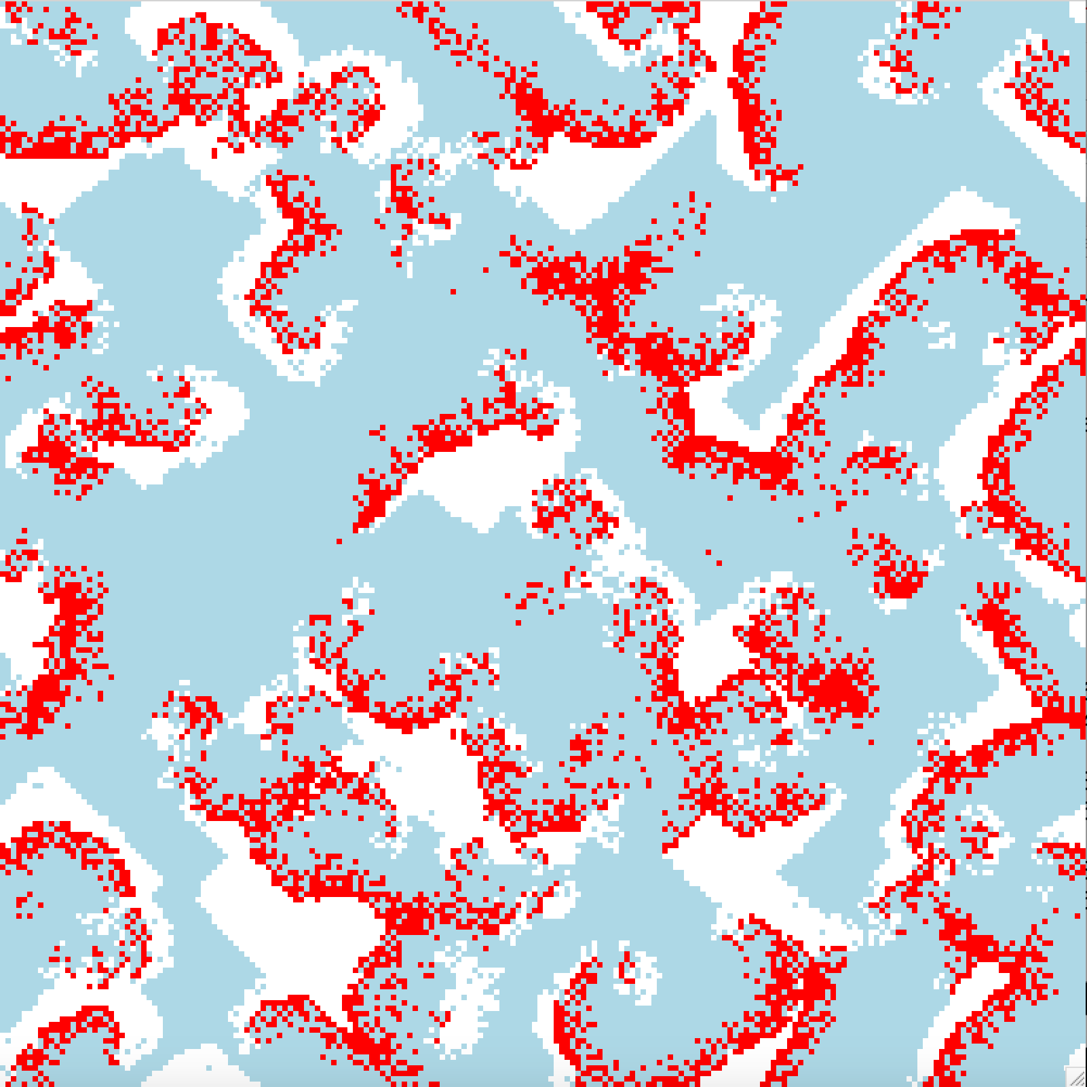
Wator 1
200x200 ocean
nfish | 3500
nshark | 10
Fish breeding age | 4
Shark breeding age | 5
Shark starvation age | 4

Slide 50
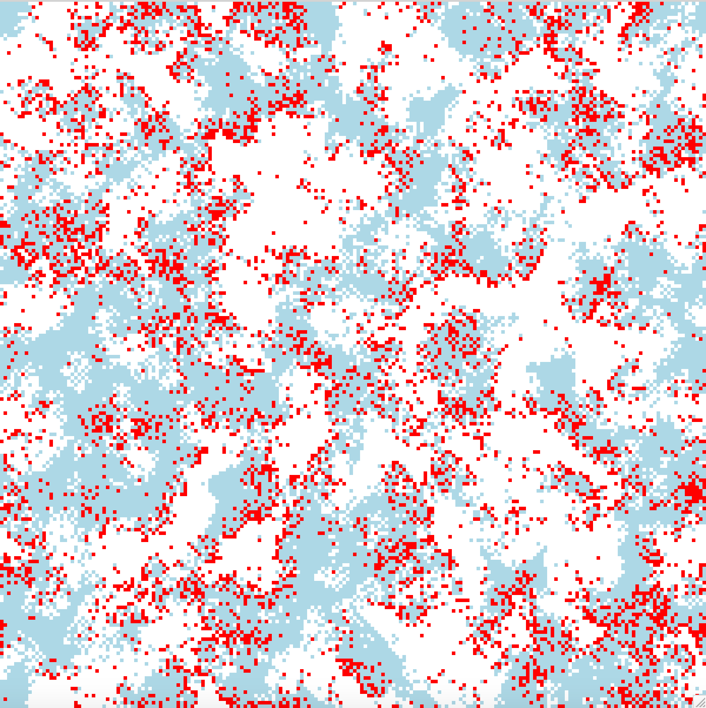
Wator 2
200x200 ocean
nfish | 3500
nshark | 10
Fish breeding age | 4
Shark breeding age | 30
Shark starvation age | 4

Slide 51
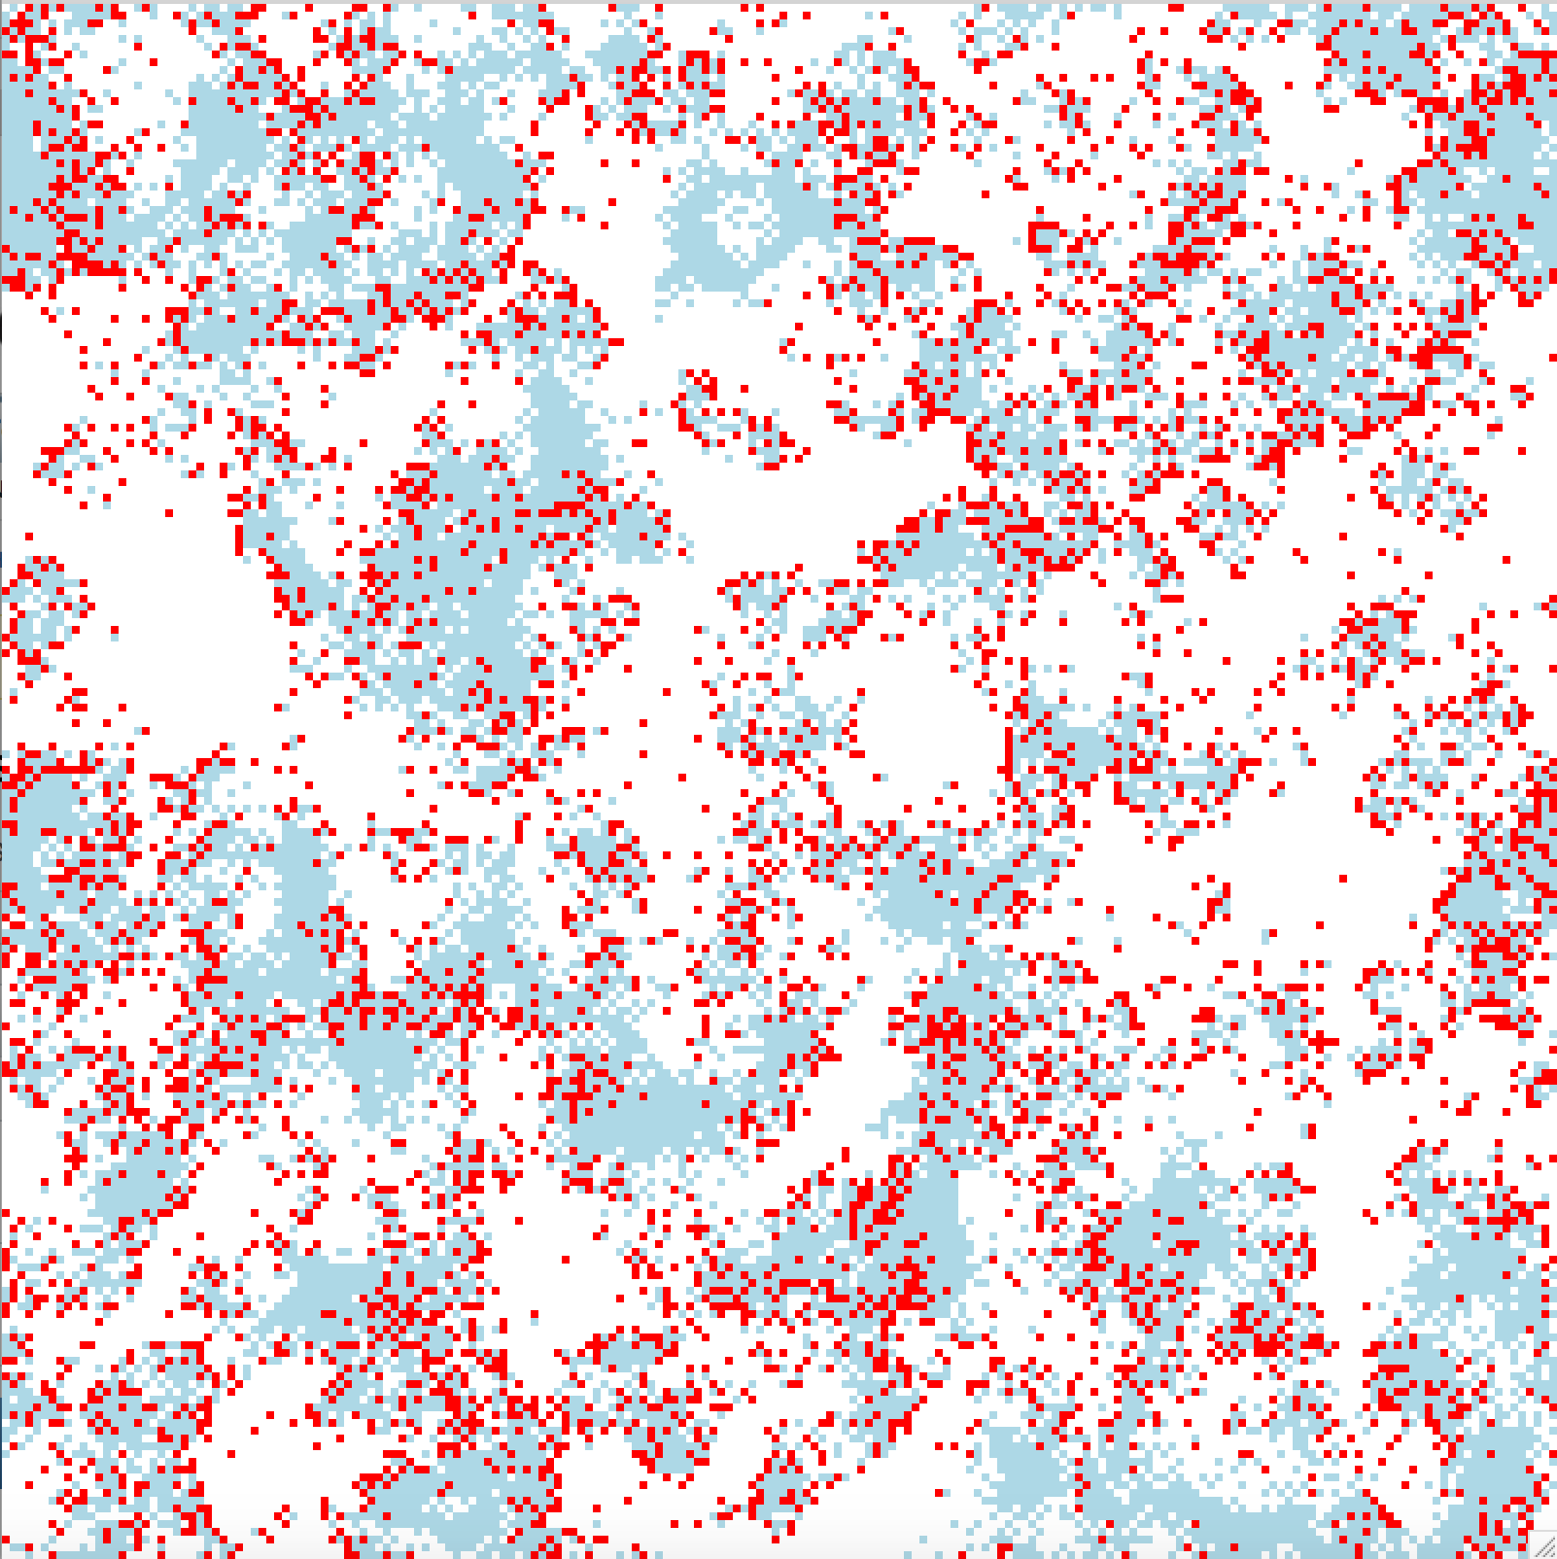
Wator 3
200x200 ocean
nfish | 3500
nshark | 10
Fish breeding age | 4
Shark breeding age | 50
Shark starvation age | 4

Slide 52
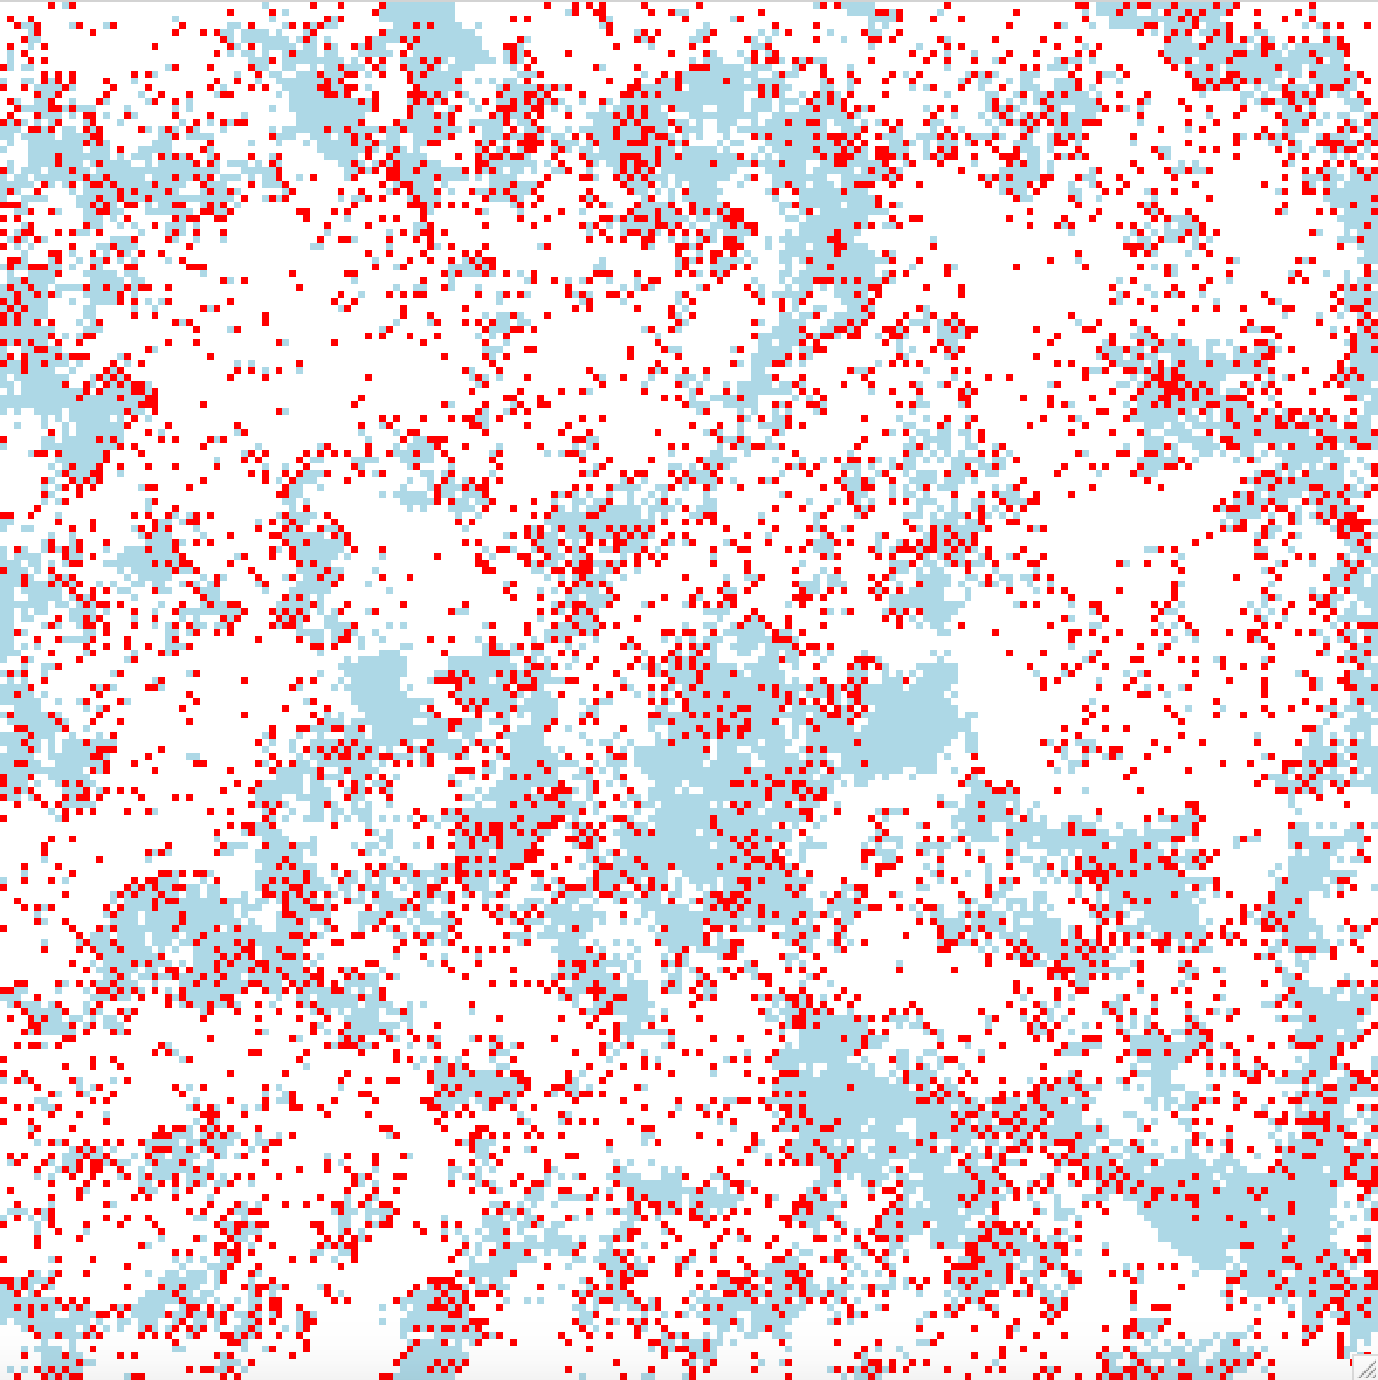
Wator 4
200x200 ocean
nfish | 3500
nshark | 10
Fish breeding age | 4
Shark breeding age | 100
Shark starvation age | 4

Slide 53
Wator 5
200x200 ocean
nfish | 3500
nshark | 10
Fish breeding age | 4
Shark breeding age | 4
Shark starvation age | 5

Slide 54
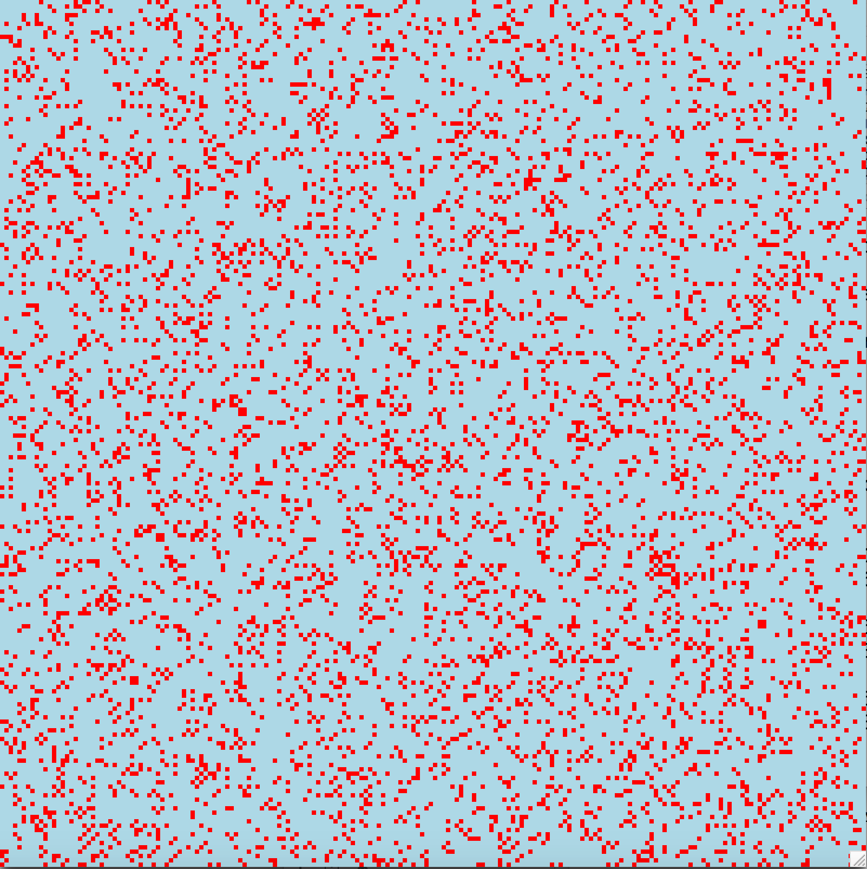
Wator 6
200x200 ocean
nfish | 3500
nshark | 10
Fish breeding age | 4
Shark breeding age | 4
Shark starvation age | 6

Slide 55
Wator 7
200x200 ocean
nfish | 3500
nshark | 10
Fish breeding age | 5
Shark breeding age | 10
Shark starvation age | 4

Slide 56
Summary of Results
SS = steady state
Input | nfish | nshark | Fish breeding age | Shark breeding age | Shark starvation age | Outcome
wator1 | 3500 | 10 | 4 | 5 | 4 | SS
wator2 | 3500 | 10 | 4 | 30 | 4 | SS
wator3 | 3500 | 10 | 4 | 50 | 4 | SS
wator4 | 3500 | 10 | 4 | 100 | 4 | SS
wator5 | 3500 | 10 | 4 | 4 | 5 | Empty
wator6 | 3500 | 10 | 4 | 4 | 6 | No fish
wator7 | 3500 | 10 | 5 | 10 | 4 | All fish

Slide 57
Outline of Sequential Code
Initialise
Initialise ocean array by placing fish and sharks at random grid locations.
Initialise fish/shark list.
Update
In each time step, we process the fish and sharks in the order in which they appear in the list.
We may also update the display, or perform some other output, in each time step.
Finalise
Output final state, statistics, etc.

Slide 58
Data Distribution
Initially we shall use a simple 2D block data distribution, just the same as in the Laplace equation problem and the molecular dynamics simulation.
Each process looks after a block of the ocean and all the fish and sharks in it.
We need to know the process number (rank), location in the process mesh, and the process numbers of the neighbouring processes.

Slide 59
Data Distribution 2
F
F
F
S
S
S
S
S
F
F
S
S
F
S
F
F
F
S
S
S
S
S
S
F
F
S
S
S
F
F
S
F
S
S
S
F
S
F
F
S
S
F
F
S
S
S
S
S
F
S
F
S
S

Slide 60
Data Dependencies
Fish and sharks lying along the boundary of a process need to know about the grid cells lying along the boundary of other processes in order to follow the WaTor rules
Each process needs data from 4 neighbouring processes.
F
S
S
F

Slide 61
Array Declarations
When we receive fishes and sharks from ocean cells lying along the boundary of adjacent processes we store them in the fish/shark list and update the local ocean cell to indicate that is is occupied.
localcellx = 4, localcelly = 4
(0,0)
(0,1)
(0,2)
(0,3)
(0,4)
(0,5)
2D array
of cells
(1,0)
(1,1)
(1,2)
(1,3)
(1,4)
(1,5)
(2,0)
(2,1)
(2,2)
(2,3)
(2,4)
(2,5)
(3,0)
(3,1)
(3,2)
(3,3)
(3,4)
(3,5)
(4,0)
(4,1)
(4,2)
(4,3)
(4,4)
(4,5)
(5,0)
(5,1)
(5,2)
(5,3)
(5,4)
(5,5)

Slide 62
Potential for Data Inconsistency
In the course of an update a fish or shark may move into a “border” grid cell. Thus, unlike in the Laplace and molecular dynamics problems, the border cells in a process may change in an update.
These changes must be communicated back to the process that originally sent that border strip, to be re-integrated into its data structures.
However, the process owning those grid cells may also have updated them, and these updates may be in conflict.

Slide 63
Example of Data Inconsistency
Here we show two adjacent processes at successive time steps.
Two sharks try to eat the same fish!
Time T
S
F
S
F
F
F
F
Time T+1
S
F
S
F
S
F
F
F
F
F
F
F
F

Slide 64
Inconsistency and Non-Determinism
On a shared memory parallel computer this type of data conflict would indicate a non-deterministic algorithm.
On a distributed memory machine using message passing the communication operations determine the update order for a memory location, so the algorithm is still deterministic – but we would still like to avoid data conflicts.

Slide 65
Rollback
One way to resolve conflicts is called rollback, and works as follows:
Return the fish or shark that crossed the process boundary back to its original process, and place it back in its original position.
If that position has been occupied by another fish or shark, then that fish or shark must be rolled back.
This rollback process continues until until every fish and shark has a place to go.

Slide 66
Rollback 2
Rollback requires us to remember the previous position of each fish and shark.
Rollback can result in complicated communication requirements if a sequence of rollbacks traverses multiple processes.
Rollback has been used in certain event-driven simulations, such as battlefields simulations.

Slide 67
Isolating Boundary Updates
We could perform updates by looping over the ocean cells instead of by processing the fish/shark list.
Then we can update all the interior (i.e., non-boundary) cells.
Next we do a left shift of the lefthand boundary fish/sharks, and update the righthand boundary (except the corners).
This is repeated to update the lefthand, upper, and lower boundaries. Then do the corners.

Slide 68
Update Order
There are 9 distinct regions that must be separately updated – 4 corners, 4 edges, and one central region.

Slide 69
Sub-Partitioning
A third way to avoid data inconsistencies is to partition the part of the ocean assigned to each process into 4 parts.
A process has a separate fish/shark list for each of these 4 sub-partitions.
Each of the 4 sub-partitions is updated in turn.
This avoids adjacent ocean cells being updated concurrently.

Slide 70
Sub-Partitioning Algorithm
Divide the ocean array of each process into 4 smaller sub-grids, labelled 1, 2, 3, and 4.
Exchange the parts of sub-grids 2 and 3 that have data along their boundaries needed to update sub-grid 1 in adjacent processes.
Update sub-grid 1 in each process.
Return boundary information to original owner and update data structures.
Repeat steps 2, 3, and 4 for each of the other sub-grids in turn.

Slide 71
Update Cycle for Sub-Partition 1
Step 1
Step 2
Step 3
1
2
1
2
Update fish and sharks in list for sub-partition 1
3
4
3
4
Right shift, down shift
Left shift, up shift

Slide 72
Communication Phases
To update sub-partition 1: shift right and down before update, then shift left and up after update.
To update sub-partition 2: shift left and down before update, then shift right and up after update.
To update sub-partition 3: shift right and up before update, then shift left and down after update.
To update sub-partition 4: shift left and up before update, then shift right and down after update.

Slide 73
Outline of Parallel Code
The update loop of the parallel version of WaTor using sub-grids is as follows:
for (each time step){
for (each sub-partition, i=1,2,3,4){
shift boundary data across 2 edges of sub-partition i
store data received in border of ocean and in
fish/shark list
update fish and sharks in sub-partition i
shift boundary data back across the 2 edges,
overwriting original data with updated data
}
}

Slide 74
Load Imbalance in WaTor
Load balance is an important consideration in WaTor and many other applications.
In WaTor the workload if generally not evenly distributed over the ocean, so distributing the data in contiguous blocks means that some processes have less work than others at certain times.
Load balance in WaTor changes with time as the fish and sharks move.

Slide 75
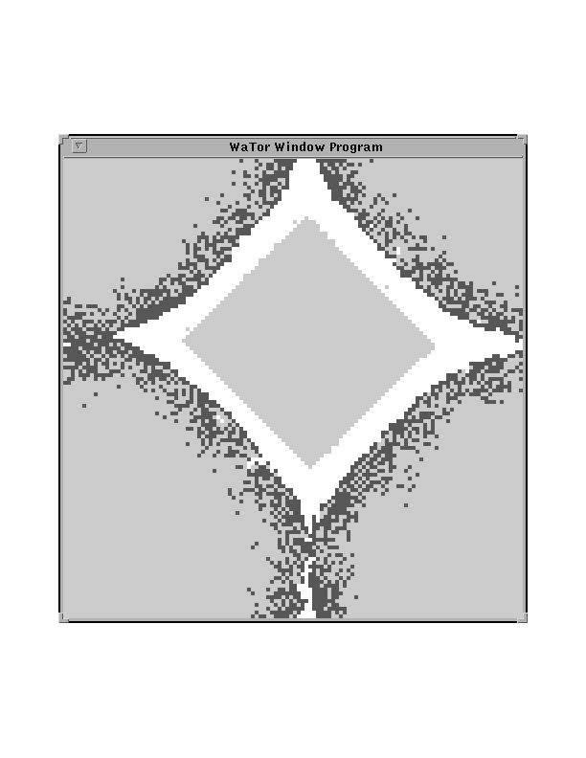
Example of WaTor Output
White = fish
Light grey = empty
Dark grey = sharks

Slide 76
Concurrent Updates in WaTor
Consider which locations cannot be update at the same time as the red location.

Slide 77
Ordering Updates in WaTor
Locations with the same number can be updated concurrently without giving rise to a race condition.
This would require 9 kernel calls in CUDA.
Can also use sub-partitioning in CUDA
1
2
3
1
2
3
1
2
3
4
5
6
4
5
6
4
5
6
7
8
9
7
8
9
7
8
9
1
2
3
1
2
3
1
2
3
4
5
6
4
5
6
4
5
6
7
8
9
7
8
9
7
8
9
1
2
3
1
2
3
1
2
3
4
5
6
4
5
6
4
5
6
7
8
9
7
8
9
7
8
9

