Slide 1
Day 7: Worksheet Questions
David W. Walker
Professor of High Performance Computing
Cardiff University
http://www.cardiff.ac.uk/people/view/118172-walker-david

Slide 2
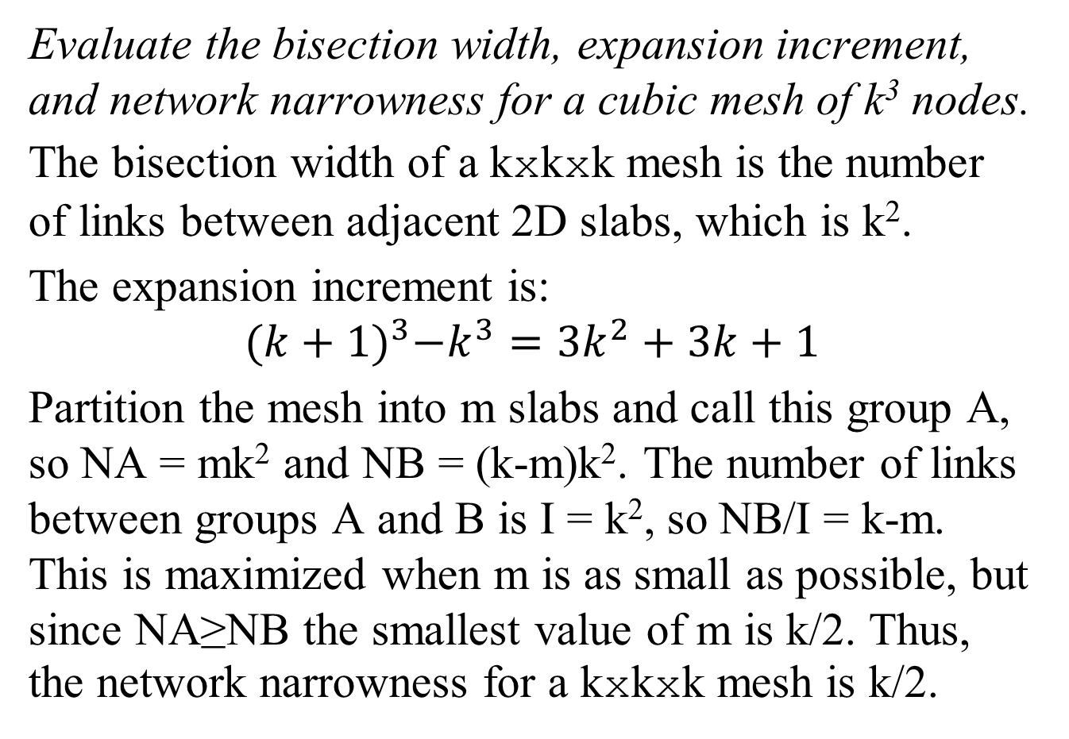
Q1: Network Metrics
Evaluate the bisection width, expansion increment, and network narrowness for a cubic mesh of k³ nodes.
The bisection width of a kxkxk mesh is the number of links between adjacent 2D slabs, which is k².
The expansion increment is:
$${(k+1)}^{3}−k^{3}={3k}^{2}+3k+1$$
Partition the mesh into m slabs and call this group A, so NA = mk² and NB = (k-m)k². The number of links between groups A and B is I = k², so NB/I = k-m. This is maximized when m is as small as possible, but since NA≥NB the smallest value of m is k/2. Thus, the network narrowness for a kxkxk mesh is k/2.

Slide 3
Q2: Non-blocking and Asynchronous Send
Explain carefully the difference between a non-blocking send and an asynchronous send in MPI.
On return from a non-blocking send it is not guaranteed that the data has “left” the calling application, so any subsequent change to the data may affect the message sent. The contents of the message buffer should not be overwritten until a subsequent MPI call has ensured that the data has “left” the calling application. An asynchronous send may return even if the matching receive operation has not started on the destination process, thus the send and receive operations may not overlap in time.

Slide 4
Q3: Application Topologies
What is meant by an application topology, and how are Cartesian mesh application topologies supported in MPI?
An application topology is the topology of the communication between processes in the application. This can be viewed as a graph in which the nodes represent the processes and the arcs between nodes represent communication. MPI provides routines for determining the process rank given a location in the mesh, and vice versa. MPI also provides a routine to find the source and destination process ranks for shift communication operations

Slide 5
Q4: Hypercube Node Numbers
In a 6-dimensional hypercube, which nodes are directly connected to node number 20?
20 as a 6-bit binary number is 010100, so node 20 is connected to nodes:
(010101)₂ = 21, (010110)₂ = 22,
(010000)₂ = 16, (011100)₂ = 28,
(000100)₂ = 4, (110100)₂ = 52.

Slide 6
Q5: Mapping Meshes to Hypercubes
A regular 4x4 mesh is mapped onto a 4-dimensional hypercube so that neighbouring nodes in the mesh are also neighbours in the hypercube. Determine the node number of the hypercube node at each location in the mesh.

Slide 7
Q5: Answer
Location | Split | Gray | Node
(0,0) | (00,00) | (00,00) | 0
(0,1) | (00,01) | (00,01) | 1
(0.2) | (00,10) | (00,11) | 3
(0,3) | (00,11) | (00,10) | 2
(1,0) | (01,00) | (01,00) | 4
(1,1) | (01,01) | (01,01) | 5
(1,2) | (01,10) | (01,11) | 7
(1,3) | (01,11) | (01,10) | 6
(2,0) | (10,00) | (11,00) | 12
(2,1) | (10,01) | (11,01) | 13
(2,2) | (10,10) | (11,11) | 15
(2,3) | (10,11) | (11,10) | 14
(3,0) | (11,00) | (10,00) | 8
(3,1) | (11,01) | (10,01) | 9
(3,2) | (11,10) | (10,11) | 11
(3,3) | (11,11) | (10,10) | 10
0 | 1 | 3 | 2
4 | 5 | 7 | 6
12 | 13 | 15 | 14
8 | 9 | 11 | 10

Slide 8
Q6: OpenMP For Loop
Consider the following piece of OpenMP code (the line numbers are not part of the code):
1 int n=12, chunk=10, i, j;
2 float x[n][n], y[n][n], xji;
3 #pragma omp parallel shared(default) private(xji,i,j) num_threads(5)
4 {
5 #pragma omp for collapse(2) schedule(static,chunk)
6 for(j=0;j<n;j++)
7 for(i=0;i<n;i++){
8 xji = x[j][i];
9 y[j][i] = xji*xji + 4.0*xji + 7.0;
10 }
11 }
Which elements of the array y will be evaluated by thread 4?
If the collapse clause is removed from line 5, which thread will evaluate y[5][10]?

Slide 9
Q6: Answer
In linearized form, chunk c is evaluated by thread 4 if c mod
5 = 4, so chunks 4, 9, and 14 (there are only 15 chunks) are
evaluated by thread 4. Chunk c starts at (10c/12; (10c)%12) and ends at ((10c + 9)/12; (10c + 9)%12) (except when the last chunk is not full). So the elements evaluated by thread 4 are:
Chunk 4: (3,4), (3,5), (3,6), (3,7), (3,8) (3,9), (3,10), (3,11), (4,0), (4,1)
Chunk 9: (7,6), (7,7), (7,8), (7,9), (7,10), (7,11), (8,0), (8,1), (8,2), (8,3)
Chunk 14: (11,8), (11,9), (11,10), (11, 11)
If the collapse clause is removed then only the outer loop
will be parallelized, so the first 10 iterations of the outer loop will be done by thread 0. Thus, y[5][10] will be evaluated by thread 0.

Slide 10
Q7a: Cyclic Data Distribution
Suppose we have a (cyclic[4],cyclic[5]) data distribution that is used to distribute a matrix, A, over a 3x4 process mesh. What is the position in the process mesh of the process holding matrix element (21,36)? Note: all indexing starts at 0.

Slide 11
Q7a: Answer
We treat each dimension independently.
First the row direction: if the block size is 4 then element 21 is in global block 21/4 = 5. If there are 3 processes per row then this block will be in process row 5mod(3) = 2.
Next the column direction: if the block size is 5
then element 36 is in global block 36/5 = 7. If there are 4 processes per column then this block will be in process column 7mod(4) = 3. Thus, the processor position is (2,3).

Slide 12
Q7b: Cyclic Data Distribution
On a distributed memory computer each process holds its part of the matrix A in a local array, L. If the same data distribution is used as in Q7a, what is the global index (m,n) of the element of the matrix A stored at location (3,3) of L in the process at location (2,3) of the processor mesh?

Slide 13
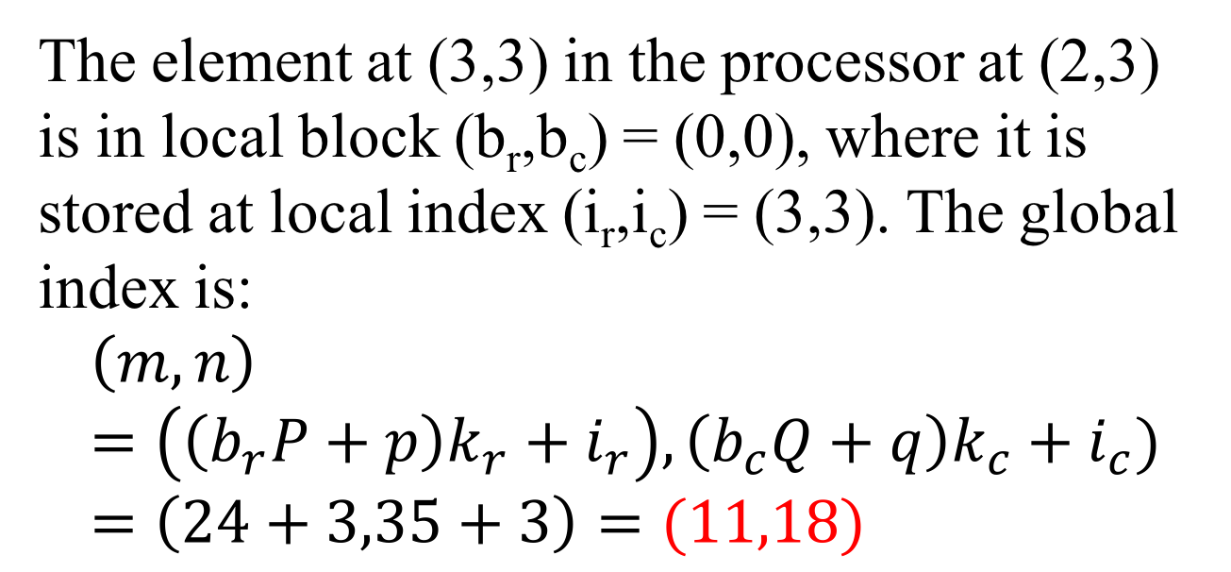
Q7b: Answer
The element at (3,3) in the processor at (2,3) is in local block (b_{r},b_{c}) = (0,0), where it is stored at local index (i_{r},i_{c}) = (3,3). The global index is:
$$\left(m,n\right)=\left(\left(b_{r}P+p\right)k_{r}+i_{r}\right), \left(b_{c}Q+q\right)k_{c}+i_{c})=\left(24+3,35+3\right)=(11,18)$$

Slide 14
Q8: Parallel Efficiency
An identical parallel application is run on two parallel computers, A and B. A and B both have the same number of processors, but the processors on A and B are of different types, with those on B having twice the serial speed as those of A. On A the parallel efficiency is 0.7, and on B it is 0.5, when running on all the
processors. What is the ratio of the parallel execution times for the application on A and B?

Slide 15
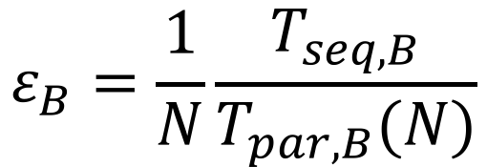
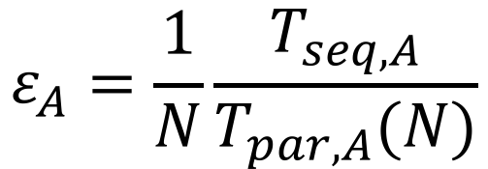
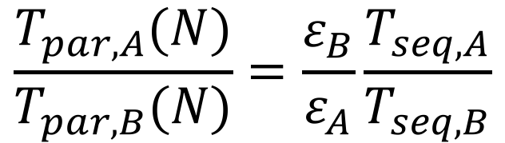
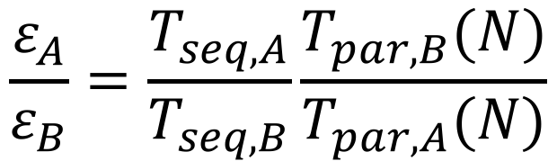
Q8: Answer
Let N be the number of processors:
$$ε_{A}=\frac{1}{N}\frac{T_{seq,A}}{T_{par,A}(N)}$$
$$ε_{B}=\frac{1}{N}\frac{T_{seq,B}}{T_{par,B}(N)}$$
and
So,
$$\frac{ε_{A}}{ε_{B}}=\frac{T_{seq,A}}{T_{seq,B}}\frac{T_{par,B}(N)}{T_{par,A}(N)}$$
$$\frac{T_{par,A}(N)}{T_{par,B}(N)}=\frac{ε_{B}}{ε_{A}}\frac{T_{seq,A}}{T_{seq,B}}$$
⇒
So the ratio of parallel execution times is (0.5/0.7)*2 = 1.4285.

Slide 16
Q9: CUDA Thread Block Sizes
Two matrices of size 8200x8200 are multiplied together to produce a third
matrix. CUDA is used to perform this operation on a GPU by using one thread to calculate each element of the output matrix. A square layout of thread blocks is used, and each thread block is 32x32.
What are the grid dimensions in blocks?
How many threads are in the grid?

Slide 17
Q9: Answers
ceil(8200/32) = 257 so the grid will be of size 257x257 blocks.
The number of threads is 257x257x32x32 = 67634176.

Slide 18
Q10: Compute To Global Memory Access Ratio
The bandwidth for global memory accesses on a GeForce GTX 960 GPU is 112GByte/s. Assuming a compute to global memory access ratio of 8.0, and that each floating-point value is of size 4 bytes, what is the maximum execution speed in Gflop/s?
For each global memory access 8 floating-point operations can be performed. 112x10⁹/4 = 28x10⁹ floats can be accessed per second, so the maximum
execution speed is 8x28x10⁹ flop/s, or 224 Gflop/s.

Slide 19
Q11: Performance Analysis
A data parallel algorithm running on N processes operates on a nxnxn mesh of points in a series of time steps. Each point requires 12 floating-point operations per time step. In addition, each time step of the parallel algorithm involves 6 data shift operations, in each of which a process communicates n² floating-point numbers. Determine the efficiency of the parallel algorithm, assuming that the best sequential algorithm is the same as the parallel algorithm running on one process.

Slide 20
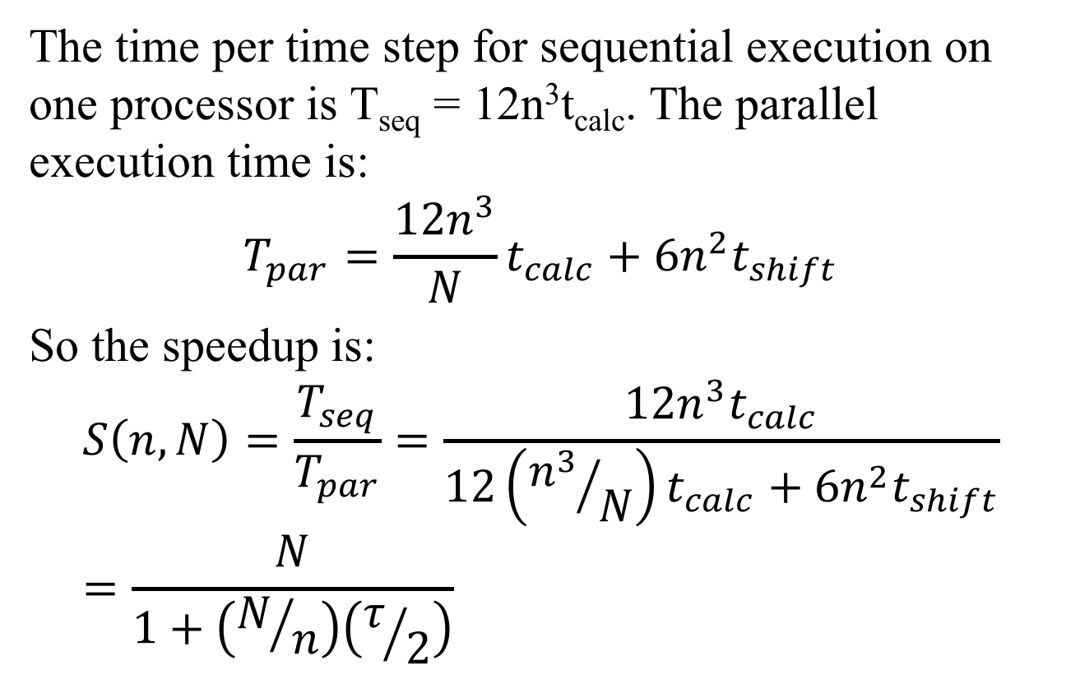
Q11: Answer
The time per time step for sequential execution on one processor is T_{seq} = 12n³t_{calc}. The parallel execution time is:
$$T_{par}=\frac{{12n}^{3}}{N}t_{calc}+{6n}^{2}t_{shift}$$
So the speedup is:
$$S\left(n,N\right)=\frac{T_{seq}}{T_{par}}=\frac{{12n}^{3}t_{calc}}{12\left({n^{3}}/N\right)t_{calc}+{6n}^{2}t_{shift}}=\frac{N}{1+\left(N/n\right)\left(τ/2\right)}$$
where 𝜏 = t_{shift}/t_{calc}

Slide 21
Q12: Performance Analysis
A sequential algorithm requires 2n³ floating-point operations to multiply two nxn matrices together. The corresponding parallel algorithm on a square mesh of PxP processors assigns a (n/P)x(n/P) submatrix to each processor, and consists of P stages. In each stage each processor does the following:
Performs 2(n/P)³ floating-point operations.
Is involved in a broadcast that takes time ((n/P)² log₂P)t_{comm}, where t_{comm} is the time to communicate one floating-point number between two processors.
Except for the first stage, is involved in a point-to-point communication that takes time (n/P)² t_{comm}.
What is the parallel efficiency of the algorithm?

Slide 22
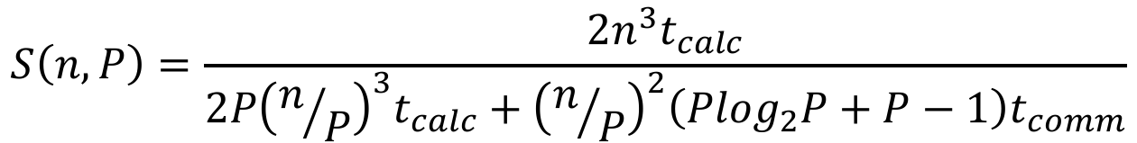
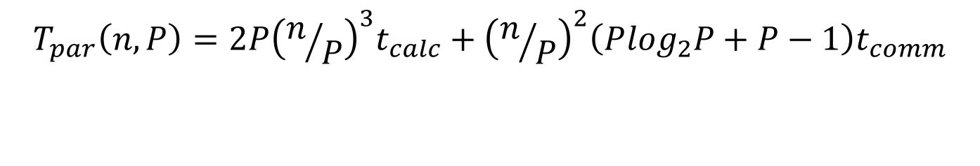
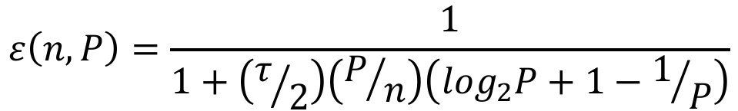
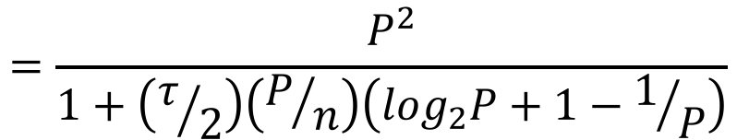
Q12: Answer
$$T_{par}\left(n,P\right)=2P{\left(n/P\right)}^{3}t_{calc}+{\left(n/P\right)}^{2}\left(P\log_{2}P+P−1\right)t_{comm}$$
$$S\left(n,P\right)=\frac{{2n}^{3}t_{calc}}{2P{\left(n/P\right)}^{3}t_{calc}+{\left(n/P\right)}^{2}\left(P\log_{2}P+P−1\right)t_{comm}}$$
$$=\frac{P^{2}}{1+\left(τ/2\right)\left(P/n\right)\left(\log_{2}P+1−1/P\right)}$$
$$ε\left(n,P\right)=\frac{1}{1+\left(τ/2\right)\left(P/n\right)\left(\log_{2}P+1−1/P\right)}$$

Slide 23
Q13: Cyclic Data Distribution
Suppose we have a block-cyclic data distribution with block size 3x4 that is used to distribute a matrix, A, over a 3x6 processor mesh. On a distributed memory computer each processor holds its part of the matrix A in a local array, L. What is the global index (m,n) of the element of the matrix A stored at location (2,4) of L in the processor at location (1,4) of the processor mesh?

Slide 24
Q13: Answer
Use: m = (bN+p)k + i
We treat each dimension independently.
First the row direction: the item stored locally in row 2 is in local row block 2/3=0 at row index 2%3=2 within the block. If this is in the processor in row 1 of the processor mesh, then the global row block is 1, so the global row is 1*3+2 = 5.
Next the column direction: the item stored locally in column 4 is in local column block 4/4=1 at column index 4%4=0 within the block. If this is in the processor in column 4 of the processor mesh, then the global column block is 1*6+4=10, so the global column is 10*4+0 = 40. Thus, the item is at global location (5,40).

Slide 25
Q14: OpenMP For Loop
In the following fragment of OpenMP code, a, b, and c are two-dimensional arrays:
int N = 15;
int i, j, chunk = 5;
#pragma omp parallel shared(a,b,c,chunk) private(i,j)
{
#pragma omp for collapse(2) schedule(static,chunk)
for (i=0; i < N; i++)
for (j=0; j<N; j++)
c[i][j] = a[i][j] + b[i][j];
}
Draw a diagram showing how the first 3 iterations of the outer loop are assigned to threads in the above code fragment, assuming there are 6 threads.

Slide 26
Q14: Answer
0 | 0 | 0 | 0 | 0 | 1 | 1 | 1 | 1 | 1 | 2 | 2 | 2 | 2 | 2
3 | 3 | 3 | 3 | 3 | 4 | 4 | 4 | 4 | 4 | 5 | 5 | 5 | 5 | 5
0 | 0 | 0 | 0 | 0 | 1 | 1 | 1 | 1 | 1 | 2 | 2 | 2 | 2 | 2

Slide 27
Q15: Performance Analysis
An ocean model on an n x n numerical grid performs 10000n³T floating-point operations to simulate T seconds of global ocean circulation.
Give an formula for the execution rate in floating-point operations per second that must be achieved if a 100-year simulation is to complete in one hour. You should assume there are 365.25 days in a year.
If the current fastest supercomputer can compute at a rate of 15x10¹⁵ floating-point operations per second (15 Petaflop/s), what is the largest problem that can be simulated for 100 years in one hour on this machine?
If supercomputers keep increasing in speed by a factor of 100 every 5 years:
In 15 years from now what will be the largest problem that can be simulated for 100 years in one hour?
How long will it be before a problem of size n=20000 can be simulated for 100 years in one hour?

Slide 28
Q15: Answer
Number of operations for 100 year simulation = 100x365.25x24x3600x10000n³ = 3.15576x10¹³n³
To complete in one hour the execution rate must be:
3.15576x10¹³n³/3600 = 8.766x10⁹ n³ floating-point operations per second
= 8.766n³ Gflop/s.
The largest problem is given by 8.766x10⁹n³ = 15x10¹⁵, so n³ = 1.7112x10⁶, and n = 119 is the largest problem.
Speed = 15x10¹⁵ x10^{2T/5}, so speed in 15 years = 15x10²¹ flop/s. So the largest problem in 15 years is given by 8.766x10⁹n³ = 15x10²¹, so n³ = 1.7112x10¹², and n = 11960.
Speed needed to solve n=20000 problem in one hour = 8.766x10⁹x20000³ = 7.013x10²². So the time until this speed is achieved is given by 15x10¹⁵x10^{2T/5} = 7.013x10²², so 10^{2T/5} = 4.675x10⁶. The n = 20000 problem can therefore be solved in T = 16.67 years from now.

