Slide 2
Security Issues in Internet Protocols – Part 2
Dr. Sandra Scott-Hayward
CSC3064 Lecture 07
School of Electronics, Electrical Engineering and Computer Science

Slide 3
Session Overview
OSPF (Open Shortest Path First)
BGP (Border Gateway Protocol)
References:
Jacobson, Douglas. Introduction to network security. CRC Press, 2008.
Schäfer, Günter, and Michael Rossberg. Security in Fixed and Wireless Networks. John Wiley & Sons, 2016.
Stallings, William. Network security essentials: applications and standards. Pearson Education India, 2007.

Slide 4
Internet Infrastructure
Backbone
ISP
ISP
Local and inter-domain routing
TCP/IP for routing and messaging
ARP for address resolution
OSPF for inter-AS routing
BGP for routing announcements

Slide 5
Open Shortest Path First (OSPF)
Routing inside an AS (interior gateway protocol)
Computes shortest path, creates routing table
Link metrics for the routing table e.g. RTT, link throughput, availability
Link State Advertisements (LSA):
Flooded throughout AS so that all routers in the AS have a complete view of the AS topology
Neighbor discovery:
Routers dynamically discover direct neighbors on attached links --- sets up an “adjacency”
Once setup, they exchange their LSA databases

Slide 6




OSPF Example: LSA Flooding from Ra and Rb
Ra LSA
Net-1
Rb LSA
Ra
Rb
R3
LSA DB:
Net-1
Net-1
Ra
Ra
Rb
2
2
Rb
3
1
1
3
1
For a detailed explanation of OSPF:
https://tinyurl.com/y72e7fh3

Slide 7
OSPF Security Features
OSPF message integrity
Per-link authentication: Computes a secure MAC that is sent with the routing message, message can be authenticated by the receiver.
Secret shared by all routers attached to that link - Ensures that an unauthorized IP resource cannot inject OSPF routing messages into the network without detection
However, OSPF uses MD5, which is now known to be insecure MAC
Every LSA is flooded throughout the AS
If there’s only a single malicious router, valid LSAs may still reach destination
The “fight back” mechanism
If a router receives its own LSA with a newer timestamp than the latest it sent, it immediately floods a new LSA
Links must be advertised by both ends
Attacker advertising non-existent link to another router will not influence
routing tables since that router will never advertise a link back

Slide 8


OSPF – Still some possible attacks
Threat Model:
A single malicious router wants to disrupt all AS traffic
Protocol Vulnerability:
Adjacency setup requires no peer feedback
Attack Assumption:
Routers in AS configured with same secret keys
Attack:
Phantom router attracts
traffic from
nearby routers
Blackholes the traffic
e.g. DoS on net 1
Victim (DR)
a remote attacker
adjacency
phantom router
False Hello and DBD messages
adjacency
LAN
adjacency
net 1

Slide 9
OSPF – Remote False Adjacency Attack
Normal Adjacency Set up between routers
Sequence of Attack Messages

Slide 10
OSPF – Remote False Adjacency Attack
Attacker sends packets that appear to come from the phantom router (i.e. spoofed src IP) destined to the victim router
Step 1: Attacker sends hello message to victim (phantom ID numerically larger than victim ID)
Step 2: Victim starts adjacency setup with phantom (sending Database Description (DBD) message with arbitrary sequence number). This message and other messages are not received by the attacker.
Step 3: Attacker sends a DBD message claiming to be master of the exchange and suggests a different sequence number. The phantom is elected to be master as it has a higher ID (see step 1).
Step 4: Victim adopts the sequence number and attacker continues to send empty DBD messages with increasing sequence number.
To complete the protocol, attacker must complete the exchange after the victim has sent out all its DBD messages but the attacker is not receiving these messages. However, the attacker is on the same AS as the victim so knows roughly how many DBD messages would be required to convey the database content.
Step 5: The attacker sends its final DBD message, the victim does not request LSAs from the phantom because it assumes the database is empty (see Step 4) and the victim ends the adjacency setup.
Step 6: The victim advertises a link to the phantom on behalf of its network.

Slide 11
Use case for the attack
Diverted traffic intended for the victim network (10.10.0.0/16)

Slide 12
Attack Elements:
Insider Access – legitimate member of the network
Protocol vulnerability – no peer feedback
In-depth knowledge/study of the protocol
Spoofed IP address

Slide 13
Border Gateway Protocol (BGP) Example
Choose a route through the Internet
List of routes from BGP neighbours (e.g. ISPs)
Find the best path to an AS based on path attributes e.g. shortest path (origin attribute specifies the origin of the route update)
1
3
3 2 7
4
2 7
2 6 5
2 6 5
3 2 6 5
5
8
2
2 7
6 5
7 2 6 5
7
2 7
7
6
6 2 7
5
7
2 6 5
5
Host1
Host2
…
Hostn
Address blocks

Slide 14
BGP Security Issues
BGP is used for all inter-ISP routing
Locally set, internationally distributed
Benign configuration errors affect about 1% of all routing table entries at any time
Highly vulnerable to human errors, malicious attacks
Actual routing policies can be very complicated
BGP path attestations are un-authenticated
Anyone can inject advertisements for arbitrary routes
Advertisement will propagate everywhere
Used for DoS, spam, and eavesdropping
Often a result of human error

Slide 15
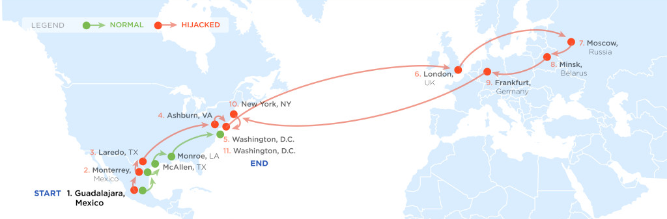
Example Path Hijack
Feb 2013: Guadalajara ⟶ Washington DC via Belarus
Normally: Alestra (Mexico) ⟶ PCCW (Texas) ⟶ Qwest (DC)
Reverse route (DC ⟶ Guadalajara) is unaffected:
Person browsing the Web in DC cannot tell by traceroute that HTTP responses are routed through Moscow
route in effect
for several hours

Slide 16
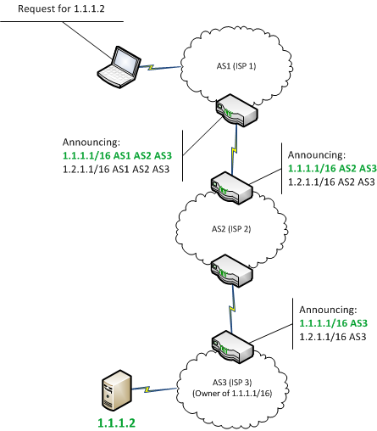
BGP

Slide 17
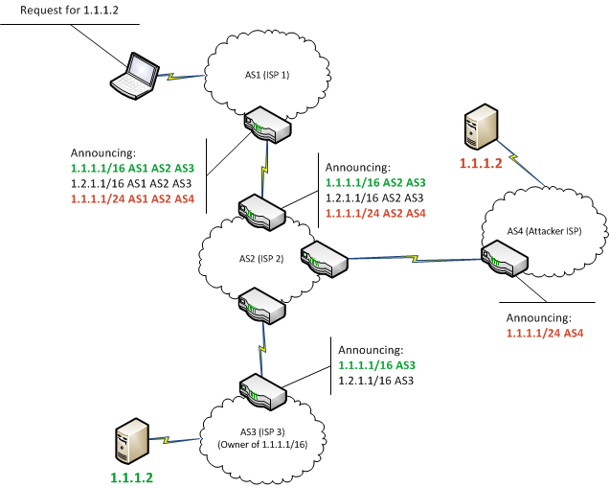
BGP - Hijack
More specific advertisement selected

Slide 18
Further examples:
2008 – Pakistani ISP to block YouTube delivery to Pakistan – blocked YouTube worldwide
2013 - Detouring bank, telephony, and government data through routers in Belarus and Iceland
2014 - Redirecting traffic within the Bitcoin infrastructure and resulting in the theft of $83,000 in Bitcoins
2017- Rostelecom hijacked large network blocks including MasterCard, Visa, HSBC and Symantec
2018 - Google BGP leak
http://blog.catchpoint.com/2018/11/13/bgp-leak-google/

Slide 19
Attack consequences
Deny access to internet services;
Detour internet traffic to permit eavesdropping and to facilitate on-path attacks on endpoints (sites);
Mis-deliver internet network traffic to malicious endpoints;
Cause routing instability in the internet

Slide 20
BGP Security Solutions
RPKI: Resource Public Key Infrastructure
AS obtains a certificate (Route Origin Authorization) from regional authority (RIR) and attaches ROA to path advertisement. Advertisements without a valid ROA are ignored. Defends against a malicious AS
S-BGP: Sign every hop of a path advertisement
SoBGP (secure origin BGP), psBGP (pretty secure BGP)
SIDR (Secure Interdomain Routing)

Slide 21
Secure Inter-Domain Routing (SIDR) - IETF
3 Components:
Resource Public Key Infrastructure (RPKI);
allows third-parties to cryptographically validate claims to ownership of internet address blocks and internet autonomous systems.
BGP Origin Validation (BGP-OV);
Origin Validation provides protocol extensions and tools to allow BGP routers to use RPKI data to detect and filter unauthorized BGP route announcements.
Origin validation will deter simple route hijack attacks and misconfigurations (accidents)
BGP PATH Validation (BGP-PV)
PATH Validation provides further protocol extensions that allow BGP routers to cryptographically verify the sequence of networks (the autonomous systems path) that comprise a BGP route.
PATH Validation will deter more sophisticated and stealthy route detour attacks

Slide 22
Validating a Route
To validate a route from AS_{n}, AS_{n+1} needs:
address attestation from each organization owning an address block(s) in the NLRI (network layer reachability information)
address allocation certificate from each organization owning address blocks in the NLRI
route attestation from every AS along the path (AS₁ to AS_{n}), where the route attestation for AS_{k} specifies the NLRI and the path up to that point (AS₁ through AS_{k+1})
certificate for each AS or router along path (AS₁ to AS_{n}) to check signatures on the route attestations
and, of course, all the relevant CRLs (certificate revocation list) must have been checked

Slide 23
Adoption …
First component (RPKI) published in 2012 (RFC 6480):
By 2016, ~7% of global BGP announcements were then covered by ROAs.
RPKI adoption in:
Europe (~30% of its announced address space covered by ROAs)
Latin America (~13% of its announced address space covered by ROAs)
North America (~3% of its announced address space was then covered by ROAs).
Recent activity on SIDR:
https://www.nccoe.nist.gov/projects/building-blocks/secure-inter-domain-routing

Slide 24
Summary
Core protocols not designed for security
Eavesdropping, packet injection, route stealing etc.
OSPF
Existing Security Features
Remote False Adjacency Attack
BGP
Security Issues
Path Hijack Attack
Security Solutions - SIDR

Slide 25
Questions?
Next Session: Security Issues in Internet Protocols – Part 3
Friday, 01 February 2019

