Slide 1
CSC4005 High Performance Computing: Principles Of Parallel Programming Lecture 2 Parallel computer memory architectures
Blesson Varghese
b.varghese@qub.ac.uk
www.blessonv.com

Slide 2

Assignment 1
Deadline: Thursday, October 25, 23:59
You should have already started Part A and be thinking about completing it on Kelvin cluster by next week
All the best

Slide 3
Recap from Previous Lecture
What is parallel computing?
Different from sequential computing
Parallelism examples and uses
Challenges with embracing parallelism
At the software level – programming techniques
Energy efficiency
Top 500 and Green 500
Awaiting Exascale computing
Don’t forget the reading assignment!

Slide 4
Recap from Previous Lecture
Concepts and terminology
von Neumann Architecture
Flynn’s Taxonomy
Miscellaneous Definitions in Parallel Computing
Shared memory vs distributed memory
Overheads in Parallel Programs

Slide 5
Note on Self Study Slides
Start reading ‘Self-Study’ slides provided in QOL

Slide 6
Parallel computer memory architectures

Slide 7
What we aim to cover…
Shared Memory Architectures
Distributed Memory Architecture
Limitations of Memory Systems
Cache Coherence in Multi-processor Systems

Slide 8
Shared Memory Architectures
General characteristics
Has ability for all processors to access all memory as global address space
Multiple processors can operate independently but share the same memory resources
Changes to a memory location by one processor are visible to all other processors
Broadly two types based on memory access times:
Uniform Memory Access (UMA)
Non-Uniform Memory Access (NUMA)

Slide 9
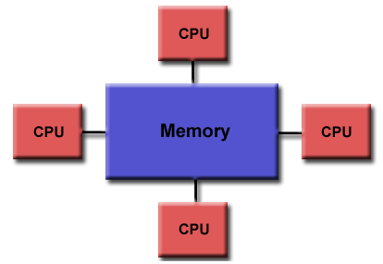
Shared Memory Architectures
Uniform Memory Access (UMA)
Commonly represented today by Symmetric Multiprocessor (SMP) machines
Examples: Intel Core2 Duo, Intel Xeon
Identical processors (homogeneous)
Equal access and access times to memory

Slide 10
Shared Memory Architectures
Uniform Memory Access (UMA) (contd.)
Sometimes called Cache Coherent UMA (CC-UMA)
Cache coherent means if one processor updates a location in shared memory, all the other processors know about the update.
Cache coherency is accomplished at the hardware level.
Video on the need for cache coherence is here

Slide 11
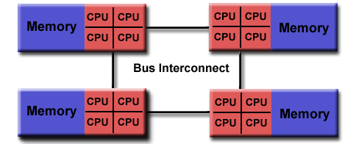
Shared Memory Architectures
Non-Uniform Memory Access (NUMA)
Often made by physically linking two or more SMPs
One SMP can directly access memory of another SMP
Not all processors have equal access time to all memories
Memory access across link is slower
If cache coherency is maintained, then may be called CC-NUMA - Cache Coherent NUMA

Slide 12
Shared Memory Architectures
Advantages
Global address space provides a user-friendly programming perspective to memory
Data sharing between tasks is both fast and uniform due to the proximity of memory to CPUs
Disadvantages
Lack of scalability between memory and CPUs
Adding more CPUs geometrically increase traffic on the shared memory-CPU path
For cache coherent systems, geometric increase in traffic associated with cache/memory management
Programmer responsibility for synchronisation constructs that ensure "correct" access of global memory.
It is difficult and expensive to design and produce shared memory machines with ever increasing numbers of processors

Slide 13
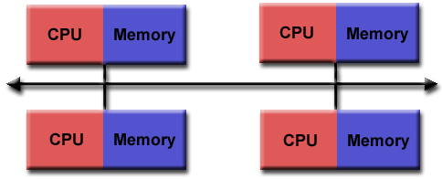
Distributed Memory Architecture
Require a communication network to connect inter-processor memory
Processors have their own local memory
Memory addresses in one processor do not map to another processor
no concept of global address space across all processors

Slide 14
Distributed Memory Architecture
Because each processor has its own local memory, it operates independently
Changes it makes to its local memory have no effect on memory of other processors.
The concept of cache coherency does not apply.
When a processor needs access to data in another processor, programmer explicitly defines how and when data is communicated
Synchronisation between tasks is programmer's responsibility.
The network "fabric" used for data transfer varies widely
Can be as simple as Ethernet
Video on distributed memory architecture is here

Slide 15
Distributed Memory Architecture
Advantages
Memory is scalable with number of processors
Increase the number of processors and the size of memory increases proportionately
Each processor rapidly accesses its own memory
No interference and no overheads incurred trying to maintain cache coherency
Cost effectiveness: can use commodity, off-the-shelf processors and networking

Slide 16
Distributed Memory Architecture
Disadvantages
The programmer is responsible for many details associated with data communication between processors.
May be difficult to map existing data structures, based on global memory, to distributed memory organisation

Slide 17
Shared Memory on Distributed Memory
Usually easier to parallelise programs on shared memory
We will see this later
But because of cost effectiveness, distributed memory systems are more common
To take advantage of the benefits of both shared and distributed memory virtual shared memory is considered
Also referred to as Partitioned Global Address Space (PGAS)
Example projects Unified Parallel C (UPC), Co-Array Fortran and Titanium
A survey on PGAS programming languages is here

Slide 18
Limitations of Memory System Performance
Memory system is often the bottleneck for many applications
Not processor speed!
Memory system performance is captured by two parameters:
Latency: time from the issue of a memory request to the time the data is available at the processor
Bandwidth: rate at which data can be pumped to the processor by the memory system

Slide 19



Latency and Bandwidth
Consider the example of a fire hose:
If water comes out of the hose two seconds after the hydrant is turned on, then
Latency of the system is 2 seconds
Once the water starts flowing, if the hydrant delivers water at the rate of 5 gallons/second, then
bandwidth of the system is 5 gallons/second
If you want immediate response from the hydrant, it is important to reduce latency
If you want to fight big fires, you want high bandwidth

Slide 20
Improving Memory Latencies
One way is using ‘Caches’
Caches are small and fast memory elements between the processor and DRAM
This memory acts as a low-latency high-bandwidth storage
If a piece of data is repeatedly used, the effective latency of this memory system can be reduced by the cache
Cache hit ratio
fraction of data references satisfied by the cache on the system
Cache hit ratio achieved by a code on a memory system determines performance
Refresher videos on cache organisation is here and cache performance is here

Slide 21
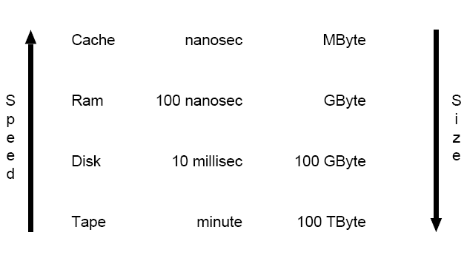
Improving Memory Latencies
Data is moved between levels in blocks (cache lines, pages).
Effective HPC arranges data and program so that entire block is used while resident in the faster memory.

Slide 22
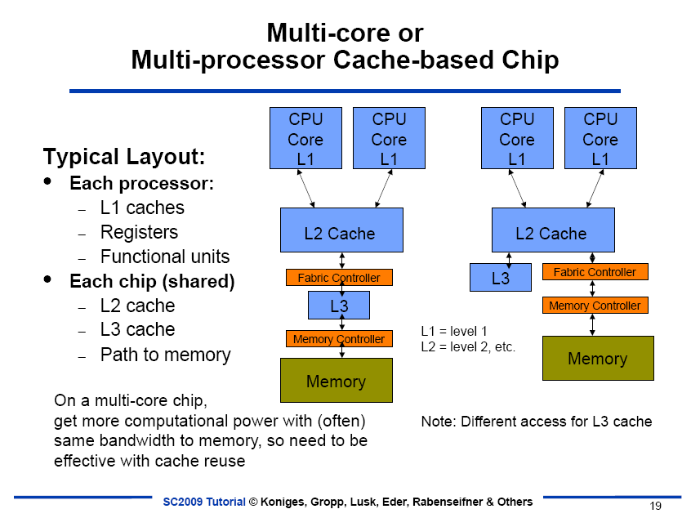
Improving Memory Latencies
Multi-core Cache organisation
Each processor
L1 (Level 1) cache
Registers
Functional units
Each chip (shared)
L2 cache
L3 cache
Path to memory
Usually computation power increases, but bandwidth to memory is same
So reuse cache effectively
Different ways of organising the cache
PDF on Intel’s implementation of cache on Pentium processors is here

Slide 23
Impact of Memory Bandwidth
Memory bandwidth is determined by the bandwidth of the memory bus and the memory units
Memory bandwidth can be improved by increasing the size of memory blocks
The underlying system takes ‘l’ time units (where ‘l’ is the latency of the system) to deliver ‘b’ units of data (where ‘b’ is the block size).

Slide 24
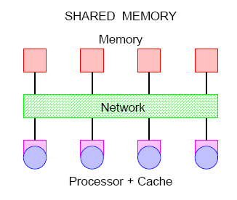
Cache Coherence In Multiprocessor Systems
Interconnects provide basic mechanisms for data transfer
In the case of shared address space machines, additional hardware is required to keep multiple copies of data consistent with each other
The underlying technique must provide some guarantees on the semantics

Slide 25
Cache Coherence In Multiprocessor Systems
When one processor changes the value of a variable, all its copies must be invalidated or updated
(a) Invalidate protocol;
(b) Update protocol for shared variables.

Slide 26
Cache Coherence in Multiprocessor Systems
If a processor just reads a value once and does not need it again, then no need to update
Update protocol may generate significant overhead
If two processors make interleaved test and updates to a variable, then an update protocol is better.
Both protocols have a problem:
false sharing overheads
two words that are not shared, however, they lie on the same cache line
Most current machines use invalidate protocols

Slide 27
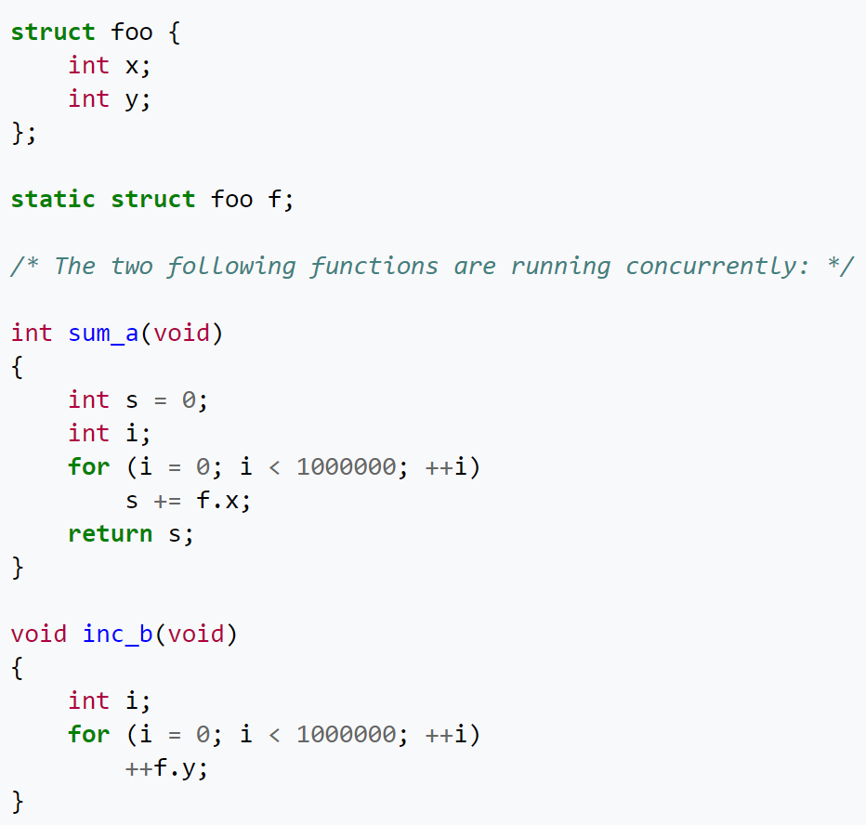
Cache Coherence in Multiprocessor Systems
Example of false sharing
sum_a may continually re-read x from main memory (instead of from cache) even though inc_b's concurrent modification of y should be irrelevant

Slide 28
Recap…
Shared Memory Architectures
Distributed Memory Architecture
Limitations of Memory Systems
Cache Coherence in Multi-processor Systems
Next item for today: Parallel programming models

Slide 29
Parallel programming models

Slide 30
What we aim to cover…
Parallel Programming Models
Threads Model
Message Passing Model
Data Parallel Model
Other Models

Slide 31
Parallel Programming Models
Are an abstraction above hardware and memory architectures
NOT specific to a particular type of machine or memory architecture
Can (theoretically) be implemented on any underlying hardware

Slide 32
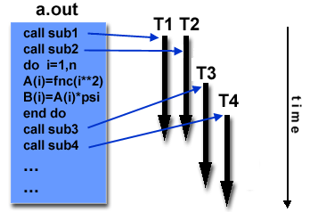
Thread Model
Difference between a thread and a process is here
A single process can have multiple concurrent execution paths
Example of a thread model on a program with multiple sub-routines
The main program a.out is scheduled to run by the native operating system
a.out loads and acquires all of the necessary system and user resources to run
a.out performs some serial work, and then creates a number of tasks (threads) that can be scheduled and run by the operating system concurrently

Slide 33
Thread Model
Each thread has local data, but also shares the entire resources of a.out.
Saves overhead associated with replicating a program's resources for each thread
Each thread has a global memory view because it shares the memory space of a.out
A thread's work may best be described as a subroutine within the main program

Slide 34
Thread Model
Any thread can execute any subroutine at the same time as other threads
Threads communicate with each other through global memory
Update address locations
Requires synchronisation to ensure that more than one thread is not updating the same global address at any time
Threads come and go, but a.out remains to provide the necessary shared resources until application completes
Commonly associated with shared memory architectures and operating systems

Slide 35
Thread Model
Implementation comprises
A library of subroutines that are called from within parallel source code
A set of compiler directives embedded in either serial or parallel source code
Programmer is responsible for determining all parallelism
Historically, hardware vendors implemented their own proprietary versions of threads.
Was difficult to develop portable threaded applications
Standardised implementations of threads
POSIX Threads and OpenMP
OpenMP API documentation is here

Slide 36
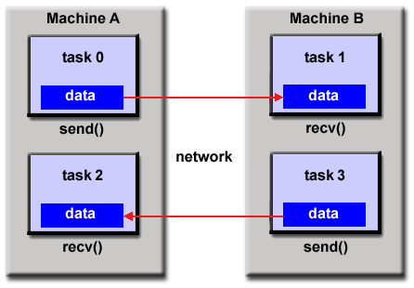
Message Passing Model
A set of tasks use their own local memory during computation.
Multiple tasks reside on the same physical machine and across machines
Tasks exchange data through communications by sending and receiving messages
Data transfer usually requires cooperative operations to be performed by each process
For example, a send operation must have a matching receive operation

Slide 37
Message Passing Model
Implementation comprises a library of subroutines that are embedded in source code
The programmer is responsible for determining all parallelism
Message Passing Interface (MPI) is a "de facto" industry standard for message passing
For shared memory architectures, MPI implementations usually do not use a network for task communications
Use shared memory (memory copies) for performance reasons
MPI Interface standards documentation is here
Differences between MPI and OpenMP is here

Slide 38
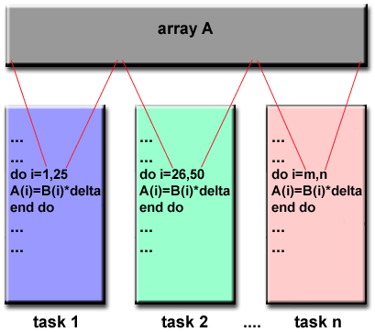
Data Parallel Model
Most of the parallel work focuses on performing operations on a data set
The data set is typically organised into a common structure, such as an array or cube
The programmer is responsible for determining all parallelism
A set of tasks work collectively on the same data structure
Each task works on a different partition of the data structure
Each task performs the same operation on its partition of work

Slide 39
Data Parallel Model
On shared memory architectures all tasks may have access to the data structure through global memory
On distributed memory architectures the data structure is split up and resides as "chunks" in the local memory of each task

Slide 40
Other Parallel Programming Models
Will consider three additional parallel models:
Hybrid
Two or more parallel programming models are combined
For example, combining MPI and either the threads model (POSIX threads) or the shared memory model (OpenMP)
Lends itself well to networked SMPs
OpenMP can be used for communicating between cores of one processor
MPI can be used for communicating between processors
A lecture on Hybrid MPI and OpenMP programming is here

Slide 41
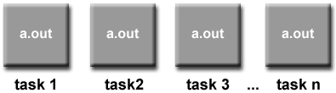
Other Parallel Programming Models
Single Program, Multiple Data (SPMD)
A "high level" programming model built on any combination of the parallel programming models
A single program is executed by all tasks simultaneously
Tasks can be executing the same or different instructions within the same program
Usually have the necessary logic programmed into them
Different tasks branch or conditionally execute only those parts of the program they are designed to execute
Tasks do not necessarily have to execute the entire program - perhaps only a portion of it.
All tasks may use different data

Slide 42
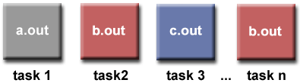
Other Parallel Programming Models
Multiple Program, Multiple Data (MPMD)
Like SPMD, a "high level" programming model built on any combination of the parallel programming models
Typically have multiple executable object files (programs)
Each task can be executing the same or different program as other tasks
All tasks may use different data

Slide 43
Recap…
Parallel Programming Models
Threads Model
Message Passing Model
Data Parallel Model
Other Models
Hybrid
Single Program, Multiple Data
Multiple Program, Multiple Data

Slide 44
Recap…
Next item for today: Group Exercise; Running your job on a cluster

Slide 45
Group exercise

Slide 46
Group Exercise
Follow the following 6 steps to complete the exercise on your lab machine:
Step 1: Go to QOL and get the zip file from Resources -> Tutorials -> Tutorial-2 -> GroupExercise.zip, which contains:
timing.h
timing.c
template_mmserial.c
template_mmserialStatic.c
mmserial.qsub (not required for running on the lab machine, but for the cluster; will be discussed shortly)

Slide 47
Group Exercise
Step 2: Work as a group to complete the function matmul which computes the matrix product C=AB
Note: Save this program in your I: drive
Note: This program will be required in the future
Step 3: Compile the program using
gcc –Wall -o <outputname> <filename.c> timing.c –lrt
Step 4: Execute the program using
./outputname
Step 5: Draw graphs of MFLOPs vs execution time and MFLOPs vs matrix size
Step 6: Present your results and conclusions to the class

Slide 48
Group Exercise
Note: Bring the graph you have plotted to the next lecture for an informal feedback session on plotting graphs.

Slide 49
RUNNING a job on kelvin cluster

Slide 50
Running a Job on Kelvin
Specifications of Kelvin are here
Loosely coupled cluster
Nodes may be removed from the network without affecting the rest of the cluster
Modern 64 bit OS on all nodes
Uses a job scheduler

Slide 51


Running a Job on Kelvin
Switch
Login Node
Compute Nodes

Slide 52
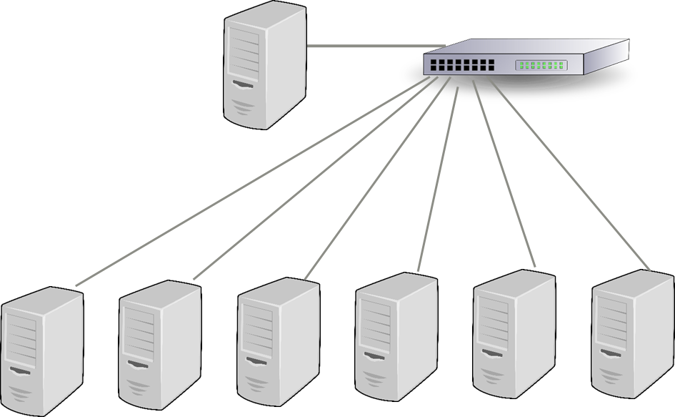
Running a Job on Kelvin
Beowulf Architecture
Normally identical cluster commodity grade computers networked into a small LAN
Cost-effective HPC cluster

Slide 53
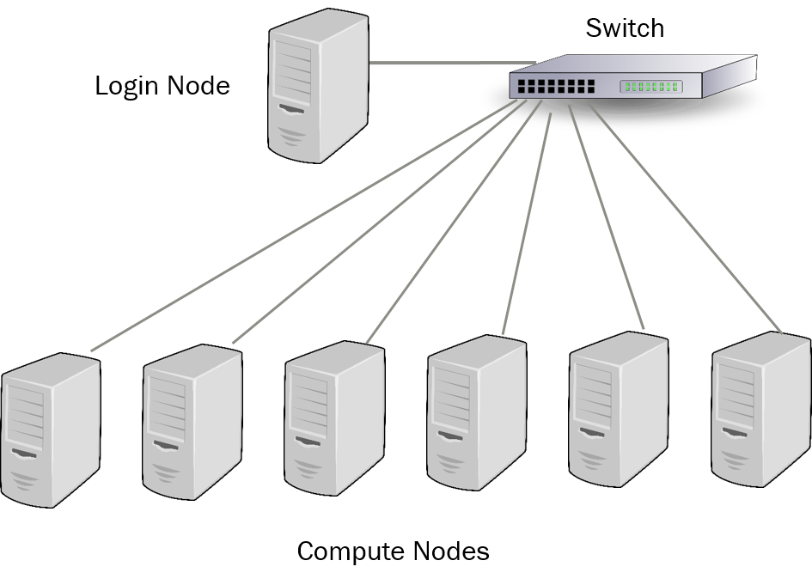
Running a Job on Kelvin
Using Kelvin
Logging in to Kelvin
User logs in to the login node using ssh

Slide 54
Running a Job on Kelvin
Using Kelvin
Logging in to Kelvin (contd.)
Use PuTTY or other similar tools
ssh username@kelvin.qub.ac.uk
Use your username and password

Slide 55
Running a Job on Kelvin
Using Kelvin
Logging in to Kelvin (contd.)
For copying program files, data etc to your cluster account use:
scp on Linux/Mac
scp <file> username@kelvin.qub.ac.uk
pscp on Windows PuTTY client
pscp <file> username@kelvin.qub.ac.uk
Graphical Interface available via FileZilla
Easier to use

Slide 56
Running a Job on Kelvin
Using Kelvin
Logging in to Kelvin (contd.)
Using FileZilla
Click on File -> Site Manager -> New Site
Host: kelvin.qub.ac.uk; Port 22
Protocol: SFTP (SSH File Transfer Protocol)
Logon Type: Normal
User: <username>; Password: <password>
Click Connect
Go to Resources -> Tutorials -> Tutorial-2 -> Kelvin Demo and download myfirstscript.sh and helloworld.c to your machine
Create a demo folder in your cluster account
Copy the files from your machine to the demo folder in your cluster account

Slide 57
Running a Job on Kelvin
Understanding the job scheduler
For allocating compute resources to users
Preventing users from overloading compute resources
Queuing jobs to run overnight or off-peak hours
Ensuring fairness for all users who want to use this
Kelvin uses the Open Grid Scheduler
qhost command provides a list of all nodes

Slide 58
Running a Job on Kelvin
Understanding types of jobs

Slide 59
Running a Job on Kelvin
Understanding class of jobs
Interactive jobs
qrsh command is used
Specify maximum runtime
Specify resources required
Uptime command gives one line display of how may users are logged on, system load averages for post 1, 5 and 15 minutes etc

Slide 60
Running a Job on Kelvin
Interactive jobs
qrsh command is used
qrsh command with right parameters provided
Allocates cores for computing to the user.
Note no direct access to the compute node

Slide 61
Running a Job on Kelvin
Interactive jobs
Run commands on the compute node allocated to you
Using the files copied to your cluster account the following executions will need to be done:
Go to the appropriate folder
cd demo
Compile helloworld.c (this is not a parallel program)
gcc helloworld.c –o helloworld
gcc compiler
-o is for specifying name of executable output
helloworld in our case
Execute the program
./helloworld

Slide 62
Running a Job on Kelvin
Understanding class of jobs
Non-interactive jobs
qsub command is used to submit jobs
Jobs are submitted via scripts
Contains commands to run the job
Contains instructions for the scheduler
qstat command provides status of the job

Slide 63
Running a Job on Kelvin
Non-interactive jobs
qsub command is used
qsub command with right parameters provided
Job script is submitted to the compute node.
Note no direct access to the compute node

Slide 64
Running a Job on Kelvin
Non-interactive jobs
Submitting a job script
To a single core; default resource used
Assigned a unique job number
Output sent to home directory
Submit myfirstscript.sh
First give myfirstscript.sh permission for execution
chmod 777 myfirstscript.sh
qsub myfirstscript.sh
Use qstat to see status of job
r – running job; qw – queuing job
See output of executing the job
cat ~/myfirstscript.sh.o<JOB_ID>

Slide 65
Running a Job on Kelvin
What is in myfirstscript.sh?
Statement to print “Starting to execute”
Statement to pause for 120 seconds
Statement to print “Completed execution”
You can include statements to execute a program
Useful to submit jobs and not have to wait on execution

Slide 66
Running a Job on Kelvin
Job scheduler instructions
Use -N <name> to set a job name
For both qsub and qrsh commands
Change of job name will be visible using qstat
Non interactive jobs provide instructions in the job script
Begin instructions with #$ identifier
Multiple lines can begin with this identifier
Modify myfirstscript.sh to include
#$ -N script_1 as second command in the script
Submit the job and see if name has changed to script_1

Slide 67
Running a Job on Kelvin
Modify myfirstscript.sh to include
#$ -N script_1 as second command in the script
Submit the job and see if name has changed to script_1
Open myfirstscript.sh using an editor
For example, nano myfirstscript.sh
Include additional commands in script
Submit the script using qsub

Slide 68
Group Exercise
Running the sequential matrix multiplication program on Kelvin
You already ran the C program on your lab machine
You presumably saved the program on your I: drive!
Follow the following 7 steps to complete the exercise:
Step 1: Go to your I: drive and copy the following files to a folder in your Kelvin cluster account (using Filezilla):
timing.h
timing.c
template_mmserial.c (or other file you used)
template_mmserialStatic.c (or other file you used)
mmsserial.qsub

Slide 69
Group Exercise
Step 2: Work as a group to complete the function matmul which computes the matrix product C=AB
You have already done this in the file you copied from your I: drive
Step 3: Experiment with the code and use the gcc command in mmserial.qsub
Step 4: Personalise mmserial.qsub and run as a batch job with qsub mmserial.qsub
Step 5: Draw graphs of MFLOP vs execution time and MFLOPs vs matrix size
Step 6: Present your results and conclusions to the class
Is this different from the results obtained in the previous exercise?
If so/if not, why?

Slide 70
Group Exercise
Good practice:
First develop your program on your lab machine
Then submit it to the Kelvin cluster
This is what we did:
First developed and tested the matrix multiplication program on the lab machine and saved it in I: drive
Then copied the program to the Kelvin cluster
Finally, submitted the program as a batch job on the cluster

Slide 71
Group Exercise
Note: Bring the graphs you have plotted to the next lecture for an informal feedback session on plotting graphs.
Each of you must bring the graphs plotted on Excel or the like
Think about:
Types of graphs
Best approaches for showing a graph

Slide 72
Next Sessions…
OpenMP
Lots of programming!
Including Lectures 3, 4 and 5
Do not miss these sessions

