Slide 1
CSC4005 High Performance Computing: Principles Of Parallel Programming Lecture 3, 4, 5 OPENMP
Blesson Varghese
b.varghese@qub.ac.uk
www.blessonv.com

Slide 2
Recap from Previous Lecture
Parallel Computer Memory Architecture
Shared Memory Architectures
Distributed Memory Architecture
Limitations of Memory Systems
Cache Coherence in Multi-processor Systems

Slide 3
Recap from Previous Lecture
Parallel Programming Models
Threads Model
Message Passing Model
Data Parallel Model
Other Models
Hybrid
Single Program, Multiple Data
Multiple Program, Multiple Data
Ran jobs on Kelvin

Slide 4
What we aim to cover today …
Feedback session
Plotting graphs for research
OpenMP

Slide 5
Feedback session: plotting graphs

Slide 6
OpenMP
Courtesy: https://computing.llnl.gov/tutorials/openMP/

Slide 7
What we aim to cover…
OpenMP
What it is and is not
Example Programs
Programming Model
Execution of OpenMP jobs on the Kelvin cluster

Slide 8
OpenMP
The website: http://www.openmp.org/
What is OpenMP?
Abbreviation for Open Multi-Processing
An API for multi-threaded, shared memory parallelism
Three primary API components:
Compiler Directives (44)
Runtime Library Routines (35)
Environment Variables (13)

Slide 9
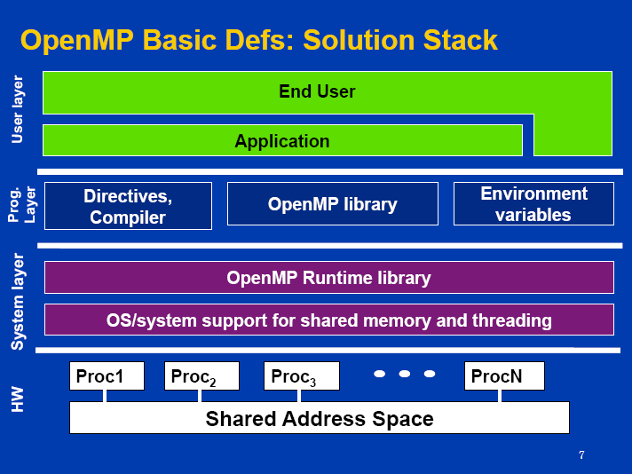
OpenMP
Courtesy: Supercomputing Conference 2009 Tutorial

Slide 10
OpenMP
What OpenMP is NOT:
Meant for distributed memory parallel systems (by itself)
Guaranteed to make most efficient use of shared memory
Designed to handle parallel I/O
The programmer is responsible for synchronising input and output.

Slide 11
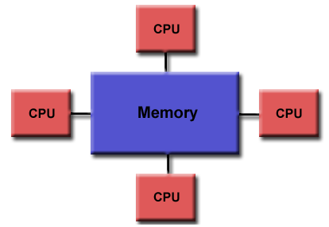
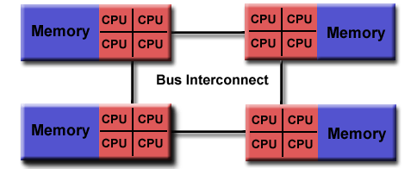
OpenMP
Programming Model
Shared Memory
Uniform Memory Access (UMA) or Non-Uniform Memory Access (NUMA)

Slide 12
OpenMP
Programming Model (contd.)
Thread Based Parallelism:
Parallelism through the use of threads
A thread of execution is the smallest unit of processing that can be scheduled by an operating system
Threads exist within the resources of a single process
Without the process, threads cease to exist.
The number of threads typically match the number of machine processors/cores
The actual use of threads is up to the application

Slide 13
OpenMP
Programming Model (contd.)
Explicit Parallelism
Not an automatic programming model
Offers the programmer full control over parallelisation
Parallelisation can be as simple as taking a serial program and inserting compiler directives, or
As complex as inserting subroutines to set multiple levels of parallelism, locks and even nested locks.

Slide 14
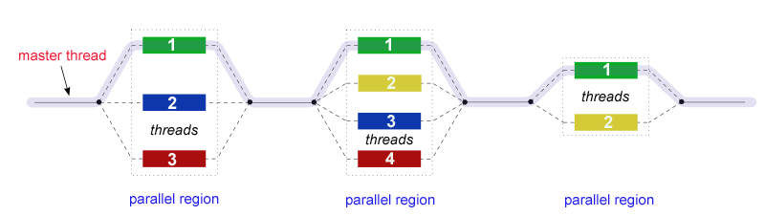
OpenMP
Programming Model (contd.)
Fork-Join Model
Begins as a single process: the master thread (sequential)
FORK: the master thread creates a team of parallel threads
JOIN: When the team completes, they synchronise and terminate

Slide 15
OpenMP
Programming Model (contd.)
Compiler Directive Based
Parallelism is specified by embedding compiler directives in code
Run-time Library Routine
To use OpenMP you need to include a header file
Environment Variables
Set them to control the execution of parallel code
If no. of threads not set at runtime, then can be set using environment variable
#pragma omp parallel default(shared) private(beta,pi)
#include <omp.h>
omp_set_num_threads(int);
export OMP_NUM_THREADS=8

Slide 16
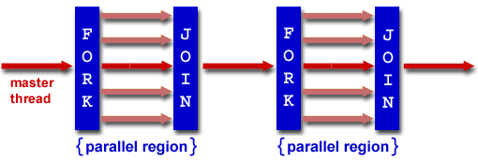
OpenMP
Code Structure
OpenMP header file
#include <omp.h>
main () {
int var1, var2, var3;
// Serial code (master thread)
// Beginning of parallel region. Fork a team of threads. Specify variable scoping
#pragma omp parallel private(var1, var2) shared(var3)
{
// Parallel region executed by all threads
// Other OpenMP directives
// Run-time Library calls
// All threads join master thread
}
// Resume serial code (master thread)
}
Main program
Parallel code

Slide 17
OpenMP
Understanding types of jobs

Slide 18
OpenMP
Joint exercise
Writing a multi-threaded program to print “hello world” on the console
Step 1: Copy the files in Resources -> Tutorial-3 -> OpenMP_Demo to the Kelvin cluster using Filezilla
Step 2: Compile this program
Step 3: Running the program
Will be discussed next

Slide 19
OpenMP
Running the OpenMP job on Kelvin
Batch mode
Open jobscript.sh
Run qsub jobscript.sh
View output file
Use cat command
Interactive mode
Try this yourself
Commands for compiling and executing is in jobscript.sh

Slide 20
Tutorials
Carefully go through:
https://computing.llnl.gov/tutorials/openMP/

Slide 21
OpenMP
Courtesy: Supercomputing Conference 2009 Tutorial

Slide 22
OpenMP
Programming Model (contd.)
Directives in C and C++ are based on the #pragma compiler directives
A directive consists of a directive name followed by clauses
#pragma omp <directive> [clause list]
The program executes serially until a parallel directive
Then a group of threads is created
#pragma omp parallel [clause list]
/* structured block */

Slide 23
OpenMP
Programming Model (contd.)
All threads have an ID
Main thread becomes master thread in the parallel section
Master thread has ID = 0
After parallel execution all threads join

Slide 24
OpenMP
Programming Model (contd.)
Clause list is used to specify conditional parallelisation, number of threads, and data handling
Conditional Parallelisation
The clause if (scalar expression) determines whether the parallel construct results in creation of threads.
Degree of Concurrency
The clause num_threads (integer expression) specifies the number of threads that are created.
Data Handling
The clause private (variable list) indicates variables local to each thread.
The clause firstprivate (variable list) is similar to the private, except values of variables are initialised to corresponding values before the parallel directive
The clause shared (variable list) indicates that variables are shared across all the threads

Slide 25
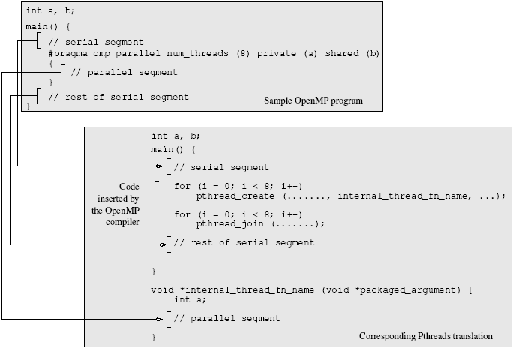
OpenMP
Example of how a compiler might translate an OpenMP program to make use of Pthreads

Slide 26
Sample Programs
Copy OpenMP_SamplePrograms.tar.gz from Tutorial-3 -> OpenMP_SamplePrograms folder to the Kelvin Cluster
Execute the following command to extract the folder
tar -xzvf OpenMP_SamplePrograms.tar.gz
There should be a 8 folders
Will be used next

Slide 27
Sample Programs - 1
Program 1 - Who am I?
A simple program to illustrate the general layout of OpenMP programs
What does the program do?
Discuss

Slide 28
Sample Programs - 2
Program 2 – Thread Interleaving
Illustrates interleaving of two parallel threads
Two parallel threads share variables c1 and c2
One thread executes c1=c1*c2
Other thread executes c1=c1+c2
The final value of c1 is printed out
What are the possible values of c1?
Run the program several times
Does this confirm your expectations

Slide 29
Sample Programs - 3
Program 3 – Race condition
An example of a race condition
Variable amount is shared by both threads
Amount is initialised to 100
One thread performs amount=amount+100
Other thread performs amount=amount+200
What are the three possible values of amount?
Run the program several times

Slide 30
Sample Program - 4
Program 4 – Another race condition
A more subtle condition
A Bank has 10,000 savings accounts each with £1000
The total assets are therefore £10,000,000
The Automatic Teller Machine (ATM) continuously picks two accounts at random and adds £500 to one and deducts £500 from the other
The totals assets should therefore remain at £10,000,000
Periodically the auditor sums the Bank's assets and outputs the total
Note how the bank account is shared by both threads
Run the program several times and observe the output
Explain the results

Slide 31
Sample Program - 5
Program 5 – Critical sections
This program is different from Program 4
Defines critical sections to protect shared variables

Slide 32
Sample Program - 6
Program 6 – Producer/Consumer problem
This program has one producer and two consumers
Share a single element buffer
First, the producer adds an element to the buffer
A new element can be added to the buffer only after the previous element added has been read by one, and only one, of the consumers
Compile the program pc.c and r un it several times. Observe whether it satisfies the above specification
Using ./pc | sort may help understand what is happening
Using a suitable critical section modify the program so that it meets the specification
Modify the program so that, first, the producer adds an element to the buffer, then a new element is added to the buffer when the previous element added has been read by both of the consumers

Slide 33
Sample Program - 7
Program 7 – Thread Scheduling
Use interactive mode
Compile using
gcc -fopenmp -std=gnu99 scheduler.c -o scheduler -lm
Run
./scheduler 1
./scheduler 1 | sort
./scheduler 2, ./scheduler 3 and ./scheduler 4
Experiment by varying the number of threads through the environment variable OMP_NUM_THREADS, for example, $export OMP_NUM_THREADS=3

Slide 34
Sample Program – 7 (contd.)
Program 7 – Thread Scheduling (contd.)
Write a job script for executing the scheduler in batch mode

Slide 35
Sample Program – 8
Program 8 – Matrix Multiplication
Multiplies two square matrices using 1..64 threads
Compile the program using
Execute, for example time ./mm 400 and observe output
Perform timings experiments using different matrix orders and threads
Run the mm program for matrix orders of 150, 300, 600, 1200, 2400 and note the time taken by each
Draw a graph of matrix order(x-axis) against time (y-axis) for 1, 2, 4, 8, 16, 32, 64 threads
Take note also of the real, user and sys time that is output. What do you think these correspond to?

Slide 36
Sample Program – 8 (contd.)
Program 8 – Matrix Multiplication (contd.)
Write a job script for executing the scheduler in batch mode

Slide 37
OpenMP
Programming Model (contd.)
If the value of the variable is_parallel equals one, eight threads are created
Each of these threads gets private copies of variables a and c, and shares a single value of variable b
The value of each copy of c is initialised to the value of c before the parallel directive
The default state of a variable is specified by the clause default(shared)or default(none)
#pragma omp parallel if (is_parallel== 1) num_threads(8) private (a) shared (b) firstprivate(c)
{
/* structured block */
}

Slide 38
OpenMP
Programming Model (contd.)
Reduction clause in OpenMP
Specifies that multiple local copies of a variable at different threads are combined into a single copy at the master when threads exit
The usage of the reduction clause is reduction (operator: variable list)
The variables in the list are implicitly specified as being private to threads
The operator can be one of +, *, -, &, |, ^, &&, and ||
Video on Reduction clause is here
#pragma omp parallel reduction(+: sum) num_threads(8)
{
/* compute local sums here */
}
/*sum here contains sum of all local instances of sums */

Slide 39
OpenMP
Parallel Reduction Example
/* ******************************************************
An OpenMP version of a threaded program to compute PI.
****************************************************** */
#pragma omp parallel default(none) shared(npoints)
private(i, rand_no_x, rand_no_y) reduction(+: sum) num_threads(8)
{
num_threads = omp_get_num_threads();
sample_points_per_thread = npoints / num_threads;
sum = 0;
for (i = 0; i < sample_points_per_thread; i++) {
rand_no_x =(double)(rand_r(&seed))/(double)((2<<14)-1);
rand_no_y =(double)(rand_r(&seed))/(double)((2<<14)-1);
if (((rand_no_x - 0.5) * (rand_no_x - 0.5) +
(rand_no_y - 0.5) * (rand_no_y - 0.5)) < 0.25)
sum ++;
}
}

Slide 40
OpenMP
Exercise
Write a simple OpenMP program that:
Uses OpenMP reduction
Uses 8 threads
Each thread should
Initialise a variable sum equal to the thread id
Then it must compute a local sum, sum = sum + 5
The reduced sum should be found outside the parallel block

Slide 41
OpenMP
Programming Model (contd.)
The parallel directive can be used in conjunction with other directives to specify concurrency across iterations and tasks
for and sections
to specify concurrent iterations and tasks.
The for directive is used to split parallel iteration spaces across threads
#pragma omp for <clause list>
/* for loop */
The clauses that can be used are: private, firstprivate, lastprivate, reduction, schedule, nowait, and ordered

Slide 42
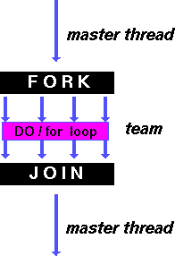
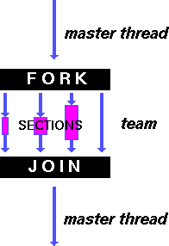
OpenMP
Programming Model (contd.)
for - shares iterations of a loop across the team of threads
Represents a type of "data parallelism"
Sections - breaks work into separate, discrete sections
Each section is executed by a thread
Can be used to implement a type of "functional parallelism"

Slide 43
OpenMP
Programming Model (contd.)
Parallel for example
#pragma omp parallel default(none)
private(i, rand_no_x, rand_no_y)
reduction(+: sum) num_threads(8)
{
sum = 0;
#pragma omp for
for (i = 0; i < npoints; i++)
{
rand_no_x =(double)(rand_r(&seed))/(double)((2<<14)-1);
rand_no_y =(double)(rand_r(&seed))/(double)((2<<14)-1);
if (((rand_no_x - 0.5) * (rand_no_x - 0.5) +
(rand_no_y - 0.5) * (rand_no_y - 0.5)) < 0.25)
sum ++;
}
}

Slide 44
OpenMP
Programming Model (contd.)
Parallel for
The schedule clause of the for directive deals with the assignment of iterations to threads
The general form of the schedule directive is schedule(scheduling_class[, parameter])
Four scheduling classes:
static, dynamic, guided, and runtime
Video on parallel for loops is here
An overview of scheduling classes is here

Slide 45
OpenMP
Programming Model (contd.)
Parallel for
/* static scheduling of matrix multiplication loops */
#pragma omp parallel default(none) private(i, j, k) shared (a, b, c, dim) num_threads(4)
#pragma omp for schedule(static)
for (i = 0; i < dim; i++) {
for (j = 0; j < dim; j++) {
c(i,j) = 0;
for (k = 0; k < dim; k++) {
c(i,j) += a(i, k) * b(k, j);
}
}
}

Slide 46
OpenMP
Programming Model (contd.)
it is desirable to have a sequence of for directives within a parallel construct that do not execute an implicit barrier at the end of each for directive
The nowait clause can be used with a for directive
#pragma omp parallel
{
#pragma omp for nowait
for (i = 0; i < nmax; i++)
...
#pragma omp for
for (i = 0; i < mmax; i++)
...
}

Slide 47
OpenMP
Programming Model (contd.)
Parallel sections
Supports non-iterative parallel task assignment
#pragma omp sections [clause list]
{
[#pragma omp section
/* structured block */
]
[#pragma omp section
/* structured block */
]
...
}

Slide 48
OpenMP
#pragma omp parallel
{
#pragma omp sections
{
#pragma omp section
{
taskA();
}
#pragma omp section
{
taskB();
}
#pragma omp section
{
taskC();
}
}
}
Programming Model (contd.)
Parallel sections example

Slide 49
OpenMP
Programming Model (contd.)
Nesting Parallel Directives
Enabled using OMP_NESTED environment variable.
Set to TRUE, nested parallelism is enabled.
Each parallel directive creates a new team of threads

Slide 50
OpenMP
Programming Model (contd.)
Synchronisation constructs
#pragma omp barrier
#pragma omp single [clause list]
structured block
#pragma omp master
structured block
#pragma omp critical [(name)]
structured block
#pragma omp ordered
structured block
Overview of synchronisation constructs is here

Slide 51
OpenMP
Programming Model
Library functions
Control execution of threaded programs
/* thread and processor count */
void omp_set_num_threads (int num_threads);
int omp_get_num_threads ();
int omp_get_max_threads ();
int omp_get_thread_num ();
int omp_get_num_procs ();
int omp_in_parallel();

Slide 52
OpenMP
Programming Model
Library functions
Control execution of threaded programs (contd.)
/* controlling and monitoring thread creation */
void omp_set_dynamic (int dynamic_threads);
int omp_get_dynamic ();
void omp_set_nested (int nested);
int omp_get_nested ();
/* mutual exclusion */
void omp_init_lock (omp_lock_t *lock);
void omp_destroy_lock (omp_lock_t *lock);
void omp_set_lock (omp_lock_t *lock);
void omp_unset_lock (omp_lock_t *lock);
int omp_test_lock (omp_lock_t *lock);

Slide 53
OpenMP
Programming Model
Environment variables
OMP_NUM_THREADS
specifies the default number of threads created in a parallel region
OMP_SET_DYNAMIC
Determines if the number of threads can be dynamically changed
OMP_NESTED
Turns on nested parallelism
OMP_SCHEDULE
Scheduling of for-loops if the clause specifies runtime

Slide 54

OpenMP
Pros
Quite easy to program compared to other parallel programming languages
Directives can be added incrementally - gradual parallelisation
Can still run the program as a serial code
Serial code statements usually don't need modification
Code is easier to understand and maybe more easily maintained
Cons
Can only be run in shared memory computers
Mostly used for loop parallelisation

Slide 55
Recap…
OpenMP
What it is and is not
Example Programs
Programming Model
Execution of OpenMP jobs on the Kelvin cluster
Next item for today: Feedback session – writing a report
Bring the draft of the report you have prepared for Assignment 1

Slide 56
Feedback session: Writing reports

Slide 57

What is a Report?
How can you identify that a document is a report…?
What features tell you it is a report and not some other form of writing?

Slide 58
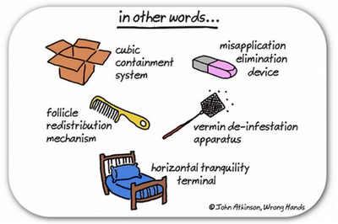





What is a report?
Possible features of a report:
Abstract or summary
Has a brief/specific purpose and audience
Sections /Headings
Data/Graphs/Tables
Often text is broken up – paragraphs and bullet points
Written concisely and to the point
Formal writing

Slide 59
Why write reports?
To communicate a research process clearly and simply
To give a logical structure to the methods, results, and findings of research
To inform the reader of the findings and possible recommendations of the research
To be easy to read and navigate for the reader
To develop clear, concise communication and documentation skills – useful for employment

Slide 60
Common problems with reports
Doesn’t answer the brief/terms of reference
Badly structured
Inappropriate writing style
Poor grammar and punctuation
Incorrect or inadequate referencing
Too much/too little/irrelevant material
Expression not clear
Doesn’t relate results to purpose
Unnecessary use of jargon

Slide 61

5 tips for writing effective reports
Tip 1: Read the brief/terms of reference carefully

Slide 62

5 tips for writing effective reports
Tip 2: Plan each section
Relate contents to the brief
Put yourself in the position of the reader
Edit ruthlessly and proofread

Slide 63
5 tips for writing effective reports
Tip 3: Relate contents to the brief

Slide 64

5 tips for writing effective reports
Tip 4: Put yourself in the position of the reader

Slide 65

5 tips for writing effective reports
Tip 5: Edit ruthlessly and proofread

Slide 66
Potential sections
Title page
Contents
Abstract or summary
Introduction
Methodology
Results or findings
Discussion
Conclusions
References
Appendices
All of these may not be required depending on the report you are preparing

Slide 67
Next Time…
Message Passing Interface (MPI)
Programming Model
Sample Programs
Running an MPI Job on the Kelvin Cluster

