Slide 1
CSC4005 High Performance Computing: Principles Of Parallel Programming Lecture 7, 8 message passing interface (MPI)
Blesson Varghese
b.varghese@qub.ac.uk
www.blessonv.com

Slide 2
Recap from Previous Lecture
Getting familiar with the Kelvin cluster
OpenMP
Programming Model
Example programs
Running jobs on Kelvin

Slide 3
Message passing interface (MPI)
https://computing.llnl.gov/tutorials/mpi/

Slide 4
What we aim to cover…
Differences between OpenMP and MPI
MPI
General characteristics
Programming Model
Submitting jobs on the Kelvin cluster

Slide 5


OpenMP vs MPI

Slide 6
OpenMP
For programming shared memory machines – multicore processors
Thread based parallelism
Have both private and shared variables
Directive based
Data racing is inherent
When two or more threads access the same memory location (shared variable)
At least one thread writes the memory location
Leads to non-deterministic behaviour (wrong results etc)
#pragma omp parallel for
for (i = 1; i < N; i++)
{
a[i] = 2.0 * i * (i - 1);
b[i] = a[i] - a[i - 1];
}

Slide 7
MPI
General Principles
For distributed memory systems on a network
But can be used for shared memory systems
Based on process based parallelism
But can be based on threads
Process in MPI has private variable no shared variable
Message based
Data racing is avoided if not using threads

Slide 8


OpenMP vs MPI
Flow Control
Directives – parallel, for etc
A team of threads can be created
Based on messages
Send data
Receive data
What are you sending or receiving?
What is the source/destination?

Slide 9
MPI
General Characteristics
The logical view of a machine supporting message-passing
p processes, each with its own exclusive address space
Each data element belongs to one of the partitions of the space
Data must be explicitly partitioned and placed.
All interactions (read-only or read/write) require cooperation of two processes
The process that has the data and the process that wants to access the data
For dynamic or unstructured interactions the complexity of the code can be high
Quite onerous!
Usually written as SPMD (Single Program, Multiple Data)

Slide 10
MPI
Two key functions
The value of a received by Process 1 must be 100
Process 0
Process 1
a = 100;
send(&a, 1, 1);
a = 0;
receive(&a, 1, 0)
printf("%d\n", a);

Slide 11
MPI
Non-buffered Blocking Message Passing
A simple method for send/receive is for the send operation to return only when it is safe to do so
In the non-buffered blocking send, the operation does not return until the matching receive has been encountered at the receiving process
Idling and deadlocks are major issues with non-buffered blocking sends

Slide 12
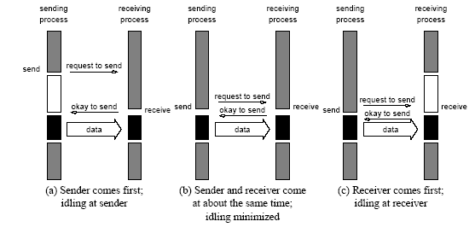
MPI
Non-buffered Blocking Message Passing (contd.)
Sender comes first; idling at sender

Slide 13
MPI
Non-buffered Blocking Message Passing (contd.)
Receiver comes first; idling at receiver

Slide 14
MPI
Non-buffered Blocking Message Passing (contd.)
Sender and Receiver come at the same time; idling is minimised

Slide 15
MPI
Non-buffered Blocking Message Passing (contd.)
Deadlocks
Process 0 Process 1
receive(&a, 1, 1); receive(&a, 1, 0);
send(&b, 1, 1); send(&b, 1, 0);

Slide 16
MPI
Buffered Blocking Message Passing
A simple solution to the idling and deadlocking problem is to rely on buffers at the sending and receiving ends
The sender copies the data into the designated buffer and returns after the copy operation has completed
The data must be buffered at the receiving end
Buffering trades off idling overhead for buffer copying overhead

Slide 17
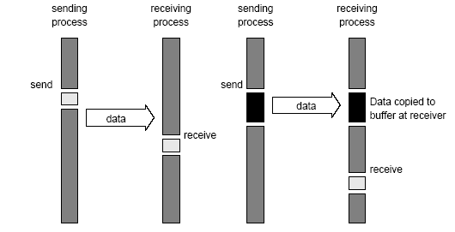
MPI
Buffered Blocking Message Passing (contd.)
When communication hardware with buffers at send and receive ends is used

Slide 18
MPI
Buffered Blocking Message Passing (contd.)
in the absence of communication hardware, sender interrupts receiver and deposits data in buffer at receiver end

Slide 19
MPI
Buffered Blocking Message Passing (contd.)
Bounded buffer sizes have significant impact on performance
What happens if the consumer is slower than the producer?
If there is enough buffer space then both processes can proceed
If not the producer will have to be blocked until the corresponding receive operations had been posted to free up buffer space
Process 0
for(i = 0; i < 1000; i++)
{
produce_data(&a);
send(&a, 1, 1);
}
Process 1
for(i = 0; i < 1000; i++)
{
receive(&a, 1, 0);
consume_data(&a);
}

Slide 20
MPI
Buffered Blocking Message Passing (contd.)
Deadlocks are still possible
Receive operations block
Process 0 Process 1
receive(&a, 1, 1); receive(&a, 1, 0);
send(&b, 1, 1); send(&b, 1, 0);

Slide 21
MPI
Non-blocking Message Passing
Returns from the send or receive operation before it is semantically safe to do so
Generally accompanied by a check-status operation
When used correctly, these primitives are capable of overlapping communication overheads with useful computations
Message passing libraries usually offer both blocking and non-blocking operations

Slide 22
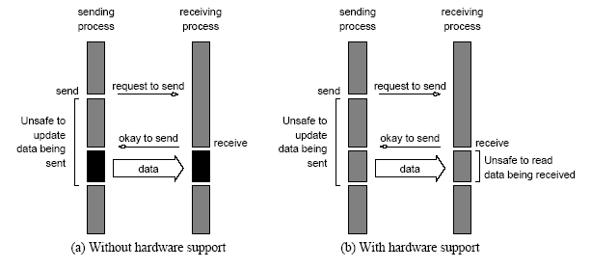
MPI
Non-blocking Message Passing (contd.)
In absence of communication hardware

Slide 23
MPI
Non-blocking Message Passing (contd.)
In presence of communication hardware

Slide 24
MPI
Defines a standard library for message-passing
Used to develop portable message-passing programs
C or Fortran programming languages
It is possible to write fully-functional message-passing programs by using only the six routines

Slide 25
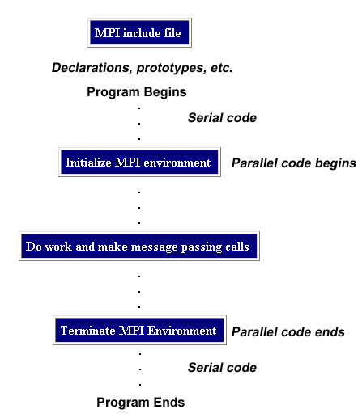
MPI
General program structure

Slide 26
MPI
Minimal set of routines
MPI_Init | Initializes MPI
MPI_Finalize | Terminates MPI
MPI_Comm_size | Determines the number of processes
MPI_Comm_rank | Determines the label of calling process
MPI_Send | Sends a message
MPI_Recv | Receives a message

Slide 27
MPI
Starting and terminating MPI libraries
MPI_Init is called prior to any calls to other MPI routines
Initialises the MPI environment
MPI_Finalize is called at the end of the computation
Performs clean-up tasks to terminate the MPI environment
The prototypes of these two functions are:
int MPI_Init(int *argc, char ***argv)
int MPI_Finalize()
MPI_Init strips off any MPI related command-line arguments
All MPI routines, data-types, and constants are prefixed by “MPI_”
The return code for successful completion is MPI_SUCCESS

Slide 28

MPI
Communicators
Defines a communication domain
A set of processes that communicate with each other
Information about communication domains is stored in variables of type MPI_Comm
Communicators are used as arguments to all message transfer MPI routines
A process can belong to many different (possibly overlapping) communication domains
MPI defines a default communicator called MPI_COMM_WORLD which includes all the processes

Slide 29
MPI
Querying information
The MPI_Comm_size determines the number of processes
int MPI_Comm_size(MPI_Comm comm, int *size)
MPI_Comm_rank determines the label of the calling process
int MPI_Comm_rank(MPI_Comm comm, int *rank)
The rank of a process is an integer that ranges from zero up to the size of the communicator minus one

Slide 30
MPI
Querying no of processes
An example first program
Querying rank of process
MPI header file
#include <mpi.h>
#include <stdio.h>
main(int argc, char *argv[])
{
int npes, myrank;
MPI_Init(&argc, &argv);
MPI_Comm_size(MPI_COMM_WORLD, &npes);
MPI_Comm_rank(MPI_COMM_WORLD, &myrank);
printf("From process %d out of %d,
Hello World!\n", myrank, npes);
MPI_Finalize();
}
Main function
Variable declarations
Initialising
Querying
Parallel code
Terminating

Slide 31
Running an MPI Job on Kelvin
Joint exercise
Writing an MPI program to print “hello world” on the console
Step 1: Copy the files in Resources -> Tutorial-4 -> MPI_Demo to the Kelvin cluster using Filezilla
Step 2: Compile this program
Step 3: Running the program
Will be discussed next

Slide 32
Running an MPI Job on Kelvin
Running the MPI job on Kelvin
Batch mode
Open jobscript.sh
Run qsub jobscript.sh
View output file
Use cat command
Interactive mode
Try this yourself
Commands for compiling and executing is in jobscript.sh

Slide 33
Running an MPI Job on Kelvin
Running the MPI job on Kelvin
Only 4 MPI slots (or cores) are available per student
You cannot run more than 4 MPI processes on Kelvin
For experimentation purposes, just in case you want to run more than one process per core you can use
--oversubscribe with mpirun (not a good practice though)

Slide 34
Tutorials
Carefully go through:
https://computing.llnl.gov/tutorials/mpi/

Slide 35
MPI
More information available here
Sending and Receiving functions
int MPI_Send(void *buf, int count, MPI_Datatype datatype, int dest, int tag, MPI_Comm comm)
int MPI_Recv(void *buf, int count, MPI_Datatype datatype, int source, int tag, MPI_Comm comm, MPI_Status *status)
MPI provides equivalent datatypes for all C datatypes
The message-tag can take values ranging from zero up to the MPI defined constant MPI_TAG_UB

Slide 36
MPI
Complete list of MPI Datatypes is here
Sending and Receiving functions (contd.)
MPI Datatypes (selected)
MPI Datatype | C Datatype
MPI_CHAR | signed char
MPI_INT | signed int
MPI_UNSIGNED_CHAR | unsigned char
MPI_UNSIGNED_SHORT | unsigned short int
MPI_UNSIGNED | unsigned int
MPI_FLOAT | float
MPI_DOUBLE | double

Slide 37
MPI
Sending and Receiving functions (contd.)
If source is set to MPI_ANY_SOURCE, then any process of the communication domain can be the source of the message
If tag is set to MPI_ANY_TAG, then messages with any tag are accepted
On the receive side, the message must be of length equal to or less than the length field specified

Slide 38
MPI
Sending and Receiving functions (contd.)
On the receiving end, the status variable can be used to get information about the MPI_Recv operation
The corresponding data structure contains:
typedef struct MPI_Status {
int MPI_SOURCE;
int MPI_TAG;
int MPI_ERROR; };
The MPI_Get_count function returns the precise count of data items received
int MPI_Get_count(MPI_Status *status, MPI_Datatype datatype, int *count)

Slide 39
MPI Sample Program - 1
Program 1 - Send and receive a value
A simple program to demonstrate how to send a value from one process to another
Submit the job using the job script
How is the programming style different from OpenMP?
How is the job script different from the OpenMP jobscripts?

Slide 40
MPI Sample Program - 2
Program 2 - Send and receive a value for a series of processes
Modify Program 1 so that a random character string is sent from P_{i} to P_{i+1}.
The last process may send the data to the first process.

Slide 41
MPI Sample Program - 3
Program 3 – Ping Pong
Two processes ping pong a number back and forth

Slide 42
MPI
Avoiding deadlocks
If MPI_Send is blocking then there is a deadlock
int a[10], b[10], myrank;
MPI_Status status;
...
MPI_Comm_rank(MPI_COMM_WORLD, &myrank);
if (myrank == 0) {
MPI_Send(a, 10, MPI_INT, 1, 1, MPI_COMM_WORLD);
MPI_Send(b, 10, MPI_INT, 1, 2, MPI_COMM_WORLD);
}
else if (myrank == 1) {
MPI_Recv(b, 10, MPI_INT, 0, 2, MPI_COMM_WORLD, &status);
MPI_Recv(a, 10, MPI_INT, 0, 1, MPI_COMM_WORLD, &status);
}
...

Slide 43
MPI
Avoiding deadlocks (contd.)
Process i sends a message to process i + 1 and receives a message from process i - 1
If MPI_Send is blocking then there is a deadlock
int a[10], b[10], npes, myrank;
MPI_Status status;
...
MPI_Comm_size(MPI_COMM_WORLD, &npes);
MPI_Comm_rank(MPI_COMM_WORLD, &myrank);
MPI_Send(a, 10, MPI_INT, (myrank+1)%npes, 1, MPI_COMM_WORLD);
MPI_Recv(b, 10, MPI_INT, (myrank-1+npes)%npes, 1,MPI_COMM_WORLD, &status);
...

Slide 44
MPI
Avoiding deadlocks (contd.)
Breaking circular waits
int a[10], b[10], npes, myrank;
MPI_Status status;
...
MPI_Comm_size(MPI_COMM_WORLD, &npes);
MPI_Comm_rank(MPI_COMM_WORLD, &myrank);
if (myrank%2 == 1) {
MPI_Send(a, 10, MPI_INT, (myrank+1)%npes, 1, MPI_COMM_WORLD);
MPI_Recv(b, 10, MPI_INT, (myrank-1+npes)%npes, 1, MPI_COMM_WORLD, &status);
}
else {
MPI_Recv(b, 10, MPI_INT, (myrank-1+npes)%npes, 1, MPI_COMM_WORLD, &status);
MPI_Send(a, 10, MPI_INT, (myrank+1)%npes, 1, MPI_COMM_WORLD);
}

Slide 45
MPI Sample Program - 4
Program 4
Create a deadlock free program mpi_ring.c with 4 processes and where each process, i, receives message from process i-1 (modulo 4).
For example,
processor 0 received 3 from processor 3
processor 2 received 1 from processor 1
processor 1 received 0 from processor 0
processor 3 received 2 from processor 2

Slide 46
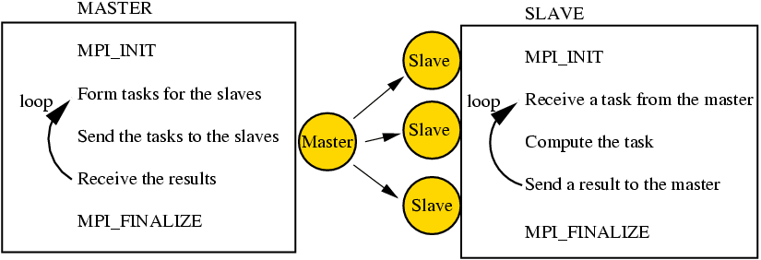
Master-Slave Model

Slide 47
MPI Sample Program - 5
Program 5
Write an MPI program to add two arrays (a and b) using 4 processes and sends the summed values to a single master process
You will need to decompose the arrays into four equal parts using the master process
Each slave process will need to receive a part of both arrays
The summed array values should be sent back to the slave process
You can try with the master process performing and not performing the addition

Slide 48
MPI
Send and receive buffers are different
Sending and receiving messages simultaneously
int MPI_Sendrecv(
void *sendbuf,
int sendcount,
MPI_Datatype sendtype,
int dest,
int sendtag,
void *recvbuf,
int recvcount,
MPI_Datatype recvtype,
int source,
int recvtag,
MPI_Comm comm,
MPI_Status *status)
int MPI_Sendrecv_replace(
void *buf,
int count,
MPI_Datatype datatype,
int dest,
int sendtag,
int source,
int recvtag,
MPI_Comm comm,
MPI_Status *status)
Send and receive buffers are the same

Slide 49
MPI Sample Program - 6
Program 6
Rewrite the program mpi_ring.c using
MPI_Sendrecv
MPI_Sendrecv_replace

Slide 50
MPI
Overlapping communication with computation
Non-blocking send and receive
int MPI_Isend(void *buf, int count, MPI_Datatype datatype, int dest, int tag, MPI_Comm comm, MPI_Request *request)
int MPI_Irecv(void *buf, int count, MPI_Datatype datatype, int source, int tag, MPI_Comm comm, MPI_Request *request)
Send/receive return before the operations have been completed

Slide 51
MPI
Overlapping communication with computation (contd.)
MPI_Test tests whether or not the non-blocking send/receive operation identified by its request has finished int MPI_Test(MPI_Request *request, int *flag, MPI_Status *status)
MPI_Wait waits for the operation to complete int MPI_Wait(MPI_Request *request, MPI_Status *status)

Slide 52
MPI
Avoiding deadlocks
Using non-blocking operations resolves the deadlock
Try replacing the blocking operations with non-blocking counterparts in some of the previous programs
int a[10], b[10], myrank;
MPI_Status status;
...
MPI_Comm_rank(MPI_COMM_WORLD, &myrank);
if (myrank == 0) {
MPI_Send(a, 10, MPI_INT, 1, 1, MPI_COMM_WORLD);
MPI_Send(b, 10, MPI_INT, 1, 2, MPI_COMM_WORLD);
}
else if (myrank == 1) {
MPI_Recv(b, 10, MPI_INT, 0, 2, MPI_COMM_WORLD, &status); MPI_Recv(a, 10, MPI_INT, 0, 1, MPI_COMM_WORLD, &status);
}
...

Slide 53
MPI
Point-to-point communication
One process communicating with another
Send/receive operations
Collective communication
Related to communication over all processes in a communicator
Operations
Barrier
Broadcast
Reduce
Scatter
Gather

Slide 54
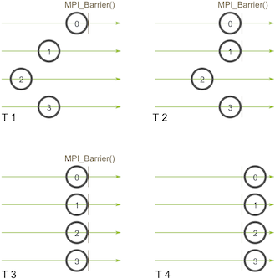
MPI
Barrier
int MPI_Barrier(MPI_Comm comm)

Slide 55
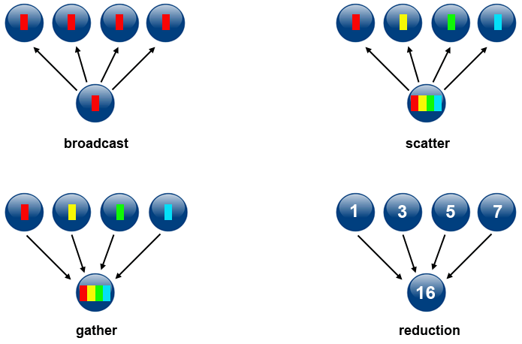
MPI
Broadcast
One to all
int MPI_Bcast(void *buf, int count, MPI_Datatype datatype, int source, MPI_Comm comm)

Slide 56
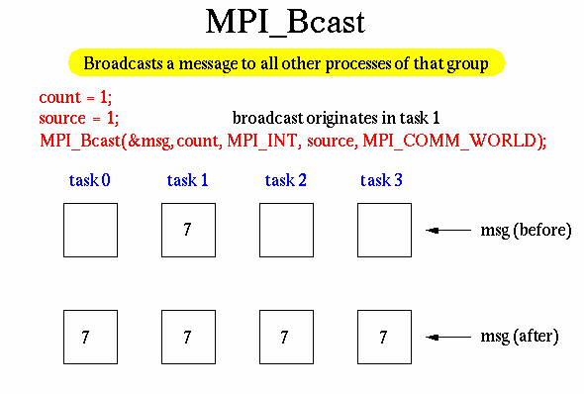
MPI
Broadcast (contd.)
Consider 4 tasks
Broadcast originates in task 1
State after broadcast

Slide 57
MPI
Broadcast (contd.)
Write a broadcast program that will generate similar output
before broadcast buffer in processor 0 is 10
before broadcast buffer in processor 1 is 0
before broadcast buffer in processor 2 is 0
before broadcast buffer in processor 3 is 0
after broadcast buffer in processor 2 is 10
after broadcast buffer in processor 1 is 10
after broadcast buffer in processor 3 is 10
after broadcast buffer in processor 0 is 10

Slide 58
MPI
Reduce
All to one
int MPI_Reduce(void *sendbuf, void *recvbuf, int count, MPI_Datatype datatype, MPI_Op op, int target, MPI_Comm comm)

Slide 59
MPI
Reduce (contd.)
Operation | Meaning | Datatypes
MPI_MAX | Maximum | C integers and floating point
MPI_MIN | Minimum | C integers and floating point
MPI_SUM | Sum | C integers and floating point
MPI_PROD | Product | C integers and floating point
MPI_LAND | Logical AND | C integers
MPI_BAND | Bit-wise AND | C integers and byte
MPI_LOR | Logical OR | C integers
MPI_BOR | Bit-wise OR | C integers and byte
MPI_LXOR | Logical XOR | C integers
MPI_BXOR | Bit-wise XOR | C integers and byte
MPI_MAXLOC | max-min value-location | Data-pairs
MPI_MINLOC | min-min value-location | Data-pairs

Slide 60
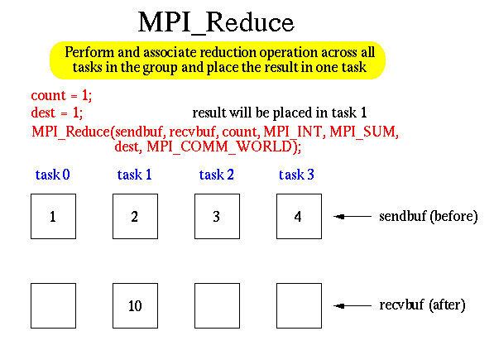
MPI
Reduce (contd.)
Consider 4 tasks
Reduce operation is MPI_SUM
Reduce to task 1

Slide 61
MPI
Reduce (contd.)
Write a reduce program that will generate similar output
before reduce, in processor 0, send_buffer is 1, receive_buffer is 0
before reduce, in processor 3, send_buffer is 4, receive_buffer is 0
before reduce, in processor 1, send_buffer is 2, receive_buffer is 0
before reduce, in processor 2, send_buffer is 3, receive_buffer is 0
after reduce, in processor 2, send_buffer is 3, receive_buffer is 0
after reduce, in processor 1, send_buffer is 2, receive_buffer is 0
after reduce, in processor 3, send_buffer is 4, receive_buffer is 0
after reduce, in processor 0, send_buffer is 1, receive_buffer is 10

Slide 62

MPI
Note scatter is different from broadcast: not same data sent to all processes
Scatter
From one to all, but not broadcast
int MPI_Scatter(void *sendbuf, int sendcount, MPI_Datatype sendtype, void *recvbuf, int recvcount, MPI_Datatype recvtype, int source, MPI_Comm comm)

Slide 63
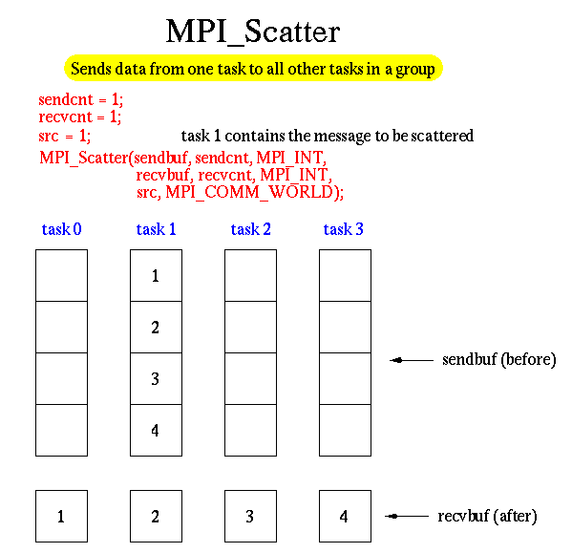
MPI
Scatter (contd.)
Consider 4 tasks
If task 1 is scattering one integer, then
source=1; sendcount=1; recvcount=1

Slide 64
MPI
Scatter (contd.)
Write a scatter program that generate similar output
before scatter receive buffer in processor 0 is 0
before scatter receive buffer in processor 1 is 0
before scatter receive buffer in processor 2 is 0
after scatter receive buffer in processor 0 is 1
after scatter receive buffer in processor 1 is 2
after scatter receive buffer in processor 2 is 3
before scatter receive buffer in processor 3 is 0
after scatter receive buffer in processor 3 is 4

Slide 65
MPI
Gather
From all to one, but not reduce
Opposite of scatter
int MPI_Gather(const void *sendbuf, int sendcount, MPI_Datatype sendtype, void *recvbuf, int recvcount, MPI_Datatype recvtype, int root, MPI_Comm comm)

Slide 66
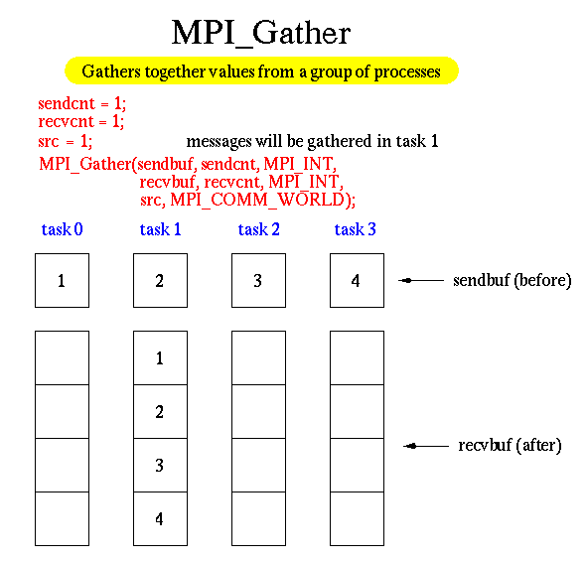
MPI
Gather (contd.)
Consider 4 tasks
If source=1; sendcount=1; recvcount=1

Slide 67
MPI
Gather (contd.)
Write a gather program that generate similar output
before gather receive buffer in processor 0 is 0, 0, 0, 0
before gather receive buffer in processor 2 is 0, 0, 0, 0
before gather receive buffer in processor 1 is 0, 0, 0, 0
after gather receive buffer in processor 2 is 0, 0, 0, 0
after gather receive buffer in processor 1 is 0, 0, 0, 0
before gather receive buffer in processor 3 is 0, 0, 0, 0
after gather receive buffer in processor 0 is 1, 2, 3, 4
after gather receive buffer in processor 3 is 0, 0, 0, 0

Slide 68
MPI Sample Program - 7
Program 7
Modify Program 5 (summation of arrays a and b) to use MPI_Scatter and MPI_Gather

Slide 69

MPI
Pros
Runs on either shared or distributed memory architectures
Can be used on a wider range of problems than OpenMP
Each process has its own local variables
Distributed memory computers are less expensive than large shared memory computers
Cons
Requires more programming changes to go from a serial program to a parallel version
Can be harder to debug
Performance is limited by the communication network between the nodes

Slide 70
Recap…
MPI
Programming Model
Example Programs
Execution of MPI jobs on the Kelvin cluster

Slide 71
Next Time…
Last lecture
We will discuss the Self Study lecture slides
Time to prepare for MPI assignment, final project etc

