Slide 1
CSC4005 High Performance Computing: Principles Of Parallel Programming Self-Study Notes designing parallel programs
Blesson Varghese
b.varghese@qub.ac.uk
www.blessonv.com

Slide 2

A Note on the Self Study Notes
Tips provided in these self study notes will be useful pointers to do all your assignments
Refer to them as frequently as possible
There are things in here you need to know for developing your parallel programming skill

Slide 3
What we aim to cover…
Parallelisable vs Non-parallelisable programs
Understanding a program
Parallelisation problem
Parallel and serial performance analysis
Considerations for boosting performance
Limits of parallel programming

Slide 4
Designing parallel programs

Slide 5
Parallelisable vs Non-parallelisable Programs
High-level steps for converting a serial program to a parallel program
Understand the serial program
Understand the existing code
Understand the problem in parallel
Is the following a parallel problem?
Calculate the potential energy for each of several thousand independent conformations of a molecule. When done, find the minimum energy conformation.

Slide 6
Parallelisable vs Non-parallelisable Programs
This is a parallel problem
Each of the molecular conformations can be independently determined
The calculation of minimum energy is also parallelisable
Calculate the potential energy for each of several thousand independent conformations of a molecule. When done, find the minimum energy conformation.

Slide 7
Parallelisable vs Non-parallelisable Programs
Is the following a parallel problem
Cannot be parallelised
Not independent calculations, but dependent
The calculation of the k + 2 value uses those of both k + 1 and k
These three terms cannot be calculated independently and therefore, not in parallel.
Calculation of the Fibonacci series (1,1,2,3,5,8,13,21,...) by use of the formula: F(k + 2) = F(k + 1) + F(k)

Slide 8
Understanding the Program and the Problem
Identify program hotspots
Know where the real work is done in a program
Majority of scientific and technical programs accomplish most of their work in a few places
Profilers and performance analysers tools help here
Focus should be on parallelising hotspots
Ignore sections that account for little CPU usage
More information on identifying program hotspots is here

Slide 9
Understanding the Program and the Problem
Identify bottlenecks in the program
Are there areas in the program that are disproportionately slow
Are there areas in the parallelisable work to halt or be deferred?
For example, I/O is usually something that slows a program down.
It may be possible to restructure the program or use a different algorithm to reduce or eliminate unnecessary slow areas

Slide 10
Understanding the Program and the Problem
Identify inhibitors to parallelism
Common class of inhibitors is data dependence
Like in Fibonacci series
Investigate alternate algorithms if possible
This is important (may not be easy or straightforward)

Slide 11
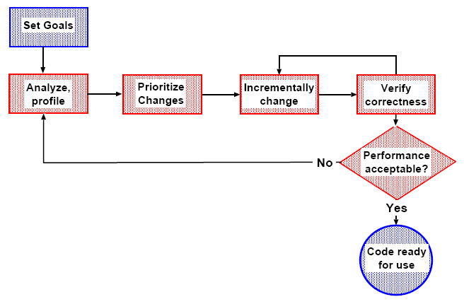
Parallelisation Problem
A generic flow of steps for parallelising a problem

Slide 12
Parallelisation Problem
Incremental change
Tackle a bit of the problem at a time
Helps recover from mistakes and poor attempts
Verify correctness
Develop test cases and constantly check results
Profile
Determine where time is spent
Determine where effort will yield most reward
Checkpoint/restart
Aids testing and debugging since some problems only occur late in the program execution
Lecture on profiling MPI applications is here

Slide 13

Incremental Change: On Shared Memory
Incremental parallelisation easiest on shared memory
Benefits to this approach include:
Smaller changes make it is easier to locate mistakes
It is easier to determine where efficiency is poor
Should have test cases available and constantly verify correctness

Slide 14
Incremental Change: On Distributed Memory
More complicated on distributed memory than on shared memory
Harder to get started, but basic approaches are similar
Do coarse-grained profiling
Determine the time consumed in the different sections of the program
Develop maps of the major data structures and where they are used

Slide 15
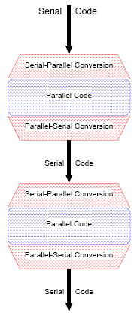
Incremental Change: On Distributed Memory
Start parallelising sections of code and data structures
Initially, all processors have the complete standard serial data structures (global data structures)
To parallelise code and data structures (local data structures), develop ‘scaffolding’ conversion routines
serial → parallel
parallel → serial
Verify correctness on test cases by showing serial → parallel → serial = serial for global data structures
Profile to see if efficiency of this piece is acceptable
If not, then develop an alternative

Slide 16
Parallel and Serial Performance Analysis
Performance goal
Reduce the wall clock execution time of a program
Practical and iterative approach
Measure the code with a hardware performance monitor and profiler
Analyse hotspots
Optimise and parallelise hotspots
Eliminate bottlenecks
Evaluate performance results and improve optimisation/ parallelisation
Lecture on performance analysis and tuning is here

Slide 17
Parallel and Serial Performance Analysis
Analysis technique
Timing (e.g. MPI_Wtime)
Counting (hardware counter)
Profiling
Tracing

Slide 18
Hardware Performance Monitors
Hardware counters
Gather performance-relevant events of the processor without affecting the performance of the analysed program
Two types
Processor monitor
Non-intrusive counts
Consists of a group of special purpose registers
Registers keep track of events during runtime:
General and floating point instructions, cache misses
System level monitor
bus monitor:
memory traffic, cache coherency
network monitor records network traffic

Slide 19
Performance API (PAPI)
Publicly available tool: http://icl.cs.utk.edu/papi/index.html
Vendor independent hardware counter tool
Supports most current processors
User needs to instrument code ⇒ PAPI functions
Fortran and C/C++ user interfaces
Easy-to-use and powerful high level API

Slide 20
OpenMP and MPI Trace Tools
Collect data at run-time
Post mortem analysis and visualisation of this data
Assess performance
Locate bottlenecks
Identify load-balancing problems
Examples
Intel’s trace visualisation tool - Trace Analyser & Collector
Only on Intel platforms
Vampir and Vampirtrace Trace analyser developed
Platform independent
http://vampir.eu
Tutorial with a use-case on Vampir is available here

Slide 21
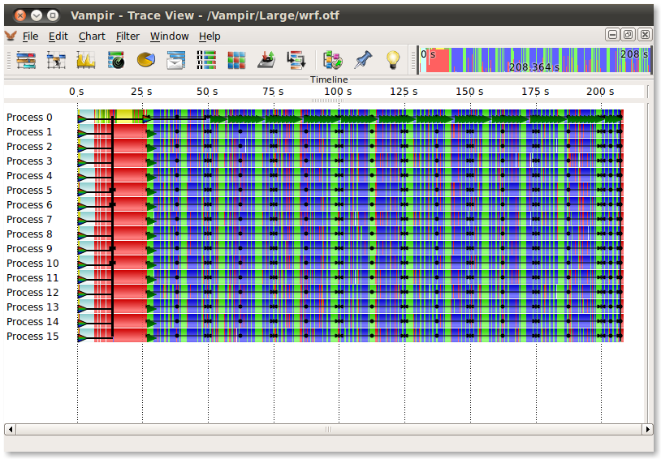
OpenMP and MPI Trace Tools
Sample output from Vampir

Slide 22
Debugging of Parallel Programs
Increased parallel complexity makes debugging difficult
Traditional sequential debugging technique is cyclic
Program is repeatedly stopped at breakpoints and then continued or re-executed again
Conventional style of debugging not possible with parallel programs
Do not always show reproducible behaviour, e.g. race condition.
Always: turn on compiler debugging options like array-bound checks
Commercial debuggers
TotalView (http://www.roguewave.com/products/totalview.aspx)
Allinea DDT (http://www.allinea.com)
Video on debugging an MPI program using TotalView is here
Video on debugging an OpenMP program using DDT is here

Slide 23
Boosting Performance: Practical Tips
Turn on optimisation flags
Search for better algorithms and data structures
For scientific codes use optimized math libraries
Tune the program
Data locality and cache re-use within loops
Avoid divisions, indirect addressing, IF statements, especially in loops
Loop unrolling and function in-lining (often compiler option), minimize/optimize I/O, ...

Slide 24
Boosting Performance: Practical Tips
Load-balance the code
Avoid synchronisation/barriers whenever possible
Optimise partitioning to minimise communication
Identify inhibitors to parallelism: data dependencies, I/O

Slide 25
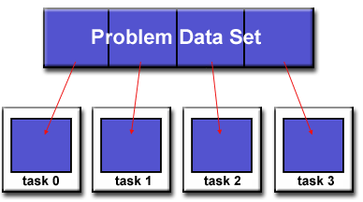
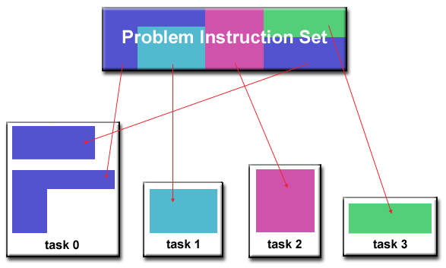
Partitioning
Breaking down (or decomposing) the problem into smaller chunks that are distributed to multiple tasks
Two types of partitioning
Domain decomposition
Functional decomposition

Slide 26
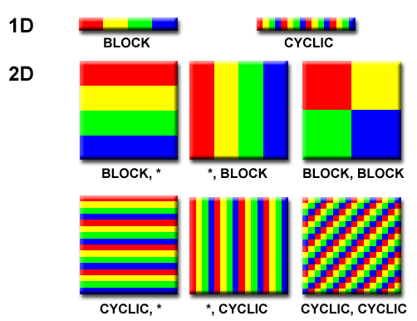
Partitioning: Domain Decomposition
Data is partitioned
Each parallel tasks works on one portion of the original data

Slide 27
Partitioning: Functional Decomposition
Focus on computation not on data
Problem decomposed according to work that must be done
Each task performs a portion of the overall task

Slide 28
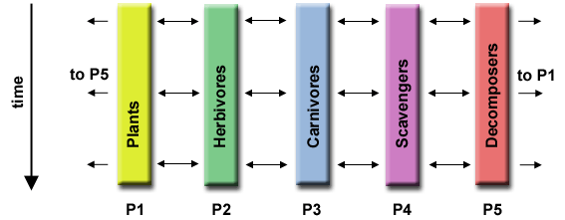
Partitioning: Functional Decomposition
Example
Ecosystem Modelling
Each process is to calculate population of a given group
Each group's growth depends on its neighbours
As time progresses, each process calculates its current state, then exchanges information with neighbour populations
All tasks then progress to calculate the state at the next time step

Slide 29
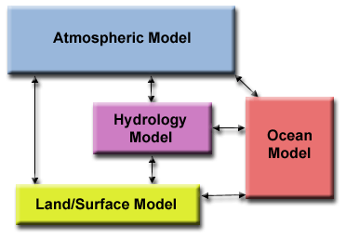
Partitioning: Functional Decomposition
Example
Climate Modelling
Atmosphere model generates wind velocity data that are used by the ocean model
Ocean model generates sea surface temperature data that are used by the atmosphere model, and so on…

Slide 30
Communications
The need for communication depends on the problem
Some types of problems can be decomposed and executed in parallel with virtually no need for tasks to share data
Called embarrassingly parallel
No inter task communication
Example
Image processing algorithm for a black and white image
Consider reversing every black pixel to white and vice versa
A parallel program can do this without any tasks communicating with each other

Slide 31
Communications
Most parallel applications are not simple
Require tasks to share data with each other
Example
A 3-D heat diffusion problem requires a task to know the temperatures calculated by the tasks that have neighbouring data
Changes to neighbouring data has a direct effect on that task's data

Slide 32
Communications
Factors to consider designing programs with inter-task communication
Cost of communications
Inter-task communication virtually always implies overhead
Machine cycles and resources that could be used for computation are instead used to package and transmit data
Communications frequently require some type of synchronisation between tasks
Results in tasks spending time "waiting" instead of doing work
Competing communication traffic can saturate the available network bandwidth

Slide 33
Communications
Factors to consider designing programs with inter-task communication (contd.)
Latency vs Bandwidth
Latency is the time taken to send a minimal (0 byte) message from point A to point B
Commonly expressed in microseconds.
Bandwidth is the amount of data that can be communicated per unit of time
Commonly expressed as megabytes/sec or gigabytes/sec
Sending many small messages can cause latency to dominate communication overheads
More efficient to package small messages into a larger message
Increases the effective communications bandwidth

Slide 34
Communications
Factors to consider designing programs with inter-task communication (contd.)
Visibility of communications
With the Message Passing model, communications are explicit
Generally quite visible and under the control of the programmer
With the Data Parallel model, communications occur transparently to the programmer, particularly on distributed memory architectures
The programmer may not even be able to know exactly how inter-task communications are being accomplished.

Slide 35
Communications
Factors to consider designing programs with inter-task communication (contd.)
Synchronous vs. asynchronous communications
Synchronous communications require some type of "handshaking" between tasks that are sharing data
Blocking communications since other work must wait until the communications have completed
Asynchronous communications allow tasks to transfer data independently from one another
Non-blocking communications since other work can be done while the communications are taking place
Interleaving computation with communication is the single greatest benefit for using asynchronous communications

Slide 36
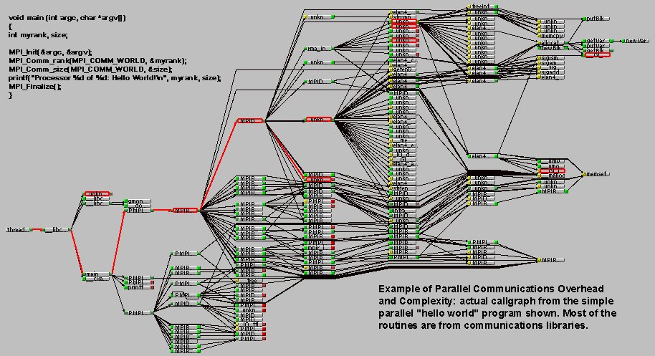
Communications
Overheads and Complexity

Slide 37
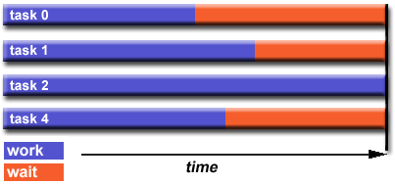
Load Balancing
Distributing work among tasks so that all tasks are kept busy all of the time
Minimises task idle time
Affects performance
Example - if all tasks are subject to a barrier synchronisation point, the slowest task will determine the overall performance

Slide 38
Load Balancing
Equally partition the work each task receives
Practical Tips
For array/matrix operations where each task performs similar work, evenly distribute the data set among the tasks
For loop iterations where the work done in each iteration is similar, evenly distribute the iterations across the tasks
If a heterogeneous mix of machines with varying performance characteristics are used, use performance analysis tools to detect and adjust load imbalances

Slide 39
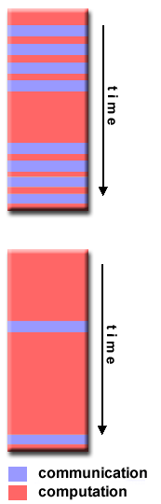
Granularity
Quantitative measure
Ratio of computing to communication
Fine grain parallelism
Relatively small amounts of computational work are done between communication events
Low computation to communication ratio
Facilitates load balancing
Implies high communication overhead and less opportunity for performance enhancement
If granularity is too fine it is possible that the overhead required for communications and synchronisation between tasks takes longer than the computation

Slide 40
Granularity
Coarse grain parallelism
Relatively large amounts of computational work are done between communication/synchronisation events
High computation to communication ratio
Implies more opportunity for performance increase
Harder to load balance efficiently

Slide 41
Granularity
Which is best?
The most efficient granularity is dependent on the algorithm and the hardware environment in which it runs
In most cases the overhead associated with communications and synchronisation is high relative to execution speed so it is advantageous to have coarse granularity
Fine-grain parallelism can help reduce overheads due to load imbalance

Slide 42
I/O
Inhibitor to parallelism
Parallel File Systems are available
GPFS: General Parallel File System for AIX (IBM)
Lustre: for Linux clusters (SUN Microsystems)
PVFS/PVFS2: Parallel Virtual File System for Linux clusters
(Clemson/Argonne/Ohio State/others)
PanFS: Panasas ActiveScale File System for Linux clusters (Panasas, Inc.)
HP SFS: HP StorageWorks Scalable File Share. Lustre based parallel file system (Global File System for Linux) product from HP

Slide 43
Portability
Standardisation helps to run parallel programs across multiple platforms
POSIX, MPI, OpenMP APIs are standardised
Different implementations may be available
Code modification may be required to make program portable
Vendor specific enhancement to APIs may not be portable
Other factors affecting portability
Operating System
Hardware architecture

Slide 44
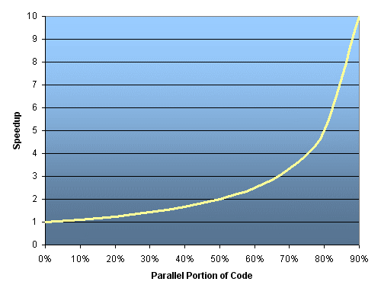
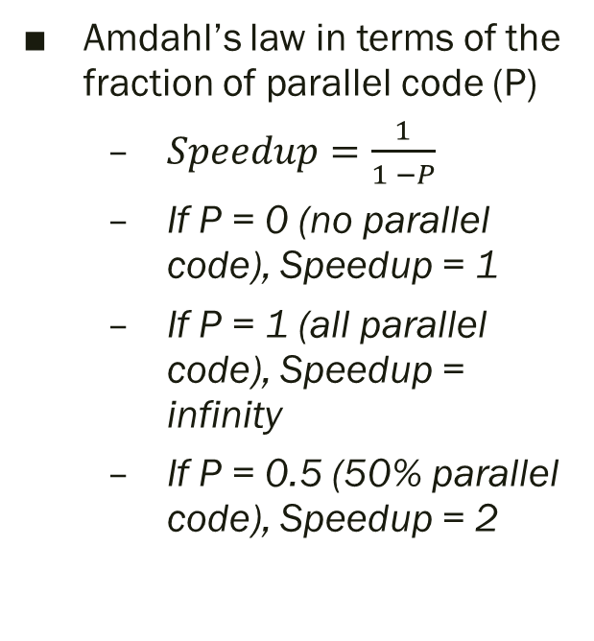
Limits of Parallel Programming
Amdahl’s law in terms of the fraction of parallel code (P)
$Speedup=\frac{1}{1 −P}$
If P = 0 (no parallel code), Speedup = 1
If P = 1 (all parallel code), Speedup = infinity
If P = 0.5 (50% parallel code), Speedup = 2

Slide 45
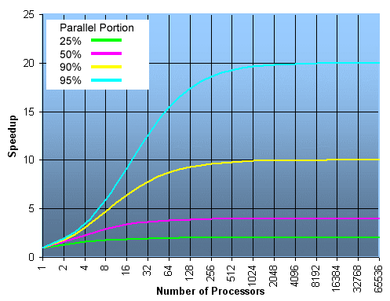
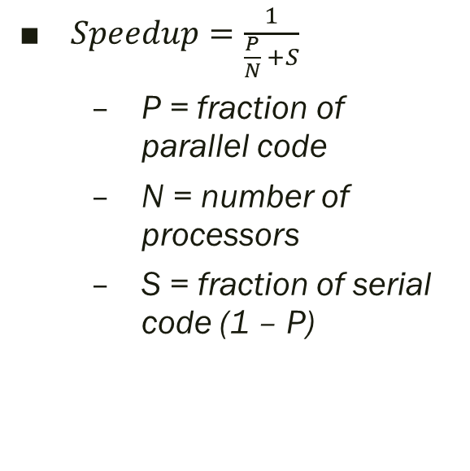
Limits of Parallel Programming
$Speedup=\frac{1}{\frac{P}{N} +S}$
P = fraction of parallel code
N = number of processors
S = fraction of serial code (1 – P)

Slide 46
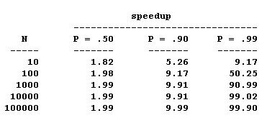
Limits of Parallel Programming
There are limits to the scalability of parallelism

Slide 47
What was covered…
Parallelisable vs Non-parallelisable programs
Understanding a program
Parallelisation problem
Parallel and serial performance analysis
Considerations for boosting performance
Limits of parallel programming

