Slide 1

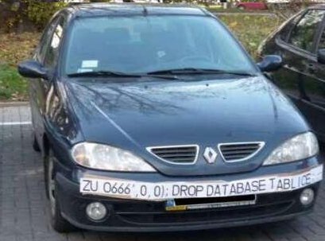
Course: Introduction to Intelligent Transportation Systems
University of Tartu, Institute of Computer Science
Project:
Automatic Plate Number Recognition (APNR)
Student: Leonid Dashko

Slide 2
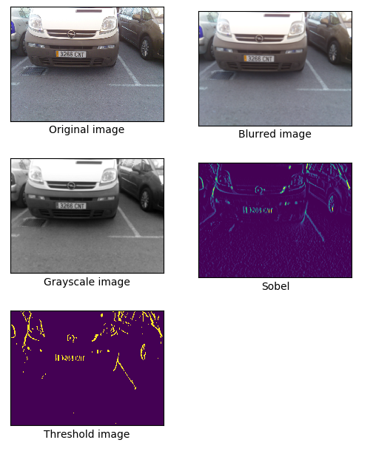
APNR: STEPS #1-5
Load image
Apply blur filter (to remove noise)
Convert blurred image to grayscale
Apply Sobel filter to find vertical edges (car plates have a high density of vertical lines)
Apply threshold with Ostu’s Binarization
(Ostu’s binarization will automatically calculate optimal threshold from image histogram)

Slide 3

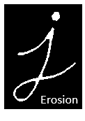


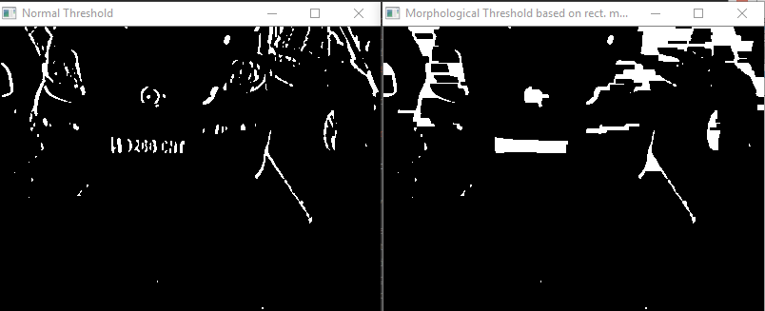

APNR: STEP #6 (Morphological filters in OpenCV)
Then I created a rectangular mask of size of 17x3 and applied “closing” filter (shown on the right) to detect plate number more clearly
Notes:
Also tried to apply “diliate”, but the result was not satisfactory.

Slide 4
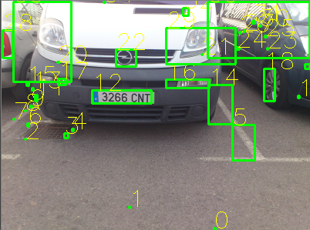
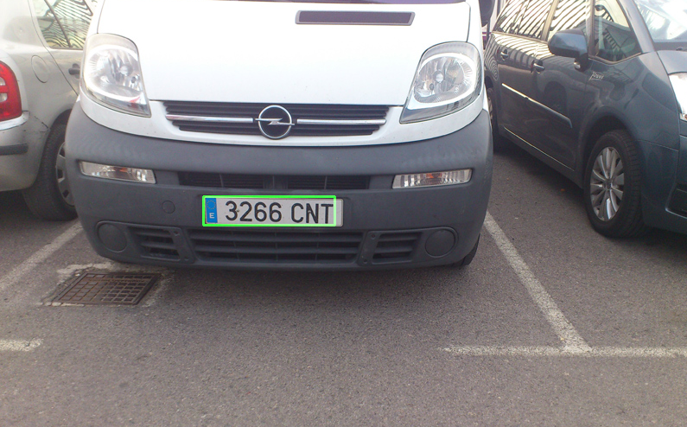

APNR: STEPS #7-9
Find and fetch contours of possible plates
Validate contours and clear out those, that can't be potential plate numbers
- Is white color dominant?
- Rotated not more than 15 degrees
- In Europe, car plate size: 52x11, aspect 4,7272
- Define min && max area of plate number
After (8), apply “dilate” filter and threshold to validated contours to get numbers and characters
Notes:
# After applying these functions, we have regions in the image that could contain a plate; # However, most of the regions will not contain license plates.

Slide 5
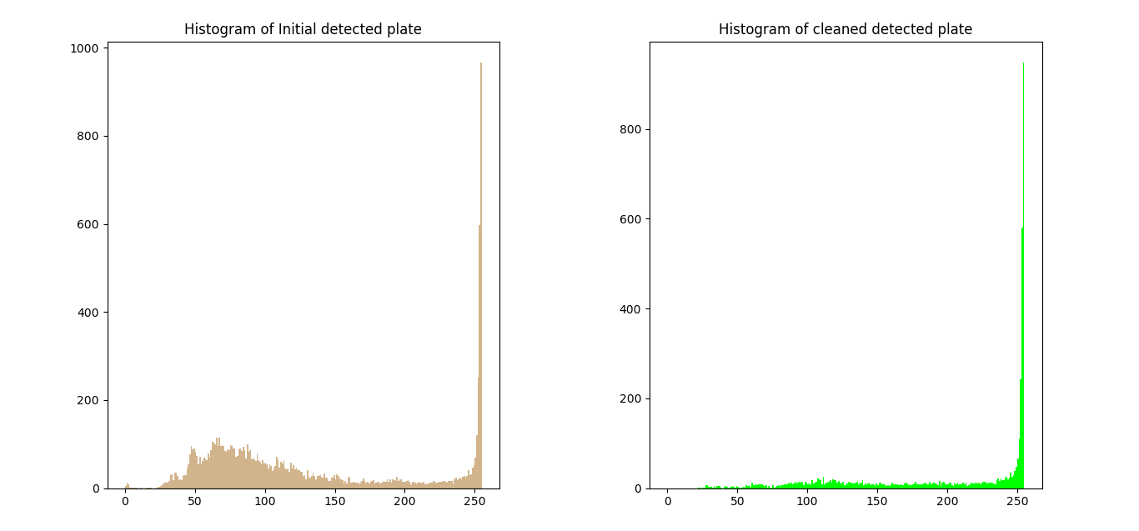
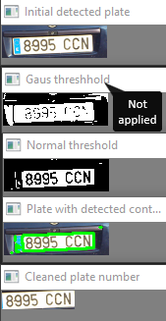
APNR: STEP #9 in details
Notes:
# After applying these functions, we have regions in the image that could contain a plate; # However, most of the regions will not contain license plates.

Slide 6
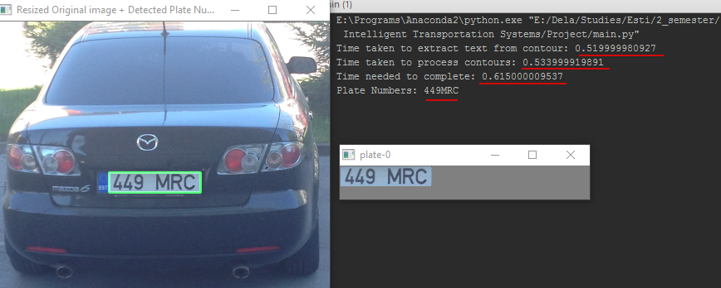
APNR: STEP #10 (parse plate number from image)
Apply Tesseract to extract plate number as a text.
Tesseract is an optical character recognition (OCR) engine sponsored by Google
Notes:
# After applying these functions, we have regions in the image that could contain a plate; # However, most of the regions will not contain license plates.

Slide 7
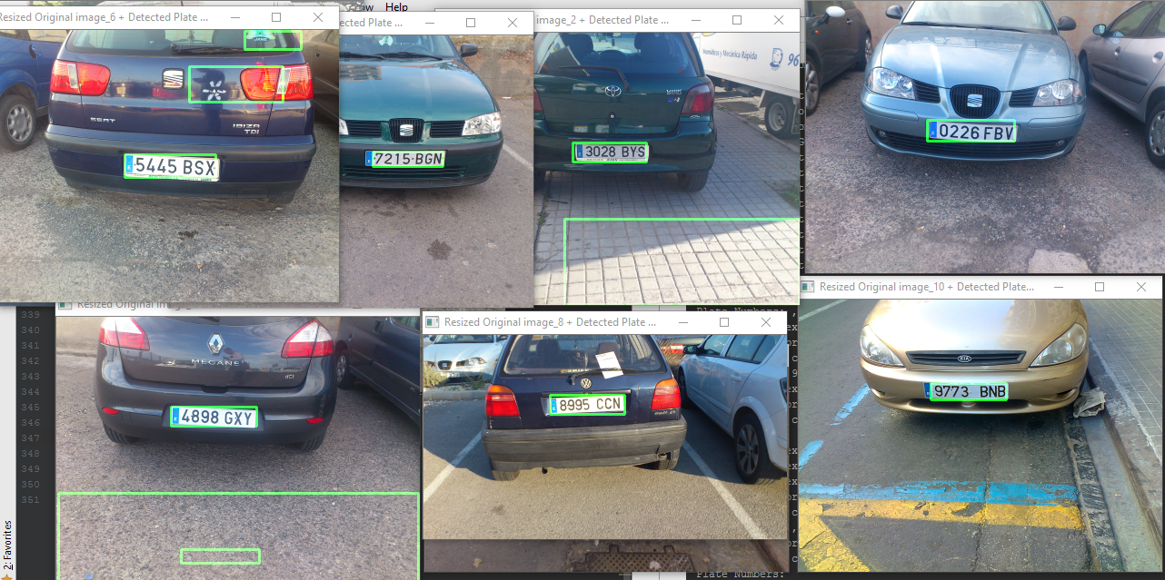
APNR: Final Result
Notes:
# After applying these functions, we have regions in the image that could contain a plate; # However, most of the regions will not contain license plates.

Slide 8
Thank you for attention!
Notes:
# After applying these functions, we have regions in the image that could contain a plate; # However, most of the regions will not contain license plates.

