Slide 1
E-COMMERCE
Team Members Guided By Dheerendra Kag Jaynam Sanghvi

Slide 2



Technologies used
Java is a high-level, class-based, object-oriented programming language that is designed to have as few implementation dependencies as possible.
JAVA
Spring Boot is an open source, microservice-based Java web framework. Spring Boot framework creates a fully production-ready environment that is completely configurable using its prebuilt code within its codebase.
SPRING BOOT
Angular is a platform and framework for building single-page client applications using HTML and TypeScript. Angular is written in TypeScript. It implements core and optional functionality as a set of TypeScript libraries that you import into your applications.
ANGULAR

Slide 3
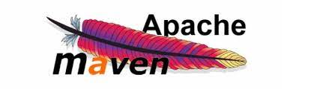


Technologies used
Maven is a build automation tool used primarily for Java projects. Maven can also be used to build and manage projects written in C#, Ruby, Scala, and other languages.
MAVEN
MySQL is an open source relational database management system. For WordPress sites, that means it helps you store all your blog posts, users, plugin information, etc.
MYSQL
Bootstrap is a free and open-source CSS framework directed at responsive, mobile-first front-end web development.
BOOTSTRAP

Slide 4
Problem statement
This projects aims to develop an online shopping for customers with the goal so that it is very easy to shop your loved things from a extensive number of online shopping sites available on the web. With the help of this you can carry out an online shopping from your home. Here is no compelling reason to go to the crowed stores or shopping centers during festival seasons. You simply require a PC or a laptop and one important payment sending option to shop online. To get to this online shopping system all the customers will need to have a email and password to login and proceed your shopping . The login credentials for an online shopping system are under high security and nobody will have the capacity to crack it easily. Upon successful login the customers can purchase a wide range of things such as mobiles, books, apparel, jewellery, infant care, gifts, tools, etc. can be dispatched using online shopping system. Not just these, you can also purchase from outside nations by few clicks on your mouse. And of course you will get your requested ordered items at your door step.

Slide 5
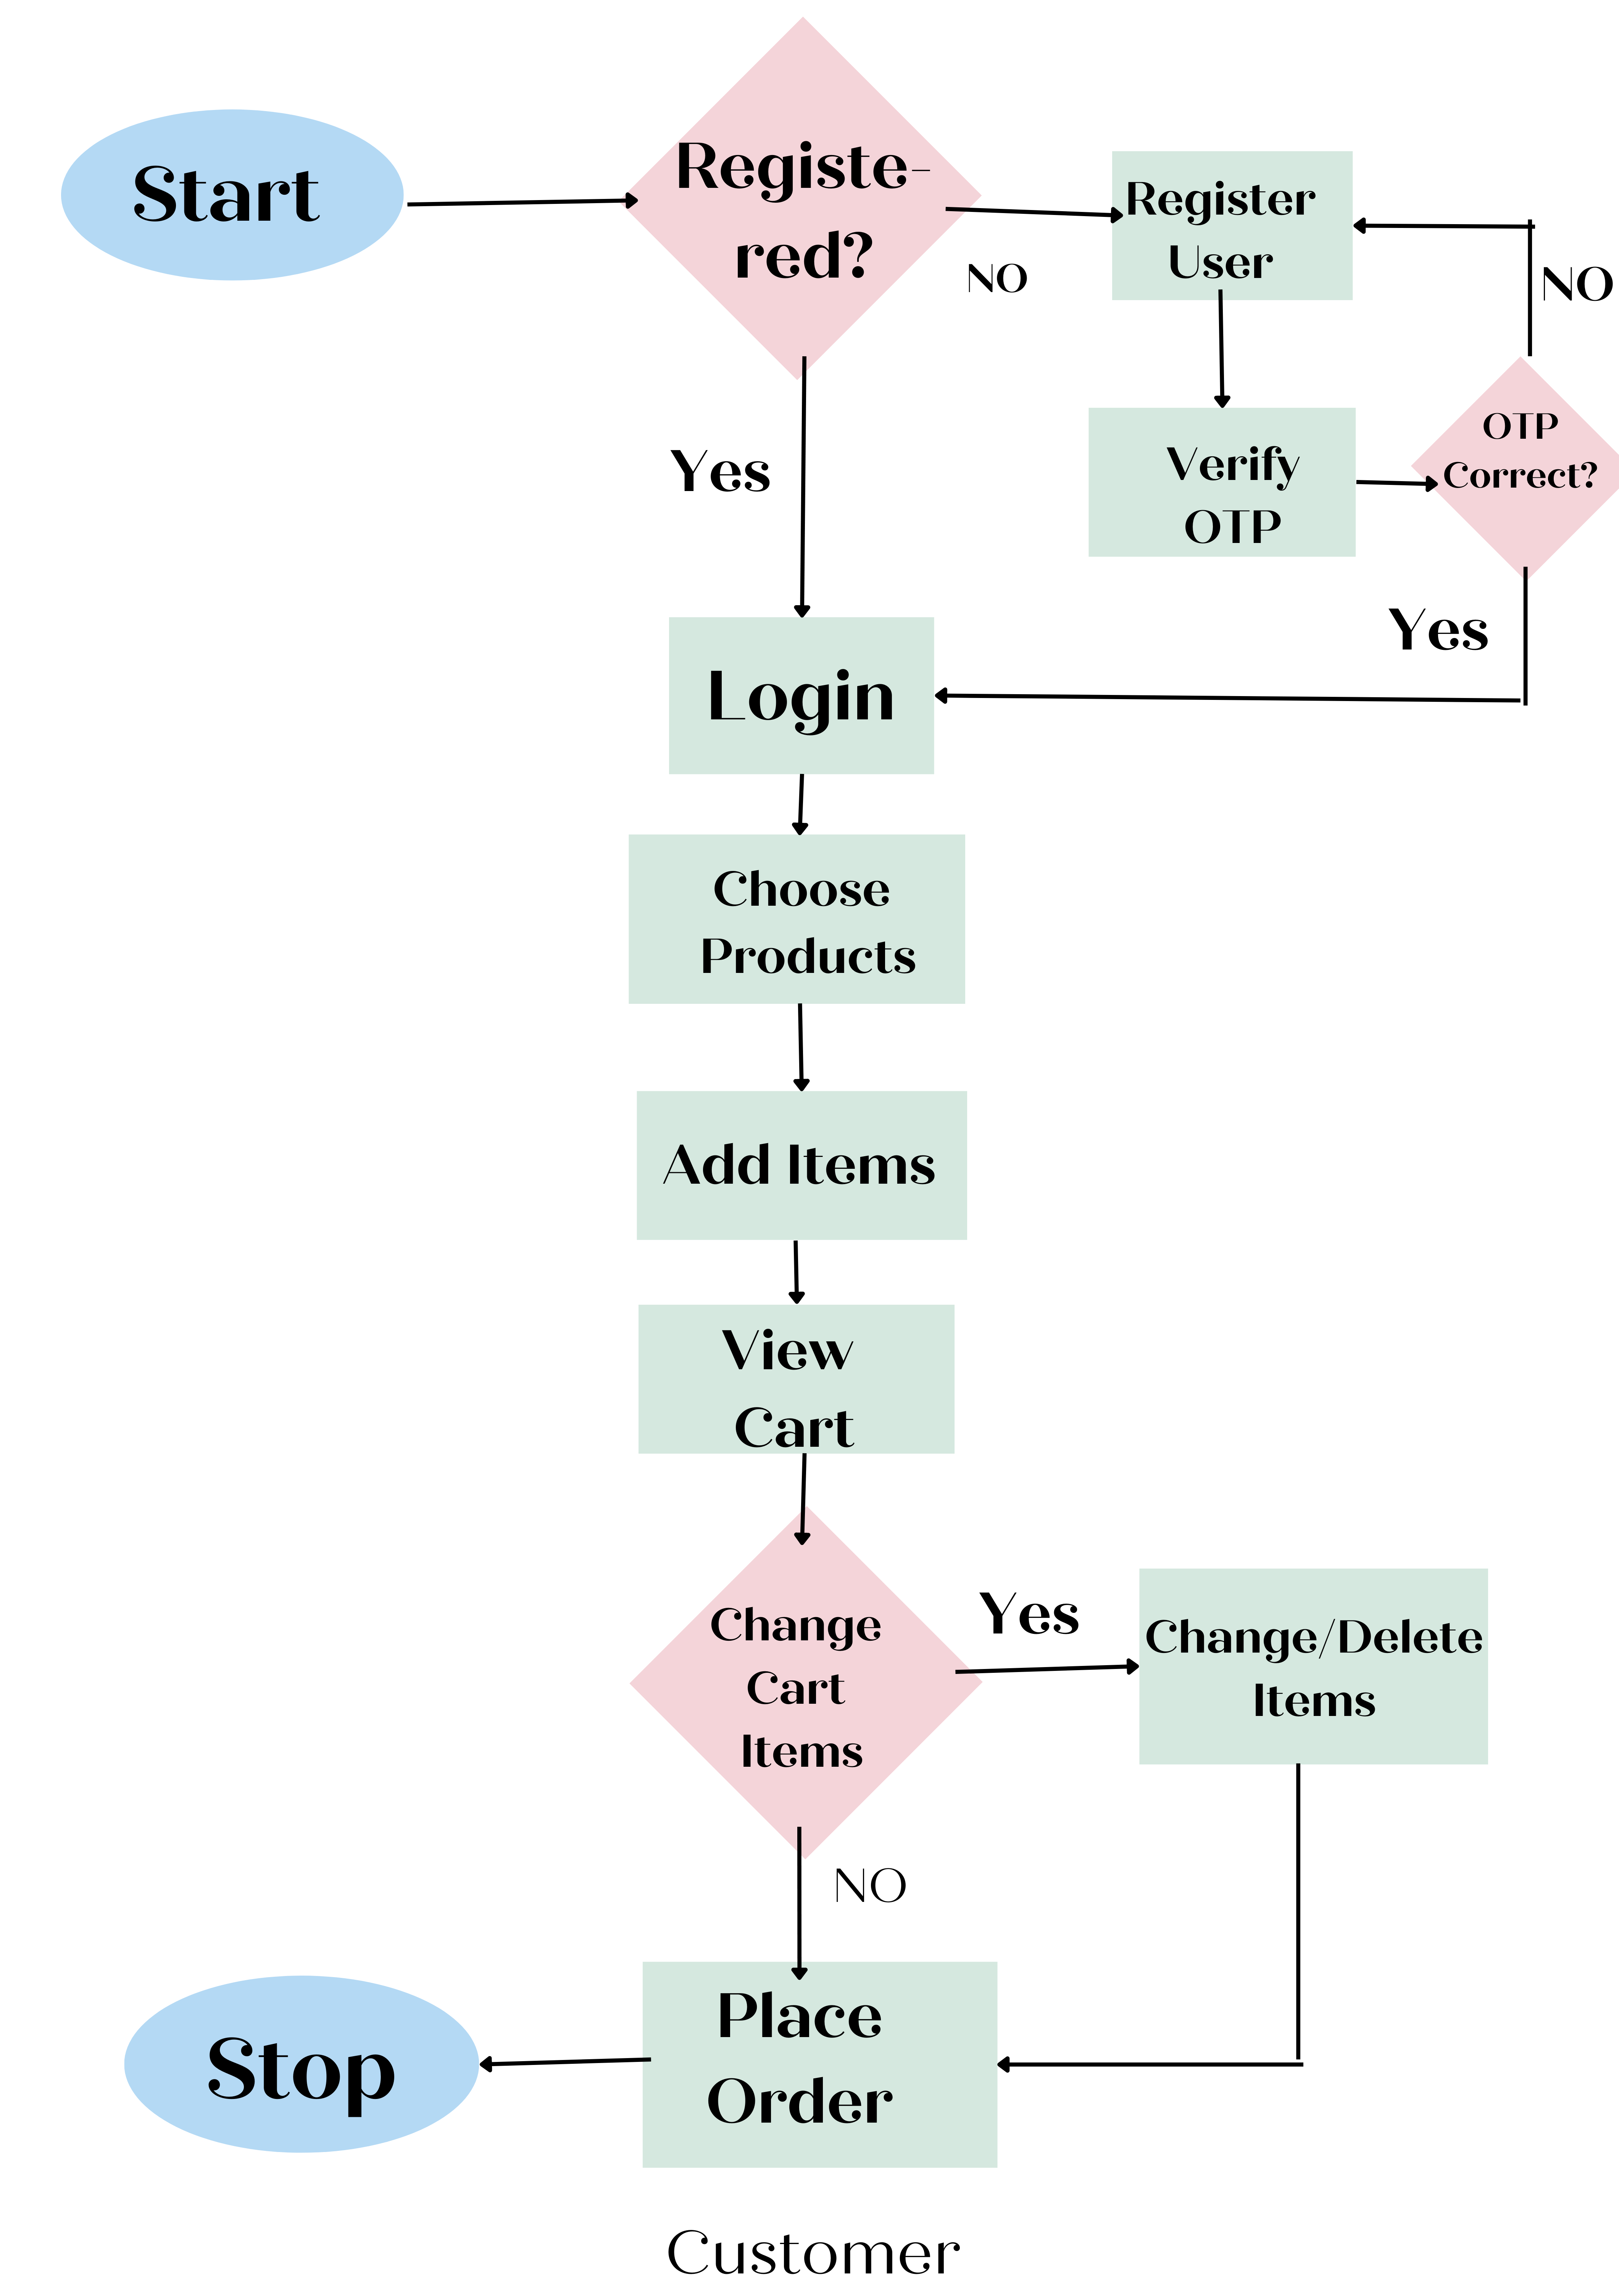
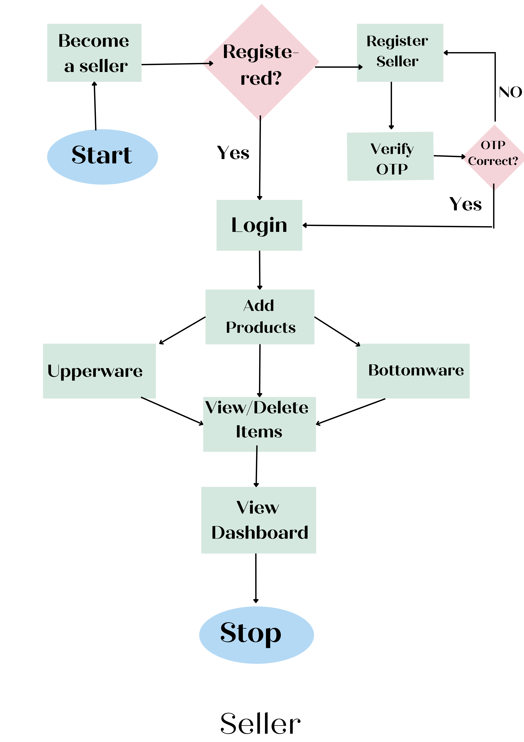
Plan
1. Design:

Slide 6
Plan
2. TDD approach:
Test
Driven
Development
Red
Green
Refactor
Start here
Write a test
Clean code
Test Fails
Workable code to make test pass
Write code to make test pass
Code passes test

Slide 7
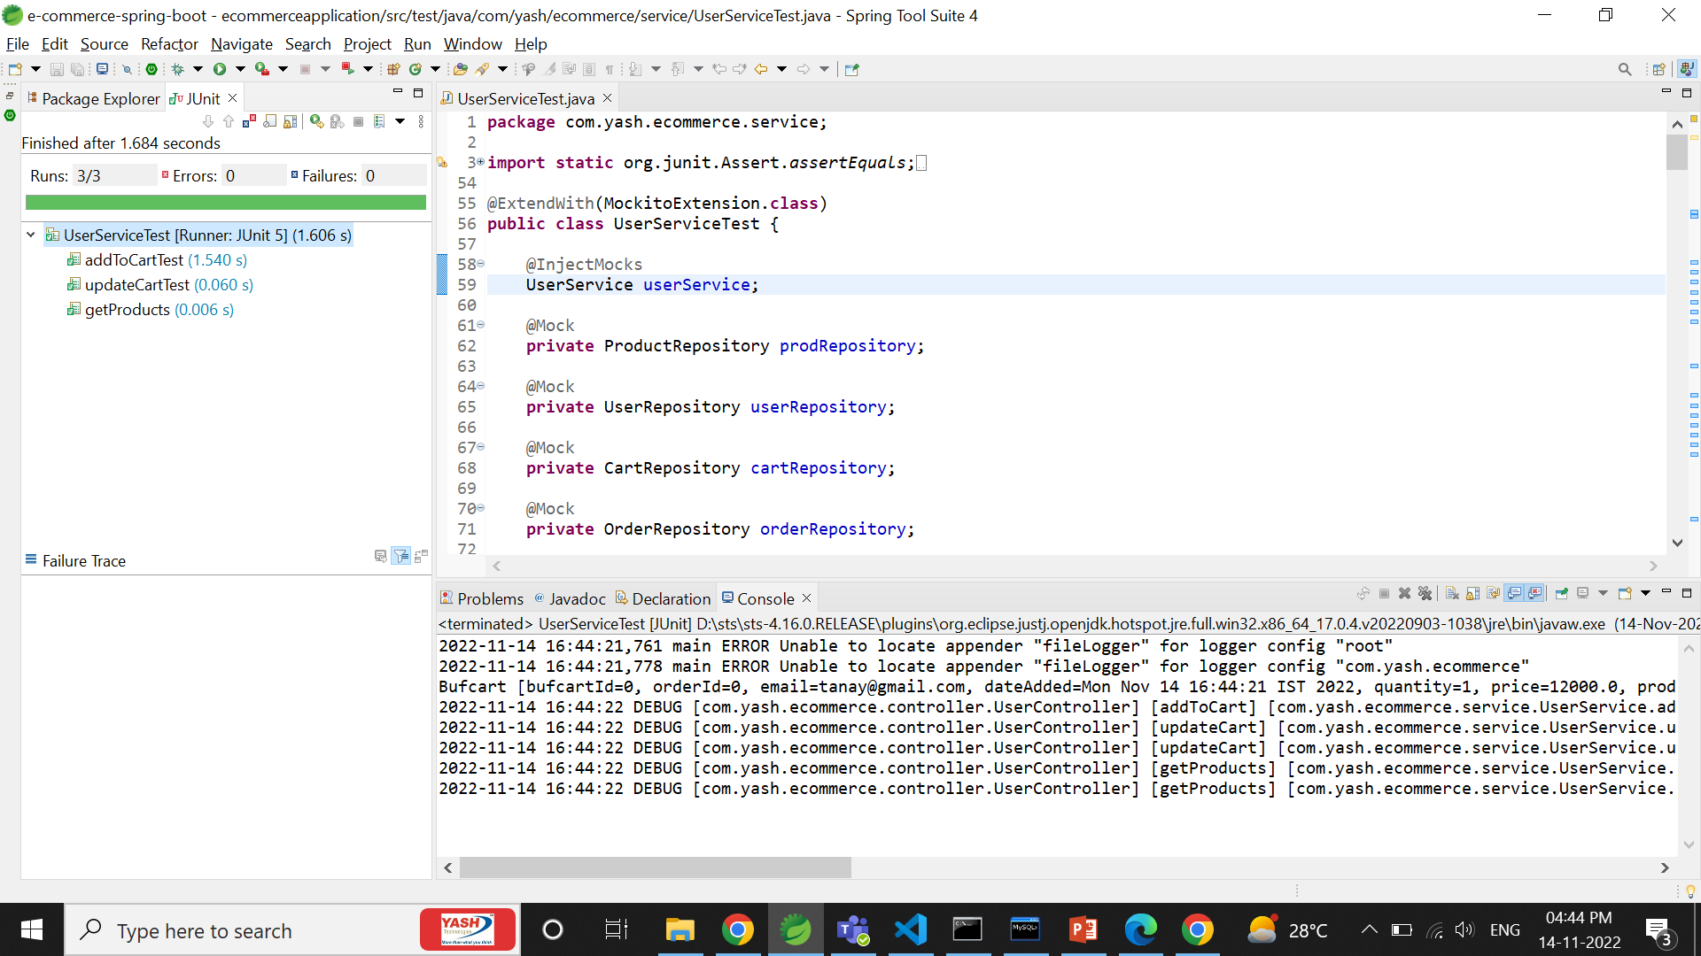
Plan

Slide 8
Modules
Modules
Seller
Customer

Slide 9
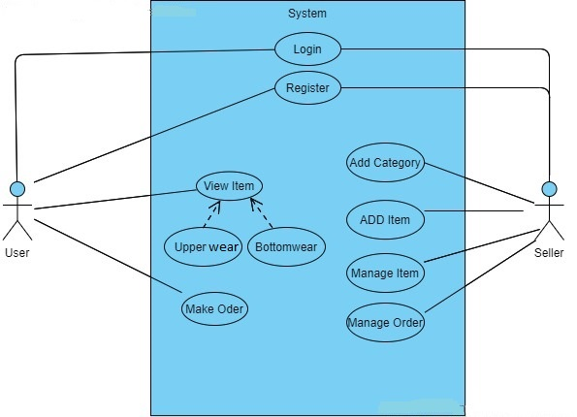
Use case diagram

Slide 10
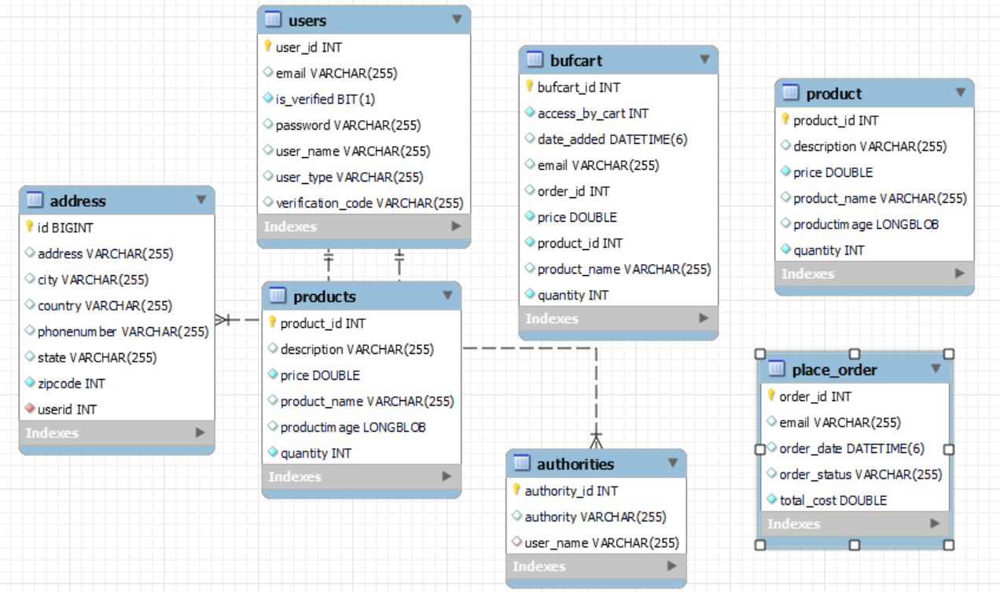
ER-Diagram

Slide 11
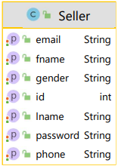
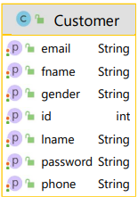
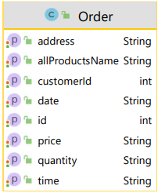
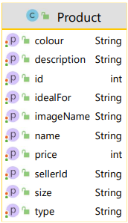
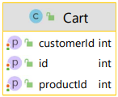
Pojo classes

Slide 12
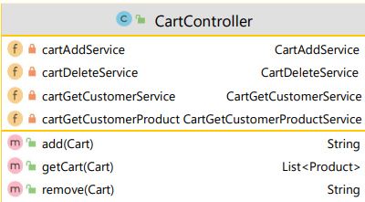
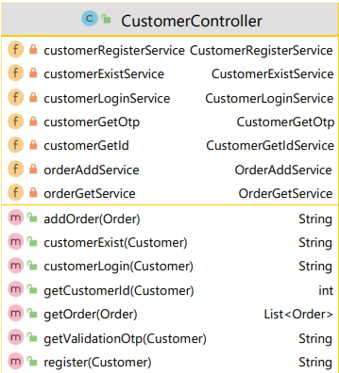
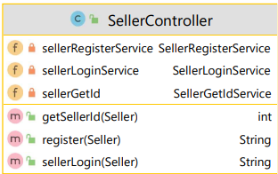
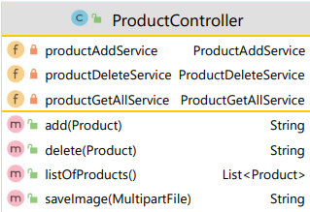
Controller classes

Slide 13
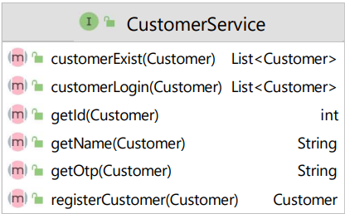
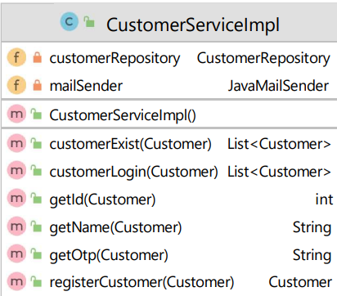
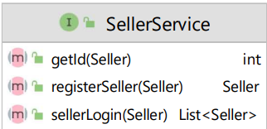
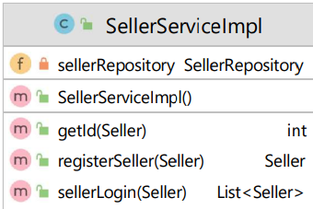
service classes

Slide 14
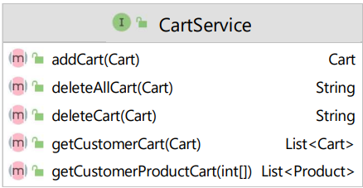
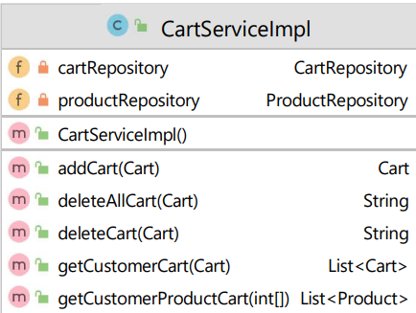
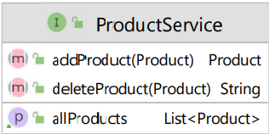
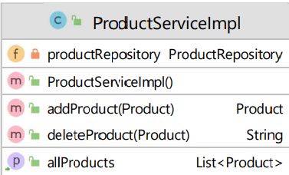
service classes

Slide 15
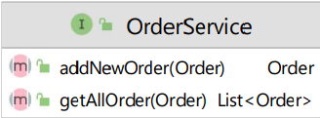
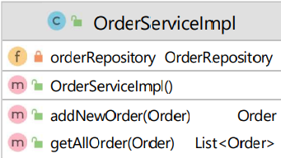
service classes

Slide 16





Repository classes

Slide 17
Conclusion

