Slide 1
Classification of Vowels from Imagined Speech

Slide 2
INTRODUCTION
This Research uses Imagined Speech which can be used to allow physically impaired patients to communicate.
The objective of this research is to develop a classifier that uses deep learning to classify EEG signals associated with imagining pronouncing vowels
The main focus is on developing a model that is less complex to try and achieve accuracy similar to the already developed models.
We are attempting to check that, if higher complexity is required in imagined speech classification.

Slide 3
DATA SET
The dataset consists of EEG signals recorded from 15 subjects who performed overt and covert speech tasks, pronouncing five vowels and six words in Spanish.
The EEG signals were recorded with an 18-channel analogue amplifier at a sampling rate of 1024 Hz, and the electrodes were positioned at six locations according to the 10–20 international system.
The experimental protocol consisted of a two second pre-trial period, a four second period of imagined pronunciation, and a two second rest period. The vowel had to be pronounced for the whole four seconds, while the word had to be repeated three times.
The text states that only the vowel part of the dataset was used in this study.

Slide 4
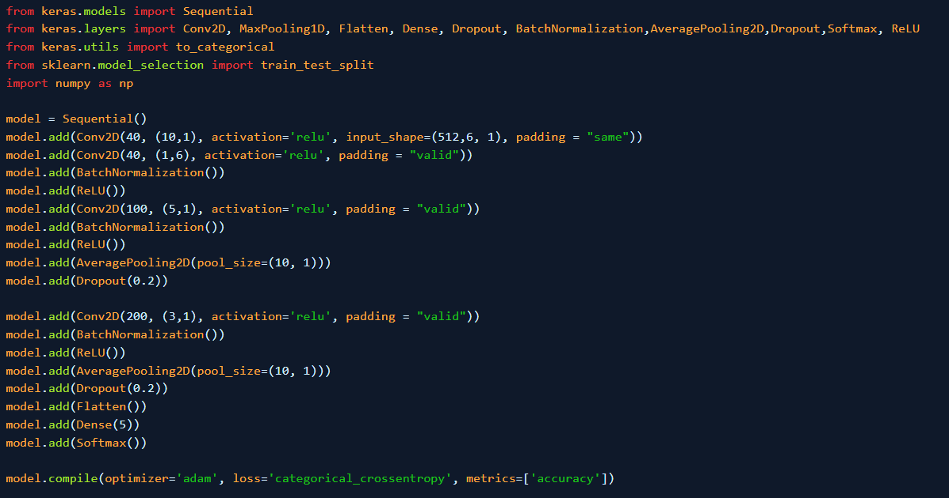
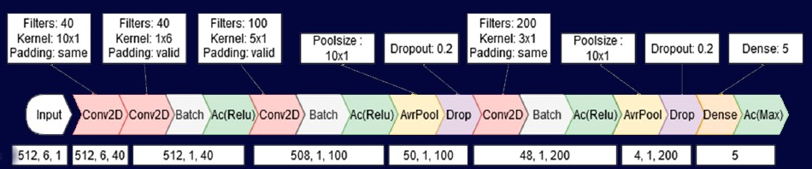
MODEL

Slide 5
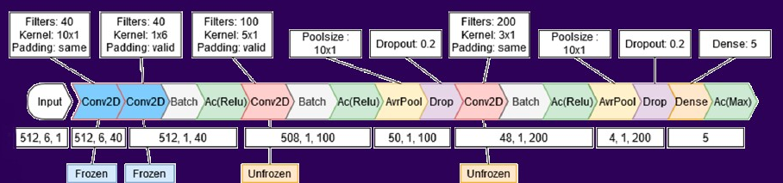
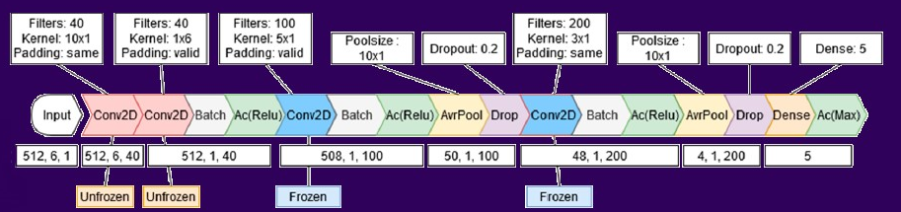
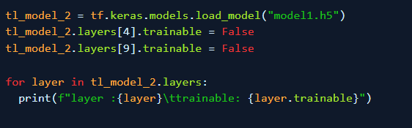
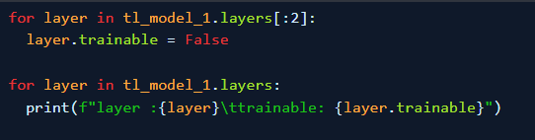
TRASFER LEARNING

Slide 6
CONCLUSION
Improved classification accuracy with a 16-layer neural network and transfer learning methods.
Emphasized the importance of deeper neural networks for personalized EEG imagined speech classification.
Replicated and confirmed previous results on imagined speech data using a 15-subject dataset
The Average Accuracy obtained across all models is 78.54% and the best Accuracy recorded is 83.999%
The study highlights the potential of imagined speech as a tool for communication for physically disabled individuals.
This model should be re-trainable on a single subject to achieve even higher individual classification performance.

