Slide 1
Department app Java project

Slide 2
Слайд 2 с анализом проекта
Project overview
Department app is an application for managing employees and departments by managers of the company.
This app must provide:
CRUD for employees
CRUD for departments
Employees by department

Slide 3
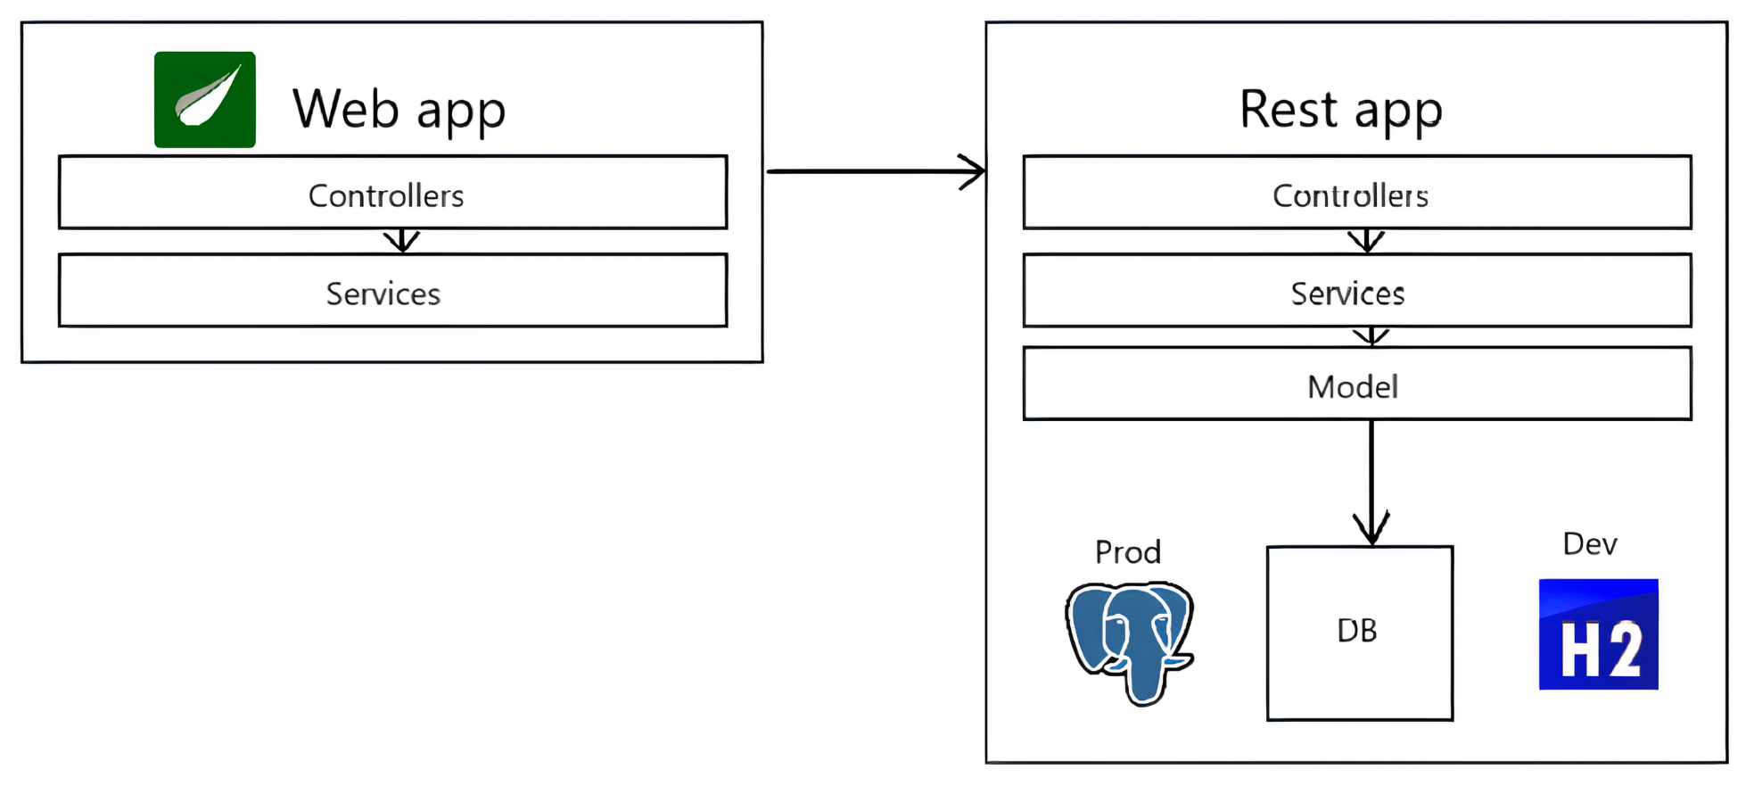
Слайд 2 с анализом проекта
Project structure
Consists of 2 apps:
Web app:
Provides view
For view – thymeleaf
Rest app:
Provides API
For production launch – PostgreSQL
For tests – h2 embedded

Slide 4
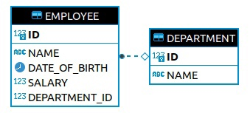
Слайд 2 с анализом проекта
Database structure
Foreign key: employee department id to department id

Slide 5
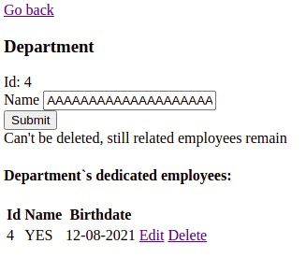
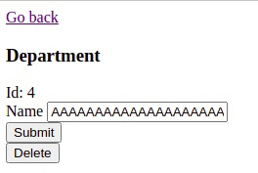
Слайд 2 с анализом проекта
Web app
Features:
Adaptive design
Controller advice to handle exceptions
- Related employee deleted ->
Picture 1 - before
Picture 2 - after

Slide 6
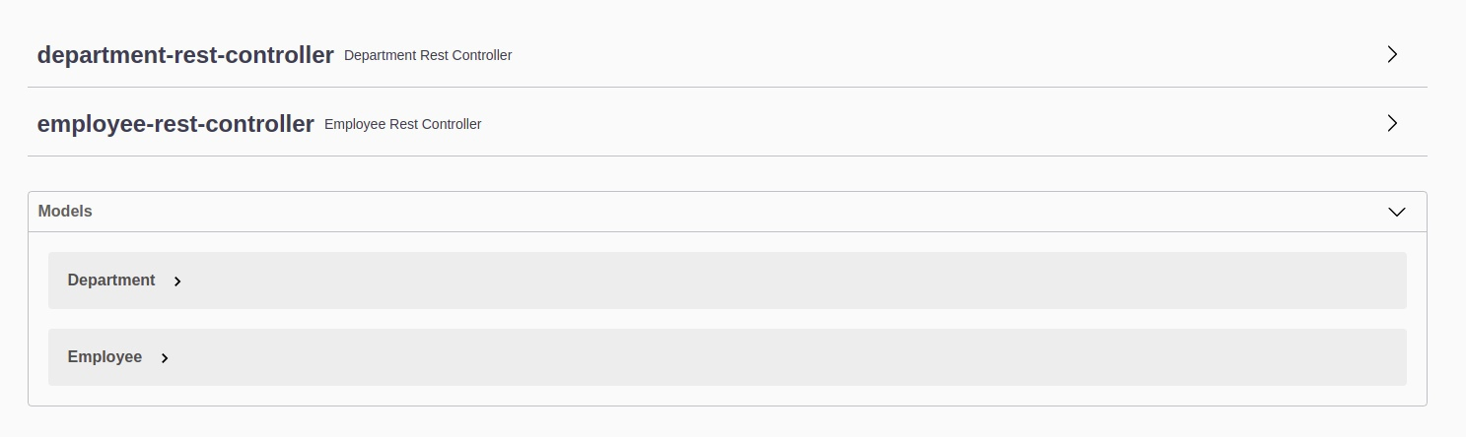
Слайд 2 с анализом проекта
Rest app
Features:
High code coverage – every layer tested
Postgres database by default, h2 for testing
API documented by Swagger
Picture 1 – swagger UI

Slide 7
Слайд 2 с анализом проекта
Application life
Used technologies:
Spring boot
Thymeleaf
Log4j2
Jupiter
Mock MVC
Apache Maven
To build and run app:
Building tool – apache maven
2 jars are generated that can be ran separately

