Slide 1
SARS-CoV-2 sequencing results from NOVASeq Workflow and comparison with Sequences from MiNon Sequencing

Slide 2
Background
-ARTIC method is the most cited workflow for SARS-CoV-2 sequencing
-Determine, which of ARTIC NoVaSeq or MiSeq is more sensitive and timely for the sequencing of SARS-CoV-2

Slide 3
Background
Different thermocyclers might have slight variation of temperature, and artic-ncov2019 protocol authors recommend optimizing the PCR annealing temperature for the sequencing of SARS-CoV-2 using both MiNion and Illumina NovaSeq sequencers (Tyson et al, 2020, bioRxiv).
I performed PCR and sequencing of RNA dilutions from two SARS-CoV-2 isolates (Sample 1 and sample 2) using MiNion NGS method (artic-ncov2019 lo-cost protocol).
Sample 1 and sample 2 had nearly the same SARS-Cov-2 RNA copies (100000)
Notes:
https://pubmed.ncbi.nlm.nih.gov/32908977/

Slide 4
Objectives
Identify the optimal PCR annealing temperature between 61°, 63°and 65°.
Compare NoVaseq Vs MiNion
Compare the coverage depth for each annealing temperatures
Compare the number of sequencing reads obtained for each annealing temperature
Compare variance of coverage depth for each annealing temperature

Slide 5
Method
In the same experiment, two nasopharyngeal swabs samples were subjected to:
RNA extraction
cDNA synthesis
Multiplex PCR (ARTICv3 protocol)
WGS

Slide 6
Method
Sample 1.2
Sample 2.2
RNA extraction
cDNA synthesis
Multiplex PCR
(Three different annealing temperatures)
61, 63 and 65 deg c
Sequencing
MiNion
NOVAseq

Slide 7
Artic prime primer scheme

Slide 8
1. Number of reads obtained using MiNion
MINION
63°
63°
61°
61°
65°
65°
Sample 1
Sample 2

Slide 9
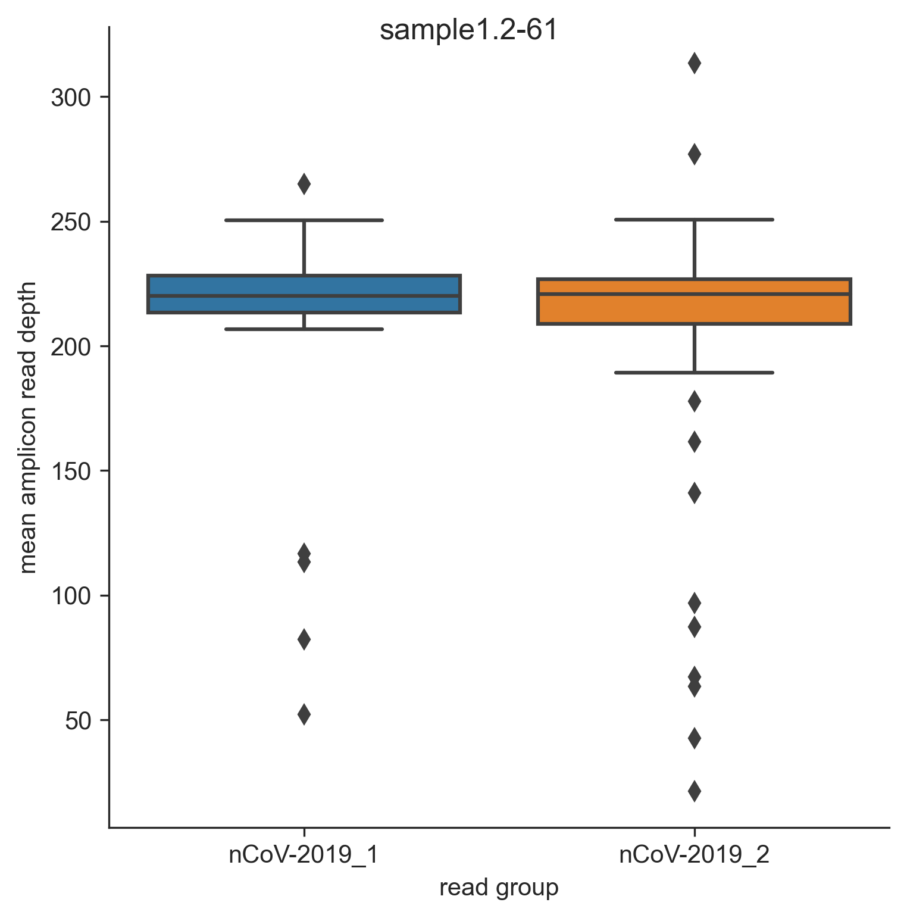
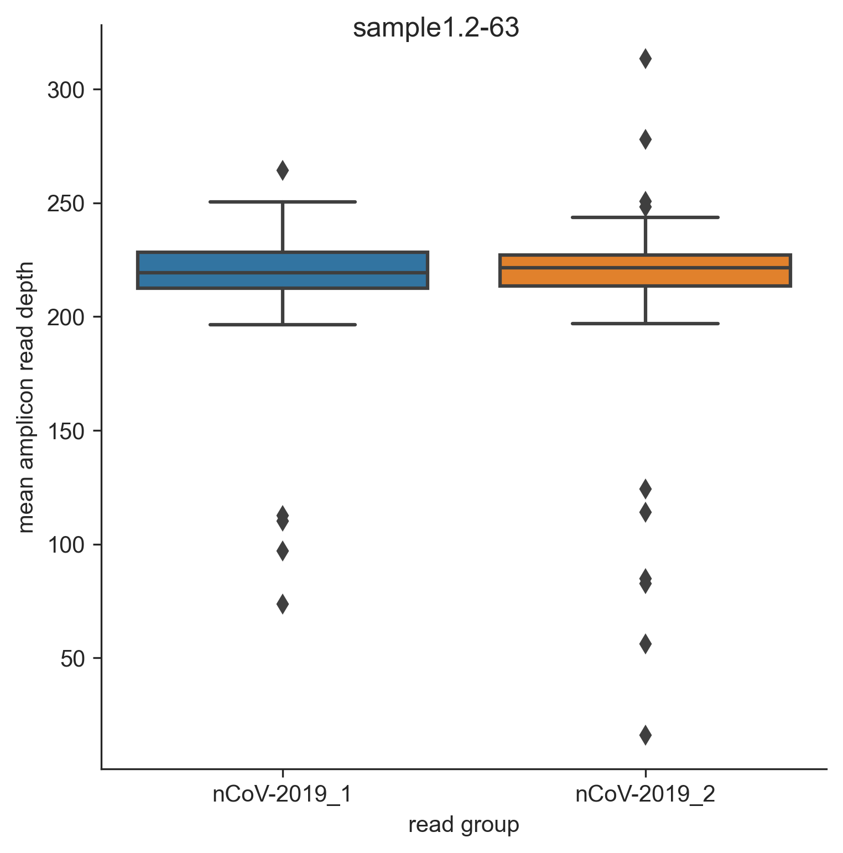
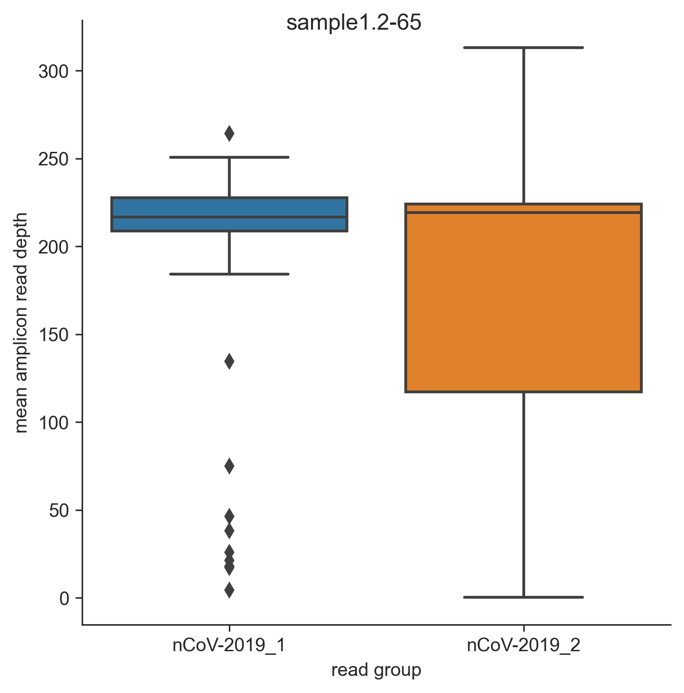
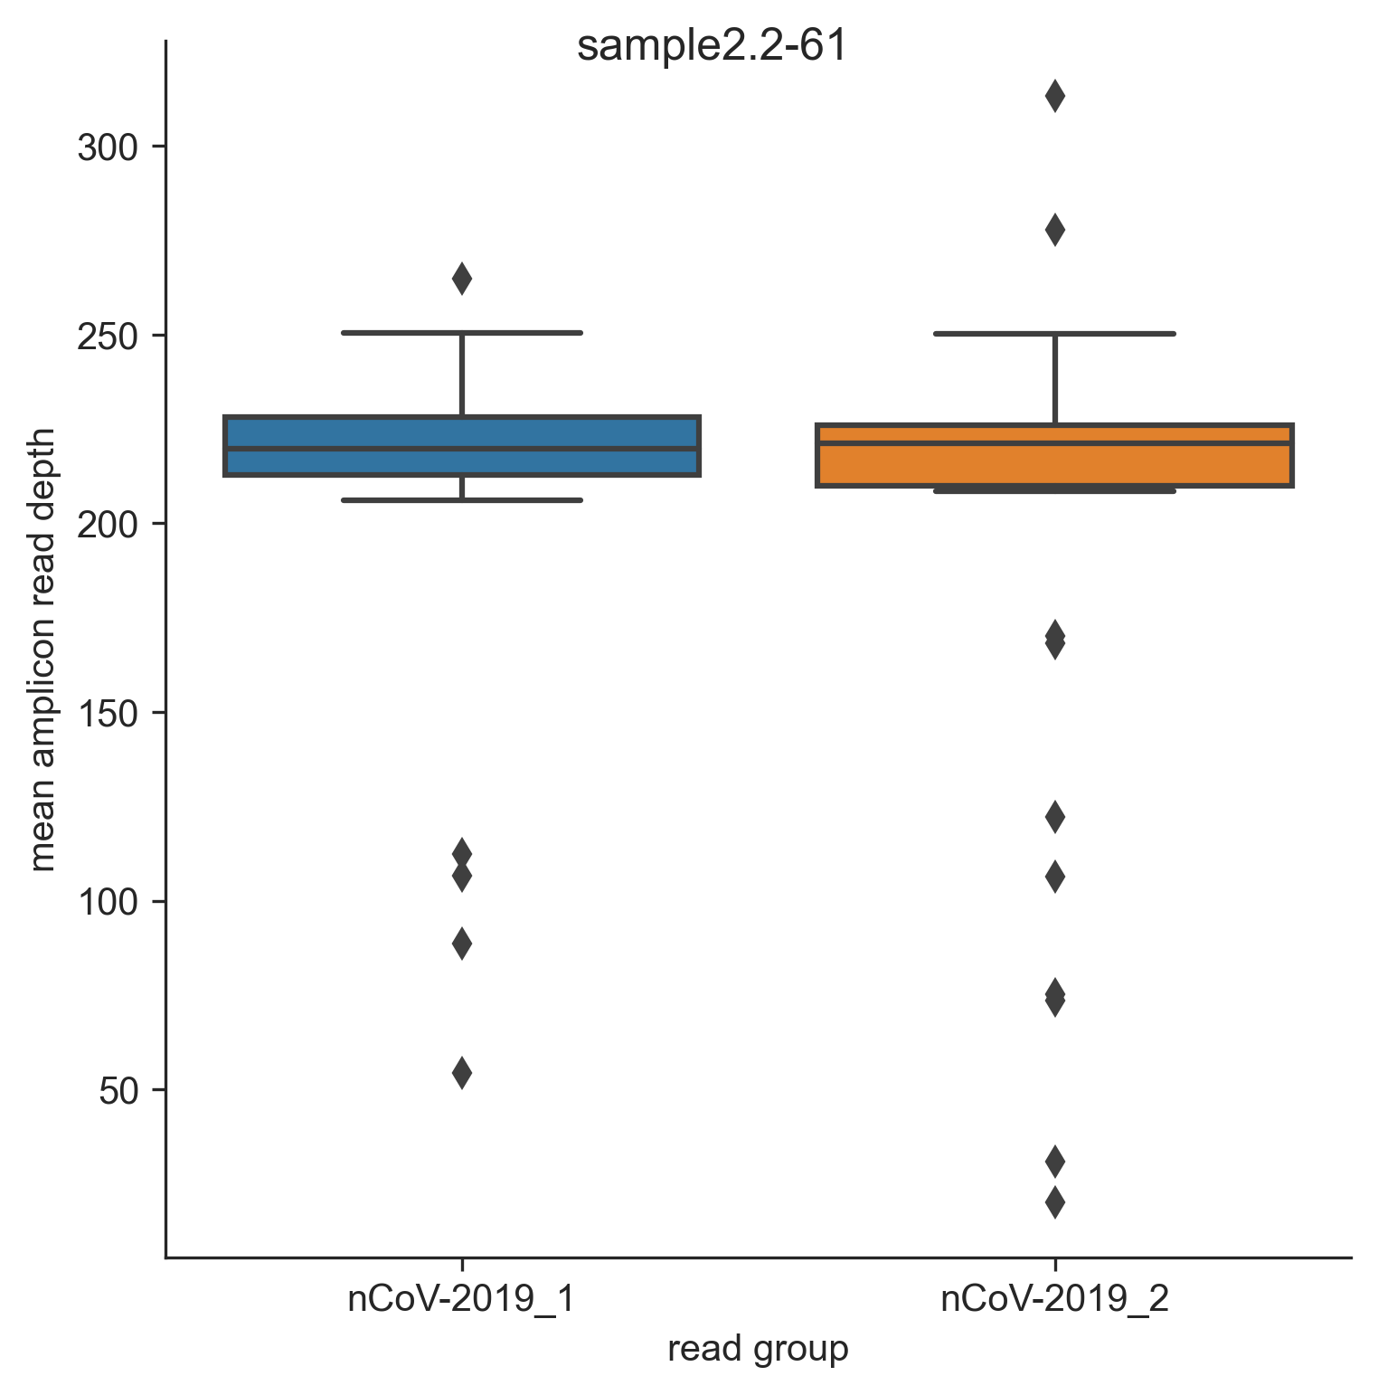

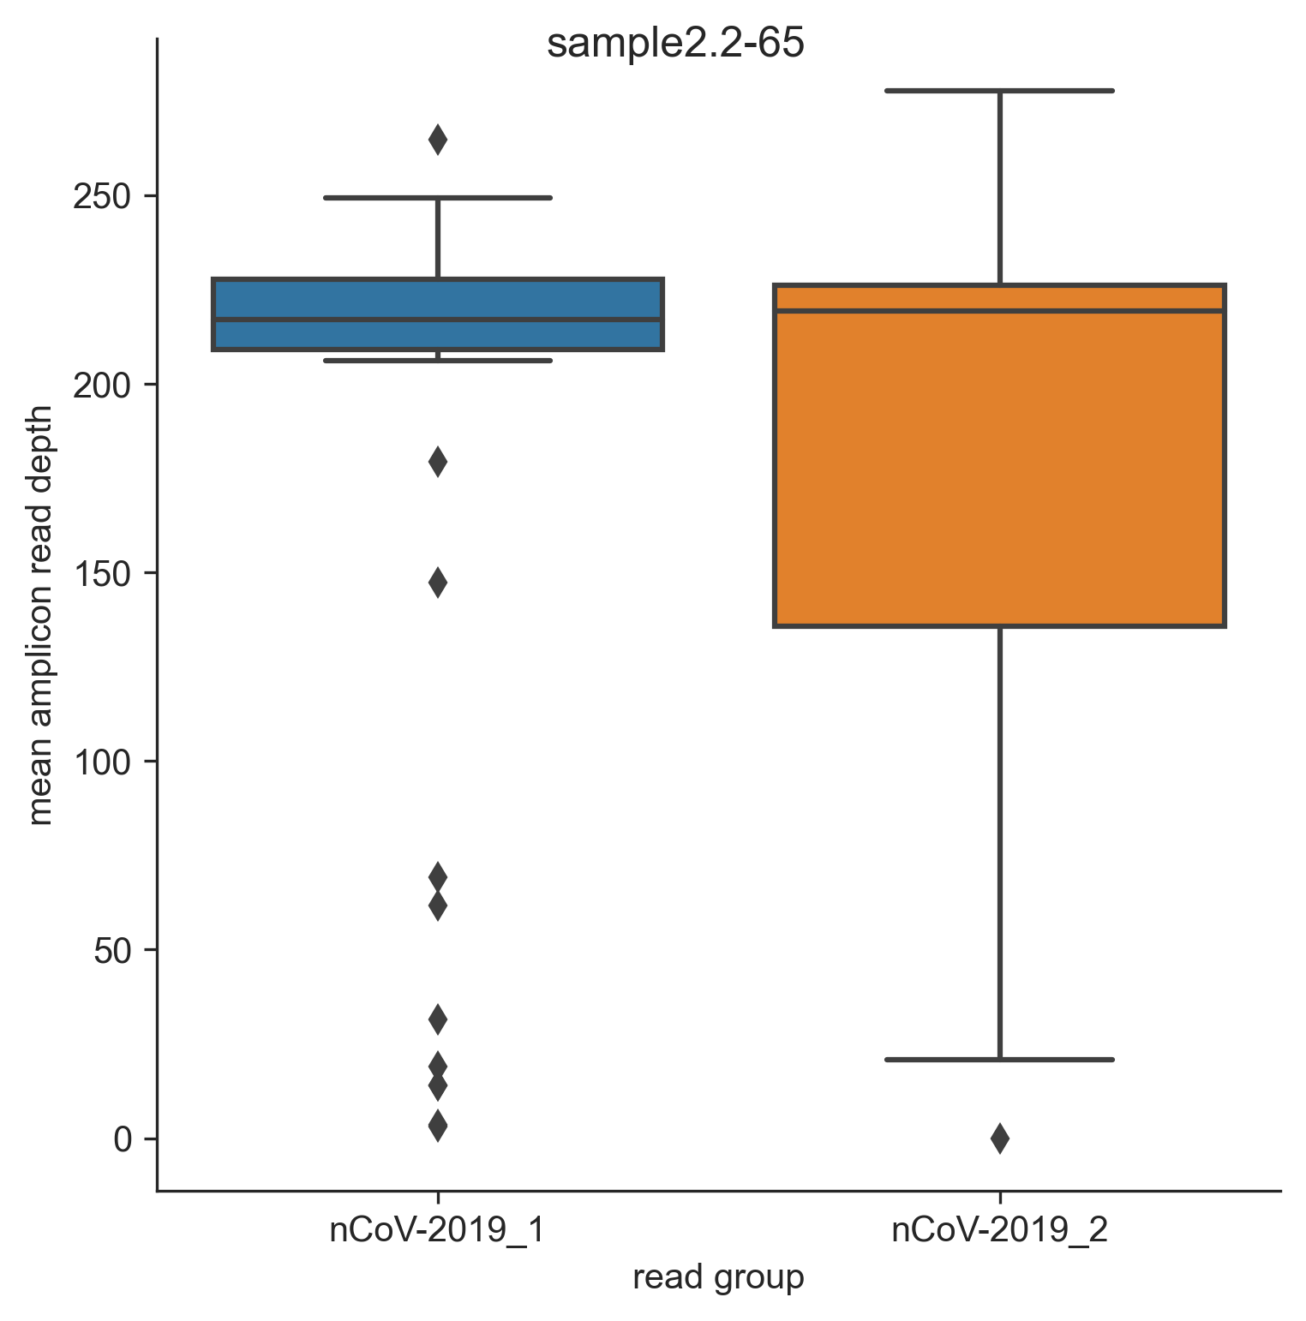
2.The highest coverage depth variation was observed in pool 2 amplicons when PCR annealing temperature when 65°Celsius
MINION
61°
63°
65°
Sample 1
61°
63°
65°
Sample 2

Slide 10
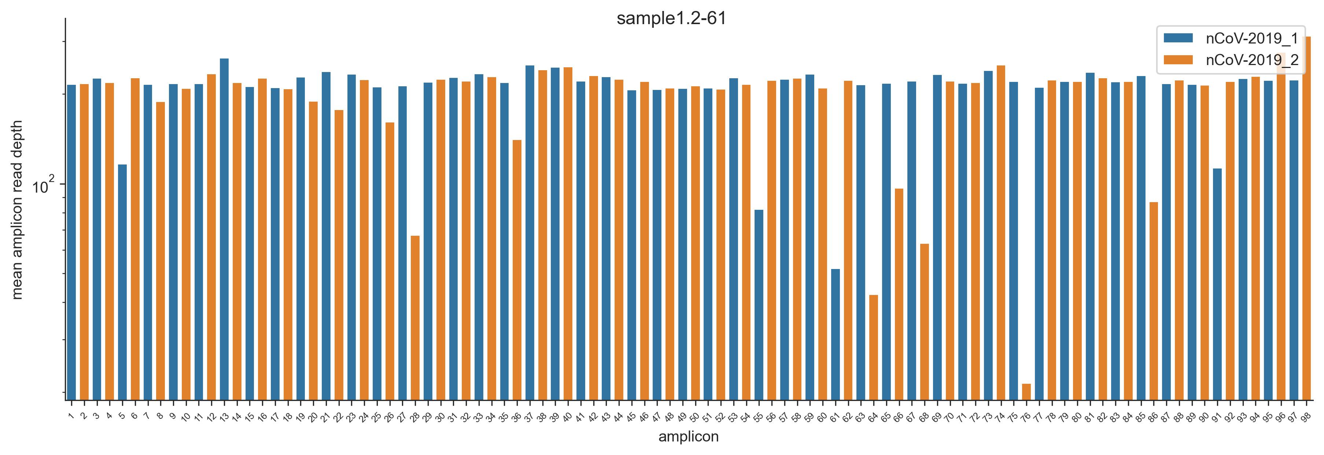
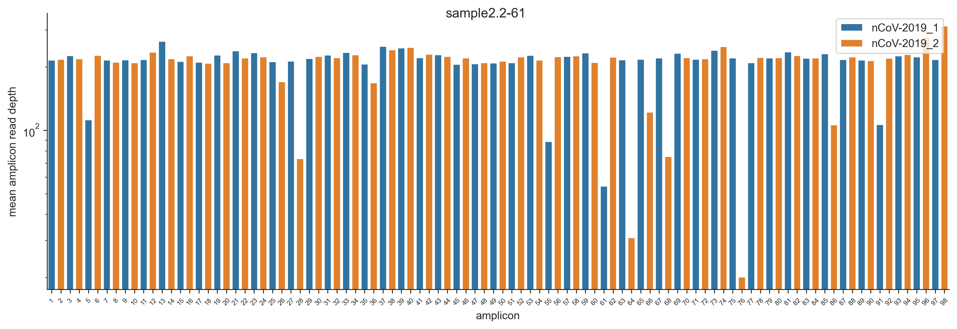
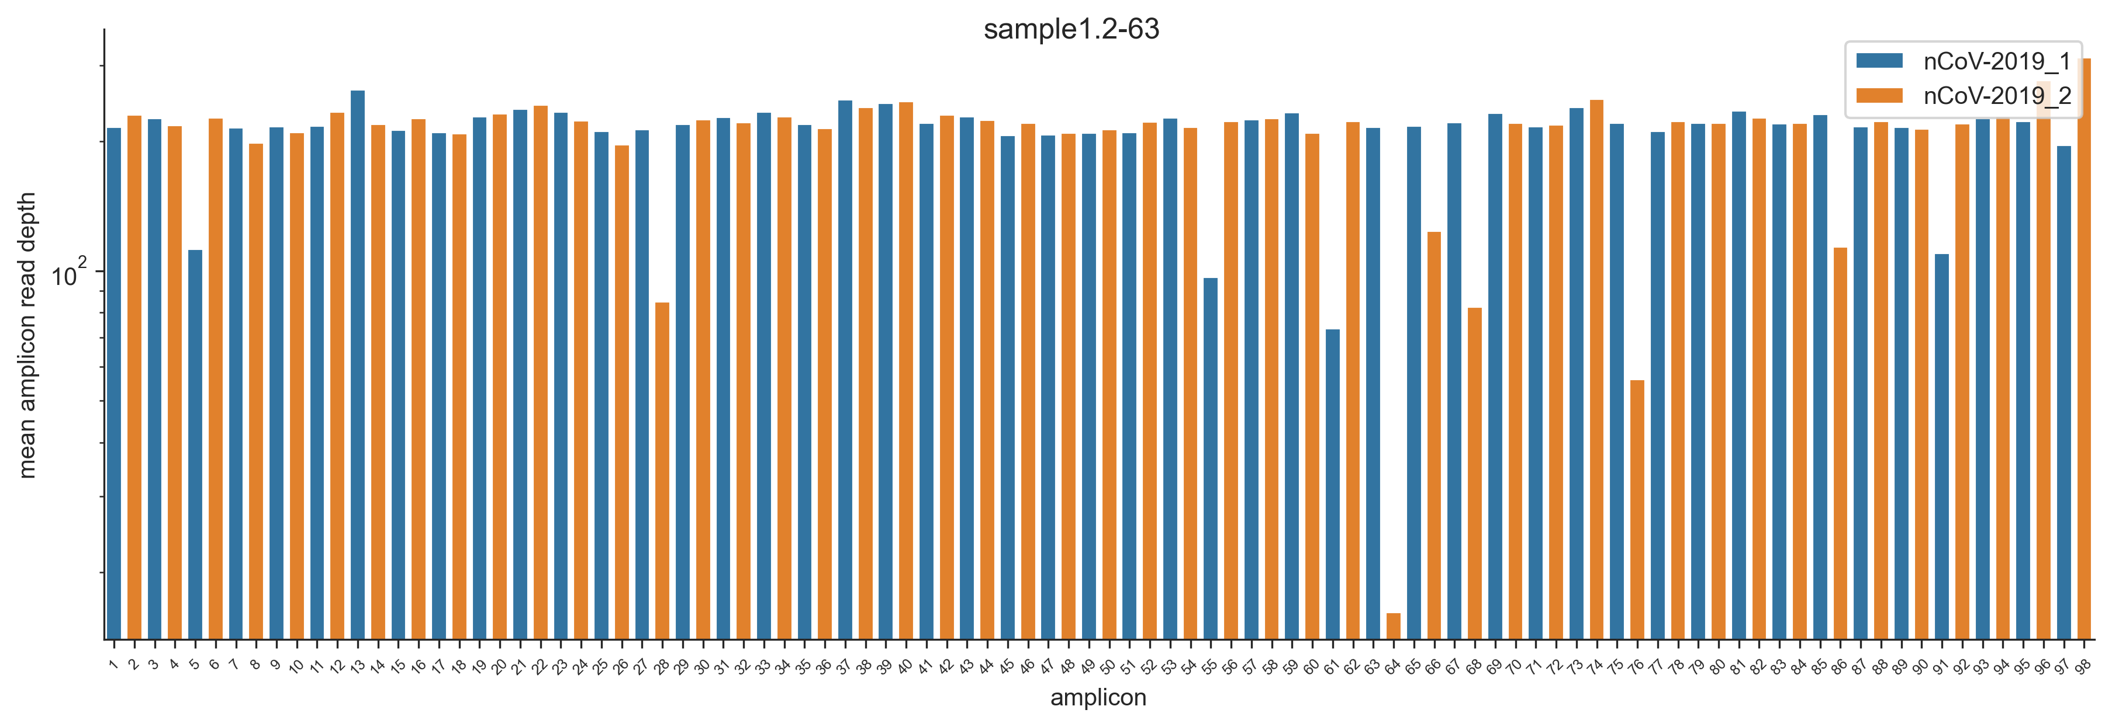
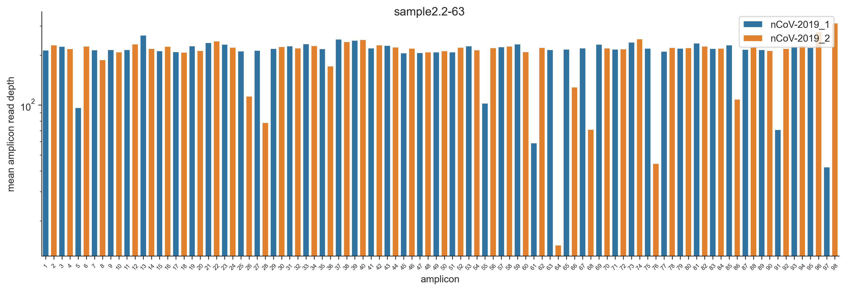
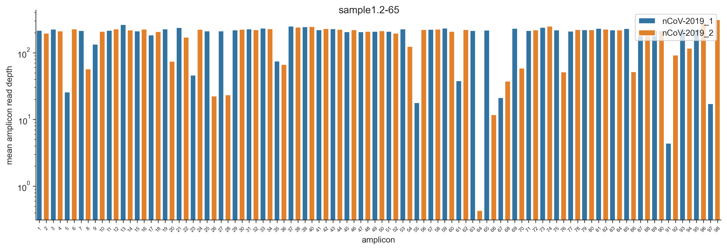
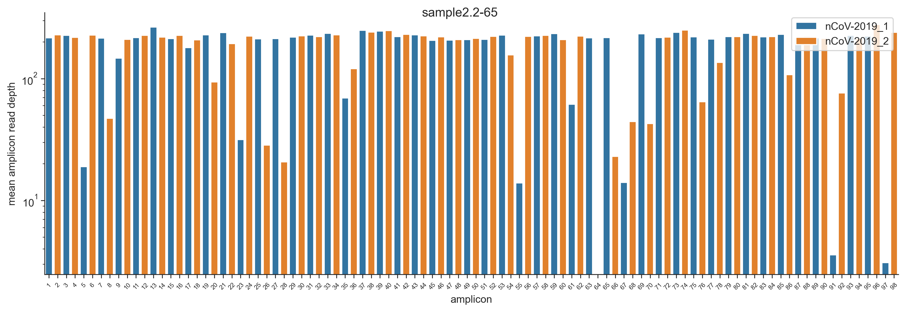
3.All amplicons were recovered, except amplicon 64 when PCR annealing temperature was 65° Celsius
MINION
Sample 1
Sample 2
61°
61°
63°
63°
65°
65°
Notes:
Improve font size of x and y axis
Those plots shows the average reads depth for each Pool1 and pool 2 amplicons
The coverage depth was normalized to 200.
Annealing temperatures were 61, 63 and 65

Slide 11
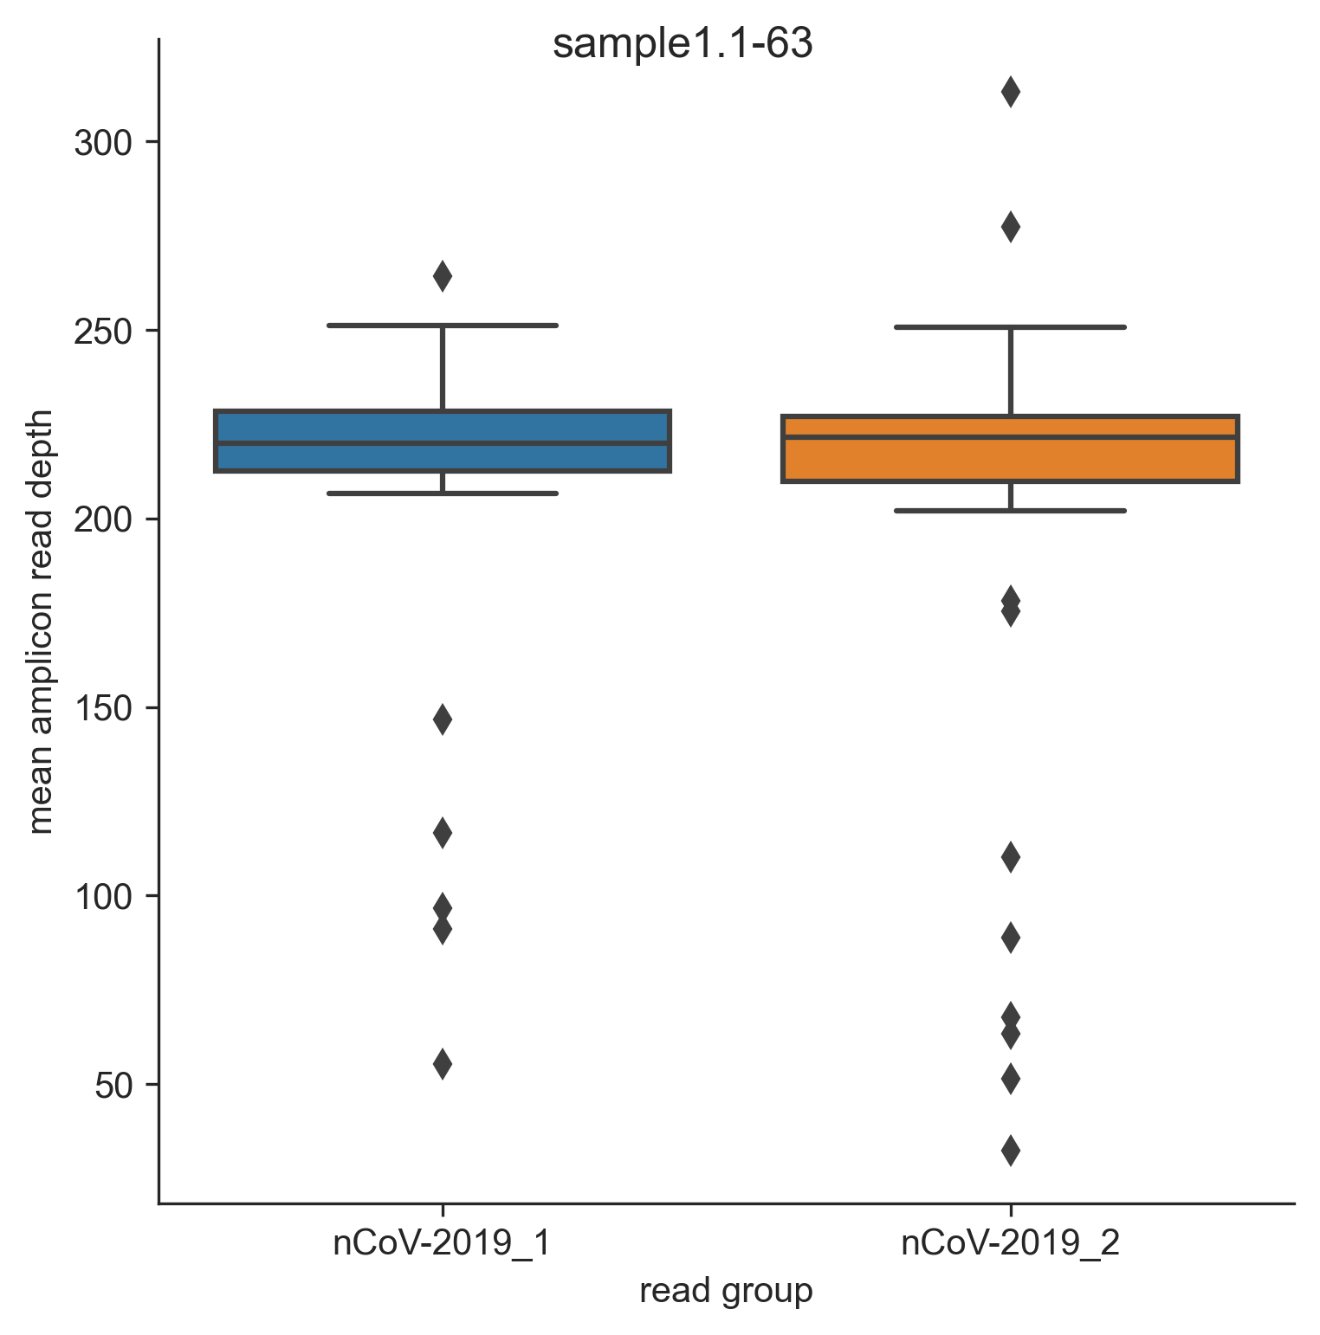
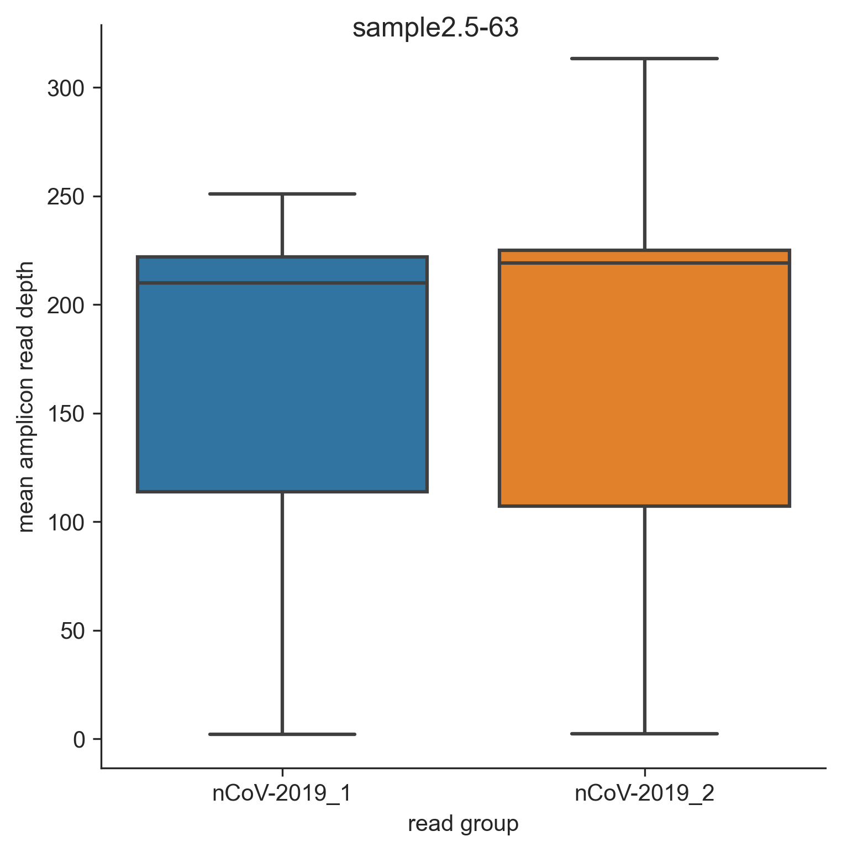
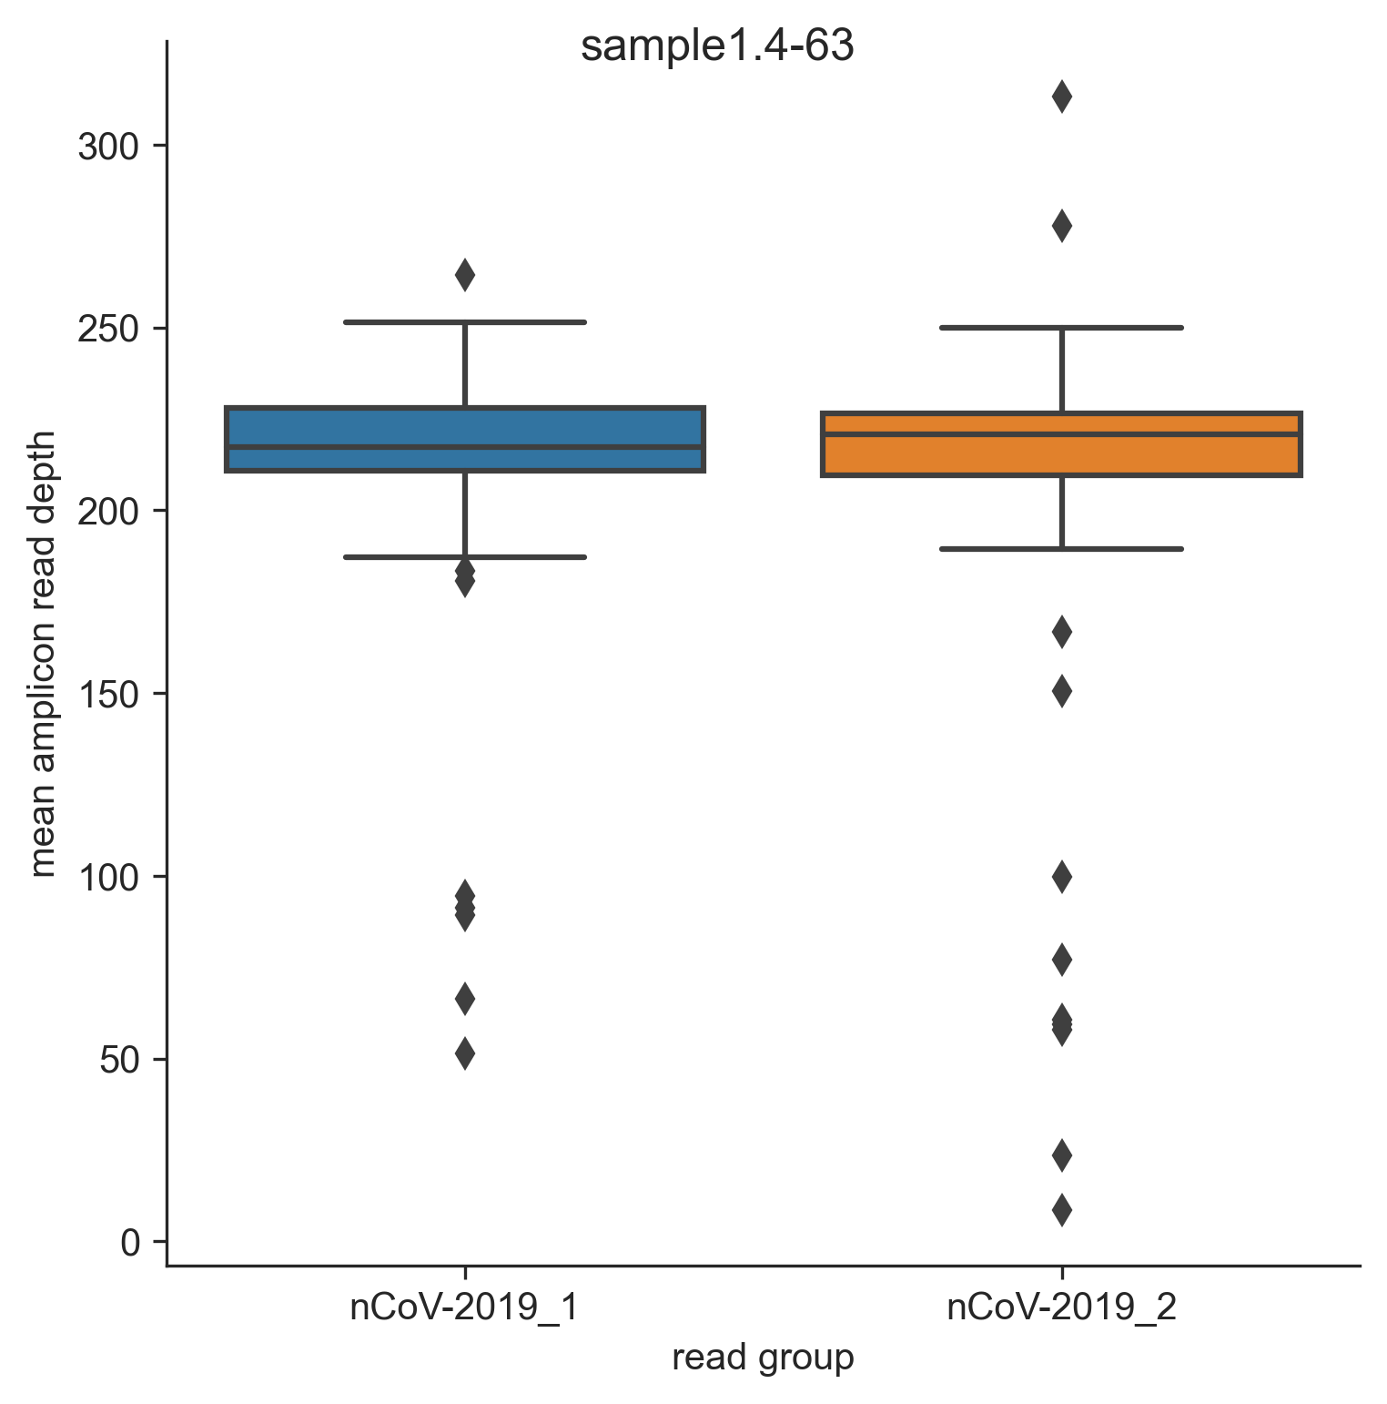
4. This boxplots show the effect of RNA input on the coverage depth variation when the PCR annealing temperature is 63°
MINION
10⁷ RNA copies
315 RNA copies
19.1 RNA copies
Mean amplicon read depth
The highest variance of mean amplicon read depth is observed when the RNA copies number is 19 (ct = 36)
Notes:
Add the CT values / copy number
Increase x axix label and y axis

Slide 12
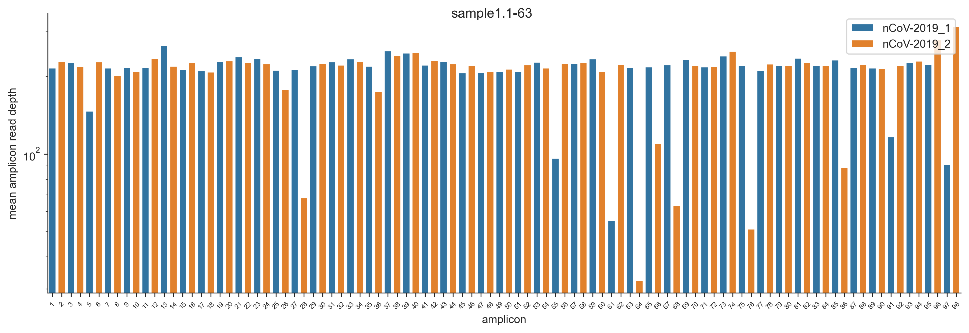
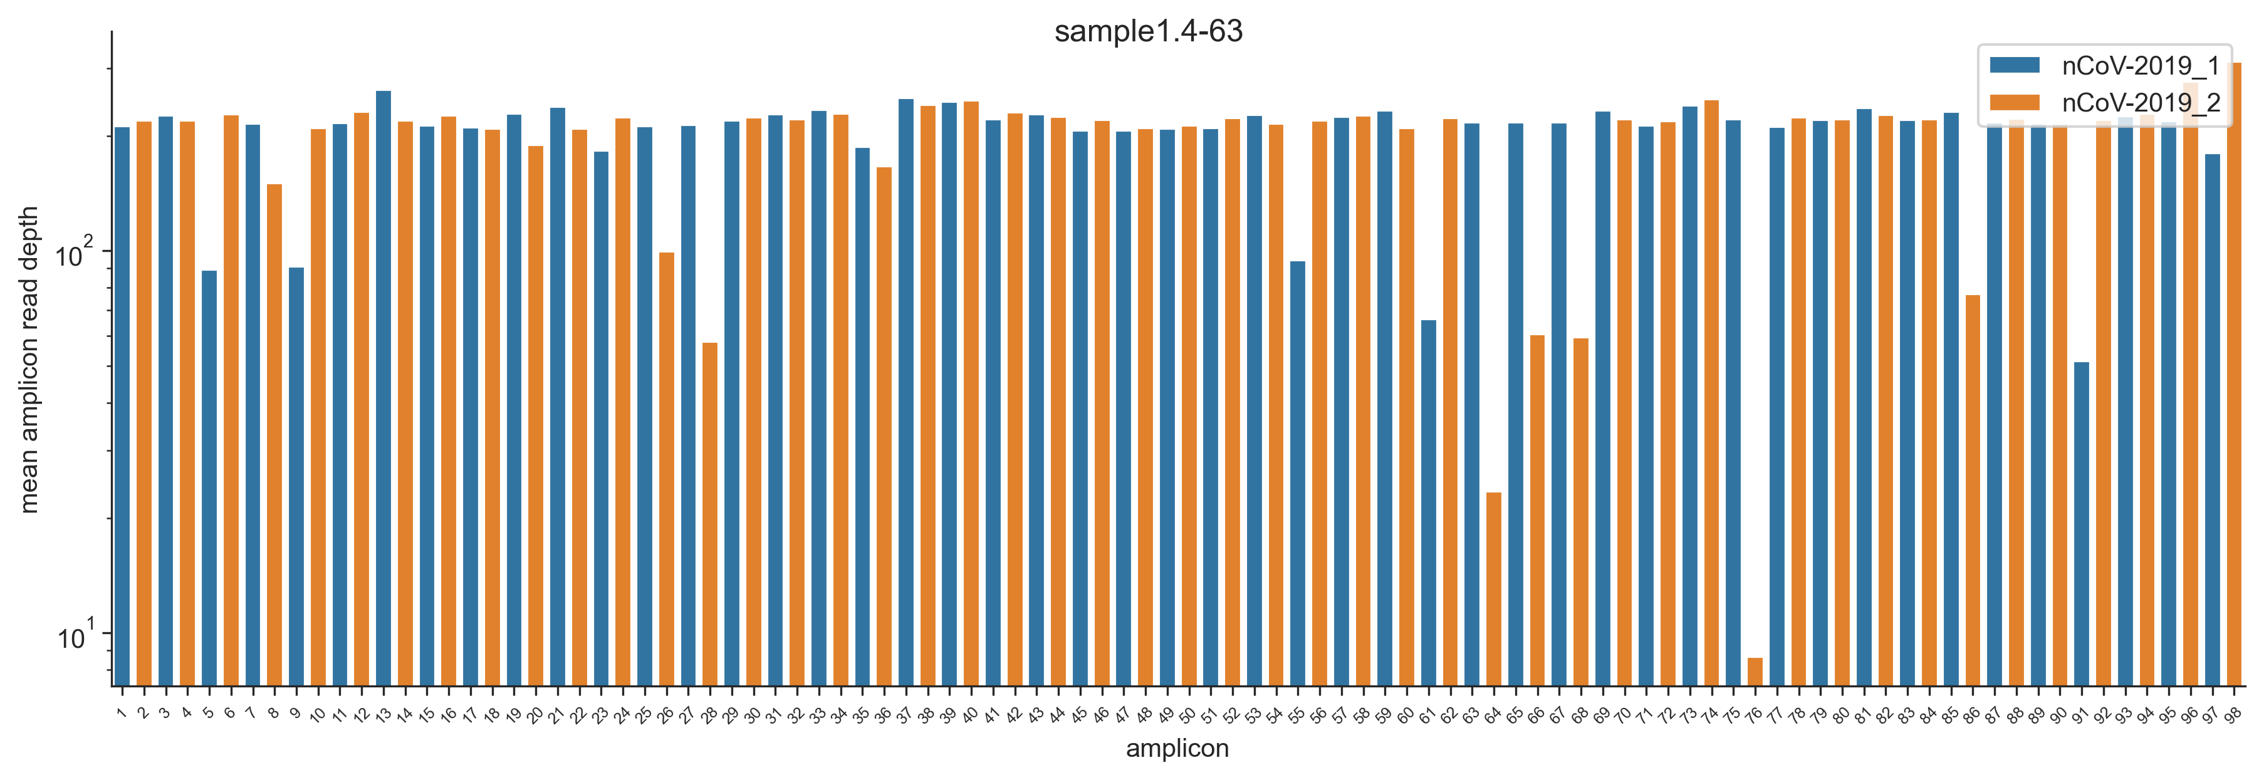
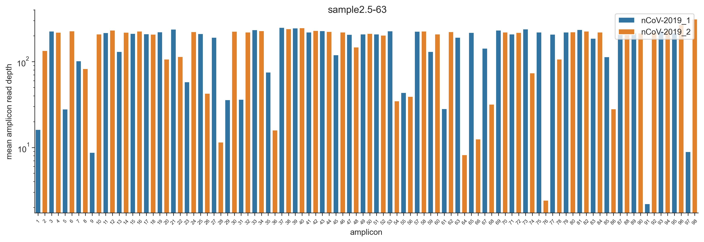
5. I could recover the SARS-CoV-2 near complete genome when viral RNA copies ranged between 10⁷(ct 17.7) and 19 (ct 36)
MINION
10⁷ copies
315 copies
19.1 copies
Legend
ncov2019-1: pool1 amplicon
ncov2019-2: pool2 amplicon
Annealing temp: 63
same sample, different RNA input
These figures show the average normalized reads depth for each pool1 and pool 2 amplicons

Slide 13
Partial for conclusion for MINION
I could obtain near complete genome sequence (99.9% coverage breadth) of SARS-CoV-2 viral RNA copies ranged between 10⁷(ct 17.7) and 19 (ct 36) copies, when the annealing temperature was 61° or 63°.
Increasing annealing temperature resulted in a loss of NGS reads. It may be related to non-specific PCR products, generated during PCR, as we observed on gel electrophoresis.
63 degrees appears to be the best annealing temperature, based on the amount of sequencing reads produced.
Using our in-house protocol, we can multiplex up to 35 clinical samples in one run, since 100 000 reads are required/sample

Slide 14
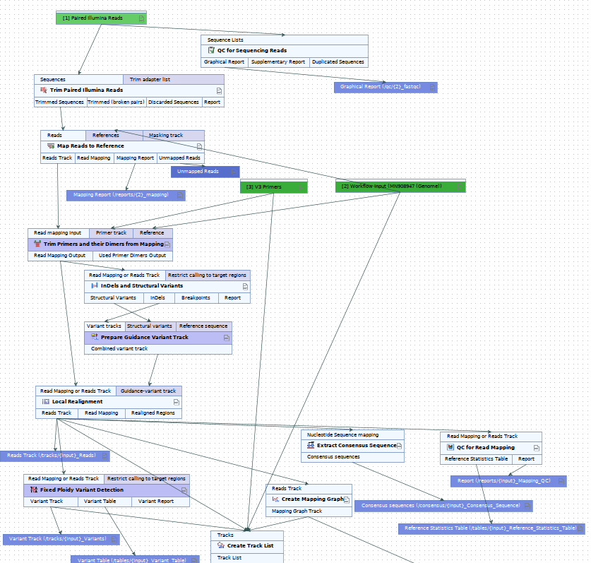
NOVASEQ
CLC genomics workflow-after NoVaSeq
The analysis workflows is different from that of MINION, and therefore the output is also different

Slide 15
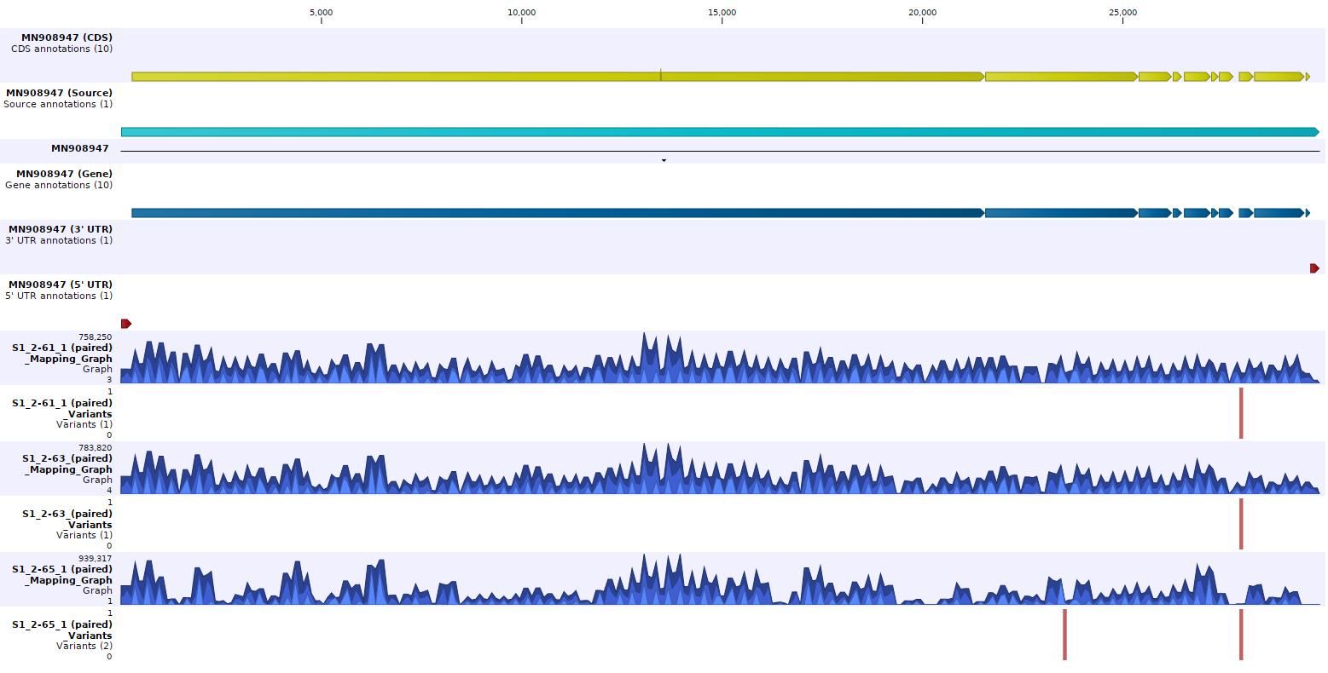
NOVASEQ
Sample1.2- results using NOVASEQ
Visibly, there’s a higher variability in S1.2-65 (when anneal. temp=65)
61
63
65
Annealing temperature
questionable mutation

Slide 16
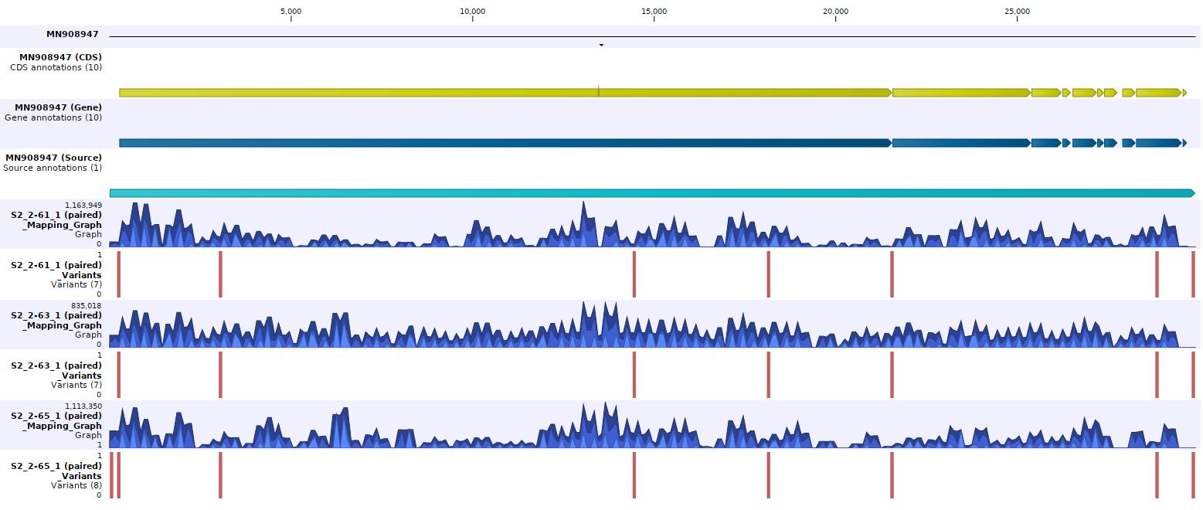
NOVASEQ
S2-2 tracks- results using NOVASEQ
Higher variability in S1-2-65 (when anneal. temp =65)
61
63
65
Annealing temperature
Questionable variant
mutations in S gene
Notes:
There is one extra variant when

Slide 17
NOVASEQ
Reads count- NOVaseq workflow
Sample | Sample Ct | Median Quality (PHRED) | Number of reads (millions) | % Mapped | Breadth of coverage (%)
S1.2-61 | 23.1 | 35 | 38.82 | 99.8 | 99
S1.2-63 | 23.1 | 35 | 38.03 | 99.8 | 99
S1.2-65 | 23.1 | 35 | 38.05 | 99.8 | 99
S2.2-61 | 22.5 | 35 | 39.77 | 99.75 | 99
S2.2-63 | 22.5 | 35 | 40.96 | 99.75 | 97
S2.2-65 | 22.5 | 35 | 41.03 | 99.75 | 97
Sample 1.2
Sample 2.2

Slide 18
NOVASEQ
Variants from illumina sequencing (1/2)
questionable variant when CT is low
Sample | type | length | reference | Consensus sequence | zigozity | count | coverage | freq | Average quality | position
S1.2-61 | SNV | 1 | C | T | homozygous | 627 | 627 | 100 | 35.86 | 27942
S1.2-63 | SNV | 1 | C | T | homozygous | 292 | 292 | 100 | 36.08 | 27942
S1.2-65 | deletion | 15 | ATCAGACTCAGACTA | - | homozygous | 41550 | 51759 | 80.2 | 33 | 23583
 | SNV | 1 | C | T | homozygous | 292 | 292 | 100 | 36.08 | 27942
questionable
Notes:
Although not shown here, the variant calling workflow for minion data produced 6 variants for this sample
All the variants called by illumina workflow was also called by MiNion workflow.
It is possible that variant calling setting are more stringent in illumina workflow.
I can not compare both methods, because there is no gold standard, and the variant calling workflows are both different

Slide 19
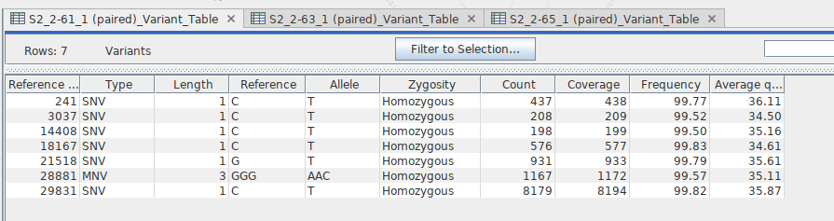
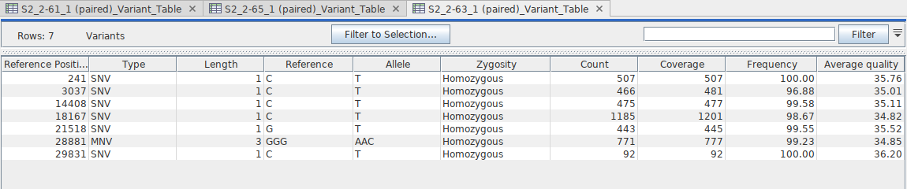
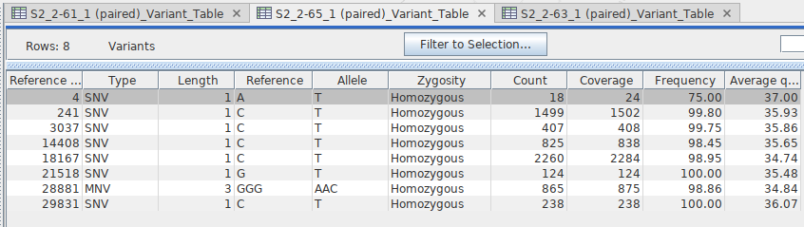
Variants from illumina sequencing (2/2)
questionable variant when CT is low
Sample 2- 61
Sample 2- 63
Sample 2- 65

Slide 20
Number of position with gaps (Ns)
MINION vs NOVASEQ
Sample | Consensus from Illumina sequencing |  | Consensus from Minion sequencing
 | 15Ns | >15Ns | 15Ns | >15Ns
S1.2-61 | 1 | 0 | 1 | 0
S1.2-63 | 1 | 0 | 1 | 0
S1.2-65 | 1 | 0 | 1 | 4
S2.2-61 | 0 | 0 | 1 | 0
S2.2-63 | 0 | 0 | 1 | 0
S2.2-65 | 0 | 0 | 1 | 3
Total number of gaps in consensus sequence | 3 |  | 13
>15Ns : the real actual of Ns was 295

Slide 21
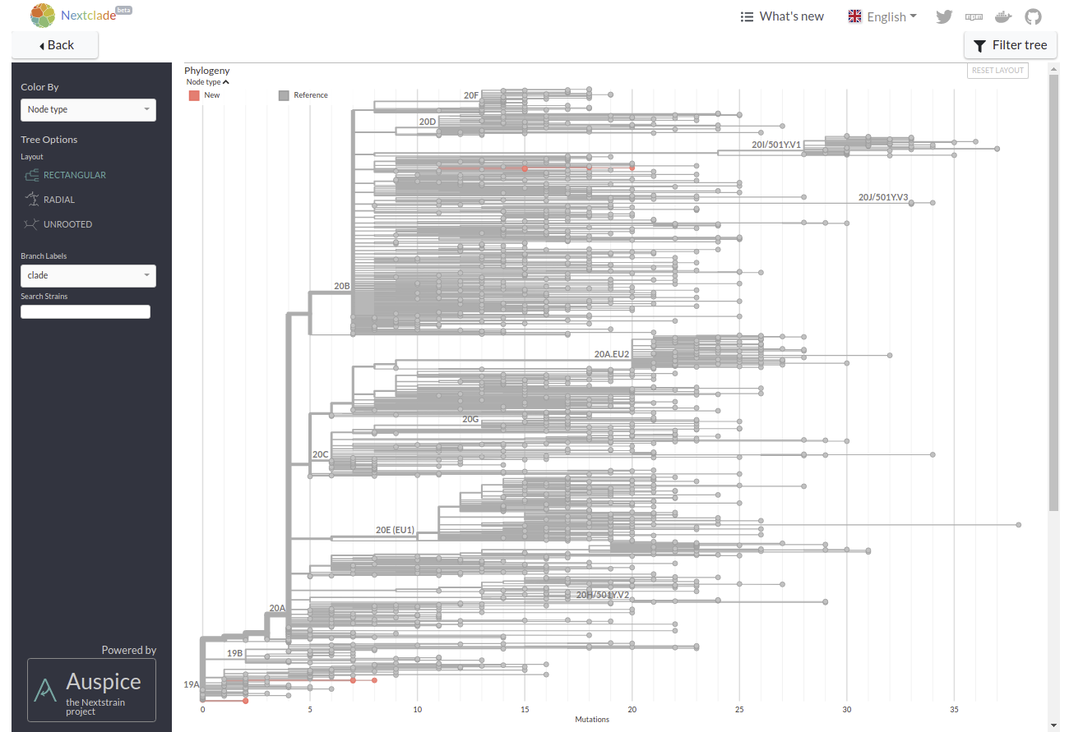
Sequences in the global phylogeny
Sample 2.2-Minion
Sample 2.2-novaseq
Sequences in red are new sequences
Wuhan strain
Sample 1.2-Minion
Sample 1.2-novaseq

Slide 22
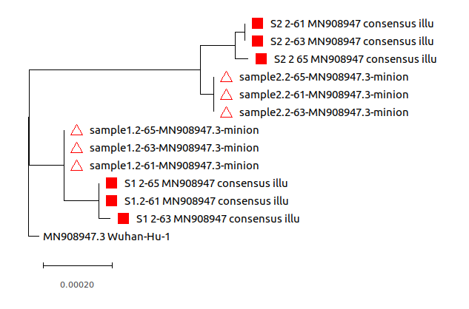
Consensus sequences S1.2 and S2.2 cluster together regardless of sequencing method
square: consensus sequence from illumina seq
Triangle: consensus sequence from Minion
Same samples are grouped in the same cluster

Slide 23
Comparison NoVaseq workflow Vs MiNion workflow
Throughput – higher in NoVaseq workflow
Quality of reads: better with NoVaseq workflow
Consensus assembly – higher breadth of coverage (and there is less number of gaps) in the consensus sequence obtained from NoVaseq
Primers efficiency – gaps when annealing temperature= 65, in MiNion workflow. Gaps were less frequent in sequences obtained using NoVaseq method.
Variants calling – Not comparable. However, There was a higher number of mutations in genomes sequenced using MINION

Slide 24
Processing time
Steps | Duration (days)
 | MiNion | NoVaseq
RNA extraction | 2 | 2
cDNA synthesis
Multiplex PCR+cleanup
Library preparation, purification and quantitation | 3
Sequencing | 2 | ~45 (Outsourced at Macrogen)
In-house Data analysis (On a Dell Precision Tower 7810 RAM: 32 Gigabytes, 12 processors) | 7 | 7
Total | 13 | 56

Slide 25
Processing time
 | Emma | Sakamoto | Clyde
Minion | 19 days / 12 (cDNA samples) | 19 days / 12 (RNA samples) | /
Illumina – MiSeq (Megank) | 27 days for 10 samples (cDNA samples)
Ilumina - NoVaseq (Macrogen) | 54 days for 6 samples (cDNA samples) | 80 days for 20 (RNA samples)
Ilumina – HiSeq | / | / | 30 days for 48 samples (RNAseq)

