Slide 2

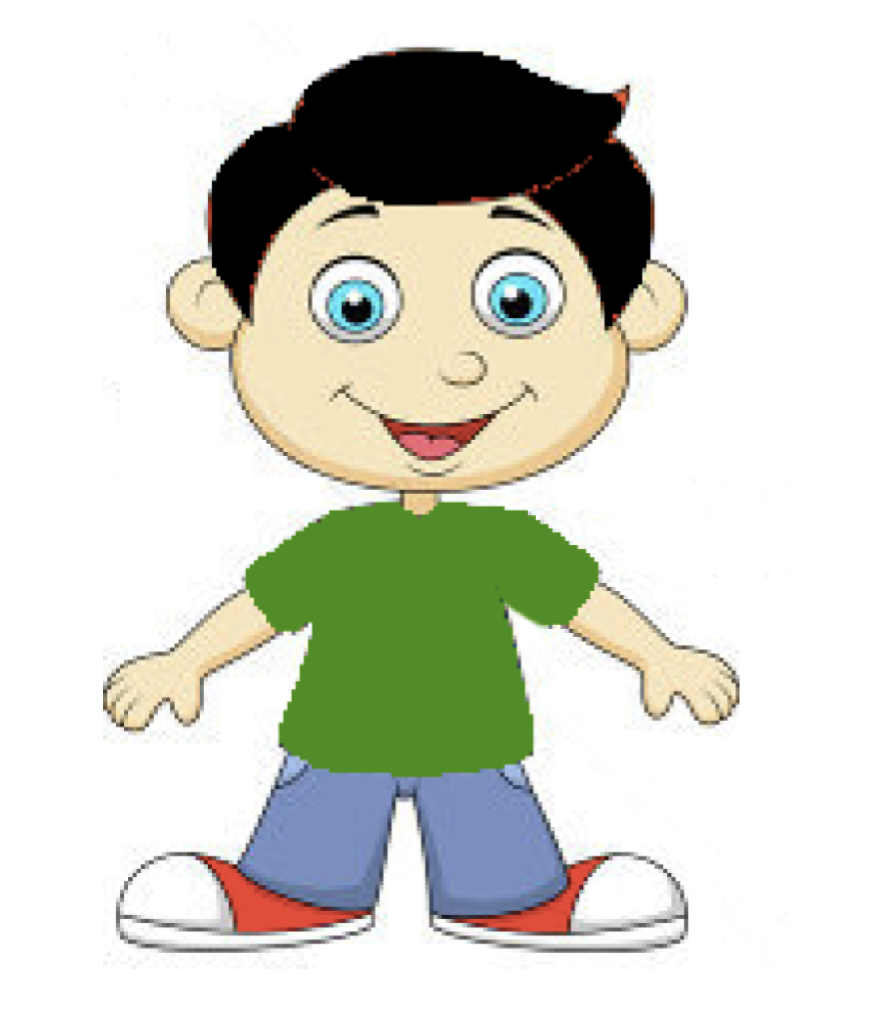
I'm going to tell you a story about two boys, Sam and Jessie, who like to play games at the playground with other kids.

Slide 3
I'm going to tell you a story about two boys, Sam and Jessie, who like to play games at the playground with other kids.

Slide 4
I'm going to tell you a story about two boys, Sam and Jessie, who like to play games at the playground with other kids.

Slide 6

This is Sam. Sam really cares about what other people think of him.
He wants everyone to think he is the best at all the games and that he wins all the time.

Slide 8
This is Jessie. Jessie doesn’t really care about what other people think of him.
He wants to play games a lot and enjoys playing them all the time.

Slide 10
Which of these two boys do you like better?
Sam or Jessie?

Slide 11
Which of these two boys do you like better?
Sam or Jessie?

Slide 12
Which of these two boys do you like better?
Sam or Jessie?

Slide 14
Today, Sam and Jessie each played a game at the playground and each of them did badly.

Slide 15
Today, Sam and Jessie each played a game at the playground and each of them did badly.

Slide 16
Today, Sam and Jessie each played a game at the playground and each of them did badly.

Slide 17
So Sam did badly at the game and Jessie did badly at the game.

Slide 18
So Sam did badly at the game and Jessie did badly at the game.

Slide 19
So Sam did badly at the game and Jessie did badly at the game.

Slide 20
Later, another kid, who just arrived at the playground,
came up to Sam and Jessie and asked each of them how they did at the game.

Slide 21
Later, another kid, who just arrived at the playground,
came up to Sam and Jessie and asked each of them how they did at the game.

Slide 22
Later, another kid, who just arrived at the playground,
came up to Sam and Jessie and asked each of them how they did at the game.

Slide 23
One of these boys lied and said he did great at the game.

Slide 24
Which boy lied and said he did great at the game?
Sam or Jessie?

Slide 25
Which boy lied and said he did great at the game?
Sam or Jessie?

Slide 26
Which boy lied and said he did great at the game?
Sam or Jessie?

Slide 28
Earlier, I told you that one of these boys really cares about what other people think of him.
He wants everyone to think he is the best at all the games and that he wins all the time.
Which boy was that? Sam or Jessie?

Slide 29
Earlier, I told you that one of these boys really cares about what other people think of him.
He wants everyone to think he is the best at all the games and that he wins all the time.
Which boy was that? Sam or Jessie?

Slide 30
Earlier, I told you that one of these boys really cares about what other people think of him.
He wants everyone to think he is the best at all the games and that he wins all the time.
Which boy was that? Sam or Jessie?

Slide 31
Sam really cares about what other people think of him.
He wants everyone to think he is the best at all the games and that he wins all the time.

Slide 33
I also told you that one of these boys doesn’t really care about what other people think of him.
He wants to play games a lot and enjoys playing them all the time.
Which boy was that? Sam or Jessie?

Slide 34
I also told you that one of these boys doesn’t really care about what other people think of him.
He wants to play games a lot and enjoys playing them all the time.
Which boy was that? Sam or Jessie?

Slide 35
I also told you that one of these boys doesn’t really care about what other people think of him.
He wants to play games a lot and enjoys playing them all the time.
Which boy was that? Sam or Jessie?

Slide 36
Jessie doesn’t really care about what other people think of him.
He wants to play games a lot and enjoys playing them all the time.

Slide 38
One day, Sam and Jessie were at the playground again, and all the kids had left a bunch of toys all over the place.

Slide 39
One day, Sam and Jessie were at the playground again, and all the kids had left a bunch of toys all over the place.

Slide 40
One day, Sam and Jessie were at the playground again, and all the kids had left a bunch of toys all over the place.

Slide 41
When everyone left to go eat lunch, someone cleaned up all the toys.

Slide 42
Later, someone asked: “Who helped clean up the toys?”

Slide 43
Even though neither of them helped clean up the toys, one of these boys lied and said
he was the one who helped clean up the toys.

Slide 44
Which boy lied and said he was the one who helped clean up the toys?
Sam or Jessie?

Slide 45
Which boy lied and said he was the one who helped clean up the toys?
Sam or Jessie?

Slide 46
Which boy lied and said he was the one who helped clean up the toys?
Sam or Jessie?

