Slide 1
TIBCO BusinessEvents Query
ETG Engineering

Slide 2
Features
Query Language – based on ODMG OQL
  BNF notation adapted to BE Namespace usage.
Semantic Compilation and Validation using
  BE & Cache Namespace Schema
  BE Function Integration
CodeGen Flavors –
  Rule
  Cache Invocable
JDBC ResultSet output
Continuous Query Resultset stream.
Complex Correlation

Slide 3
Query Architecture
Query
BE
Namespace
Schema
Antlr Parser
Working
Memory
AST Tree
Cache
Namespace
Schema Mapping
Compiler
Semantic
Compilation
Cache
RuleDecorator
CacheDecorator
HotDeploy
Rule
Cache Query
Invocable
Invocation
ResultSet

Slide 4
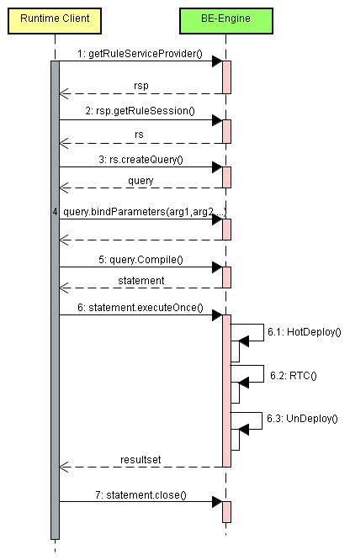
Synchronous Query Sequence Diagram

Slide 5
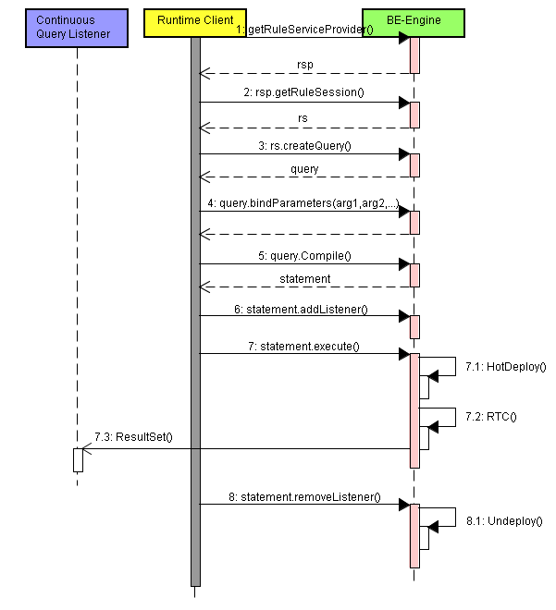
Asynchronous Query Sequence Diagram

Slide 6
Use Cases
Engine Query
  Fewer Rule Proliferation
  Complex Correlation
  Continuous Query ResultSet based action
Dashboard Query
  Continuous updates of rule engine state.
  Business state reporting.

Slide 7
Client API
RuleServiceProvider rsp = GetRuleServiceProvider();
  RuleSession session = rsp.getSession();
  Query query = session.createQuery(OQL,TYPE_WM | TYPE_CACHE);
    query.bindParameters(arg1,arg2,….);
    Statement stmt = Query.parse();
      stmt.addListener(QueryListener listener);
      stmt.execute();
    OR
      ResultSet rs = stmt.executeOnce();
    stmt.close();
QueryListener
  Interface { notify(ResultSet rs); }

Slide 8
Sample OQL
Select
  A.*,
  Datetime.now() as C,
  /RuleFunctions/GetState() as D,
  String.concat(B.customerId,”ABC”) as E
From
  /Concepts/Address as A,
  /Concepts/Customer B
Where
  A.customerId = B.customerId
Order by
  A.State,C,D,E;

Slide 9
Sample OQL
select
  B.*, A.id id, B@extid as extId
from
  EntityA as A ,
  EntityB B,
  EntityC
where
  A.id = B@extid // Entity attributes
  and ( B@parent.name = 'ABCD' or C.name = "EFGH" )
  and A.tokens[5] = 50 // array property
  and A.history[5].price > 50 // history
  and ( A.containedConceptE.price > 100
  or B.startTime > DateTime.addMinute(DateTime.now(),5) )
  and B.value between 2 and 5
  group by a1:A.name,b1:B.color having A.state = "CA"
  order by A@extId,B.name
  ;

Slide 10
Query –to – Rule Mapping
Scope
  FROM CLAUSE – All Entities in BE Namespace
Conditions
  WHERE CLAUSE
Action
  PROJECTION ATTRIBUTES
    Entity attributes,properties,child Entities and its properties and attributes
    RuleFunctions (User defined)
    Static Functions ( BE Palette functions)
    Group Functions (sum,avg,max,min)
  GROUP BY CLAUSE (not allowed in continuous query)
    Group ResultSet
  ORDER BY CLAUSE
    Sort ResultSet

Slide 11
BNF Notation
<query> ::= <selectExpr> ";"
<selectExpr> ::= "select" <projectionAttributes>
<fromClause>
[<whereClause>]
[<groupClause>]
[<orderClause>]
<projectionAttributes> ::= <projectionList>
| "*"
<projectionList> ::= <projection> { "," <projection> }
<projection> ::= <expr> [ [ ["as"] <labelIdentifier> ] | "." "*" ]

Slide 12
BNF Notation
<fromClause> ::= "from" <iteratorDef> { "," <iteratorDef> }
<iteratorDef> ::= <labelIdentifier> "in" <expr> => NOT SUPPORTED
| ["/"] <expr> ["as"] <LabelIdentifier>
<whereClause> ::= "where" <expr>
<groupClause> ::= "group" "by" <groupColumn> { "," <groupColumn> }
<orderClause> ::= "order" "by" <sortCriterion> { "," <sortCriterion> }
<groupColumn> ::= <fieldlist>
<sortCriterion> ::= <expr> [ ( "asc" | "desc" ) ]
<expr> ::= <castExpr>

Slide 13
BNF Notation
<castExpr> ::= <orExpr>
| "(" type ")" <orExpr>
<orExpr> ::= <andExpr> { "or" <andExpr> }
<andExpr> ::= <quantifierExpr> { "and" <quantifierExpr> }
<quantifierExpr> ::= <equalityExpr>
| "for" "all" <inClause> ":" <equalityExpr>
| "exists" <inClause> ":" <equalityExpr>
<inClause> ::= <labelIdentifier> "in" <expr>

Slide 14
BNF Notation
<equalityExpr> ::= <relationalExpr>
{ ( "=" | "!=" | "<>")
<relationalExpr> }
| <relationalExpr> { "like" <relationalExpr> }
<relationalExpr> ::= <additiveExpr>
{( "<" | "<=" | ">" | ">=" )
<additiveExpr> }
| <additiveExpr> "between"
<additiveExpr> "and" <additiveExpr>

Slide 15
BNF Notation
<inExpr> ::= <unaryExpr> { "in" <unaryExpr>}
<unaryExpr> ::= "+" <unaryExpr>
| "-" <unaryExpr>
| "abs" <unaryExpr>
| "not" <unaryExpr>
| <postfixExpr>
<postfixExpr> ::= <primaryExpr> {"[" <index> "]" }
| <primaryExpr> {( "." | "@" )<identifier> [ <arglist> ] }
<index> ::= <expr> { "," <expr> }
| <expr> ":" <expr>

Slide 16
BNF Notation
<primaryExpr> ::= <conversionExpr>
| <aggregateExpr>
| <befunctionExpr>
| <identifier> "[" <arglist> | nothing "]"
| <queryParam>
| <literal>
| "(" <query> ")"
<aggregateExpr> ::= "sum" "(" <query> ")"
| "min" "(" <query> ")"
| "max" "(" <query> ")"
| "avg" "(" <query> ")"
| "count" "(" ( <query> | "*" ) ")"

Slide 17
BNF Notation
<additiveExpr> ::= <multiplicativeExpr> { "+" <multiplicativeExpr> }
| <multiplicativeExpr> { "-" <multiplicativeExpr> }
| <multiplicativeExpr> { "union" <multiplicativeExpr> }
| <multiplicativeExpr> { "except" <multiplicativeExpr> }
| <multiplicativeExpr> { "||" <multiplicativeExpr> }
<multiplicativeExpr> ::= <inExpr> { "*" <inExpr> }
| <inExpr> { "/" <inExpr> }
| <inExpr> { "mod" <inExpr> }

Slide 18
BNF Notation
<undefinedExpr> ::= "is_undefined" "(" <query> ")"
| "is_defined" "(" <query> ")“
<argList> ::= ( "[" <valueList> "]" )
<fieldlist> ::= <field> , { "," <field> }
<field> ::= <labelIdentifier> ":" <expr>
<valueList> ::= <expr> { "," <expr> }
<listRange> ::= <expr> ".." <expr>
<labelIdentifier> ::= <Identifier>

Slide 19
BNF Notation
<type>::="long“
| "float"
| "double"
| "char"
| "String"
| "boolean"
| "Datetime"
| <typeIdentifier>
<NameFirstCharacter> ::= ( 'A'..'Z' | 'a'..'z' | '_' )
<NameCharacter> ::= ( <NameFirstCharacter> | '0'..'9' )

Slide 20
BNF Notation
<identifier> ::= <NameFirstCharacter> { <NameCharacter> }
<literal> ::= <objectLiteral>
| <booleanLiteral>
| <longLiteral>
| <doubleLiteral>
| <charLiteral>
| <stringLiteral>
| <dateLiteral>
| <timeLiteral>
| <timestampLiteral>

Slide 21
BNF Notation
<objectLiteral> ::= "null"
<booleanLiteral> ::= "true" | "false"
<longLiteral> ::= <digit> {<digit>}
<doubleLiteral> ::= <digit> { <digit> } "." <digit> { <digit> }
[("E" | "e" )["+" | "-" ] <digit> { <digit> } ]
<charLiteral> ::= "\'" <character> "\'"
<stringLiteral> ::= "\"" {<character>} "\""

Slide 22
BNF Notation
<dateLiteral> ::= "date" "\'" <longLiteral> "-" <longLiteral> "-" <longLiteral> "\'"
| "date" <stringLiteral>
<timeLiteral> ::= "time" "\'" <longLiteral> ":" <longLiteral> ":" <floatLiteral> "\'"
| "time" <stringLiteral>
<timestampLiteral> ::= "timestamp"
"\'" <longLiteral> "-" <longLiteral> "-" <longLiteral>
<longLiteral> ":" <longLiteral> ":" floatLiteral "\'"

Slide 23
BNF Notation
<floatLiteral> ::= <digit>{<digit>}"."<digit>{<digit>}
<character> ::= <letter>
| <digit>
| <special-character>
<letter> ::= ('A'..'Z','a'..'z')
<digit> ::= ('0'..'9')
<special-character> ::= ('?'|'_'|'*'|'%'|'\\')

Slide 24
BNF Notation
befunctionExpr:
dateTimefuncExpr
| enginefuncExpr
| channelfuncExpr
| mathfuncExpr
| numberfuncExpr
| stringfuncExpr
| systemfuncExpr
| instancefuncExpr
| temporalfuncExpr
;

Slide 25
The End

