Slide 1
ECE 759 High Performance Computing for Applications in Engineering [Spring 2025]
N-body Simulation
3/3/2025

Slide 2
Introduction to N-body Simulation
Topic of programming assignment #4
A dynamical system of particles interacting gravitationally, e.g.,
Orbits of planets in the solar system
Movement of stars in a galaxy
Algorithm key components:
Force Calculation
Time Integration

Slide 3
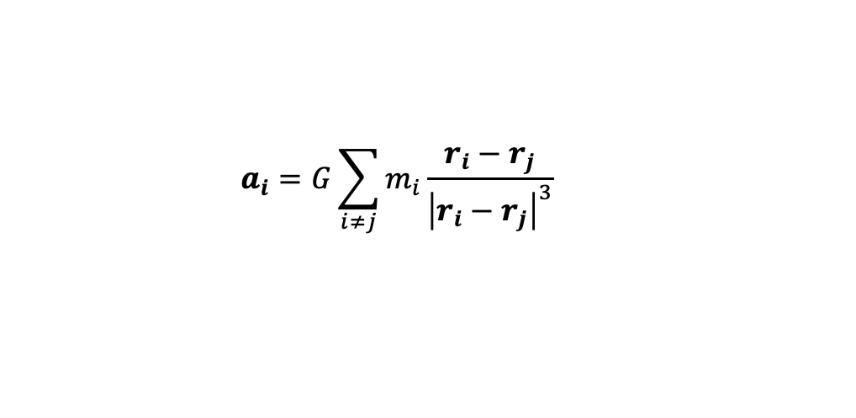

Force Calculation
Assume a system of N point particles, indexed by $i=1,…, N$. Each particle has the :
mass $m_{i}$
position $r_{i}=[x_{i}, y_{i}, z_{i}]$
velocity $v_{i}=[vx_{i},vy_{i}, vz_{i}]$
According to Newton’s law of universal gravitation, the acceleration $a_{i}$ of particle $i$ is given by
$$a_{i}=G\sum_{i≠j}{m_{i}\frac{r_{i}−r_{j}}{{\left|r_{i}−r_{j}\right|}^{3}}}$$

Slide 4
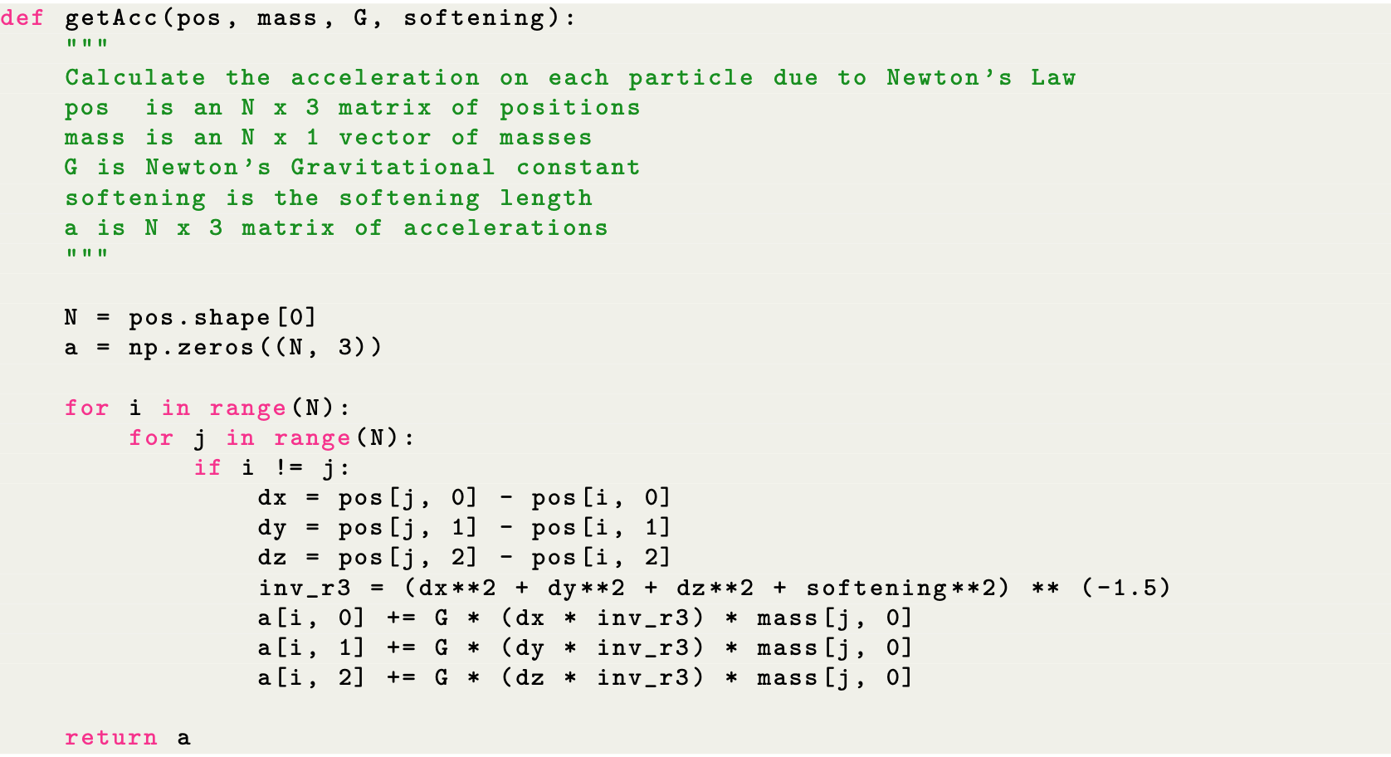
Force Calculation Python Code

Slide 5
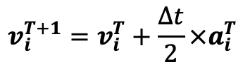
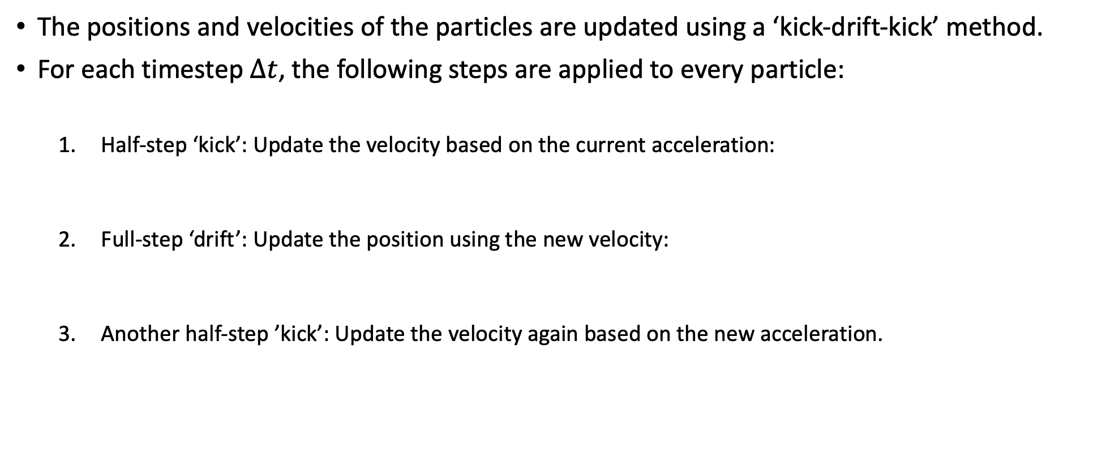

Time Integration
The positions and velocities of the particles are updated using a ‘kick-drift-kick’ method.
For each timestep $Δt$, the following steps are applied to every particle:
Half-step ‘kick’: Update the velocity based on the current acceleration:
Full-step ‘drift’: Update the position using the new velocity:
Another half-step ’kick’: Update the velocity again based on the new acceleration.
$$v_{i}^{T+1}=v_{i}^{T}+\frac{Δt}{2}×a_{i}^{T}$$
$$r_{i}^{T+1}=r_{i}^{T}+Δt×v_{i}^{T}$$

Slide 6
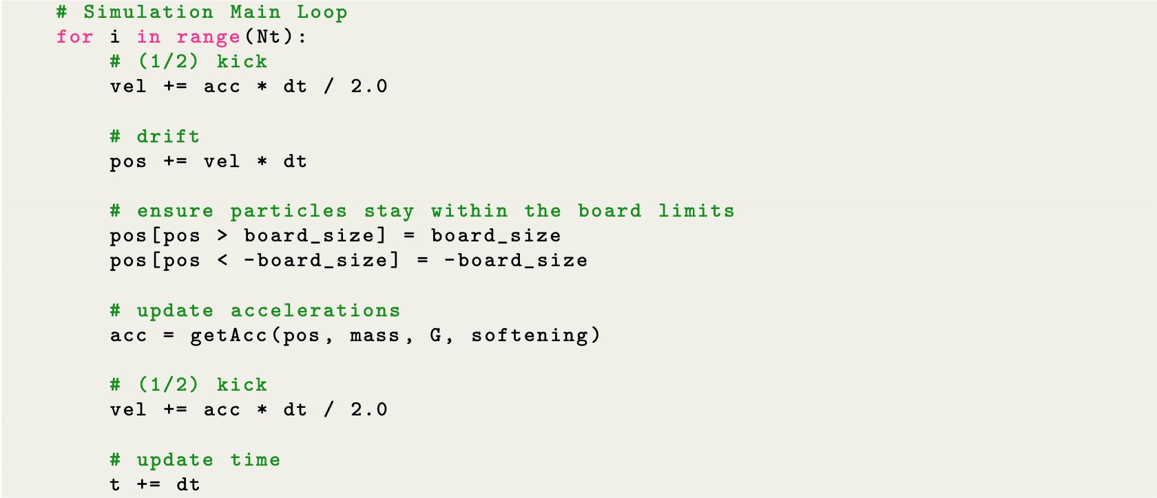
Time Integration Python Code

Slide 7
N-body Simulation Demo
Run command:
>>> python3 nbody.py

Slide 8
Programming Assignment Tasks
Port the n-body simulation Python code to C++.
We will provide a skeleton code.
Parallelize the n-body C++ code using OpenMP (highlighted below).

