Slide 1
Using unsupervised Self Organizing Maps to predict malignancy in mammography images
Kristofer Ågren

Slide 2
Overview
Mammography datasets are often fairly small while the images themselves are quite large, as such they pose a challenge to typical deep learning methods that will require a lot of images to be able to train effectively
Thus unsupervised methods can be suitable as an initial step in order to increase performance and generalization of classifiers
I will explore this by training a SOM on patches of mammography images and use the SOM as an encoder and train a basic predictive model on the encodings, and evaluate these in a cross validated setup with some basic hyper parameter tuning

Slide 3
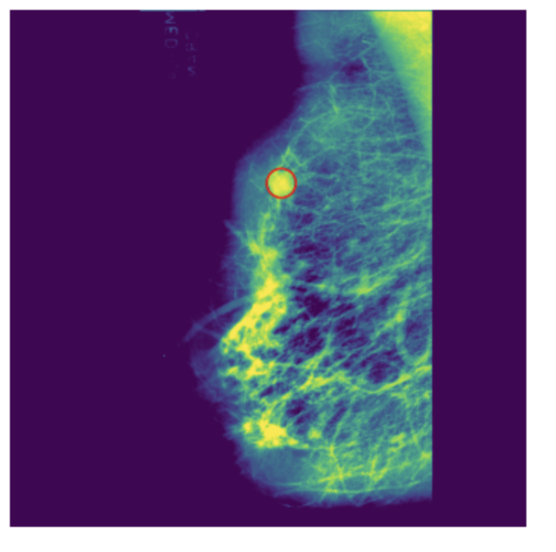
Dataset & preprocessing
Well known dataset of mammography images¹
All images in grayscale and 1024x1024
Significantly imbalanced (which is typical of mammography images)
271 images that are benign
48 images that are malignant
Malignant tissue is labelled as a coordinate and radius of the mass of interest as seen in Figure 1
Preprocessing
CLAHE is applied as indicated by Akila et al² to have good image enhancing capabilities
Thresholding (Otsu) to ensure the background is always 0 consistently
Figure 1. Mammography image showing a malignant mass, highlighted by a red circle plotted after the dataset has been loaded and preprocessed with CLAHE and thresholding
1) http://peipa.essex.ac.uk/info/mias.html
2) https://core.ac.uk/download/pdf/82063715.pdf

Slide 4
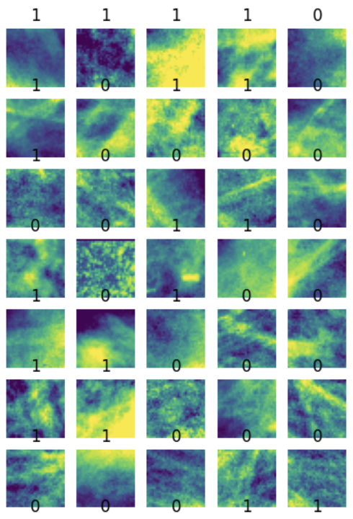
Methods
The image is split after preprocessing into 32x32 patches, and those with more than 20% background are removed
Each patch is determined to be either contain cancer or not by using the coordinate & radius of the malignant mass as indicated in the dataset
As the resulting patch dataset is even more imbalanced that the original full image dataset, a resampling is done before training to achieve the same ratio of positive/negative as the original full image dataset
Cross validation with folds = 5 is applied to train and evaluate:
A Self Organizing Map (SOM) is trained using a dimension 32 on the training fold
Encodings are extracted from the SOM by using weighted averaging of the weight vector of the N nearest neurons. This is done for both the training fold and test fold.
The train encodings are used to train a support vector classifier (the SVC classifier from the scikit-learn package)
The test encodings are used to predict from the trained SVC classifier
Accuracy and F1 score is evaluated on the test fold. The mean accuracy and F1 scores for all folds is reported
The above is repeated for hyper parameter search to find optimal values for: SOM learning rate, number of SOM epochs, number of N nearest weight vectors to use when extracting encodings from the SOM

Slide 5
Implementation
Jupyterlab on a GPU enabled machine using the typical Python libraries like matplotlib, numpy, tec
SOM implementation based on the lab source code but performance enhanced to run faster using Pytorch and the GPU
Scikit-learn for cross validation splitting and the support vector machine used to try the supervised predictions on the unsupervised generated encodings

Slide 6
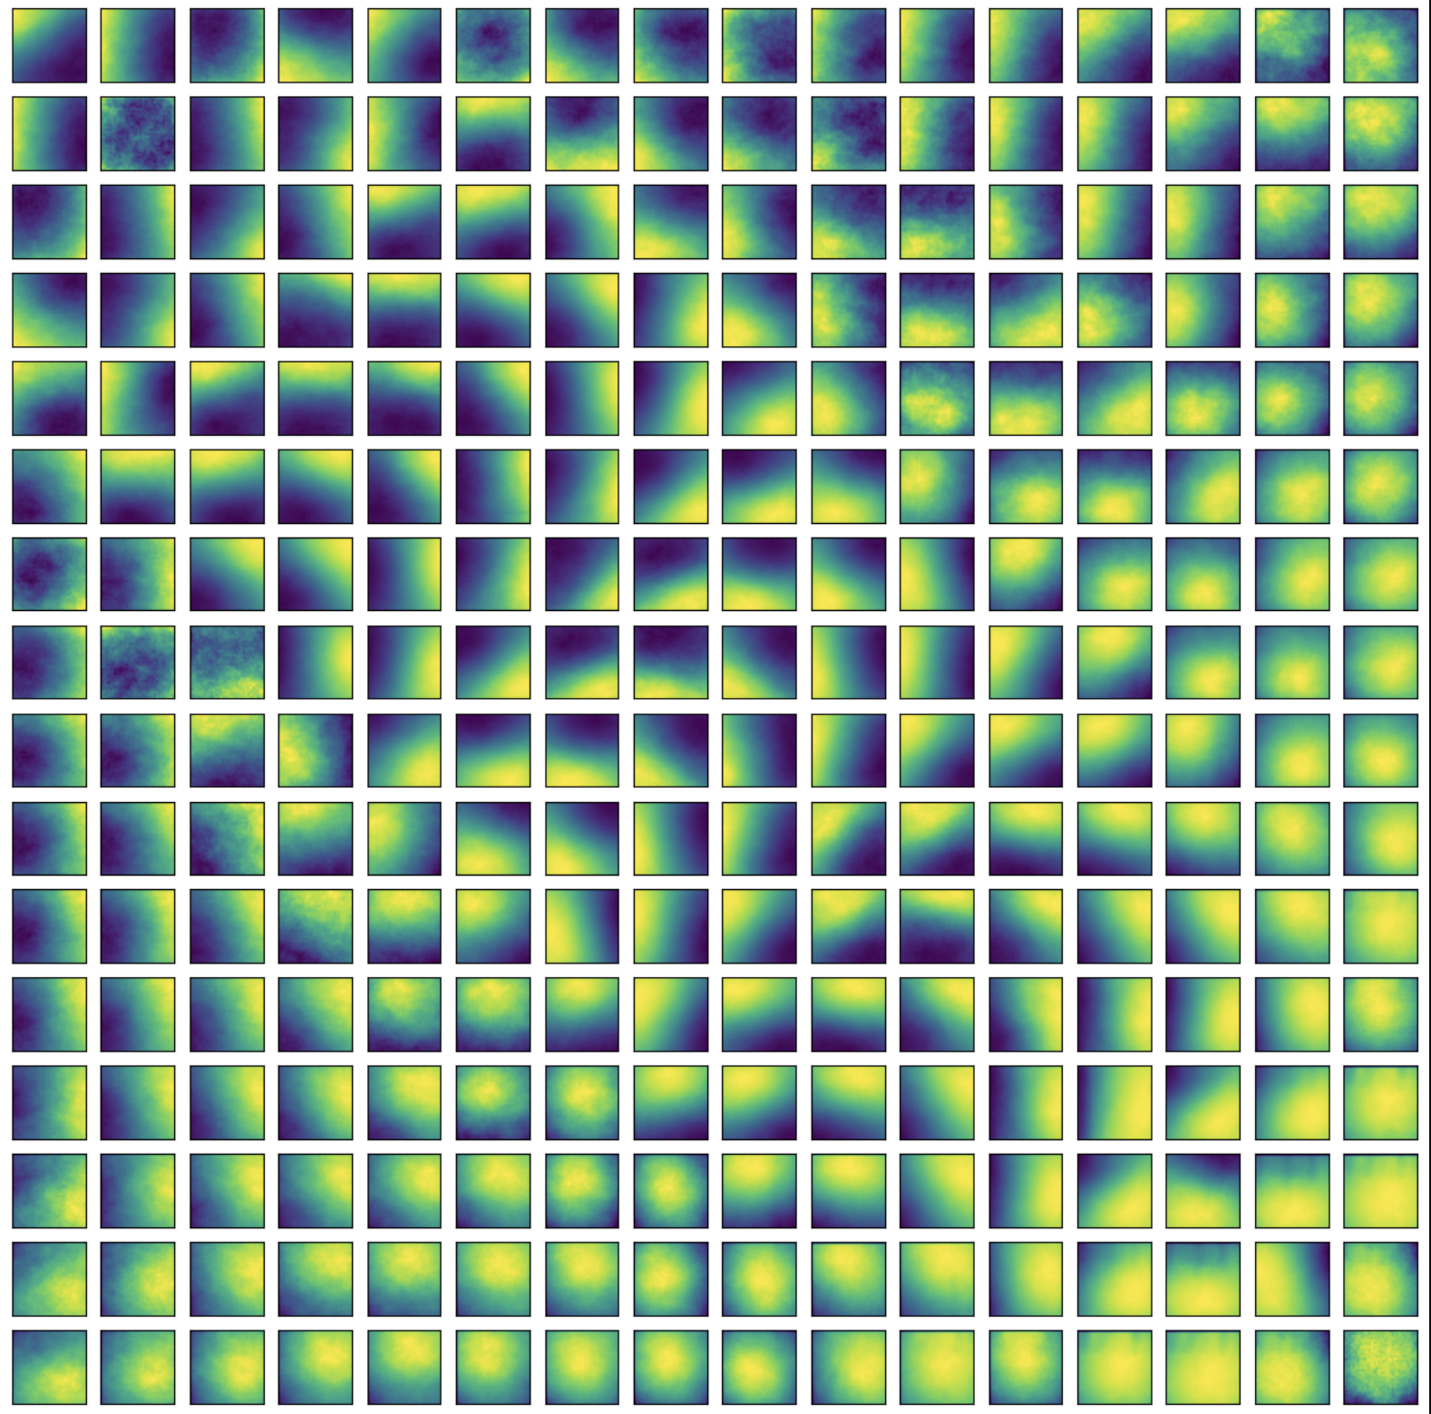
Results - CV hyper parameter tuning
The hyper parameter search for learning rate and N nearest weight vectors show 0.4 as the optimal learning rate with N = 1
 | Learning rate | N nearest | F1 score
Run 1 | 0.4 | 1 | 0.71
Run 2 | 0.4 | 3 | 0.69
Run 3 | 0.8 | 1 | 0.67
Run 4 | 0.8 | 3 | 0.68

Slide 7
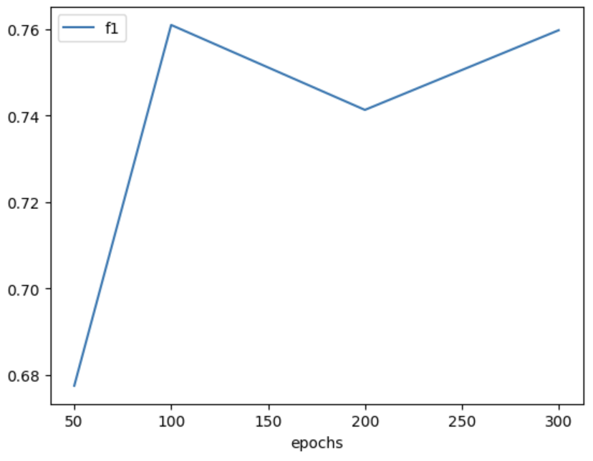
Results - CV hyper parameter tuning
After selecting an optimal learning rate and N, the number of epochs is tuned and the following epochs are tested 50, 100, 200 and 300.
The optimal number of epochs resulting in an F1 score of 0.76
For reference, a recent study¹ achieved 0.74 on malignant full images on the same dataset. Not fully comparable as methods differ, however.
1) https://www.tandfonline.com/doi/full/10.1080/23311916.2021.1968324

Slide 8
Discussion
While my method is quite simplified, it seems to indicate that SOMs can indeed be used to generate encodings suitable for predicting malignancy in mammography images. Hyper parameter tuning shows that there is possibility to increase performance by tuning at least SOM learning rate, N nearest weights, and SOM epochs.
Suggested further improvements could be:
Implement another distance metric for SOM that better captures the changes in texture between malignant and benign tissue, e.g. perhaps using edge detection
Our tests indicated that the best results was achieved when the weight vector of a single neuron was used. More approaches can be tested of how to combine weight vectors from neighbouring neurons
More advanced data augmentation techniques could be used to generate more images for the SOM to train on, especially malignant ones as they are significantly underrepresented in the dataset

