Slide 1
Lesson – Exploring the apache http webserver
Objectives –
1. Understand more about 1 web server -> Appache http server
2. Explore a few config file options
3. Understand the log files
4. Learn difference between built in languages (e.g,. Php VS CGI)

Slide 2
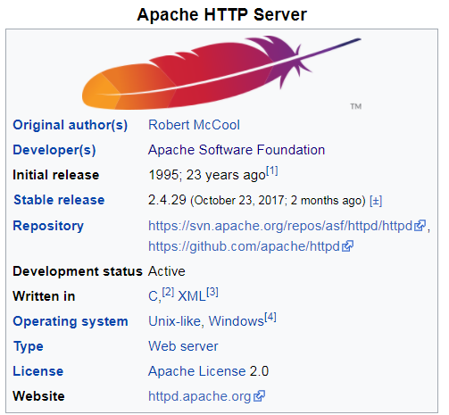
Lesson – Exploring the apache http webserver
1. Free and open source.
cross-platform but => as of 1 June 2017 92% of Apache HTTPS Server copies
Some common language interfaces: Perl, PHP, Python, TCL
A few more popular features:
Virtual hosts -> 1 physical instance appears as multiple URLs (e.g., www.mysite.com and www.someplace.com )
Highly Scalable -> Can easily handle > 10,000 simultaneous connections
Load balancing across > 1 physical server
URL rewriting -> e.g., www.abc.com/apples/baker/bananas -> www.mysite.com
Dynamic module loadin (e.g, can add on a module (like https w/o restart)
Bandwidth throttling ->

Slide 3

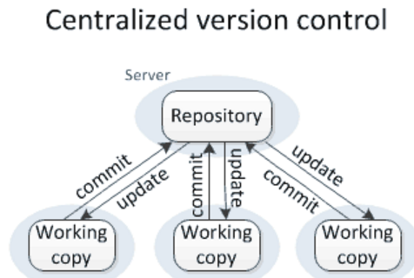
How many web servers do I need?
Code running here is what the world can see. . . We need to be VERY careful with it. . . If this has trouble we get calls …
I could log into the server and make changes BUT use source control instead
The production web server
(http://45.55.136.114/~dlash/hello.html
My Local webserver
http://webserver1/hello.html
My teammates webserver
http://webserver1/hello.html
Each team-member will run their own webserver that is a close as possible to the production. . .
Usually there are rules that define
When you can check items back (unit tests, and conflicts resolved, and code inspection results )
Who puts up development version, what tests must be passed and when deployed
We will share a source-code repository that keeps track of whats being developed and whats in production
Development is combined and pushed out to a development server first. Regression testing is done here
The production web server
(http://45.55.136.114/~Dev/hello.html

Slide 4
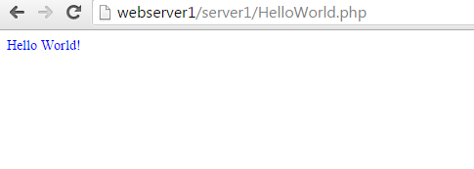
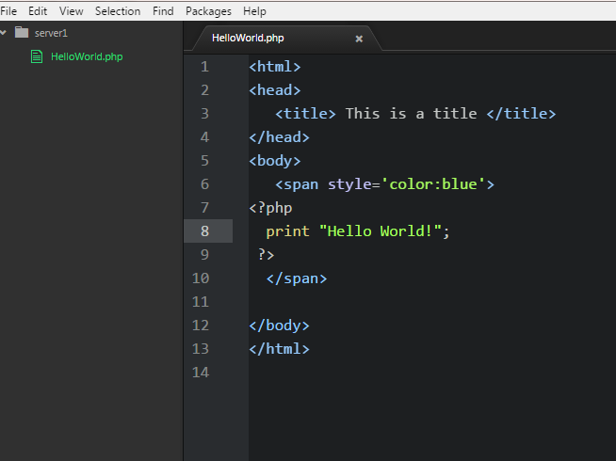

Developing locally
My HelloWorld.php script is stored within my webserver while I work on it
Save file -> C:\xampp\htdocs\webserver\server1
Notice how php can add php to html code BUT need to use .php suffix
(e.g., HelloWorld.php )

Slide 5
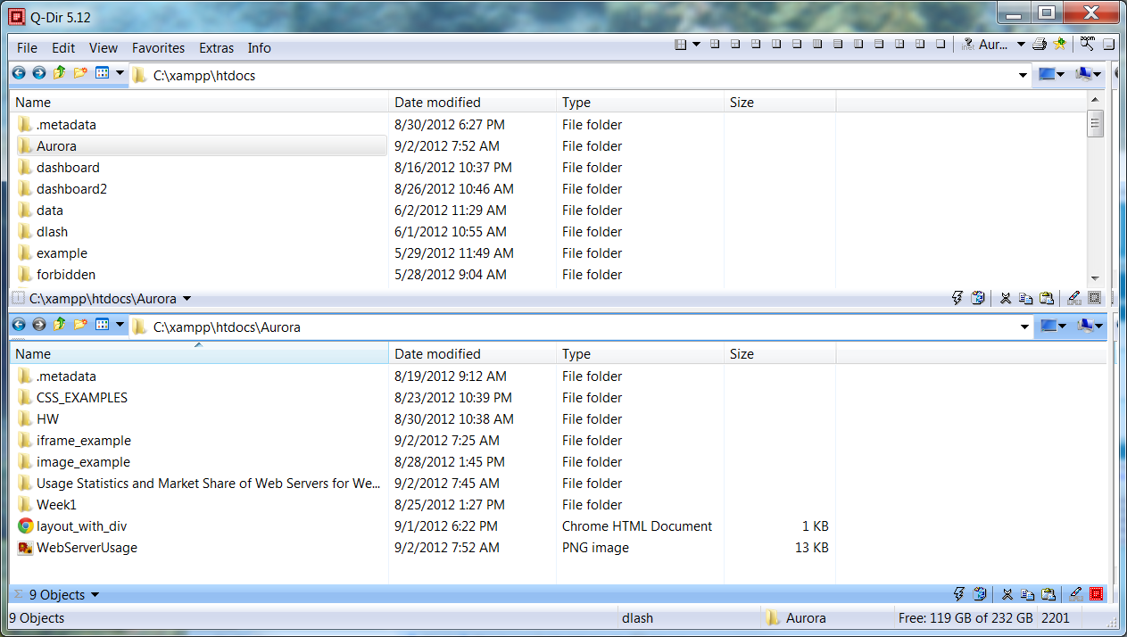
Place your files in htdocs
Note the URL.
C:\xampp\htdocs !

Slide 6
A few directives in httpd.conf - C:\xampp\apache\conf
(there are lots of modules: https://en.wikipedia.org/wiki/List_of_Apache_modules)
Module | Function | Example
mod_rewrite | Intercept URLs on-the-fly and rewrite them his module | Map: http://this.is.my.domain/this_is_my_address?=id.4567, to http://this.is.my.domain/address.
Addtype | Associate a file extension with a behavior | Run php interpreter on any file with .php suffix
Virtualhost | Create > 1 hostname for machine | Could host http:/myWebserver.com and http://myServer.com
DocumentRoot | The directory pages are served out of | Could be /home/dlash/public_html or c:\xampp\htdocs or /var/www
Listen | Specify what port to run on … default is 80. If specify > 1024 can only start as root
LoadModule | Tells apache what module to load | Php
Options | Turns some specific optional behavior | FollowSymLinks, Indexes, ExecCGI, and Includes
‘port’ is a for registering a request for a particular
Network server E.g., 80->apache (it’s a TCP thing) E.g., 111.2.3.4:80

Slide 7
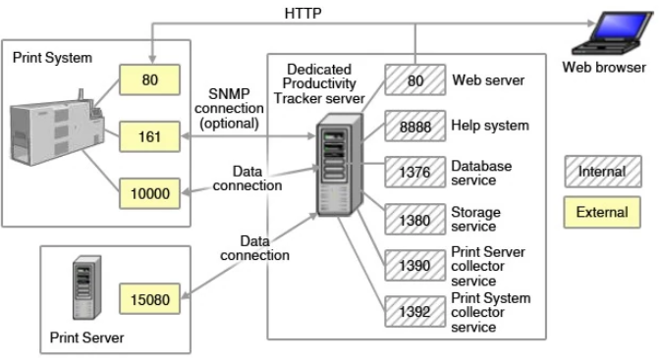
Network Port:
Network Port – A number to map a network connection between two computers.
  Each machine needs agreement => which process or application a message should be delivered.
  It is an ‘add-on’ to the network address -> indicates what ‘service’ to ask for
  There are standard use port numbers.
  Firewalls often block access to ports based on the network address and port # of the dest computer.
E.g., 20 -> FTP via TCP
22 -> SSH
25 -> SMTP via TCP
53 -> DNS via TCP
80 -> web via http
109 -> pop2 via tcp

Slide 8
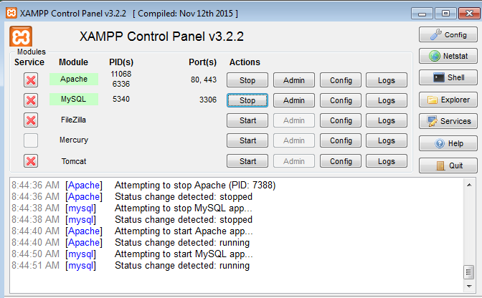
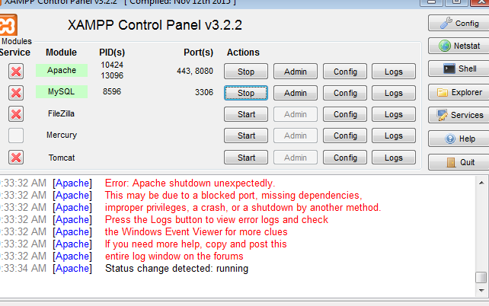

Apache config experiment1 – Change the network port
1. Navigate to C:\xampp\apache\conf
  Copy http.conf to ohttp.conf
2. Edit http.conf in notepad++
3. Edit this line:
  Listen 8080
  #Listen 80
4. Browse to a test file. E.g., http://127.0.0.1/under.png
5. Restart the apache deamon ->
  Browse to 127.0.0.1:8080 e.g., 127.0.0.1:8080/under.png
6. Reset the apache config:
  Edit this line:
    Listen 8080
    #Listen 80
7. Restart the web deamon
8. Browse to the test file:. E.g., http://127.0.0.1/under.png

Slide 9
Apache config experiment2: - change document_root
1. Navigate to C:\xampp\apache\conf
  Make sure you still have a copy:
  Do this if you DON’T HAVE A COPY:
    - Copy http.conf to ohttp.conf
2. Edit http.conf in notepad++
3. Copy these lines and then comment them out:
  #DocumentRoot "C:/xampp/htdocs"
  #<Directory "C:/xampp/htdocs">
  DocumentRoot "C:/xampp/public_html"
  <Directory "C:/xampp/public_html">
4. Create this path:
c:\xampp\public_html
5. Browse to a test file. E.g.
  http://127.0.0.1/under.png
6. Restart the apache deamon ->
  Browse to … THIS SHOULD FAIL: Browse http:127.0.0.1/under.png
7. Cp c:\xampp\htdocs\under.png to c:\xampp\public_html\under2.png
  Browse to … THIS SHOULD work: Browse http:127.0.0.1/under2.png
8. Reset the apache config:
  Edit this line:
  DocumentRoot "C:/xampp/htdocs"
  D<Directory "C:/xampp/htdocs">
  #DocumentRoot "C:/xampp/public_html"
  # <Directory "C:/xampp/public_html">
9. Restart the web deamon
10 Browse to the test file:. E.g., http://127.0.0.1/under.png

Slide 10
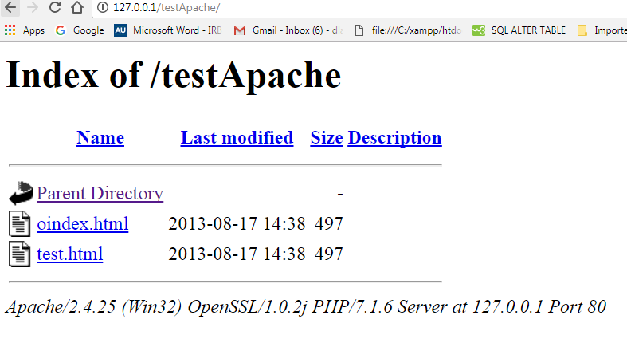
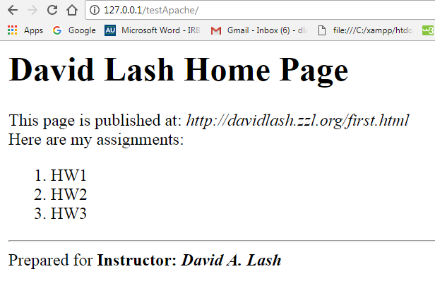
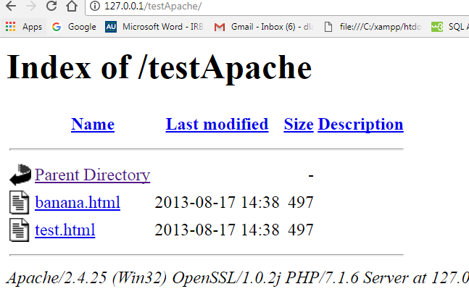
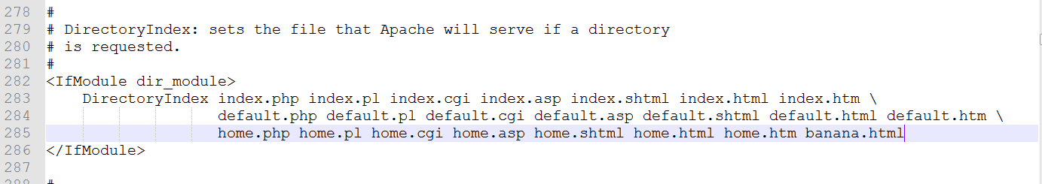
Apache config experiment3: - change indexing file
1. Navigate to C:\xampp\apache\conf
  Make sure you still have a copy:
  Do this if you DON’T HAVE A COPY:
    - Copy http.conf to ohttp.conf
2. Create this directory: C:\xampp\htdocs\testApache
- Put a file called test.html inside C:\xampp\htdocs\testApache
- Browse to http://127.0.0.1/testApache - (should see this
- cp testApache -> index.html
- Browse to http://127.0.0.1/testApache - (should see this
- rename index.html to banana.html –
- Browse to http://127.0.0.1/testApache - should see this
3. Edit http.conf in notepad++
3. Change this line – Add banana.html to the end
4. Save file and restart apache
5. Browse to http://127.0.0.1/testApache - (should see this
6. You can reedit httpd.con and remove banana.html as a index type or leave it

Slide 11
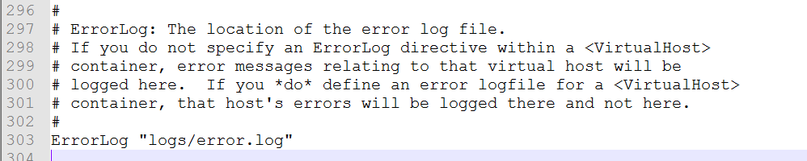
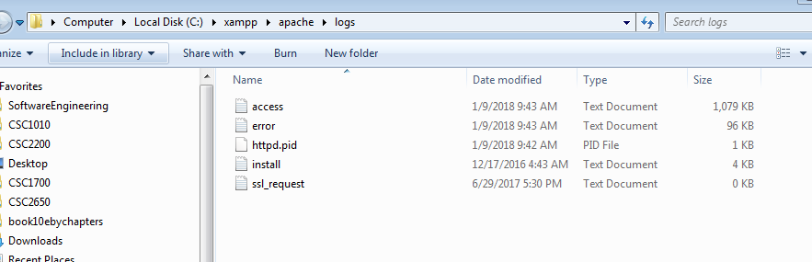
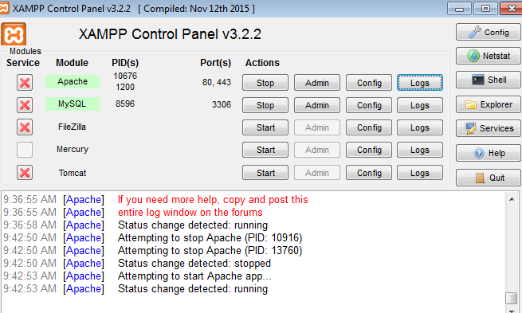
Apache config experiment4: - Error log
1. Navigate to C:\xampp\apache\conf
  Make sure you still have a copy:
  Do this if you DON’T HAVE A COPY:
    - Copy http.conf to ohttp.conf
2. Edit httpd.conf
3. Locate this line:
4. Navigate to that dir and open errors log,
Also look at access log
Here is my error log and access log … in xampp can also see here

Slide 12
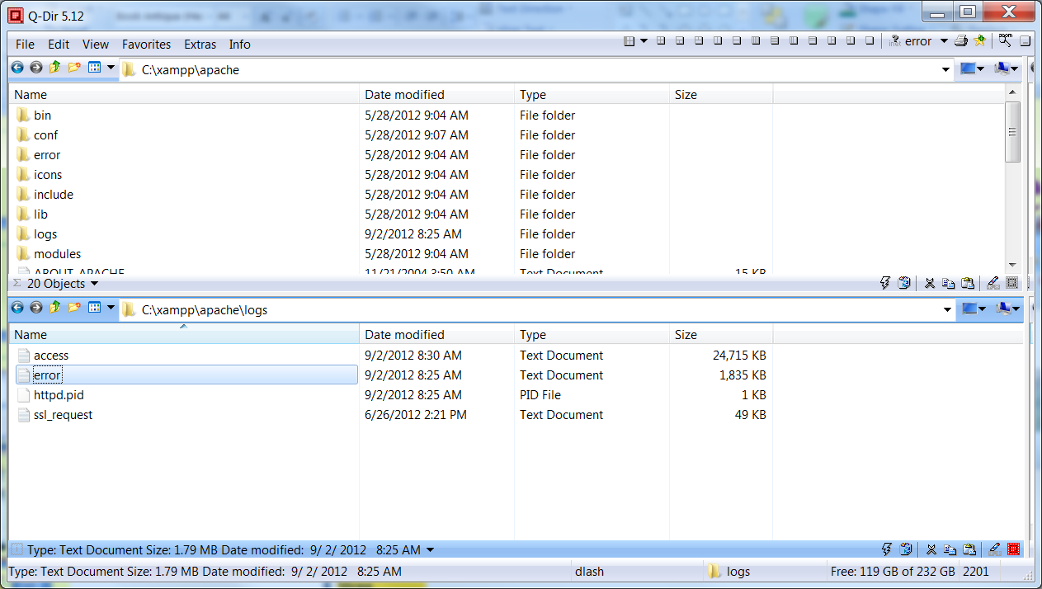
Log files are here:

Slide 13
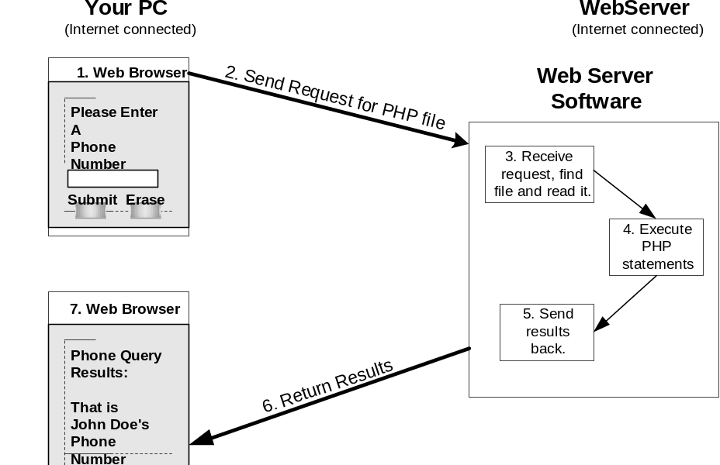
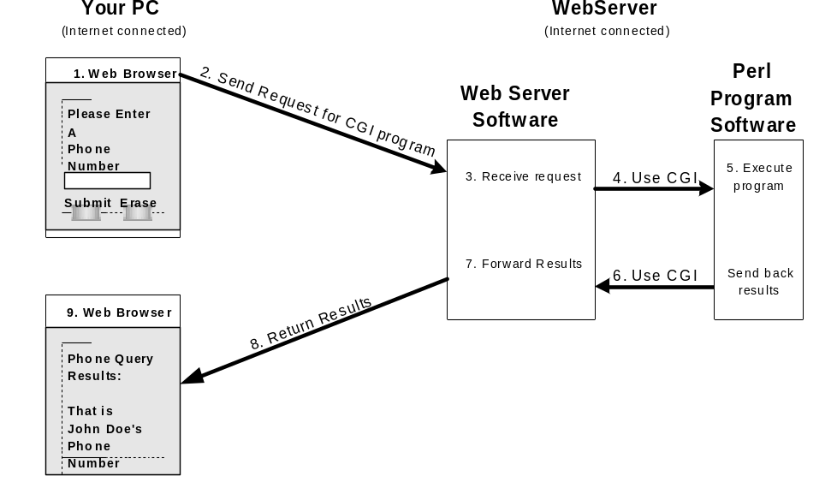
Apache config experiment4: - Run a cgi script
In xampp… apache is pre-configured to have php interpreter compiled in with it
On a UNIX server this is a fork operation
CGI-> Common Gateway interface … allows almost *any* language to work with apache

Slide 14
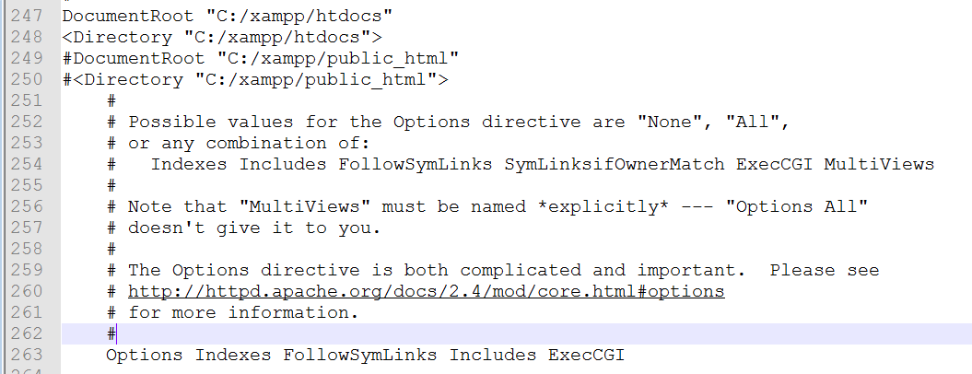
Apache config experiment4: - Run a cgi script
Locate the following
Directive essentially enables cgi scripts to run

Slide 15
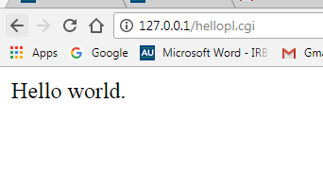
Apache config experiment4: Run a perl cgi script
Note that xampp ->
Apache, mysql, php and PERL
#!C:\xampp\perl\bin\perl.exe
# The above line is perl execution path in xampp
# The below line tells the browser, that this script will send html content.
# If you miss this line then it will show "malformed header from script" error.
print "Content-type: text/html\n\n";
print "Hello world."
Save this into c:\xampp\htdocs\helloPL.cgi
Now browse to: http://127.0.0.1/hellopl.cgi

Slide 16
Lesson – Exploring the apache http webserver
Objectives –
1. Understand more about 1 web server -> Appache http server
2. Explore a few config file options
3. Understand the log files
4. Learn difference between built in languages (e.g,. Php VS CGI)

