Slide 1
ADVANCED VISUALIZATION TECHNIQUES
PRESENTED BY GROUP 16

Slide 2
WHAT IS A HEAT MAP
This is a graphical representation of data where the individual values contained in a table are represented as colors.
Colors correspond to the level of measurement of the data.
They are used especially for large datasets which enables them to visualize the data making it easy to pick out the highs and lows values and identify patterns in the data

Slide 3
cont.
There are several steps followed when creating a heatmap.
We need to read a dataset in to R, you could use an already installed dataset in r by using the following command data(USArrests) or you could install your dataset on the desktop and there you would have to set your working space directory to be the desktop. You can use the command below to read the data
set nba <- read.csv(file= “nba.csv”, header=TURE, row.name=1) read.csv- calls the read table function specifically for csv (comma separated values)files. This function reads a table from the file and creates a data frame from it. File- indicates the file name that contain the table we are reading in. header=TRUE- indicates that our data contains a header row so r will treat the first line of data as a header. Row.name= 1- tells r that our row names are located in the first column of our table.

Slide 4
cont.
arrest <- the <- tells R to assign whatever we’re going to describe to the name arrest
read.csv calls the read.table function, specifically for CSV (comma separated value) files. This function reads a table from a file and creates a data frame from it.
file indicates the file name that contains the table we’re reading in. Because we’ve already set our working directory to the desktop, we don’t need to include the full path of the file.
header = TRUE indicates that our data contains a header row, so R will treat the first line of data as a header
row.names = 1 tells R that our rownames are located in the first column of our table

Slide 5
Cont.
3. The command nba <- nba [order(nba$Urbran), ] helps in reordering of data where it tells R to create a new data frame based on the original and includes an ordered variable Urban.
4. The data was loaded into a data frame but it has to be in form of a matrix to make a heat map thus you use the command nba_matrix <- data.matrix(nba)
5. To make the heat map, you finalize with the command nba_heatmap <- heatmap(nba_matrix, Rowv= NA, Colv=NA , col=cm.colors(256),scale=“column”,margins=c(5,10))

Slide 6
cont.
nba_matrix the name of the matrix to be used for the heat map.
Rowv determines if and how a row-based dendogram will be displayed, showing clusters. Since we don’t want a dendogram, we’ll use NA.
Colv determines if and how a column-based dendogram will be displayed, showing clusters. Since we don’t want a dendogram, we’ll use NA.
col identifies the color palette to be used. In this case, we’re using the heat.colors palette (shades of red, orange, and yellow) with 256 different shades.
scale indicates whether the values will be centered and scaled based on rows or columns. To start, we’ll use no scaling and just plot the data as is.
Margins determines the size of the margins for column and row names

Slide 7
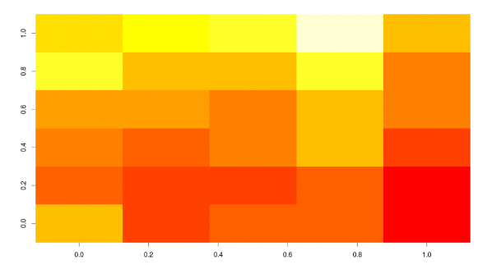
CONT.

Slide 8
Correlograms
Correlation matrices are a fundamental aspect of multivariate statistics. Which variables under consideration are strongly related to each other, and which aren’t? Are there clusters of variables that relate in specific ways? As the number of variables grows, such questions can be harder to answer
Correlograms are a relatively recent tool for visualizing the data in correlation matrices
It’s easier to explain a corrolegram once you’ve seen one. Consider the correlations among the variables in the mtcars data frame. Here you have 11 variables, each measuring some aspect of 32 automobiles. You can get the correlations using the following code:
library(corrgram)
corrgram(mtcars, order=TRUE, lower.panel=panel.shade, upper.panel=panel.pie, text.panel=panel.txt, main="Corrgram of mtcars intercorrelations")

Slide 9
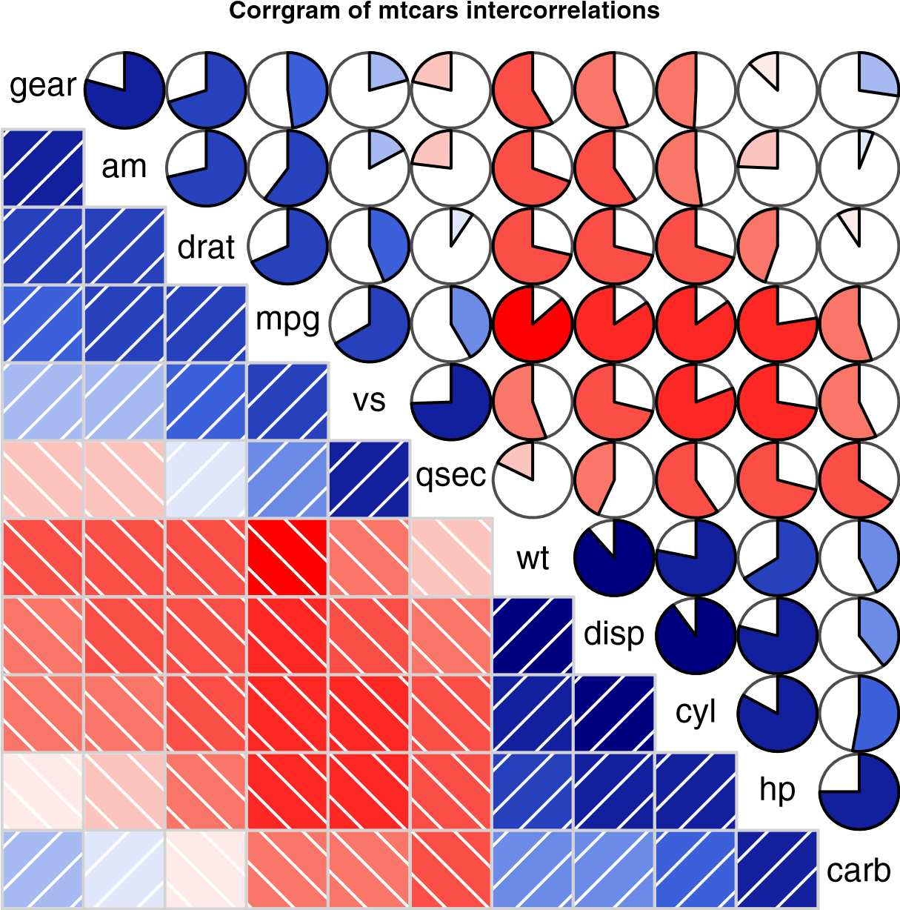
Which variables are most related? Which variables are relatively independent? Are there any patterns? It isn’t that easy to tell from the correlation matrix without significant time and effort (and probably a set of colored pens to make notations).
You can display that same correlation matrix using the corrgram() function in the corrgram package

Slide 10
Cont.
To interpret this graph, start with the lower triangle of cells (the cells below the principal diagonal). By default, a blue color and hashing that goes from lower left to upper right represent a positive correlation between the two variables that meet at that cell. Conversely, a red color and hashing that goes from the upper left to lower right represent a negative correlation. The darker and more saturated the color, the greater the magnitude of the correlation. Weak correlations, near zero, appear washed out. In the current graph, the rows and columns have been reordered (using principal components analysis) to cluster variables together that have similar correlation patterns.

Slide 11
Cont.
You can see from the shaded cells that gear, am, drat, and mpg are positively correlated with one another. You can also see that wt, disp, cyl, hp, and carb are positively correlated with one another. But the first group of variables is negatively correlated with the second group of variables. You can also see that the correlation between carb and am is weak, as is the correlation between vs and gear, vs and am, and drat and qsec.
The upper triangle of cells displays the same information using pies. Here, color plays the same role, but the strength of the correlation is displayed by the size of the filled pie slice. Positive correlations fill the pie starting at 12 o’clock and moving in a clockwise direction. Negative correlations fill the pie by moving in a counterclockwise direction.

Slide 12
Cont.
The format of the corrgram() function is
corrgram(x, order=, panel=, text.panel=, diag.panel=)
where x is a data frame with one observation per row. When order=TRUE, the variables are reordered using a principal component analysis of the correlation matrix. Reordering can help make patterns of bivariate relationships more obvious.
The option panel specifies the type of off-diagonal panels to use. Alternatively, you can use the options lower.panel and upper.panel to choose different options below and above the main diagonal. The text.panel and diag.panel options refer to the main diagonal. Allowable values for panel are described in table 0.1
Table 0.1 Panel options for the corrgram() function

Slide 13
Cont.
Placement | Panel Option | Description
Off diagonal | panel.pie | The filled portion of the pie indicates the magnitude of the correlation.
 | panel.shade | The depth of the shading indicates the magnitude of the correlation.
 | panel.ellipse | Plots a confidence ellipse and smoothed line.
 | panel.pts | Plots a scatter plot.
 | panel.conf | Prints correlations and their confidence intervals.
Main diagonal | panel.txt | Prints the variable name.
 | panel.minmax | Prints the minimum and maximum value and variable name.
 | panel.density | Prints the kernel density plot and variable name.

Slide 14
MAP VISUALISATION
This is a techinique of data visualization that allows us to visualize spartial relationships in data on a geographical map.

Slide 15
Types of map visualization
Geographical points.
This shows data point on a map by indicating markers at geographical coordinates similar to the way that an XY chart places points at XY coordinates.
Geographical areas.
This color the areas on a map to indicate a value or a category of data for an area.

Slide 16
When to use Geographical points
Incase your data refer to a specific location eg. Business or crime scenes.
Incase user want to look at data points near them eg. Local Schools performance.

Slide 17
How to creat a map in R
We need the following packages installed;
library(dplyr)
library(ggmap)
library(jsonlite)
ggmap() and qmap()
First package to introduce is ggmap. It is simply a wrapper for mainly the google map API (it also support Stamen and OpenStreet among others).The main functions of ggmap are get_map() and ggmap(). Give them a location coordinates and the map is yours!

Slide 18
Example of ggmap code
# First get Milan coordinates
Milan<-c(lat=45.464211, lon=9.191383)
#Extract the map from Google map at a specific zoom (this is up to you!)
mapMilan <- get_map(location=Milan, zoom=10)
#Visualize the map
ggmap(mapMilan)

Slide 19
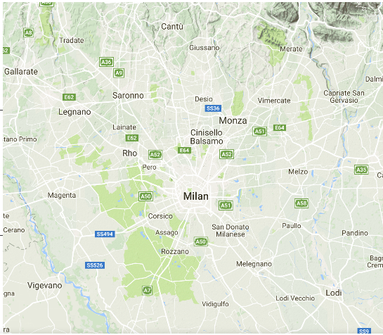
Millan map using ggmap

Slide 20
qmap
ggmap has another function for doing the same operation in less coding,
it is called qmap() and works as follows:
mapMilan<-qmap("Milan", zoom = 10)
mapMilan

Slide 21
Ggmap customize for satatelite view
#Get the map
mapMilanSat <- get_map(location=Milan, zoom=10, maptype = "satellite")
#Visualize the map
ggmap(mapMilanSat)

Slide 22
Mosaic Map
Mosaic plot is a graphical method for visualizing data from two or more qualitative variables.
mosaic plot is a graphical display of the cell frequencies of a contingency table in which the area of boxes of the plot are proportional to the cell frequencies of the contingency table.
It gives an overview of the data and makes it possible to recognize relationships between different variables.
If there are more than two categorical variables, we use mosaic maps

Slide 23
Example
A classic example of mosaic plots uses data from the passengers on the Titanic. The data used for this example has 2201 observations and 3 variables. The variables are:
the gender of the person (male / female)
the class (1st, 2nd and 3rd class, or crew)
did this person survive the sinking (yes / no)?

Slide 24
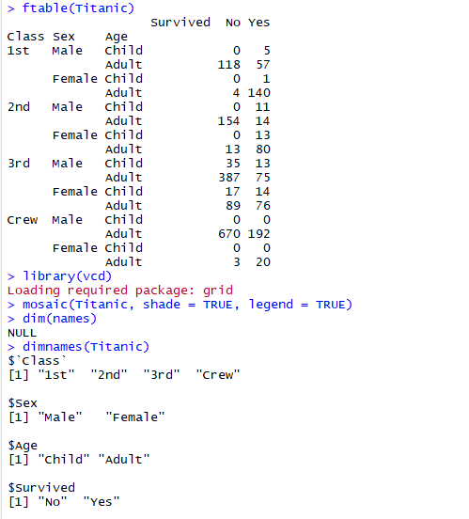

Slide 25
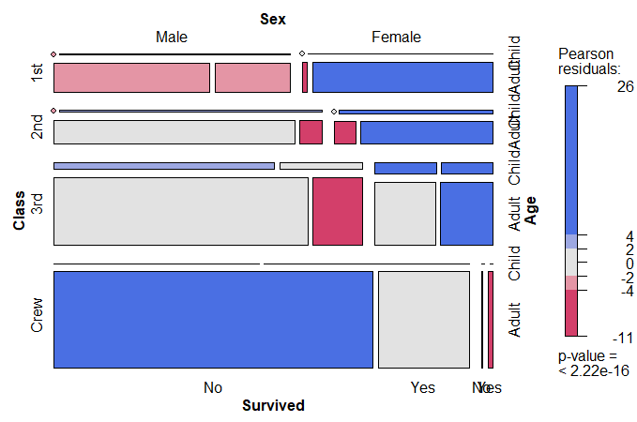

Slide 26
Keys of Interpretation of Mosaic Plots
The categories of each new factor divide each box either horizontally or vertically
If two factors are independent, the gaps between the corresponding sets of boxes will align.
The area of each box is proportional to the corresponding cell frequency.

