Slide 1
LINEAR REGRESSION
PRESENTED BY GROUP 16
NAME | REG NO. | STUD NO.
KASOZI BENJAMIN | 16/U/5538/EVE | 216015602
KAGANZI TIMOTHY | 16/U/5134/EVE | 216007287
OKURUT JULIUS | 16/U/10950/PS | 216014096
KUNYA NATHERN | 16/U/6372/EVE | 216006158

Slide 2
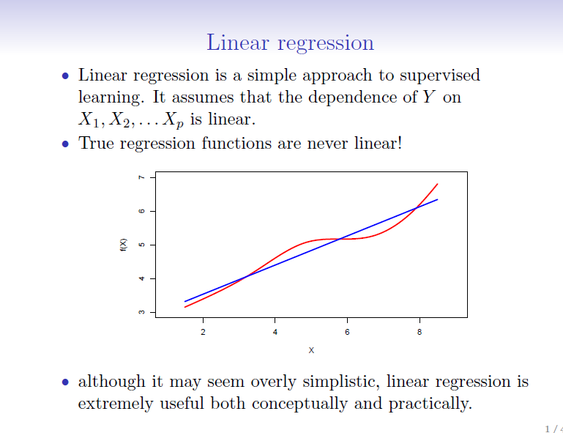

Slide 3
Linear regression is used to predict the value of an outcome variable Y based on one or more input predictor variables X.
Linear Regression has two variables called predictor and target are related through an equation.
Y = β1 + β2X + ϵ
where, β1 is the intercept and β2 is the slope. Collectively, they are called regression coefficients. ϵ is the error term, the part of Y the regression model is unable to explain.

Slide 4
Applications of linear regression
Linear Regression is a very powerful statistical technique and can be used to
Generate insights on consumer behavior,
Understanding business and factors influencing profitability.
Linear regressions can be used in business to evaluate trends and make estimates or forecasts.
Linear regression can also be used to analyze the marketing effectiveness, pricing and promotions on sales of a product
Used by the credit card industry, a financial company in minimizing the risk portfolio and wants to understand the top five factors that cause a customer to default

Slide 5
Assumptions of Linear Regression
Linear regression is an analysis that assesses whether one or more predictor variables explain the dependent (criterion) variable. The regression has five key assumptions:
Linear relationship
Multivariate normality
No or little multicollinearity
No auto-correlation
Homoscedasticity
A note about sample size. In linear regression the sample size rule of thumb is that the regression analysis requires at least 20 cases per independent variable in the analysis.

Slide 6
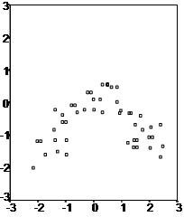
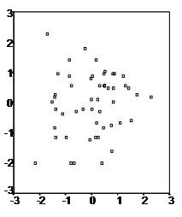
Cont.
First, linear regression needs the relationship between the independent and dependent variables to be linear. It is also important to check for outliers since linear regression is sensitive to outlier effects. The linearity assumption can best be tested with scatter plots, the following two examples depict two cases, where no and little linearity is present.

Slide 7
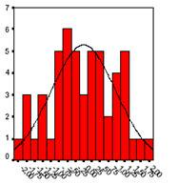
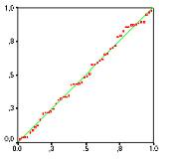
Cont.
Secondly, the linear regression analysis requires all variables to be multivariate normal. This assumption can best be checked with a histogram or a Q-Q-Plot. Normality can be checked with a goodness of fit test, e.g., the Kolmogorov-Smirnov test. When the data is not normally distributed a non-linear transformation (e.g., log-transformation) might fix this issue.

Slide 8
Cont.
Thirdly, linear regression assumes that there is little or no multicollinearity in the data. Multicollinearity occurs when the independent variables are too highly correlated with each other.
Multicollinearity may be tested with three central criteria:
1) Correlation matrix – when computing the matrix among all independent variables, the correlation coefficients need to be smaller than 1.
2) Tolerance – the tolerance measures the influence of one independent variable on all other independent variables; the tolerance is calculated with an initial linear regression analysis. Tolerance is defined as T = 1 – R² for these first step regression analysis. With T < 0.1 there might be multicollinearity in the data and with T < 0.01 there certainly is.
3) Variance Inflation Factor (VIF) – the variance inflation factor of the linear regression is defined as VIF = 1/T. With VIF > 10 there is an indication that multicollinearity may be present; with VIF > 100 there is certainly multicollinearity among the variables.
If multicollinearity is found in the data, centering the data (that is deducting the mean of the variable from each score) might help to solve the problem. However, the simplest way to address the problem is to remove independent variables with high VIF values.

Slide 9
Cont.
Fourthly, linear regression analysis requires that there is little or no autocorrelation in the data. Autocorrelation occurs when the residuals are not independent from each other. In other words when the value of y(x+1) is not independent from the value of y(x).
The last assumption of the linear regression analysis is homoscedasticity. The scatter plot is a good way to check whether the data are homoscedastic (meaning the residuals are equal across the regression line).

Slide 10
Example
For this analysis, we will use the cars dataset that comes with R by default. cars is a standard built-in dataset, that makes it convenient to demonstrate linear regression in a simple and easy to understand fashion. You can access this dataset simply by typing in cars in your R console. You will find that it consists of 50 observations(rows) and 2 variables (columns) – dist and speed. Lets print out the first six observations here..
head(cars) # display the first 6 observations
#> speed dist
#> 1 4 2
#> 2 4 10
#> 3 7 4
#> 4 7 22
#> 5 8 16
#> 6 9 10
Before we begin building the regression model, it is a good practice to analyze and understand the variables. The graphical analysis and correlation study below will help with this.

Slide 11
Graphical Analysis
The aim of this exercise is to build a simple regression model that we can use to predict Distance (dist) by establishing a statistically significant linear relationship with Speed (speed). But before jumping into the syntax, lets try to understand these variables graphically. Typically, for each of the independent variables (predictors), the following plots are drawn to visualize the following behavior:
Scatter plot: Visualize the linear relationship between the predictor and response
Box plot: To spot any outlier observations in the variable. Having outliers in your predictor can drastically affect the predictions as they can easily affect the direction/slope of the line of best fit.
Density plot: To see the distribution of the predictor variable. Ideally, a close to normal distribution (a bell shaped curve), without being skewed to the left or right is preferred. Let us see how to make each one of them.

Slide 12
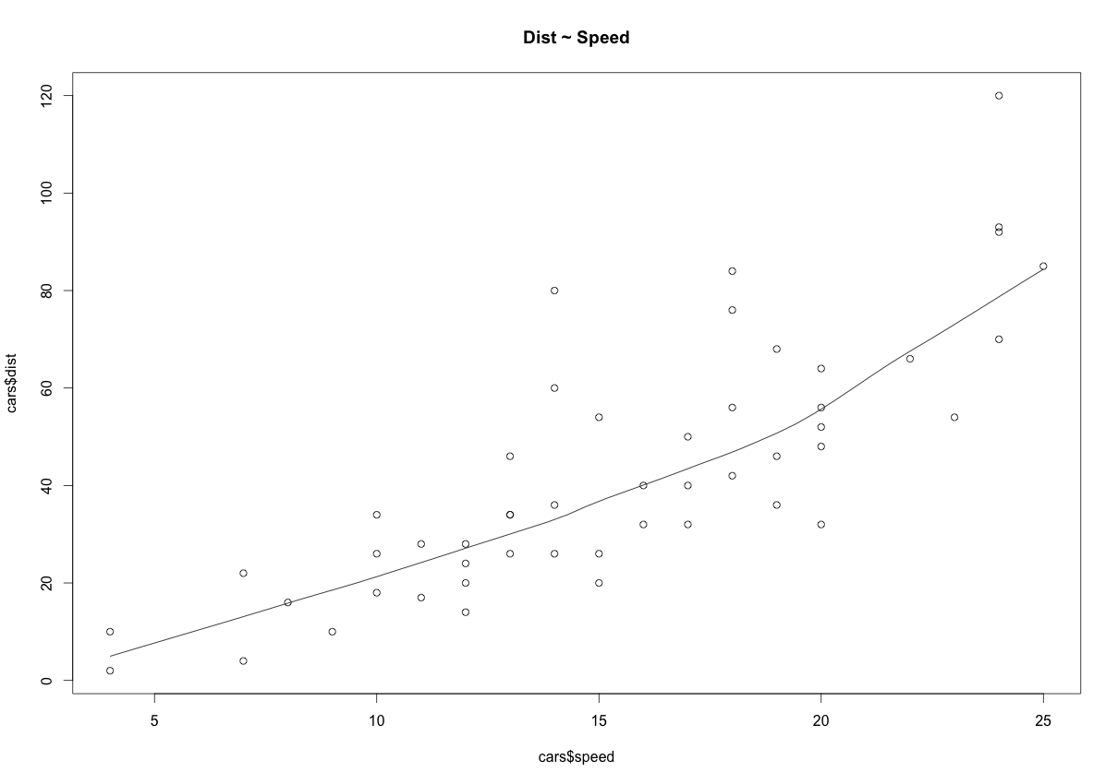
Scatter Plot
Scatter plots can help visualize any linear relationships between the dependent (response) variable and independent (predictor) variables. Ideally, if you are having multiple predictor variables, a scatter plot is drawn for each one of them against the response, along with the line of best fit as seen below.
scatter.smooth(x=cars$speed, y=cars$dist, main="Dist ~ Speed") # scatterplot

Slide 13
Cont.
The scatter plot along with the smoothing line above suggests a linearly increasing relationship between the ‘dist’ and ‘speed’ variables. This is a good thing, because, one of the underlying assumptions in linear regression is that the relationship between the response and predictor variables is linear and additive.

Slide 14
Correlation
Correlation is a statistical measure that suggests the level of linear dependence between two variables, that occur in pair – just like what we have here in speed and dist. Correlation can take values between
-1 to +1. If we observe for every instance where speed increases, the distance also increases along with it, then there is a high positive correlation between them and therefore the correlation between them will be closer to 1. The opposite is true for an inverse relationship, in which case, the correlation between the variables will be close to -1.
A value closer to 0 suggests a weak relationship between the variables. A low correlation (-0.2 < x < 0.2) probably suggests that much of variation of the response variable (Y) is unexplained by the predictor (X), in which case, we should probably look for better explanatory variables.
cor(cars$speed, cars$dist) # calculate correlation between speed and distance

Slide 15
Steps to Establish a Regression
The steps to create the relationship is −
Carry out the experiment of gathering a sample of observed values
Create a relationship model using the lm() functions in R.
Find the coefficients from the model created and create the mathematical equation using these
Get a summary of the relationship model to know the average error in prediction. Also called residuals.

Slide 16
lm() Function
This function creates the relationship model between the predictor and the response variable.
Syntax
The basic syntax for lm() function in linear regression is −
lm(formula,data)
Following is the description of the parameters used −
formula is a symbol presenting the relation between x and y.
data is the vector on which the formula will be applied.

Slide 17
Build Linear Model
Now that we have seen the linear relationship pictorially in the scatter plot and by computing the correlation, lets see the syntax for building the linear model. The function used for building linear models is lm(). The lm() function takes in two main arguments, namely: 1. Formula 2. Data. The data is typically a data.frame and the formula is a object of class formula. But the most common convention is to write out the formula directly in place of the argument as written below.
linearMod <- lm(dist ~ speed, data=cars) # build linear regression model on full data
print(linearMod)
#> Call:
#> lm(formula = dist ~ speed, data = cars)
#>
#> Coefficients:
#> (Intercept) speed
#> -17.579 3.932
Now that we have built the linear model, we also have established the relationship between the predictor and response in the form of a mathematical formula for Distance (dist) as a function for speed. For the above output, you can notice the ‘Coefficients’ part having two components: Intercept: -17.579, speed: 3.932 These are also called the beta coefficients. In other words, dist = Intercept + (β ∗ speed) => dist = −17.579 + 3.932∗speed

Slide 18
Linear Regression Diagnostics
Now the linear model is built and we have a formula that we can use to predict the dist value if a corresponding speed is known. Is this enough to actually use this model? NO! Before using a regression model, you have to ensure that it is statistically significant. How do you ensure this? Lets begin by printing the summary statistics for linearMod.
summary(linearMod) # model summary
#> Call:
#> lm(formula = dist ~ speed, data = cars)
#>
#> Residuals:
#> Min 1Q Median 3Q Max
#> -29.069 -9.525 -2.272 9.215 43.201
#>
#> Coefficients:
#> Estimate Std. Error t value Pr(>|t|)
#> (Intercept) -17.5791 6.7584 -2.601 0.0123 *
#> speed 3.9324 0.4155 9.464 1.49e-12 ***
#> ---
#> Signif. codes: 0 '***' 0.001 '**' 0.01 '*' 0.05 '.' 0.1 ' ' 1
#>
#> Residual standard error: 15.38 on 48 degrees of freedom
#> Multiple R-squared: 0.6511, Adjusted R-squared: 0.6438
#> F-statistic: 89.57 on 1 and 48 DF, p-value: 1.49e-12

Slide 19
AIC and BIC
The Akaike’s information criterion - AIC (Akaike, 1974) and the Bayesian information criterion - BIC (Schwarz, 1978) are measures of the goodness of fit of an estimated statistical model and can also be used for model selection. Both criteria depend on the maximized value of the likelihood for the estimated model.
For model comparison, the model with the lowest AIC and BIC score is preferred.
AIC(linearMod) # AIC => 419.1569
BIC(linearMod) # BIC => 424.8929

Slide 20
How to know if the model is best fit for your data?
The most common metrics to look at while selecting the model are:
STATISTIC | CRITERION
R-Squared | Higher the better (> 0.70)
Adj R-Squared | Higher the better
F-Statistic | Higher the better
Std. Error | Closer to zero the better
AIC | Lower the better
BIC | Lower the better

Slide 21
The p Value: Checking for statistical significance
The summary statistics above tells us a number of things. One of them is the model p-Value (bottom last line) and the p-Value of individual predictor variables (extreme right column under ‘Coefficients’). The p-Values are very important because, We can consider a linear model to be statistically significant only when both these p-Values are less that the pre-determined statistical significance level, which is ideally 0.05. This is visually interpreted by the significance stars at the end of the row. The more the stars beside the variable’s p-Value, the more significant the variable.

Slide 22
t-value
We can interpret the t-value something like this. A larger t-value indicates that it is less likely that the coefficient is not equal to zero purely by chance. So, higher the t-value, the better.
Pr(>|t|) or p-value is the probability that you get a t-value as high or higher than the observed value when the Null Hypothesis (the β coefficient is equal to zero or that there is no relationship) is true. So if the Pr(>|t|) is low, the coefficients are significant (significantly different from zero). If the Pr(>|t|) is high, the coefficients are not significant.
What this means to us? when p Value is less than significance level (< 0.05), we can safely reject the null hypothesis that the co-efficient β of the predictor is zero. In our case, linearMod, both these p-Values are well below the 0.05 threshold, so we can conclude our model is indeed statistically significant.

Slide 23
R-Squared and Adj R-Squared
What R-Squared tells us is the proportion of variation in the dependent (response) variable that has been explained by this model.
We don’t necessarily discard a model based on a low R-Squared value. Its a better practice to look at the AIC and prediction accuracy on validation sample when deciding on the efficacy of a model.
What about adjusted R-Squared? As you add more X variables to your model, the R-Squared value of the new bigger model will always be greater than that of the smaller subset

Slide 24
Standard Error and F-Statistic
Both standard errors and F-statistic are measures of goodness of fit.
How to calculate the t Statistic and p-Values?
When the model co-efficients and standard error are known, the formula for calculating t Statistic and p-Value is as follows:
t−Statistic=β−coefficientStd.Error
modelSummary <- summary(linearMod) # capture model summary as an object
modelCoeffs <- modelSummary$coefficients # model coefficients
beta.estimate <- modelCoeffs["speed", "Estimate"] # get beta estimate for speed
std.error <- modelCoeffs["speed", "Std. Error"] # get std.error for speed
t_value <- beta.estimate/std.error # calc t statistic
p_value <- 2*pt(-abs(t_value), df=nrow(cars)-ncol(cars)) # calc p Value
## t Value: 9.46399
## p Value: 1.489836e-12

