Slide 1
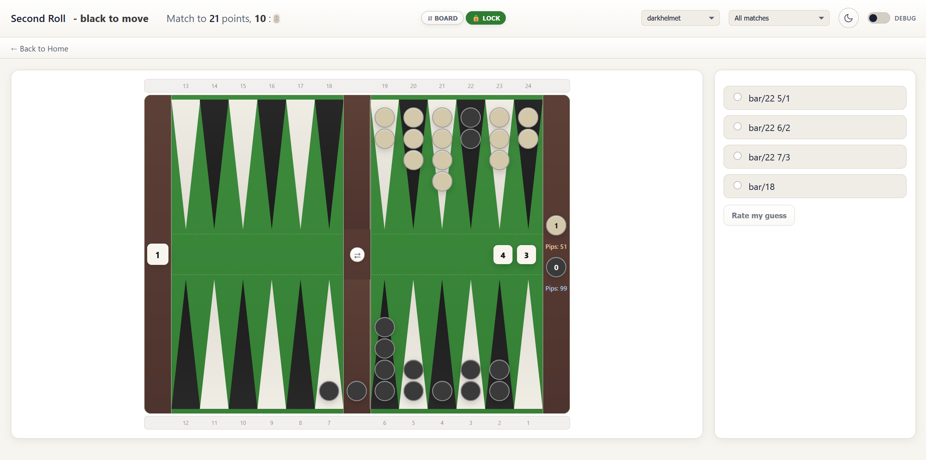
Match info
Flip the board vertically
Lock the board‘s vertical orientation
Show only quizzes from blunders of this player (or all)
Select a specific match to quiz
Toggle dark/ bright design
Back to adding quizzes or viewing stats / documentation
Quiz area: select the best move and click „rate my guess“
Flip the board horizontally (left/right bearoff)

Slide 2
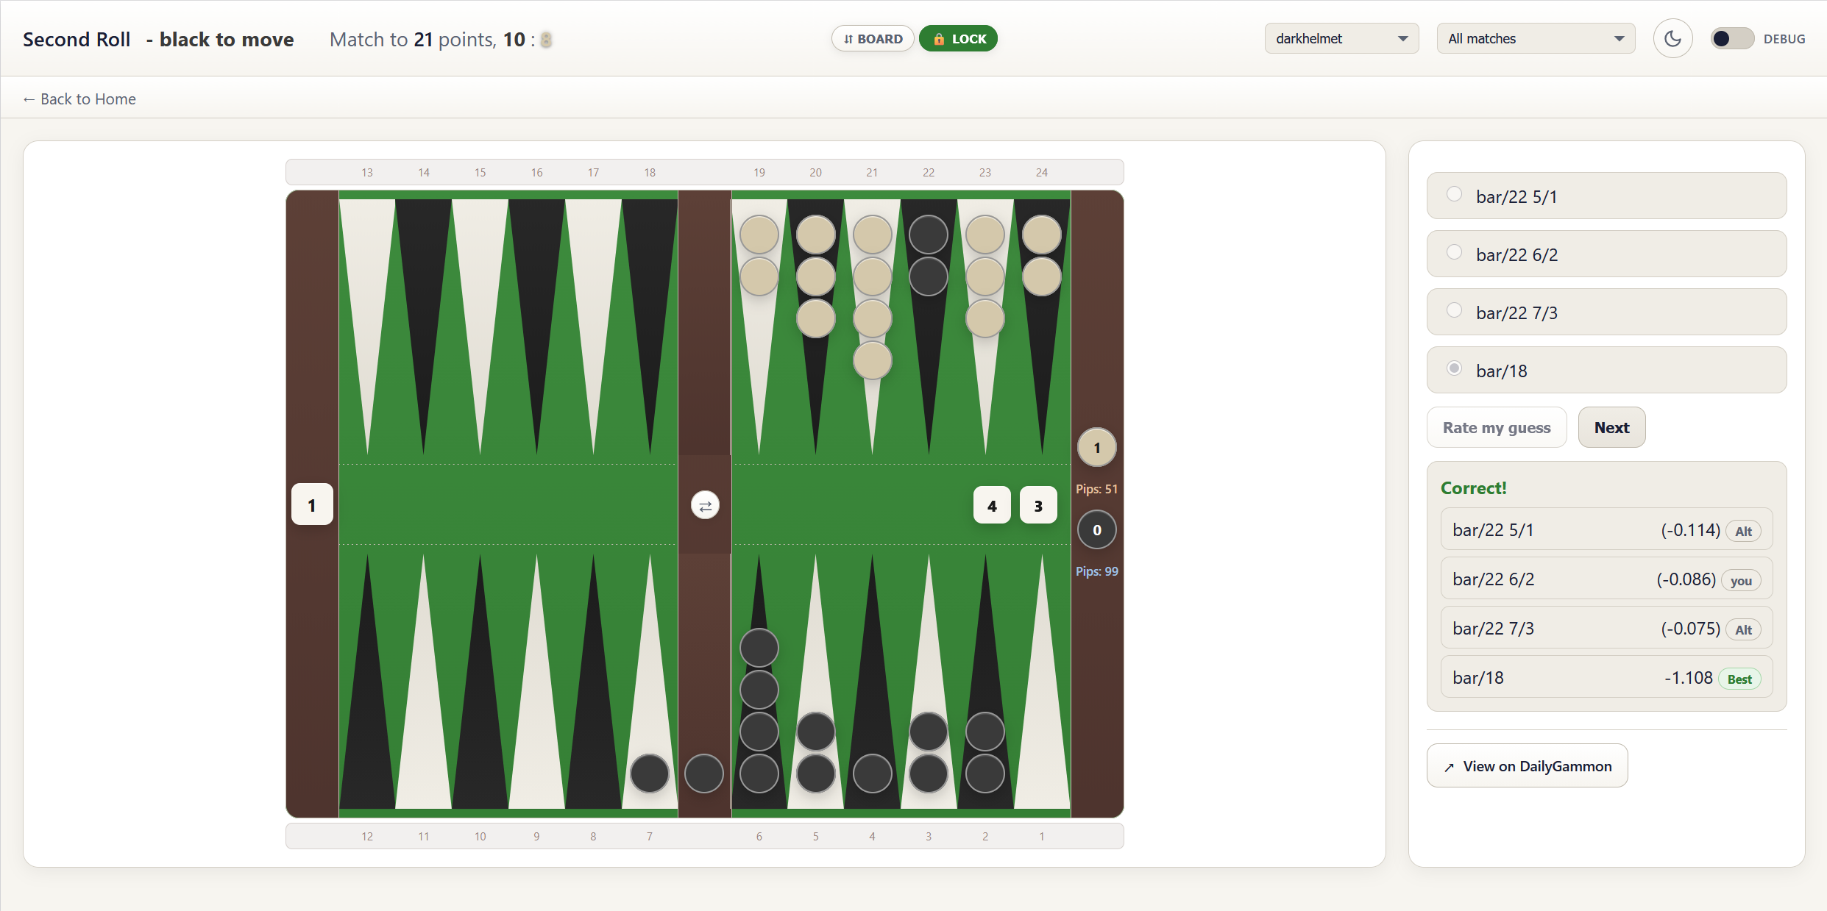
Proceed to the next quiz
Opens another browser tab with the DailyGammon app showing this move in your actual match (for the „I can‘t believe I actually played this“ effect)
Which move is the best move? Which one did you make? „Alt“ =
Alternative move added for having more choices
Equity info: match equity of the best move; relative equity to the best move in brackets for the others

