Slide 1
Exploring the disparity in deaths between the US, Iraq, and Afghanistan during the War on Terror
Katherine Hansen

Slide 2
The Origins of The War on Terror
2,977 people were killed during the 9/11 attacks
Following the 9/11 attacks, President George W. Bush launched attacks against governments who “support or shelter [terrorists].”

Slide 3
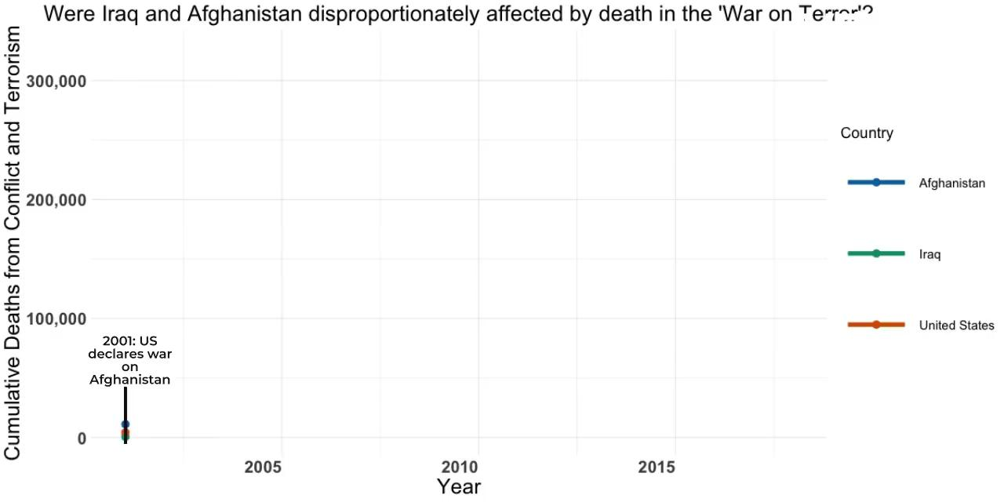

Slide 4
List of Sources
https://2001-2009.state.gov/s/ct/rls/wh/6947.htm
https://www.history.com/topics/21st-century/war-on-terror-timeline

