Slide 1




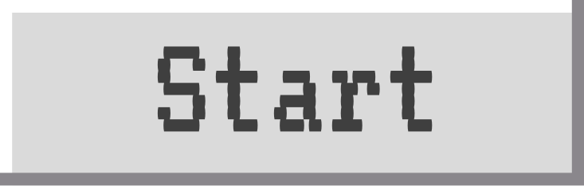
Binary code

Slide 2


What is Binary code?
A binary unit is also known as a “bit.” It is the smallest unit of digital information that a computer can understand. It is stored in a series of zeros and ones. A computer thinks by relying on zeros and ones for all information.

Slide 3
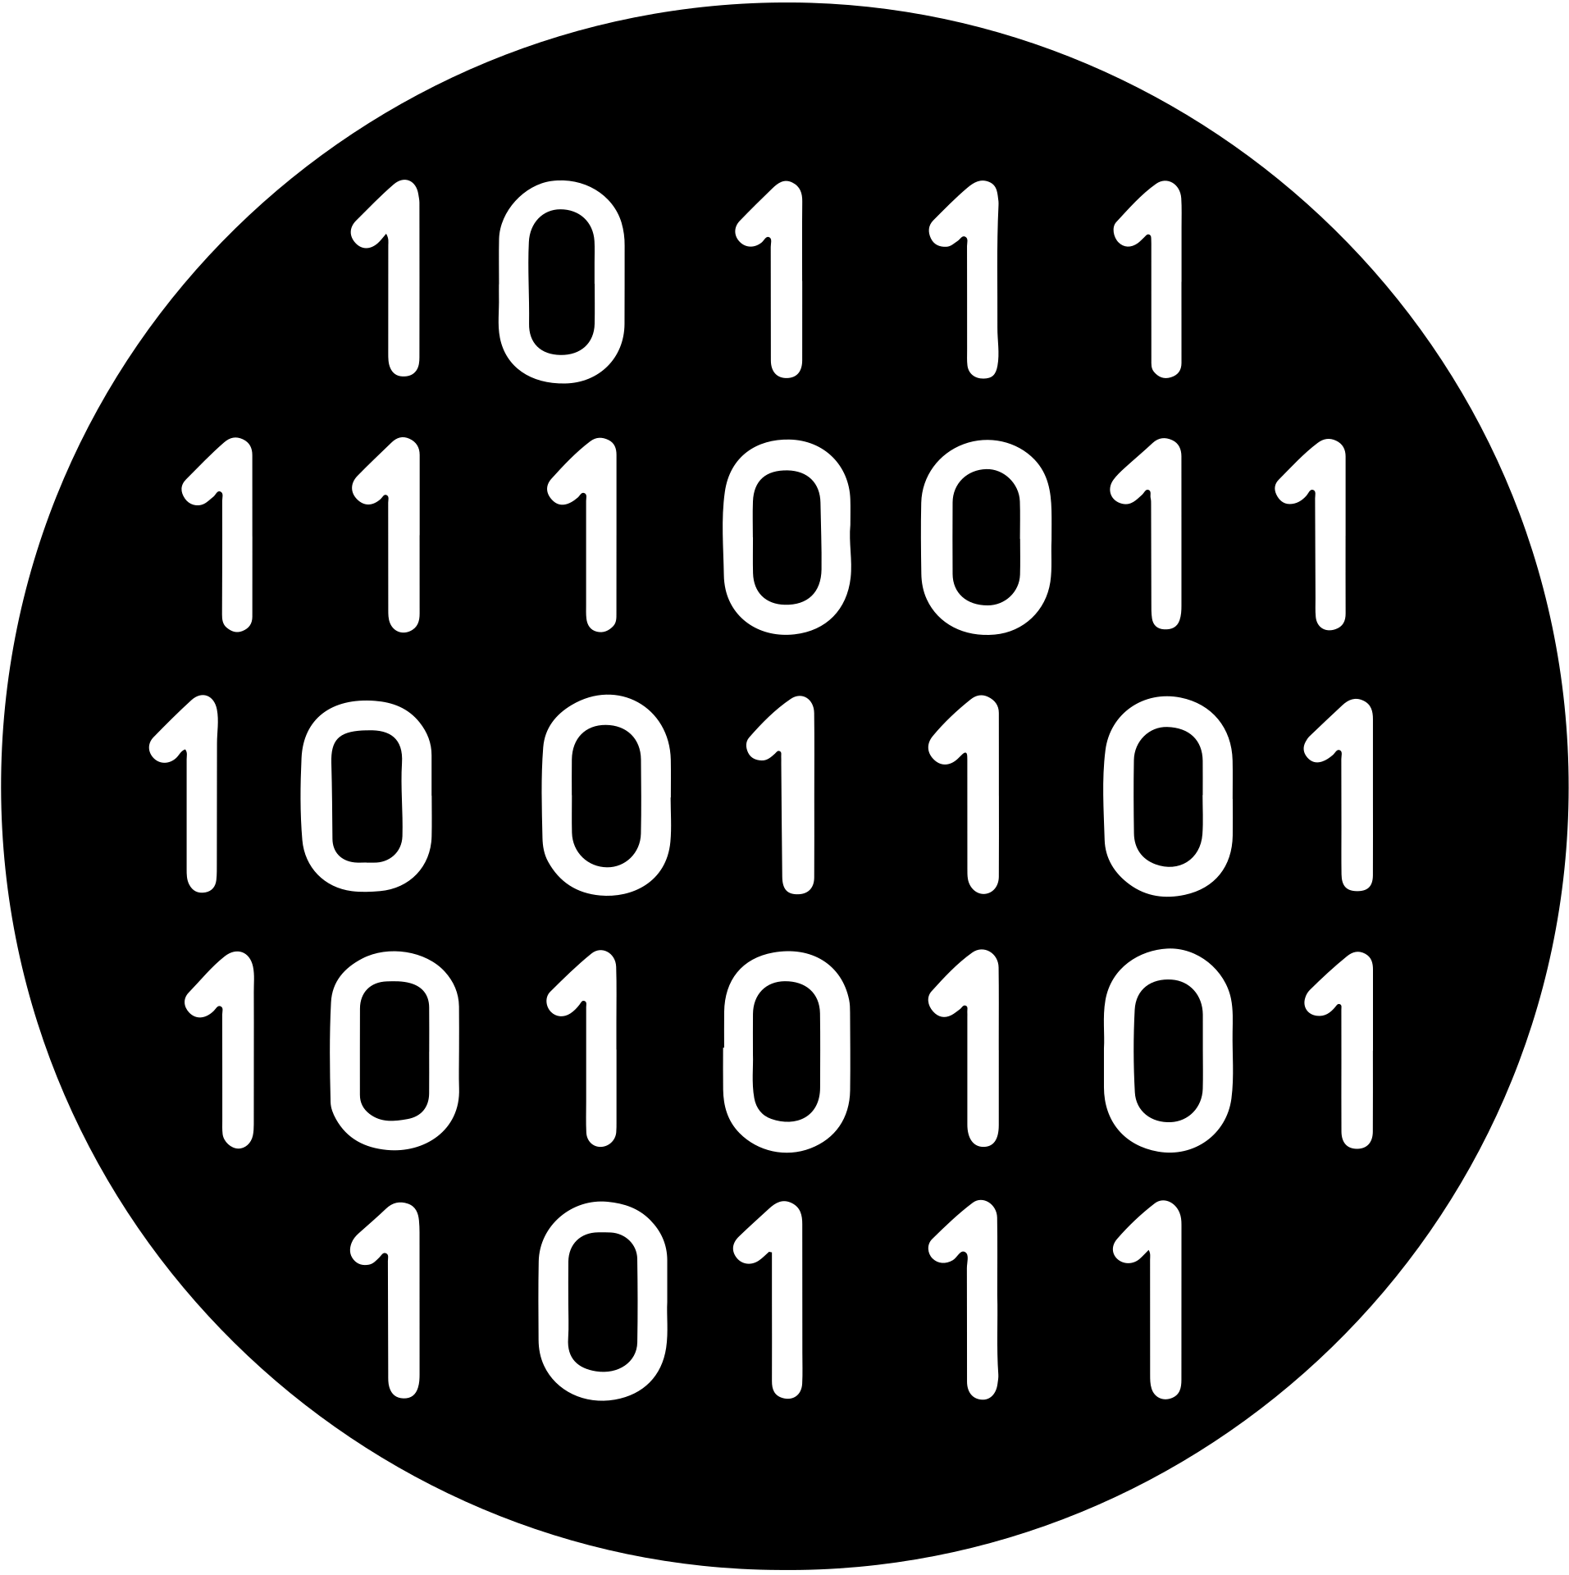

Why Binary Code?
Computers can compute the meaning of binary strings very quickly and translate them into numbers or letters. Text, images, sound, and video are converted into binary before being processed by the computer.

Slide 4


Think of the numbers like a light switch
1
0
1 is on
0 is off

Slide 5

Bit Vs Byte
While a bit is the smallest unit of information that a computer can understand, a byte is a string of 8 bits. A byte is also known as a unit of memory size.

Slide 6

Decimal | Binary
0 | 0000
1 | 0001
2 | 0010
3 | 0011
4 | 0100
5 | 0101
6 | 0110
7 | 0111
8 | 1000
9 | 1001
10 | 1010
Numbers in Binary code

Slide 7
How to read Binary
Binary Code Example: 101001100
 | 2^8 | 2^7 | 2^6 | 2^5 | 2^4 | 2^3 | 2^2 | 2^1 | 2^0
 | 256 | 128 | 64 | 32 | 16 | 8 | 4 | 2 | 0
Is this on or off? | 1=on | 0=off | 1=on | 0=off | 0=off | 1=on | 1=on | 0=off | 0=off
Total: | 256 | 0 | 64 | 0 | 0 | 8 | 4 | 0 | 0
Add it up | 256 + 0 + 64 + 0 + 0 + 8 + 4 + 0 + 0 | 256 + 0 + 64 + 0 + 0 + 8 + 4 + 0 + 0 | 256 + 0 + 64 + 0 + 0 + 8 + 4 + 0 + 0 | 256 + 0 + 64 + 0 + 0 + 8 + 4 + 0 + 0 | 256 + 0 + 64 + 0 + 0 + 8 + 4 + 0 + 0 | 256 + 0 + 64 + 0 + 0 + 8 + 4 + 0 + 0 | 256 + 0 + 64 + 0 + 0 + 8 + 4 + 0 + 0 | 256 + 0 + 64 + 0 + 0 + 8 + 4 + 0 + 0 | 256 + 0 + 64 + 0 + 0 + 8 + 4 + 0 + 0
Computer reads it as: | 332 | 332 | 332 | 332 | 332 | 332 | 332 | 332 | 332

Slide 8

From decimal number to binary
Example Number: 296
Look at your number. Subtract the largest power of 2 that is able to be subtracted from your number. In this example, we can subtract 256 so we can put a 1 in that column to indicate it is “on”.
296-256 = 40
Now look at what is left, in this case 40. You would put a “0” in the 128 and 64 columns because they cannot be subtracted. 32 CAN be subtracted so you would put a 1. Continue this until your result is zero when you subtract.
40 - 32 = 8 then... 8 - 8 = 0
256 | 128 | 64 | 32 | 16 | 8 | 4 | 2 | 0
1 | 0 | 0 | 1 | 0 | 1 | 0 | 0 | 0
296 in binary is 100101000

Slide 9
Another Way to convert
Divide your number by 2 and write the remainder until you get zero as the answer. Write the remainders starting from the last one first.
296 divided by 2 = 148 remainder 0
148 divided by 2 = 74 remainder 0
74 divided by 2 = 37 remainder 0
37 divided by 2 = 18 remainder 1
18 divided by 2 = 9 remainder 0
9 divided by 2 = 4 remainder 1
4 divided by 2 = 2 remainder 0
2 divided by 2 = 1 remainder 0
1 divided by 2 = 0 remainder 1
Example number: 296
Remainders written backwards:
100101000

Slide 10

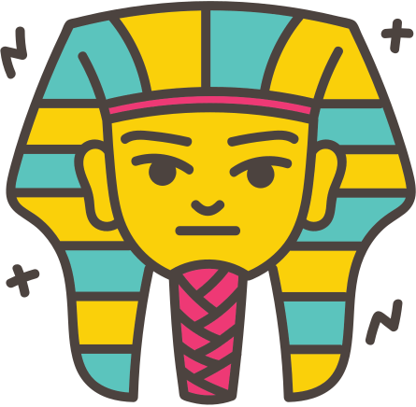

Binary Facts
Binary code is the basis for all computer languages.
Ancient Egyptians discovered binary code.
If the last digit of a binary number is 1, it will be odd. If it is 0, it will be even.
A byte is a collection of 8 binary digits.
Odd
Even

Slide 11
Teacher Resources
Press 0-9 for a timer
B
C
D
B is for blur
C is for confetti
B is for blur
O
Q
X
O is for Bubbles
Q is for Quiet
X is for close

