Slide 1
I/O Devices
Copyright ©: Nahrstedt, Angrave, Abdelzaher

Slide 2
Overview
Copyright ©: Nahrstedt, Angrave, Abdelzaher
Basic I/O hardware
  ports, buses, devices and controllers
I/O Software
  Interrupt Handlers, Device Driver, Device-Independent Software, User-Space I/O Software
Important concepts
  Three ways to perform I/O operations
    Polling, interrupt and DMAs

Slide 3
Hardware or Software?
Copyright ©: Nahrstedt, Angrave, Abdelzaher
Is the following component software or hardware?
  Device controller
Is the following component software or hardware?
  Device driver

Slide 4
Devices
Copyright ©: Nahrstedt, Angrave, Abdelzaher
Devices
  Storage devices (disk, tapes)
  Transmission devices (network card, modem)
  Human interface devices (screen, keyboard, mouse)
  Specialized device (joystick)

Slide 5
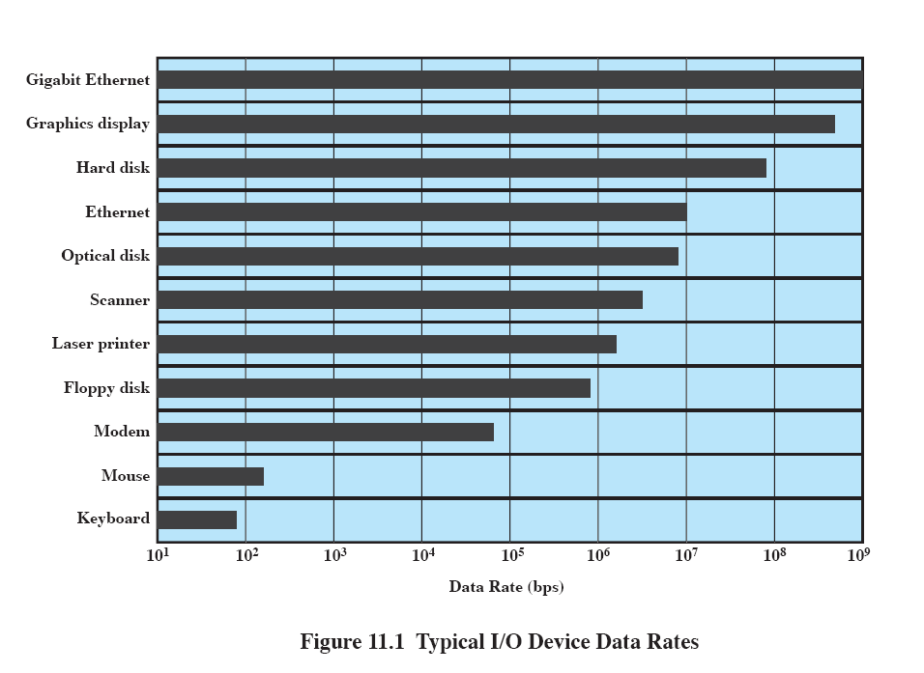
Copyright ©: Nahrstedt, Angrave, Abdelzaher

Slide 6
Device Controller
Copyright ©: Nahrstedt, Angrave, Abdelzaher
I/O units typically consist of
  A mechanical component: the device itself
  An electronic component: the device controller or adapter.
Interface between controller and device is a very low level interface.
Example:
  Disk controller converts the serial bit stream, coming off the drive into a block of bytes, and performs error correction.

Slide 7
I/O Controller
Copyright ©: Nahrstedt, Angrave, Abdelzaher
Disk controller
  implements the disk side of the protocol that does: bad error mapping, prefetching, buffering, caching
Controller has registers for data and control
CPU and controllers communicate via
  I/O instructions and registers
  Memory-mapped I/O

Slide 8
I/O Ports
Copyright ©: Nahrstedt, Angrave, Abdelzaher
4 registers - status, control, data-in, data-out
  Status - states whether the current command is completed, byte is available, device has an error, etc
  Control - host determines to start a command or change the mode of a device
  Data-in - host reads to get input
  Data-out - host writes to send output
Size of registers - 1 to 4 bytes

Slide 9
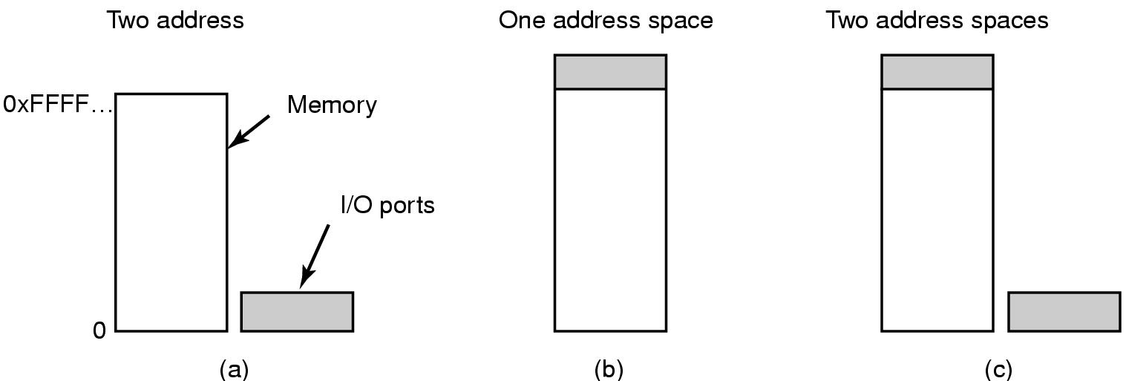
Memory-Mapped I/O (1)
Copyright ©: Nahrstedt, Angrave, Abdelzaher
(a) Separate I/O and memory space
(b) Memory-mapped I/O
(c) Hybrid
Benefit?

Slide 10
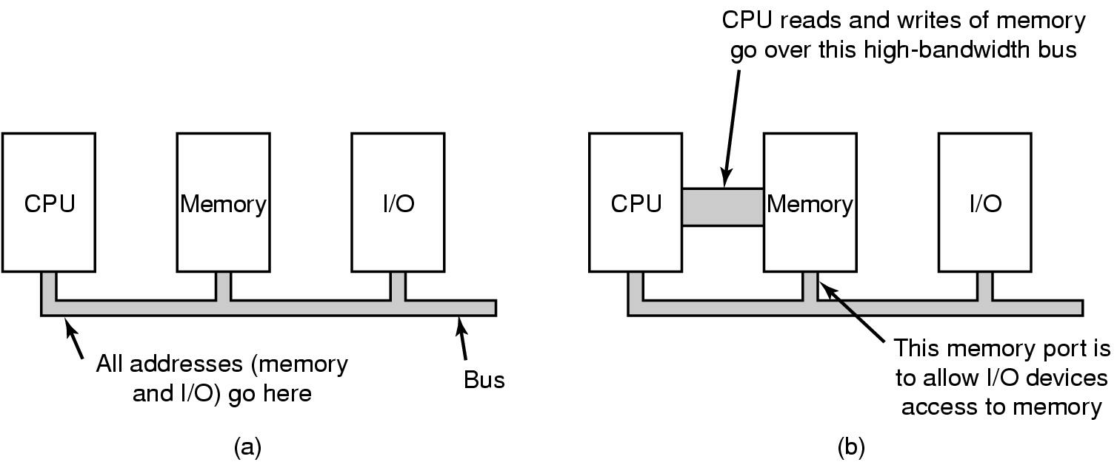
Memory-Mapped I/O (2)
Copyright ©: Nahrstedt, Angrave, Abdelzaher
Benefit?
(a) A single-bus architecture
(b) A dual-bus memory architecture

Slide 11
3 Ways to Perform I/O
Copyright ©: Nahrstedt, Angrave, Abdelzaher
Polling
Interrupt
DMA

Slide 12
Polling
Copyright ©: Nahrstedt, Angrave, Abdelzaher
Polling - use CPU to
    Busy wait and watch status bits
    Feed data into a controller register 1 byte at a time
      EXPENSIVE for large transfers
Not acceptable except small dedicated systems not running multiple processes

Slide 13

Interrupts
Copyright ©: Nahrstedt, Angrave, Abdelzaher
Connections between devices and interrupt controller actually use interrupt lines on the bus rather than dedicated wires

Slide 14
Host-controller interface: Interrupts
Copyright ©: Nahrstedt, Angrave, Abdelzaher
CPU hardware has the interrupt report line that the CPU senses after executing every instruction
  device raises an interrupt
  CPU catches the interrupt and saves the state (e.g., Instruction pointer)
  CPU dispatches the interrupt handler
  interrupt handler determines cause, services the device and clears the interrupt
Why interrupts?
Real life analogy for interrupt
  An alarm sets off when the food/laundry is ready
  So you can do other things in between

Slide 15
Support for Interrupts
Copyright ©: Nahrstedt, Angrave, Abdelzaher
Need the ability to defer interrupt handling during critical processing
Need efficient way to dispatch the proper device
  Interrupt comes with an address (offset in interrupt vector) that selects a specific interrupt handling
Need multilevel interrupts - interrupt priority level

Slide 16
Interrupt Handler
Copyright ©: Nahrstedt, Angrave, Abdelzaher
At boot time, OS probes the hardware buses to
  determine what devices are present
  install corresponding interrupt handlers into the interrupt vector
During I/O interrupt, controller signals that device is ready

Slide 17
Other Types of Interrupts
Copyright ©: Nahrstedt, Angrave, Abdelzaher
Interrupt mechanisms are used to handle wide variety of exceptions:
  Division by zero, wrong address
  Virtual memory paging
  System calls (software interrupts/signals, trap)

Slide 18
Direct Memory Access (DMA)
Copyright ©: Nahrstedt, Angrave, Abdelzaher
Direct memory access (DMA)
  Assists in exchange of data between CPU and I/O controller
    CPU can request data from I/O controller byte by byte – but this might be inefficient (e.g. for disk data transfer)
  Uses a special purpose processor, called a DMA controller

Slide 19
DMA-CPU Protocol
Copyright ©: Nahrstedt, Angrave, Abdelzaher
Use disk DMA as an example
CPU programs DMA controller, sets registers to specify source/destination addresses, byte count and control information (e.g., read/write) and goes on with other work
DMA controller proceeds to operate the memory bus directly without help of main CPU – request from I/O controller to move data to memory
Disk controller transfers data to main memory
Disk controller acks transfer to DMA controller

Slide 20

Direct Memory Access (DMA)
Copyright ©: Nahrstedt, Angrave, Abdelzaher
Operation of a DMA transfer

Slide 21
DMA Issues
Copyright ©: Nahrstedt, Angrave, Abdelzaher
Handshaking between DMA controller and the device controller
Cycle stealing
  DMA controller takes away CPU cycles when it uses CPU memory bus, hence blocks the CPU from accessing the memory
In general DMA controller improves the total system performance

Slide 22
Discussion
Copyright ©: Nahrstedt, Angrave, Abdelzaher
Tradeoffs between
  Programmed I/O
  Interrupt-driven I/O
  I/O using DMA
Which one is the fastest for a single I/O request?
Which one gives the highest throughput?

Slide 23
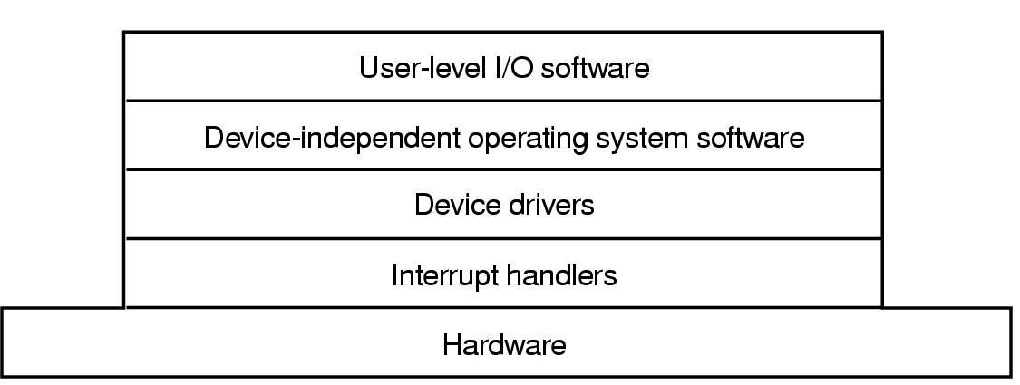
I/O Software Layers
Copyright ©: Nahrstedt, Angrave, Abdelzaher
Layers of the I/O Software System

Slide 24
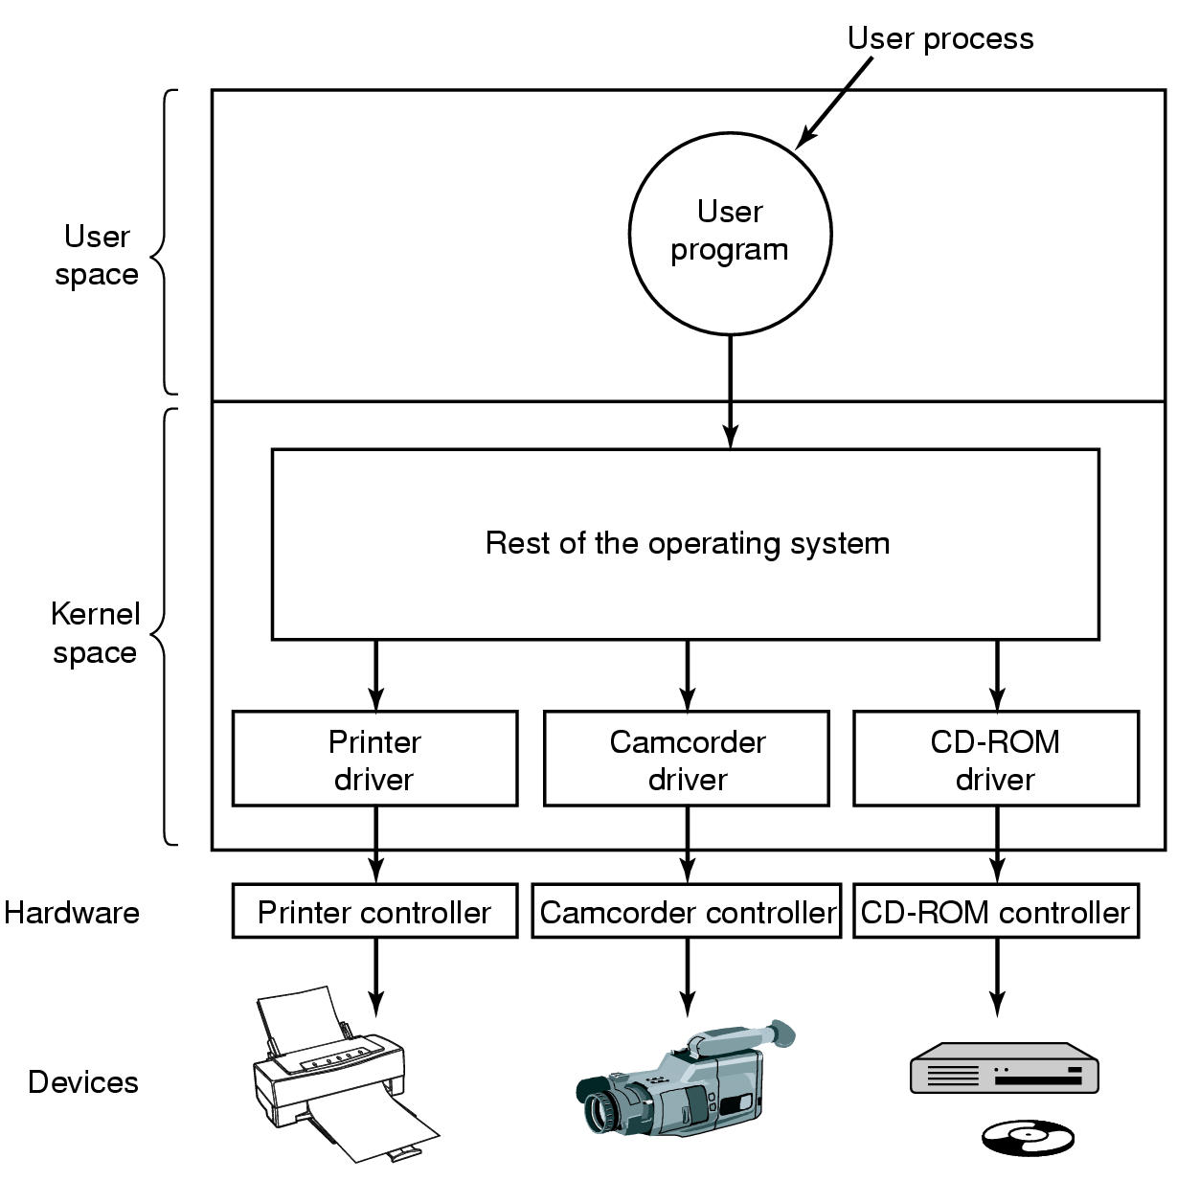
Device Drivers
Copyright ©: Nahrstedt, Angrave, Abdelzaher
Logical position of device drivers is shown here
Communications between drivers and device controllers goes over the bus

Slide 25
Device Drivers
Copyright ©: Nahrstedt, Angrave, Abdelzaher
Device-specific code to control an IO device, is usually written by device's manufacturer
  Each controller has some device registers used to give it commands. The number of device registers and the nature of commands vary from device to device (e.g., mouse driver accepts information from the mouse how far it has moved, disk driver has to know about sectors, tracks, heads, etc).
A device driver is usually part of the OS kernel
  Compiled with the OS
  Dynamically loaded into the OS during execution
Each device driver handles
  one device type (e.g., mouse)
  one class of closely related devices (e.g., SCSI disk driver to handle multiple disks of different sizes and different speeds.).
Categories:
  Block devices
  Character devices

Slide 26
Functions in Device Drivers
Copyright ©: Nahrstedt, Angrave, Abdelzaher
Accept abstract read and write requests from the device-independent layer above;
Initialize the device;
Manage power requirements and log events
Check input parameters if they are valid
Translate valid input from abstract to concrete terms
  e.g., convert linear block number into the head, track, sector and cylinder number for disk access
Check the device if it is in use (i.e., check the status bit)
Control the device by issuing a sequence of commands. The driver determines what commands will be issued.

Slide 27
Buffering
Copyright ©: Nahrstedt, Angrave, Abdelzaher
Buffer is a memory area that stores data while they are transferred between two devices or between a device and an application.
Reasons of buffering:
  cope with speed mismatch between the producer and consumer of a data stream - use double buffering
  adapt between devices that have different data-transfer sizes
  support of copy semantics for application I/O - application writes to an application buffer and the OS copies it to the kernel buffer and then writes it to the disk.
  Unbuffered input strategy is ineffective, as the user process must be started up with every incoming character.
  Buffering is also important on output.
Caching
  cache is region of fast memory that holds copies of data and it allows for more efficient access.

Slide 28
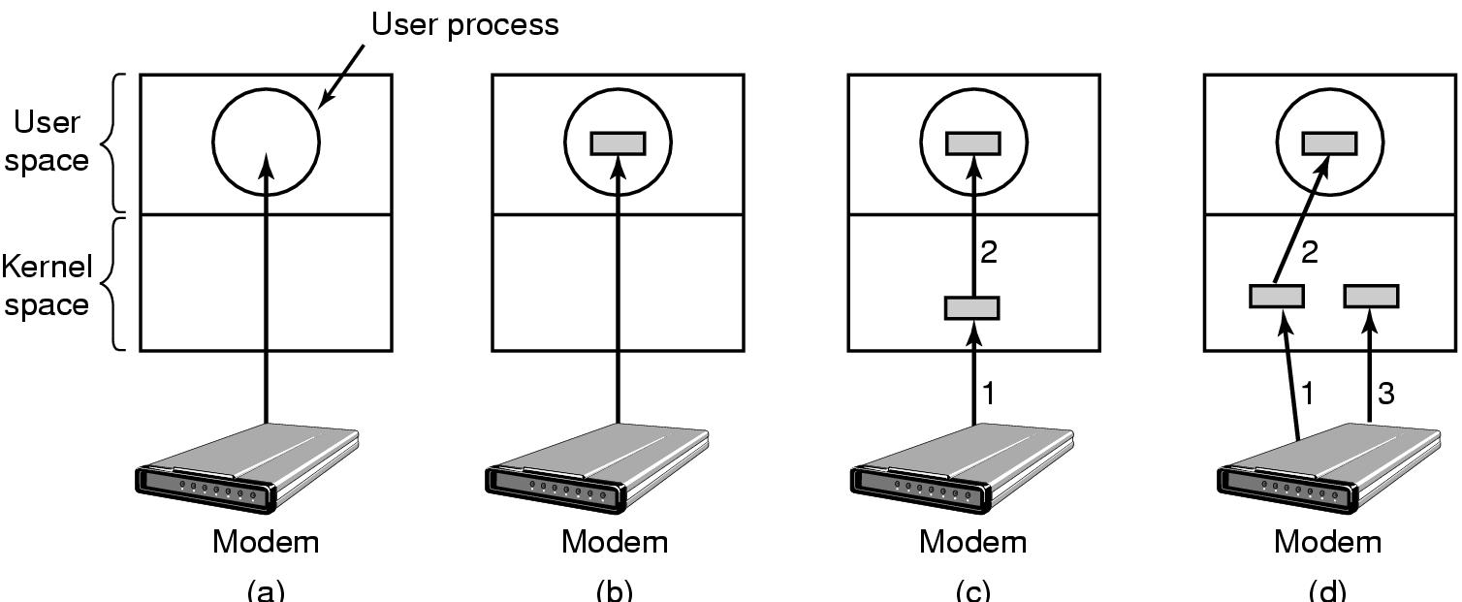
Buffering strategies
Copyright ©: Nahrstedt, Angrave, Abdelzaher
(a) Unbuffered input
(b) Buffering in user space
(c) Buffering in the kernel followed by copying to user space
(d) Double buffering in the kernel

Slide 29
Error Reporting
Copyright ©: Nahrstedt, Angrave, Abdelzaher
Programming IO Errors
  these errors occur when a process asks for something impossible (e.g., write to an input device such as keyboard, or read from output device such as printer).
Actual IO Errors
  errors occur at the device level (e.g., read disk block that has been damaged, or try to read from video camera which is switched off)
The device-independent IO software detects the errors and responds to them by reporting to the user-space IO software.

Slide 30
Quiz
Copyright ©: Nahrstedt, Angrave, Abdelzaher
A server has an average service time of 0.1 seconds per request. Requests arrive at a rate of 7 requests per second. What is the server utilization?

