Slide 1
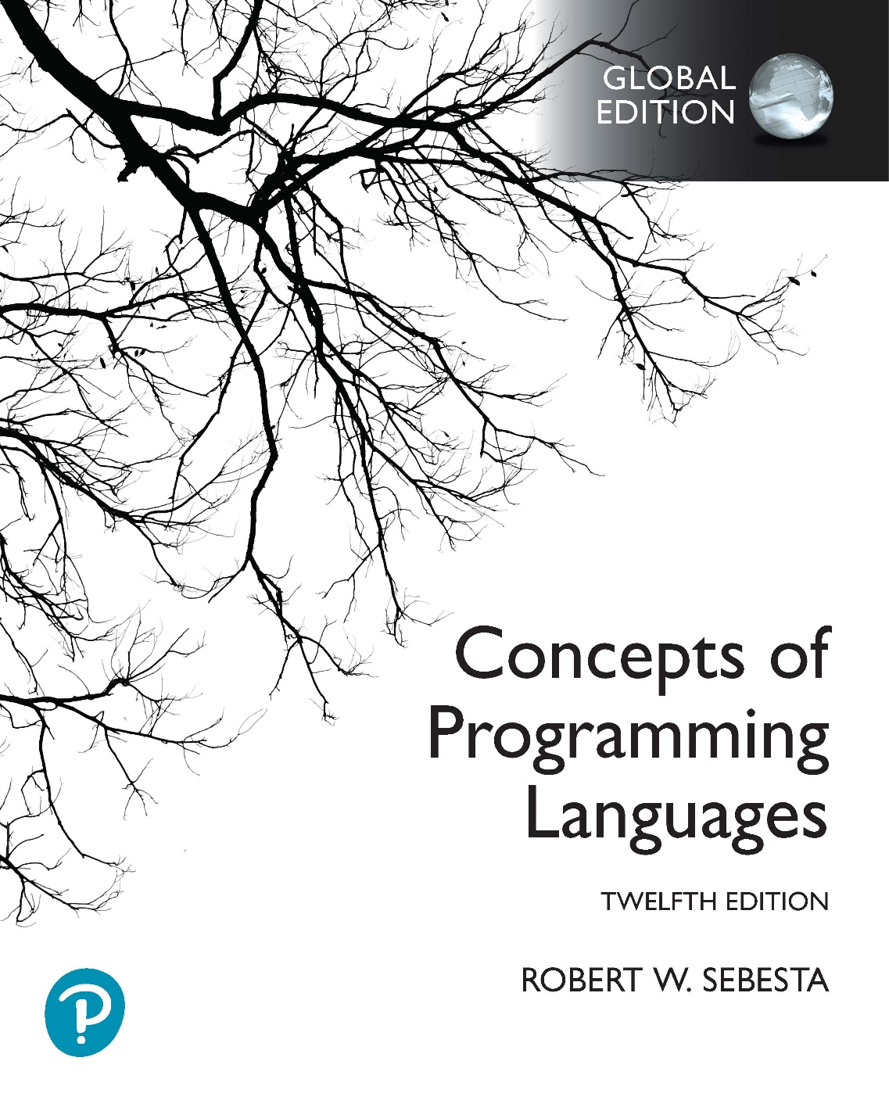
Chapter 1 Part 1
Preliminaries

Slide 2
Topic
Reasons for Studying Concepts of Programming Languages

Slide 3
Reasons for Studying Concepts of Programming Languages
Increased ability to express ideas
Improved background for choosing appropriate languages
Increased ability to learn new languages
Better understanding of significance of implementation
Better use of languages that are already known
Overall advancement of computing
Notes:
A common test or exam question that you can expect related to these reasons will take the form of a short scenario that I describe. This scenario will involve an individual, and you will have to provide a reason for why this individual needs to know about general programming language concepts. It is important that the reason you provide is relevant to the individual described.
For example, the scenario may involve a manager in a software development company. In this scenario, the first, third, fourth, and fifth reasons are unlikely to be relevant, because a manager will not be actively programming. The second and last reasons are applicable, because a manager might decide on a language to use for a project, and decisions like this will steer the field of computing in some way.

Slide 4
Reasons for Studying Concepts of Programming Languages
Increased ability to express ideas
You cannot express what you cannot describe
A language limits the structures you can use
Even if your language is dictated, unsupported structures can be simulated if you know about them
1-4
Notes:
4

Slide 5
Reasons for Studying Concepts of Programming Languages
Helps choose appropriate languages
Programmers are often limited
In-house training
Formal training a long time ago
Language concepts allow informed choices
It is better to use a directly supported feature
1-5
Notes:
5

Slide 6
Reasons for Studying Concepts of Programming Languages
Increased ability to learn new languages
Programming is a young discipline
New languages constantly evolving
Usage patterns constantly change
General language concept knowledge helps
Reduces time taken to learn a new language
Helps interpretation of literature on languages
1-6
Notes:
6

Slide 7
Reasons for Studying Concepts of Programming Languages
Better understanding of implementation
Why languages work the way they do
Use languages as they were intended to be used
Understanding low-level bugs
Understanding efficiency tradeoffs
1-7
Notes:
7

Slide 8
Reasons for Studying Concepts of Programming Languages
Better use of already known languages
Contemporary languages are large & complex
Many programmers use only a subset of features
Knowing about features lets you exploit them
1-8
Notes:
8

Slide 9
Reasons for Studying Concepts of Programming Languages
Overall advancement of computing
Language evolution is complex (chapter 2)
Language popularity is often not well founded
ALGOL 60 versus Fortran
Better understanding of underlying issues
Those in charge would choose better languages
Better languages would eventually dominate
1-9
Notes:
9

